Slide 1
Exploratory Data Analysis of Internships in India
Team Members
ARUL R & SARANYA S
5/7/2025

Slide 2


PROBLEM STATEMENT
To analyze internship opportunities across locations, stipends, roles, and job offers using data from Internshala.com.
OBJECTIVES
Understand key trends in stipend, location, hiring type, and early application behavior.

Slide 3

Tools used for eda
Python (3.12)+ Jupyter Notebook
Python libraries ,
For data extract : BeautifulSoup (Web Scraping), Random, Request, Time, numpy , Regular Expressions.
For data analysis : Pandas, Datetime
For data visualization : Matplotlib, Seaborn.

Slide 4
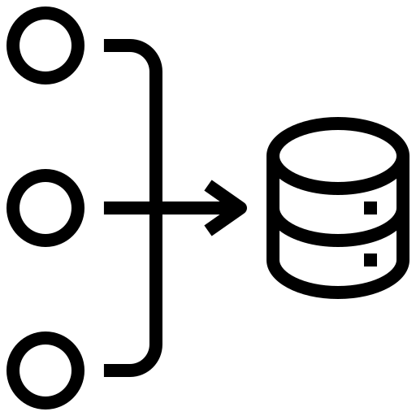


DATASET OVERVIEW
DATASET SOURCE
DATASET SHAPE
Scraped from Internshala using BeautifulSoup (web scraping)
6050 rows x 10 columns
KEY COLUMNS
intern_role, company_name, hiring_type, location,job_offer(LPA), stipend_per_month, duration(months), posted_time, early_applicant, apply_links

Slide 5


Analyzing Data
COLUMN CLEANING
1. Column name : job_offer(LPA)
After removing the currency symbol from the job_offer(LPA) column, the values changed from ₹ 3.5 to 3.5, and the data type converted from object to float.
2. Column name : posted_time
The posted_time column had values like "just now", "1 day ago", etc., stored as text. We converted them to numbers (e.g., "today" → 0, "1 day ago" → 1), then subtracted these from the data extraction date (2025-06-23) to get the exact posted_date. The data type was changed from object to datetime64[ns].
3. Column name : hiring_type
The hiring_type column had values like “actively_hiring" and NaN. We cleaned it by converting “actively_hiring" to "yes" and missing values (NaN) to "no", assuming companies not listed as actively hiring are treated as "no".
4. Column name : early_applicant
The early_applicant column had values like "Early Applicant" and NaN. We converted "Early Applicant" to "yes" and missing values to "no", assuming no info means not early. This cleaning was done to improve visualization.

Slide 6

REMOVING DUPLICATES
Duplicate rows are exact copies of other rows in the dataset.
First, check duplicates.
If duplicates are found, delete the rows.
In my dataset, found “26 rows × 10 columns” duplicates and deleted permanently.
Removing duplicates helped improve the quality of analysis and ensured each internship record was unique.
6

Slide 7

HANDLING NAN VALUES
Checked null values :
code for check null or nan values with count,
df.isna().sum()
Filled missing values :
Calculated the mode for the numeric column duration(months) and replaced missing (NaN) values with the mode.
After identifying the mode, we used it to fill the missing values.
Column | Missing Values
duration(months) | 477
Other columns | 0

Slide 8

NUMERIC ESTIMATION/OUTLIER REMOVAL
What is outliers ?
Outliers are data points that are significantly higher or lower than the rest of the dataset. They can distort analysis and lead to misleading insights.
Column name: stipend_per_month
Ex: stipend_per_month – 5 Too low
stipend_per_month – 300000 Too high
Method used to handle : IQR Method (Interqurtile Range)
Q1 = df['stipend_per_month'].quantile(0.25) # 0.25 → 25% of data points
Q3 = df['stipend_per_month'].quantile(0.75) #0.75 → 75% of data points
IQR = Q3 - Q1
lower_bound = Q1 - 1.5 * IQR
upper_bound = Q3 + 1.5 * IQR
Filter out outliers
df = df[(df['stipend_per_month'] >= lower_bound) & (df['stipend_per_month'] <= upper_bound)]
In my dataset, I found many outliers. For those columns with outliers, I replaced the NaN values for the outliers.

Slide 9
Median or Mode ?
If outliers are found in a column, fill the NaN values with the median. If there are no outliers, fill the NaN values with the mode.
Replaced the NaN values with the median in the stipend column.
Necessary to clean the outliers before modeling or visualization.
Delete the unwanted Columns:
apply_links, and potsed_time
Verified types using: df.info()
Ensured no NaNs remained before analysis
# | Column Name | Non-Null Count | Data Type
1 | intern_role | 6024 | object
2 | company_name | 6024 | object
3 | hiring_type | 6024 | object
4 | location | 6023 | object
5 | job_offer(LPA) | 6024 | float64
6 | stipend_per_month | 6024 | int32
7 | duration(months) | 6024 | float64
8 | early_applicant | 6024 | object
9 | posted_date | 6024 | datetime64[ns]

Slide 10

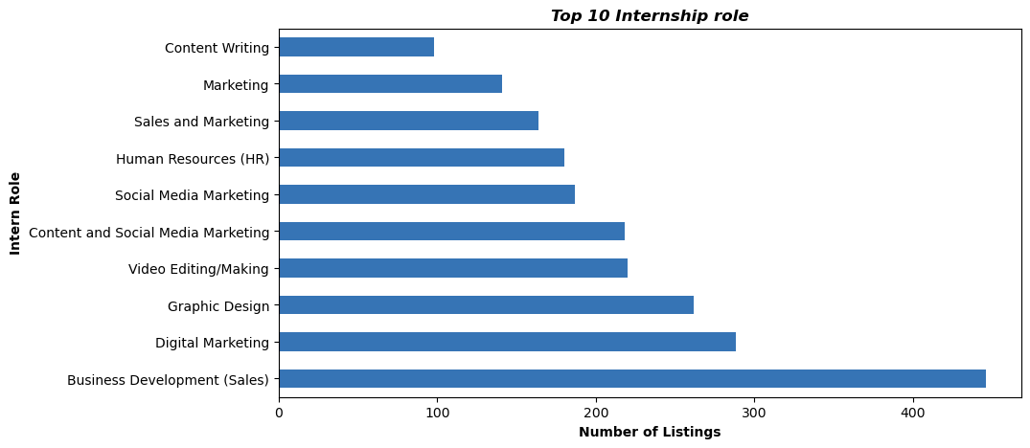
Data visualization
UNIVARIATE ANALYSIS:
In this graph ,the most wanted internship roles are listed.
Business Development and Digital Marketing roles are the most in-demand internships , highlighting strong industry focus on sales and digital skills.
Business Development is the most available internships

Slide 11
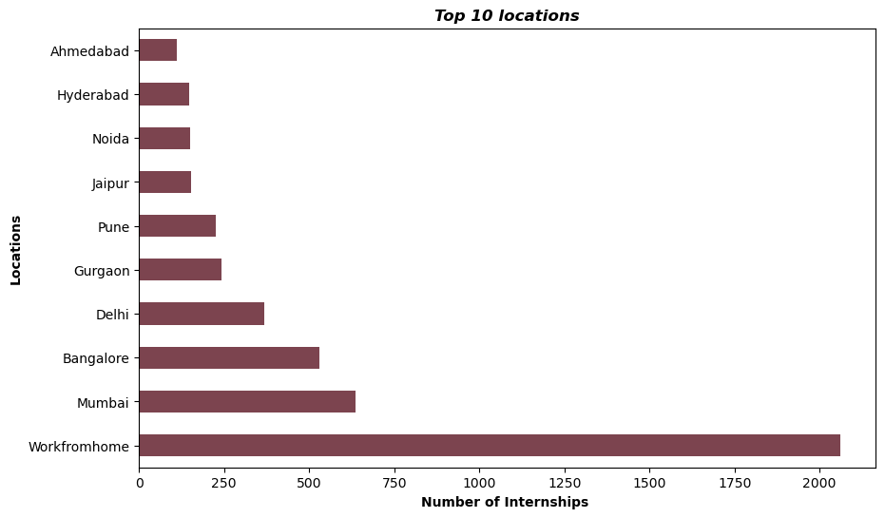
Work-from-home internships dominate the listings, followed by major cities like Mumbai, Bangalore, and Delhi, reflecting a strong shift toward remote opportunities.

Slide 12
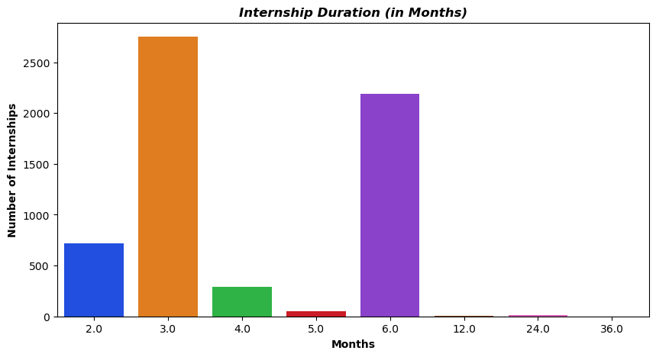
Most internships have a duration of 3 to 6 months, indicating that companies prefer medium-term internship commitments.

Slide 13
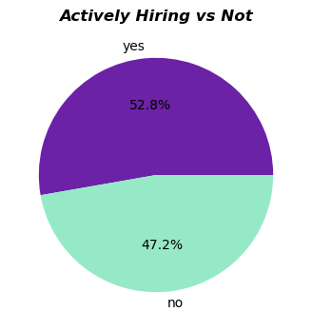
Over half (52.8%) of the internships are from actively hiring companies, indicating strong ongoing recruitment demand.

Slide 14
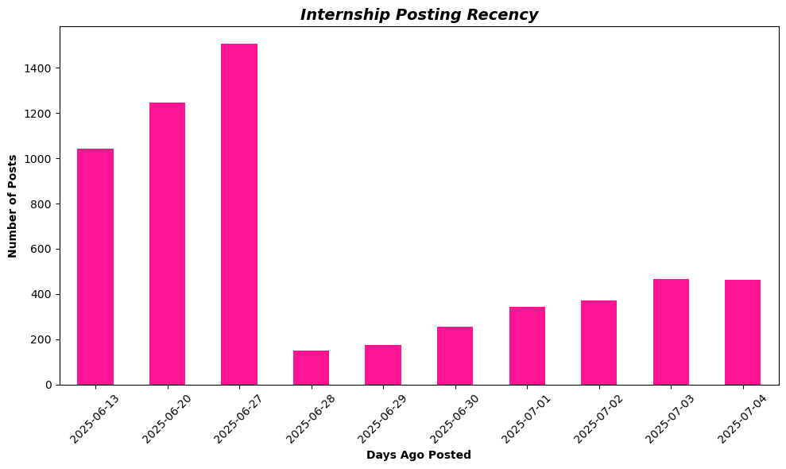
Most internships were posted between June 13 and June 27, especially on June 27 which saw the highest number of posts.
After that, postings dropped and slowly increased again by July 3–4.

Slide 15
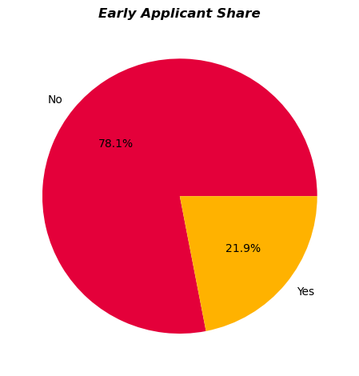
Around 21.9% of companies posted only posted with the early applicant.

Slide 16
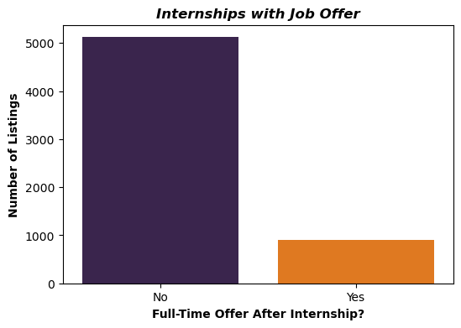
From 6024 listings, there are only have less than 1000 full-time job offers.

Slide 17
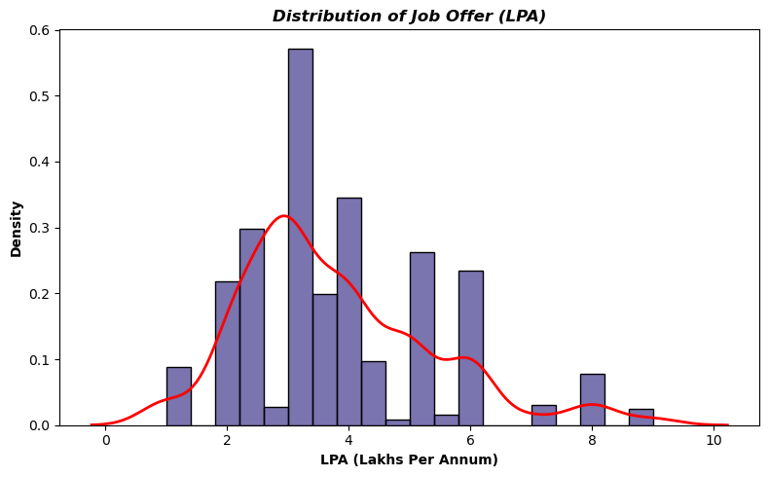
Most job offers fall between 2 to 4 LPA.
The curve is right-skewed, meaning fewer high-paying offers (above 6 LPA) exist.
Very few internships offer job offers greater than 7 LPA.

Slide 18
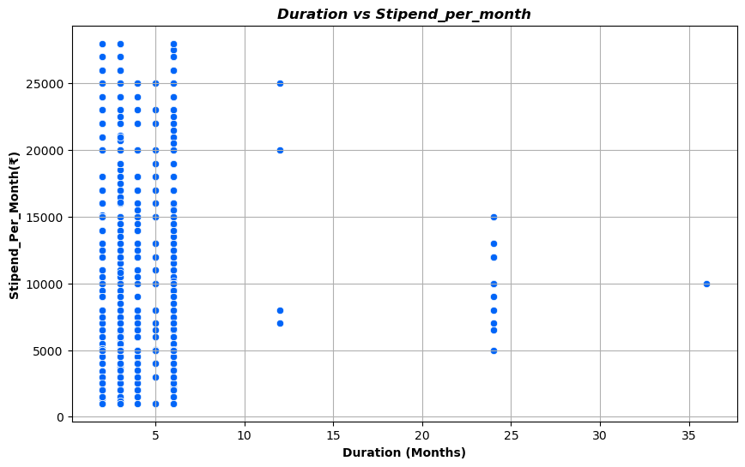
BI-VARIATE ANALYSIS/MULTIVARIATE
Continues VS Continues
Most internships last 2–6 months and offer variable stipends, showing no strong link between longer duration and higher pay.

Slide 19
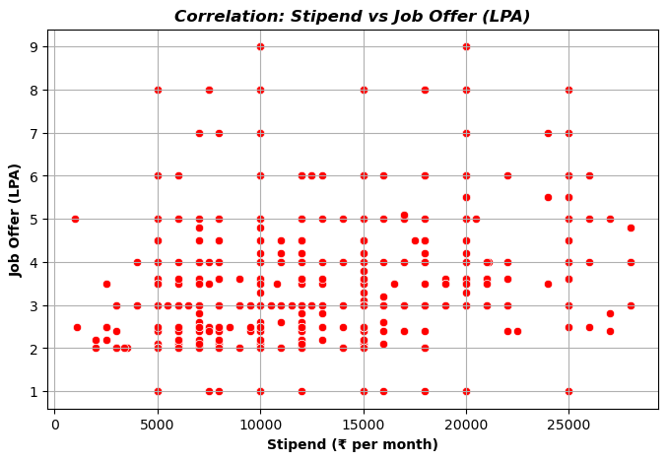
There is no strong correlation between stipend and job offer — higher stipend doesn’t guarantee a higher job offer (LPA). Most offers are around 2–4 LPA regardless of stipend.

Slide 20
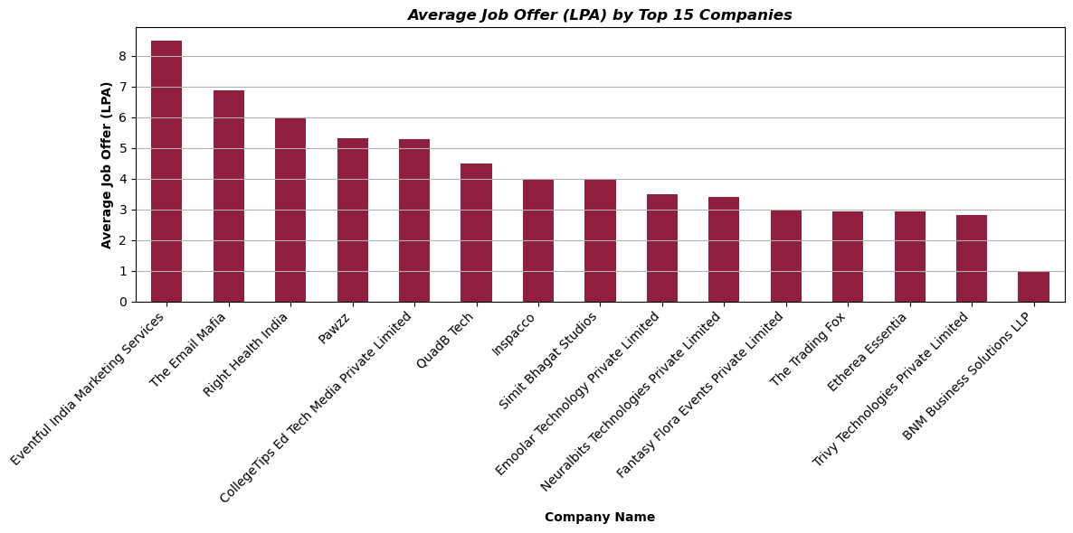
NUMERICAL VS CATEGORICAL
Among the top 15 companies offering internships, those with higher full-time job offers (LPA) indicate that students should also consider the employer.

Slide 21
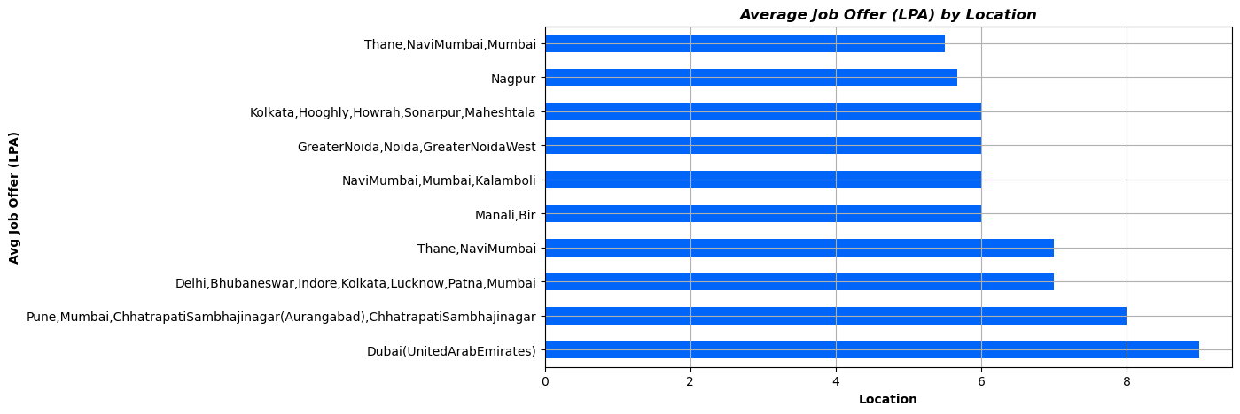
Dubai gives the highest job offer (above 9 LPA), followed by Pune, Mumbai, and Aurangabad with around 8 LPA.Nagpur, Thane, and Kolkata areas have lower job offers (around 5–6 LPA).

Slide 22
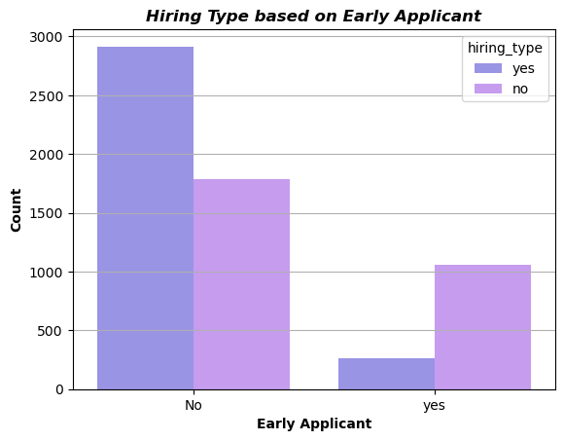
CATEGORICAL VS CATEGORICAL
Most internships were applied without early applicant status
In both early and non-early cases, many companies were not actively hiring.
So, being early doesn't guarantee hiring — but it might still help visibility.

Slide 23
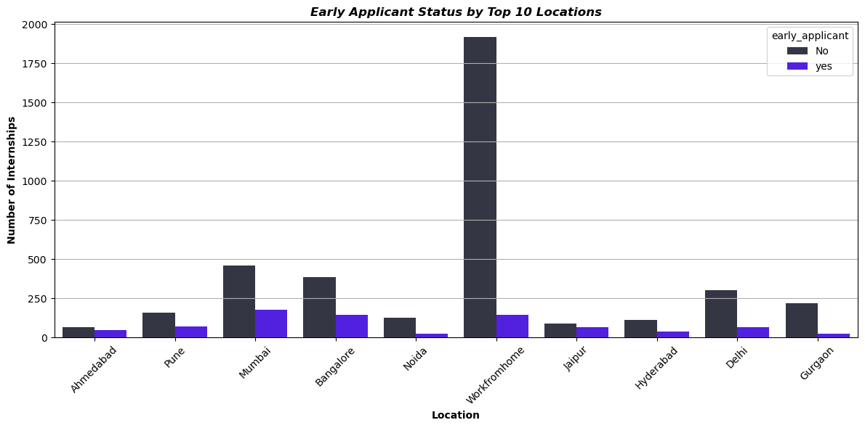
Work from home has the highest number of internships, but most are not early applicants.Mumbai and Bangalore also have many internships with some early applicants.

Slide 24
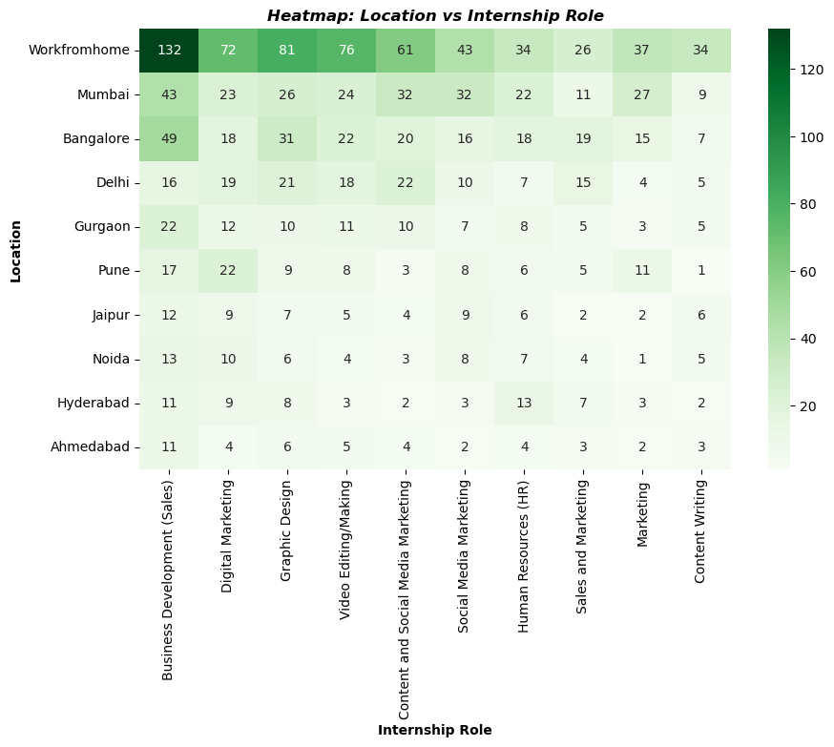
Work-from-home internships dominate all roles, offering the widest variety. Big cities like Mumbai, Bangalore, and Delhi follow next with decent opportunities across multiple roles, while smaller cities have fewer and more specific roles.

Slide 25
Summary of Observations
Work-from-home roles dominate across India
Most internships are paid (₹5000–₹10000)
High job offers (LPA) are rare and not tightly linked to stipend
Business Development & Digital Marketing are most common roles
Early applicants don't always guarantee job conversion

Slide 26
This EDA helped uncover:
Internship trends across India
Pay structure and job offer chances
Student behavior around early applications
This can guide:
Students in internship selection
Companies in targeting talent

Slide 27
THANK YOU
Any Q/A
Presented by:
Arul R & Saranya S

