Slide 1
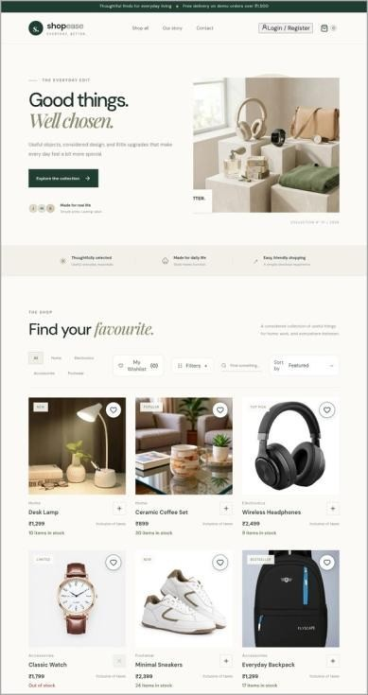

E-Commerce Website – ShopEase
SUMMER INTERNSHIP PROJECT PRESENTATION | CS3711
A MERN Stack Application
Arul Jebaraj M | 810023104006
B.E. Computer Science and Engineering, 7th Semester
University College of Engineering (BIT Campus), Anna University, Tiruchirappalli
Notes:
Good morning. I am Arul Jebaraj M, a seventh-semester CSE student at University College of Engineering, BIT Campus. I will present my 30-day MERN stack internship at Fantasy Solution, Tiruchirappalli, and the project I built: ShopEase, an e-commerce website.

Slide 2

Company profile and domain
Fantasy Solution, Trichy
DOMAIN
MERN Stack Development
IT solutions and training company, Melapudur, Tiruchirappalli
01/06/2026 to 30/06/2026 (30 days)
M
MongoDB
Database
Software development
Web design and hosting
Real-time project work
IT training for students and businesses
E
Express.js
Server and API
R
React
User interface
Industrial expert: Mohamed Farook, Software Developer
N
Node.js
Server runtime
Notes:
Fantasy Solution is an IT solutions and training company in Melapudur, Tiruchirappalli. It offers software development, web design and hosting, real-time project work and IT training. My domain was MERN stack development, from 1 to 30 June 2026, under industrial expert Mohamed Farook, a software developer. Vision: to be a leading IT company providing consulting and the best business software solutions.

Slide 3



Problem statement and objectives
The problem
Objectives
Customers cannot browse the full catalog or order at any time
The owner manages stock and orders by hand
No confirmation or tracking after an order
No central record of customers and orders
Build a full-stack MERN online store with admin dashboard
Add order tracking and email updates
Learn React, Node.js, Express.js and MongoDB
Build REST APIs and deploy the application
Notes:
Many small shops sell only through physical stores or social media pages. Customers cannot see the full catalog or order at any time, the owner manages stock and orders by hand, and nobody can track an order after it is placed. The objective was to build a complete MERN online store, ShopEase, that solves this, and to learn the full stack in the process.

Slide 4
System architecture and workflow
Visitor | Customer | Administrator
Data flow
REACT CLIENT (Vite), on Vercel
Client sends an HTTP request
1
Store
Cart
Account
Orders
Admin
2
Express checks login and rules
REST API: HTTP request / JSON response
EXPRESS.JS SERVER (Node.js)
3
Mongoose reads or writes MongoDB
Products
Orders
Auth (JWT)
Admin
Middleware
MONGOOSE: models and validation
4
JSON response updates the page
MONGODB DATABASE
5
Email sent on order and status change
Products
Users
Orders
Reviews
Notes:
ShopEase has two applications. The React client, deployed on Vercel, shows the pages and sends HTTP requests. The Express server on Node.js applies the rules and authentication, and uses Mongoose to read and write MongoDB, which holds products, users, orders and reviews. Data travels as JSON. When an order is placed or its status changes, the server sends an email through an SMTP service.

Slide 5




Technologies and tools used
Frontend
Backend
Database
DevOps and tools
JavaScript (ES6)
React with Vite
React Router
Context API, hooks
Axios
Node.js
Express.js, REST API
JWT and bcrypt
SMTP email service
dotenv
MongoDB
Mongoose schemas
Validation
MongoDB Compass
Git and GitHub
VS Code
curl for API tests
Vercel deployment
Notes:
Frontend: JavaScript, React built with Vite, React Router, Context API and Axios. Backend: Node.js and Express.js, with JWT and bcrypt for secure login and an SMTP email service. Database: MongoDB with Mongoose, and MongoDB Compass during learning. Tools: Git, GitHub, VS Code, curl for API testing, and Vercel for deployment.

Slide 6






Modules and my contributions
Product catalog
Shopping cart
Customer account
Products from the API; search, category tabs, sorting, wishlist, quick view with reviews
Add, remove and change quantity; subtotal recalculated on every change
Registration and login; hashed passwords and JWT
Checkout and orders
Tracking and email
Admin dashboard
Demo checkout saves the order in MongoDB; simulated payment
Status timeline in My Orders; confirmation and status emails
Sales indicators; product create, update, delete; order status update
Notes:
I split the work into six modules and built each one: the product catalog, shopping cart, customer accounts, checkout and orders, order tracking with email notification, and the admin dashboard. I designed the models, wrote the routes and the React components, and connected them through the REST API.

Slide 7




Implementation and algorithm
1
Add to cart; subtotal = price × quantity
Server-side total
Prices come from the database, not the client
2
Checkout: name, email, address
3
Client sends items to POST /api/orders
Status history
Each change saved with date and time; drives the timeline
4
Server calculates total from stored prices
5
Order saved: Placed, payment Pending
JWT and authorization
Admin routes protected on the server
6
Confirmation email sent
7
Payment simulation: Pending to Paid
Safe emails
If an email fails, the order is still saved
8
Admin updates status; customer emailed
Notes:
This is the main algorithm, cart to order. The subtotal is the sum of price times quantity. At checkout the client sends the items to POST api/orders, and the server calculates the total from stored prices. The order is saved with status Placed, payment Pending, and the first timeline entry, and the confirmation email is sent. After payment simulation it becomes Paid, and the admin moves the order through Processing, Shipped and Delivered with an email each time.

Slide 8
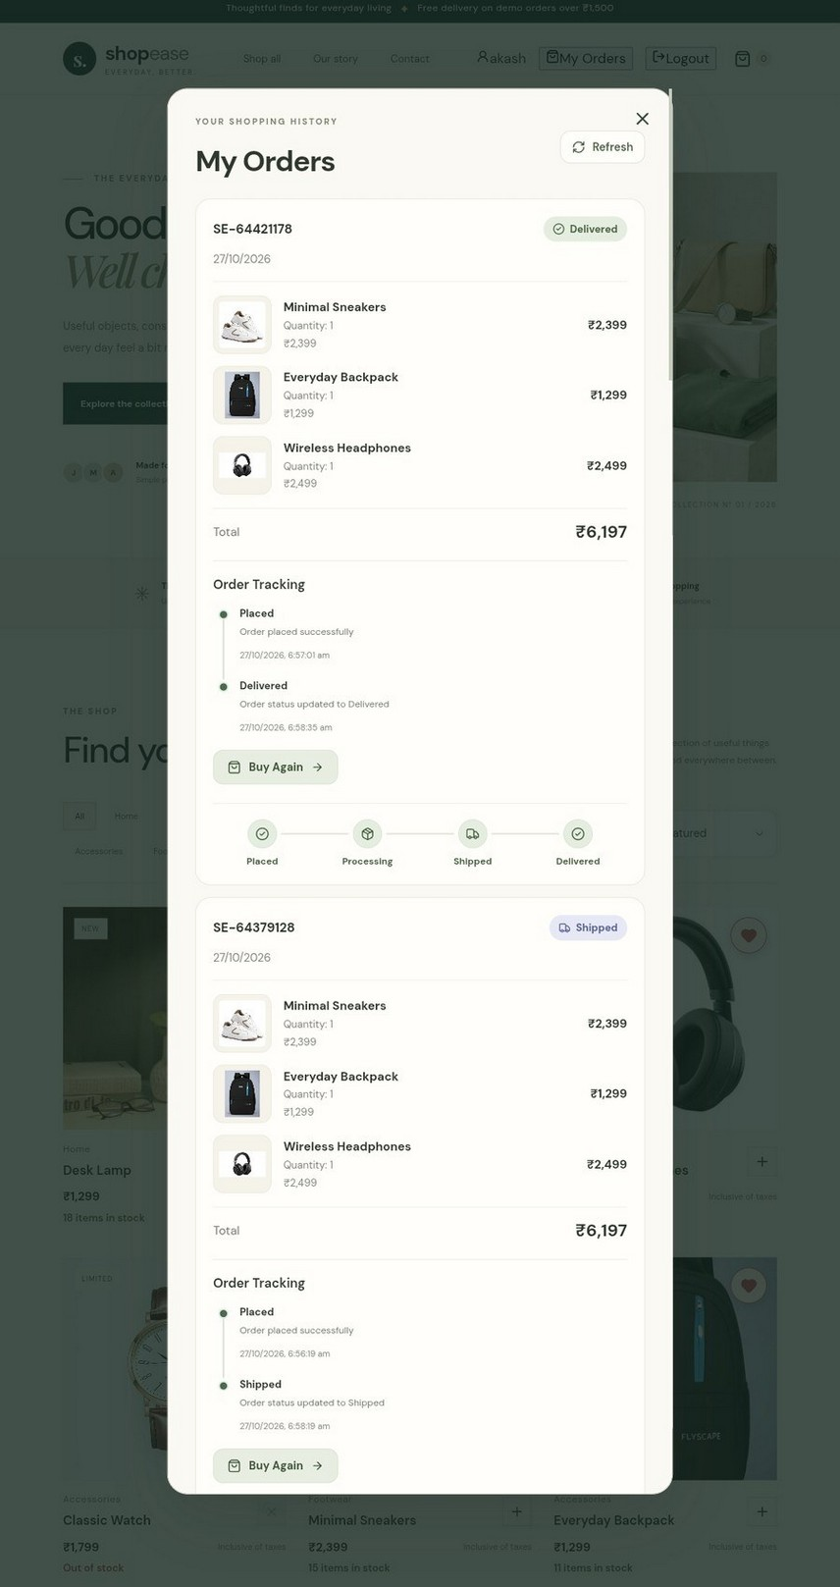
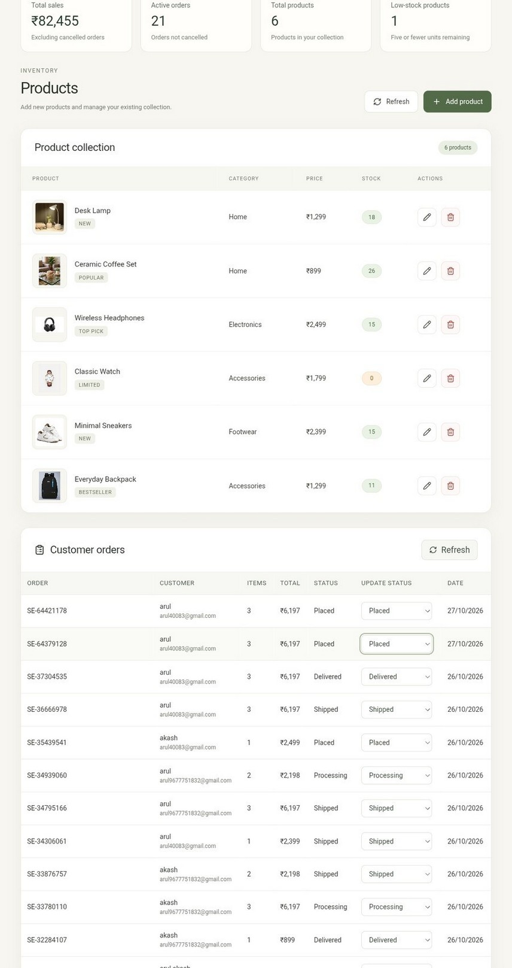
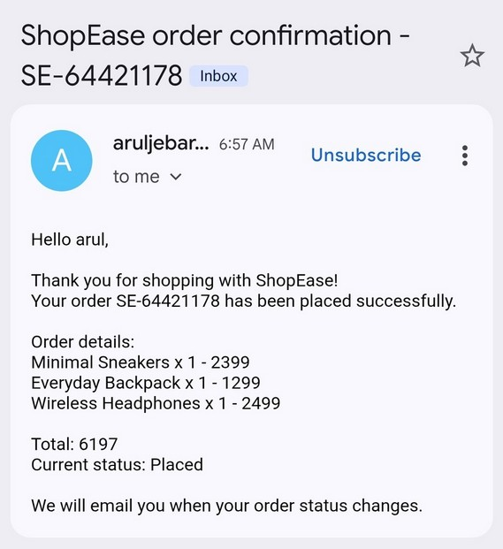
Snapshots of output
Home and catalog
Order tracking
Admin dashboard
Order confirmation email
Notes:
These are screenshots from the deployed application. The home page and catalog, My Orders with the tracking timeline, and the admin dashboard where the status is changed from a drop-down. On the right is the real order confirmation email received by the customer. All fourteen test areas passed, covering the API, UI, order tracking and email delivery.

Slide 9


Key learnings and skills
Technical skills
Industry practices
React: components, state, hooks, routing
Version control with Git and GitHub
Secrets in environment variables, never committed
Node.js and Express.js: REST APIs, middleware
REST API design and HTTP status codes
MongoDB and Mongoose: data modelling
Manual and curl testing, bug fixing
Documentation: README and .env.example
Authentication: bcrypt hashing and JWT
Deployment on Vercel
Notes:
Technically I learned React, Node.js with Express, MongoDB with Mongoose, and authentication with bcrypt and JWT. Beyond the code I learned industry practices: using Git and GitHub for version control, keeping secrets in environment variables, designing REST APIs, testing in the browser and with curl, and writing documentation such as the README and the env example file.

Slide 10
Conclusion and references
Conclusion
References
In 30 days I learned the MERN stack and built ShopEase, a deployed online store with order tracking, email updates and an admin dashboard. The internship improved my technical skills and confidence with real-world projects.
React documentation: react.dev
Vite documentation: vite.dev
Node.js documentation: nodejs.org
Express.js documentation: expressjs.com
MongoDB documentation: mongodb.com/docs
Future work
Mongoose documentation: mongoosejs.com
SMS or WhatsApp notifications
Payment-provider sandbox
Automated unit and integration tests
React Router: reactrouter.com
MDN Web Docs: developer.mozilla.org
Git documentation: git-scm.com
Nodemailer: nodemailer.com
Notes:
To conclude: in 30 days I learned the MERN stack step by step and built ShopEase, a complete, deployed online store with order tracking, email updates and an admin dashboard. Future work includes SMS or WhatsApp notifications, a payment-provider sandbox, and automated tests. These are the documentation sources I used. Thank you. I am happy to take questions.

