Slide 1

Department of Computer Science and Engineering
MOBILE APPLICATION DEVELOPMENT
GroupDeal – Buy Together, Save More
Presentation by
ARUL MURUGAN M - 24CS0084
RITVIK DODDAPANENI - 24CS0755
Supervisor
Mrs.Sindhu
MOBILE APPLICATION DEVELOPMENT PROJECT-ZEROTH REVIEW

Slide 2
CONTENTS
Introduction
Problem Statement
Project Description
Aim and Scope of the Proposed work
Literature Survey
Tech Stack
Block Diagram Design
Project Planning
MOBILE APPLICATION DEVELOPMENT PROJECT-ZEROTH REVIEW

Slide 3
Introduction
Growing Need for Affordable Shopping: Online shopping has become a part of everyday life, but individual buyers often miss out on wholesale prices and bulk discounts, resulting in higher costs for frequently purchased products.
Innovative Solution – GroupDeal: GroupDeal is a locality-based mobile application that allows users within the same pincode to form buying groups. As more members join, the product price decreases in real time, making shopping more affordable.
Smart and Transparent Buying: The app compares prices from multiple e-commerce platforms, enables supplier bidding for the best deal, and uses a reputation system to ensure secure, trustworthy, and cost-effective group purchases.
MOBILE APPLICATION DEVELOPMENT PROJECT-ZEROTH REVIEW

Slide 4
Problem Statement
Limited Access to Wholesale Prices: Individual consumers usually purchase products at retail prices, while wholesale discounts remain available only to businesses or buyers purchasing in large quantities.
Lack of Community-Based Buying: Existing e-commerce platforms do not allow users from the same locality to combine their purchases, preventing them from benefiting from collective buying power and better pricing.
Need for a Smarter Buying Platform: There is a need for a mobile application that enables locality-based group buying, provides real-time price comparison and dynamic price reduction, and allows supplier bidding to ensure users receive the lowest possible price with a transparent and trustworthy purchasing proce
MOBILE APPLICATION DEVELOPMENT PROJECT-ZEROTH REVIEW

Slide 5
Project Description
GroupDeal is a locality-based mobile application where users in the same pincode join together to purchase products in bulk and unlock wholesale prices.
The app compares prices from major e-commerce platforms and displays the best individual price alongside the estimated group-buying price. As more users join, the product price decreases dynamically in real time.
Once the group reaches the required number of members, suppliers compete through bidding to offer the lowest possible price, ensuring maximum savings for buyers.
The application also includes secure payments, referral rewards, demand-based group creation, and a reputation system to provide a transparent, reliable, and cost-effective shopping experience.
MOBILE APPLICATION DEVELOPMENT PROJECT-ZEROTH REVIEW

Slide 6
Aim and Scope of the Proposed work
Aim
To develop a locality-based mobile application that enables users to purchase products collectively at wholesale prices through group buying.
To provide a transparent and cost-effective shopping experience using dynamic pricing, supplier bidding, and secure payment mechanisms.
Scope
Supports pincode-based group formation, real-time price comparison, dynamic price reduction, and automated supplier bidding.
Includes referral rewards, demand-based group creation, reputation management, and secure payment processing for reliable group purchases.
MOBILE APPLICATION DEVELOPMENT PROJECT-ZEROTH REVIEW

Slide 7
Literature Survey
1. Online Group Buying
Anand & Aron (2003) proposed web-based group buying to provide quantity discounts through collective purchasing. The study explains pricing mechanisms but does not support locality-based mobile group buying.
Reference:
Anand, K.S., & Aron, R. (2003). Group Buying on the Web: A Comparison of Price-Discovery Mechanisms.
2. Community Group Buying (CGB)
A 2024 systematic review analyzed 41 studies on Community Group Buying (CGB). It identified trust, logistics, and localization as major factors while highlighting research gaps in platform design and scalability.
Reference:
Journal of Internet Commerce (2024). Community Group Buying: A Systematic Literature Review.
MOBILE APPLICATION DEVELOPMENT PROJECT-ZEROTH REVIEW

Slide 8
3. Supplier Competition & Reverse Auctions
Jap (2003) showed that reverse auctions increase supplier competition and improve procurement efficiency. However, the approach mainly targets business procurement rather than consumer group-buying applications.
Reference:
Jap, S.D. (2003). An Exploratory Study of Supplier Participation in Online Reverse Auctions.

Slide 9
Tech Stack
Programming Language: Dart
Framework: Flutter
IDE: Visual Studio Code / Android Studio
Backend: Node.js + Express.js
Database: MongoDB
Authentication: Firebase Authentication
Price Comparison: Amazon, Flipkart, Meesho & IndiaMART APIs
Notifications: Firebase Cloud Messaging (FCM)
Payment Gateway: Razorpay
Version Control: Git & GitHub
MOBILE APPLICATION DEVELOPMENT PROJECT-ZEROTH REVIEW

Slide 10
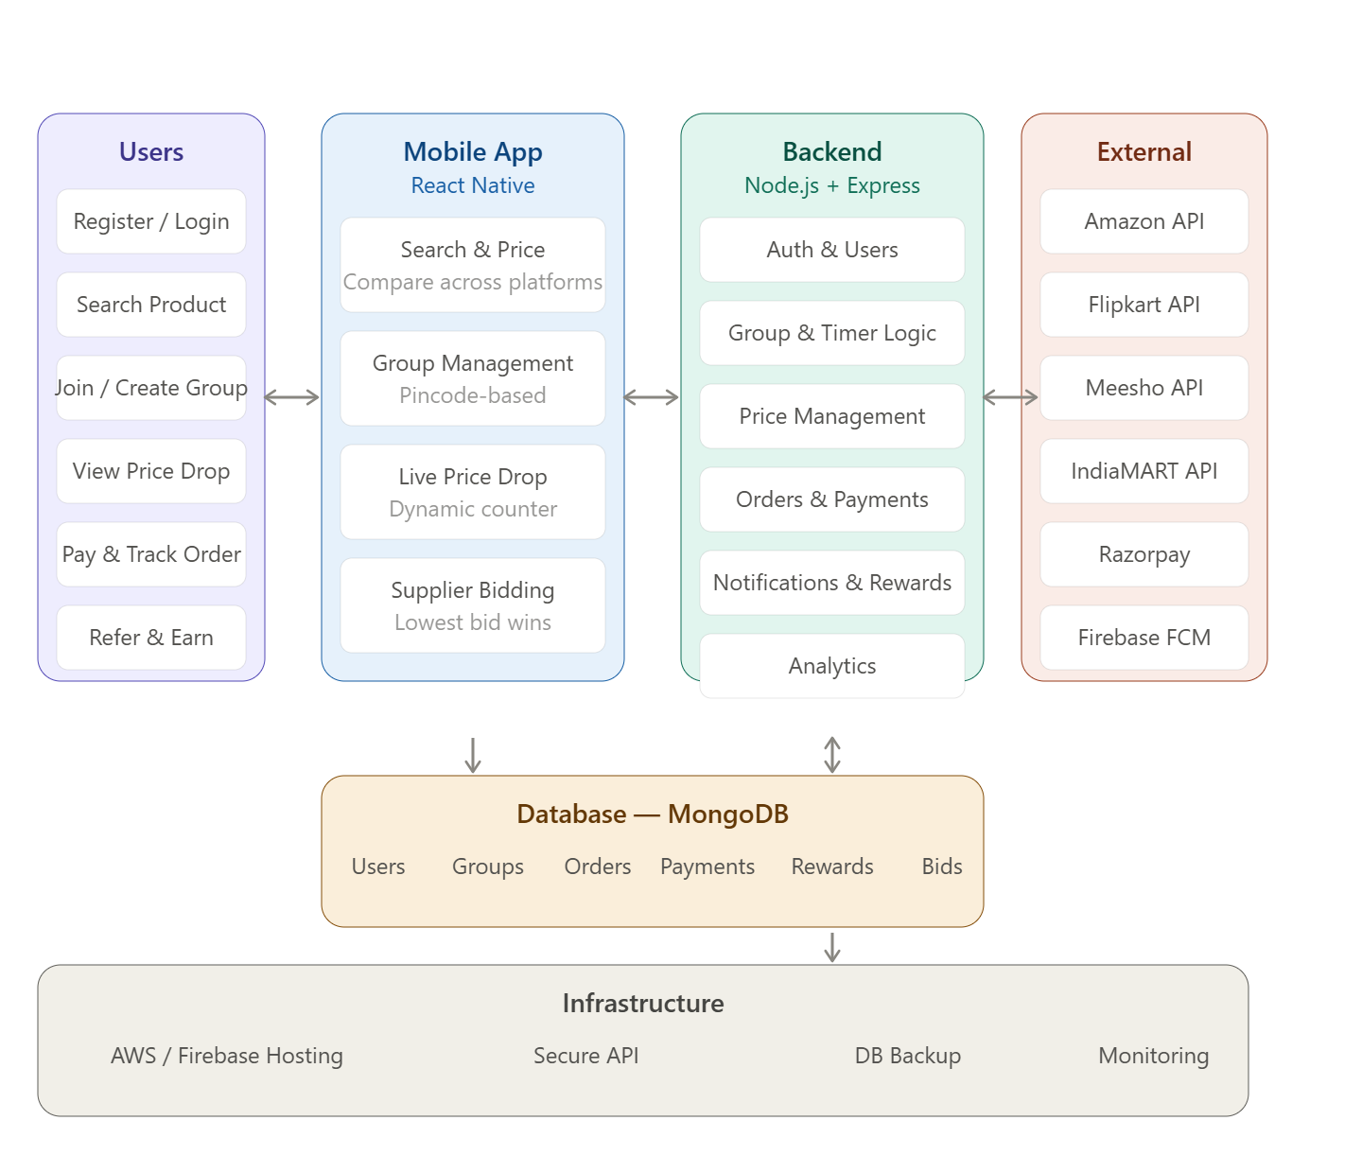
Block Diagram Design
MOBILE APPLICATION DEVELOPMENT PROJECT-ZEROTH REVIEW

Slide 11
Project Planning
Requirement Analysis
Identify user requirements, define the group-buying workflow, and analyze API, payment, and supplier integration needs.
UI/UX Design
Design user-friendly interfaces for product search, group creation, live price tracking, payment, and order management.
Application Development
Develop the Flutter frontend, Node.js backend, MongoDB database, and implement authentication and group management.
API & Feature Integration
Integrate e-commerce APIs, payment gateway, notifications, dynamic pricing, and supplier bidding functionality.
Testing & Deployment
Test application performance, payment security, API integration, and group-buying workflow before deployment.
MOBILE APPLICATION DEVELOPMENT PROJECT-ZEROTH REVIEW

Slide 12
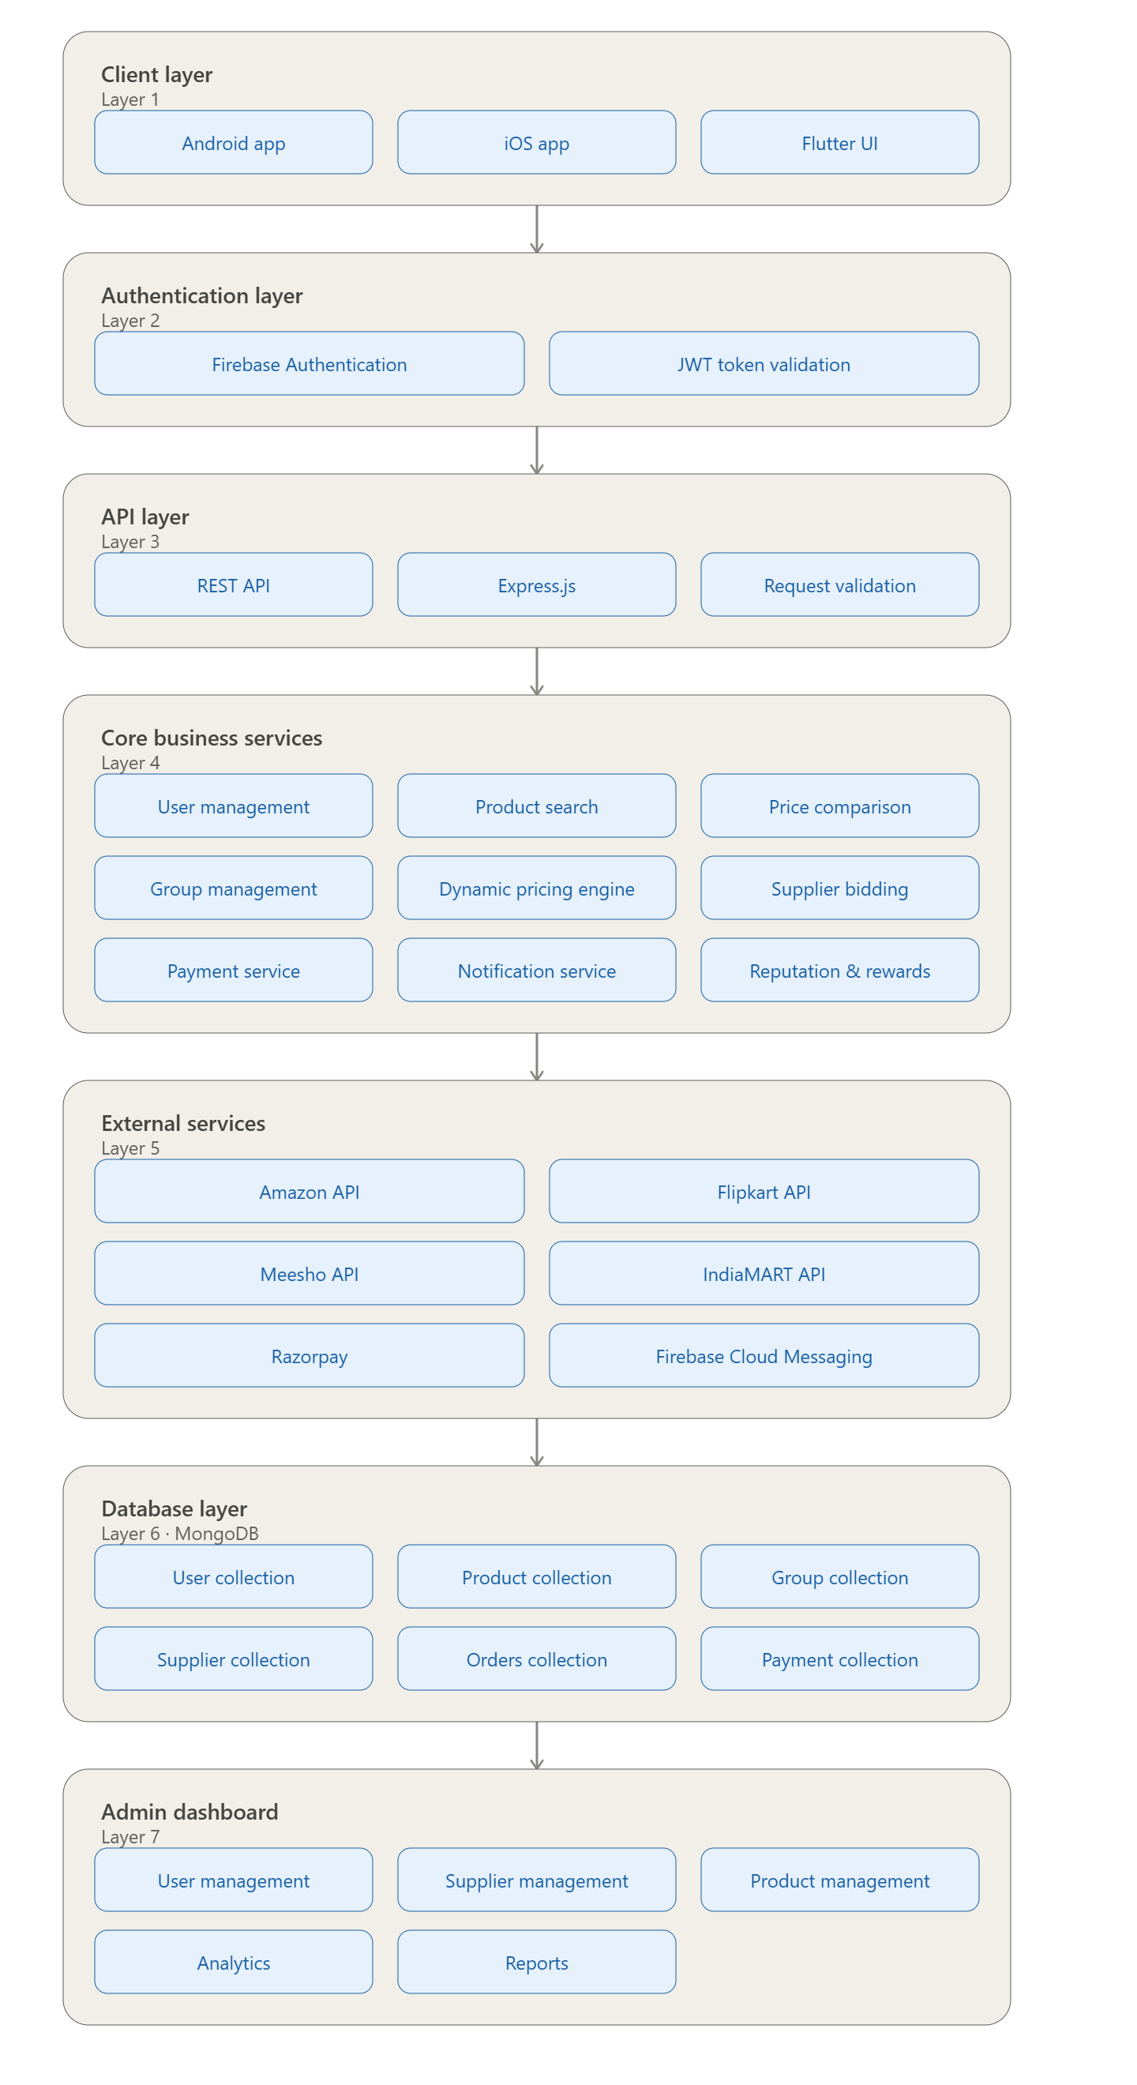
GroupDeal - Experience The Joy Of Shopping

