Slide 1
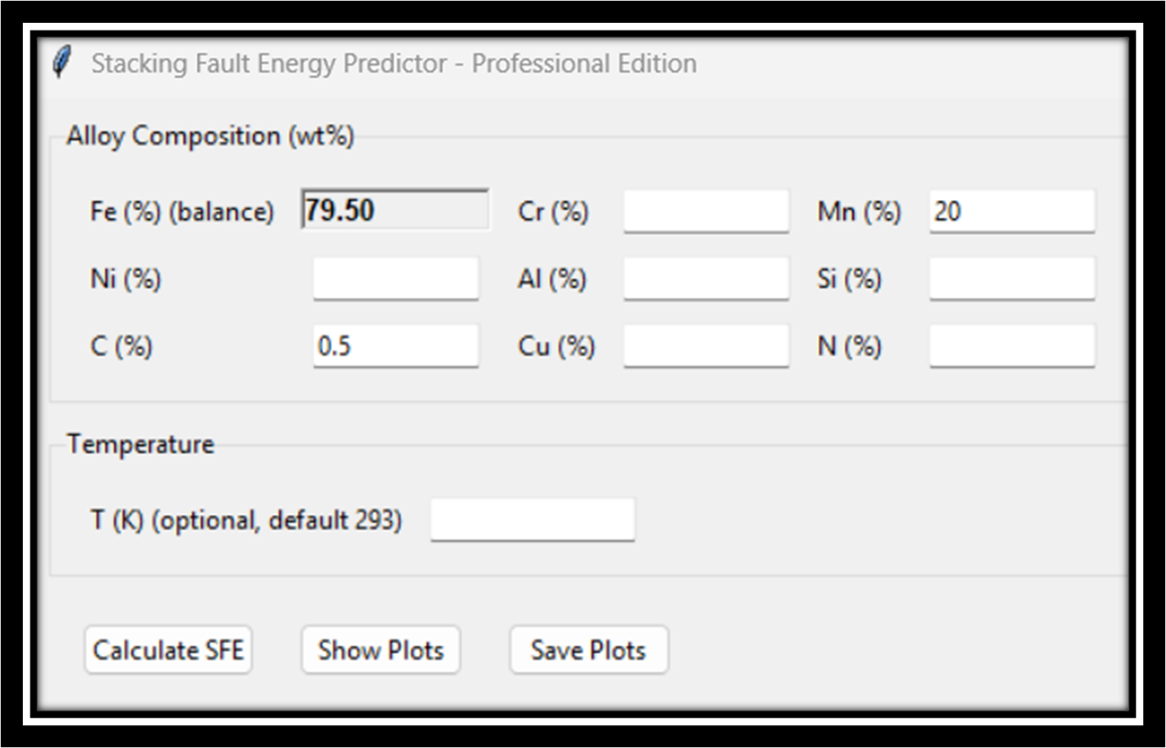
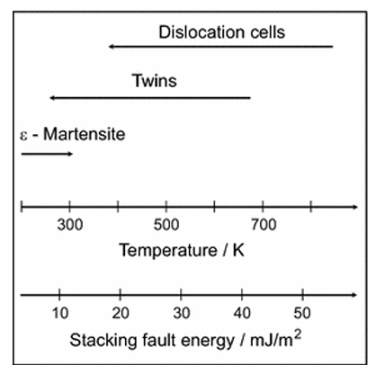
pySFE window
SFE vs plastic deformation mechanisms
Source:

Slide 2
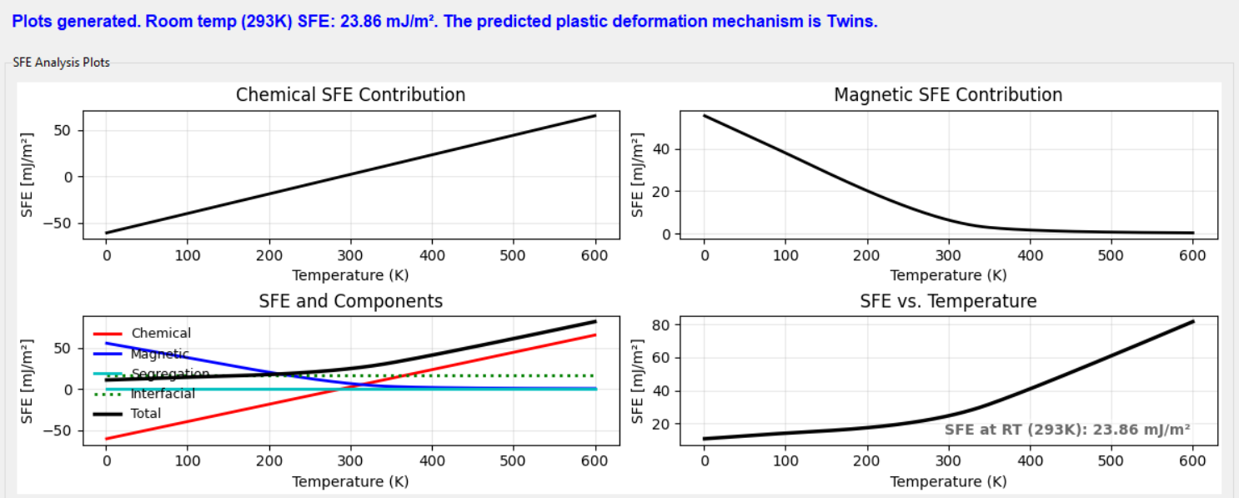
Deformation mechanism
Predicted SFE value is

