Slide 1
FACITITATE PAYMENT GATEWAY FOR SMART TAXI BOOKING
GUIDED BY
SUBMITTED BY
2206135
NANDHINI.R
II MSC CS
Mr. G. PRABHU, M.Sc., M.Phil.,

Slide 2
ABOUT THE PROJECT :-
The project “SMART TAXI WEB APPLICATION-FACILITATE PAYMENT GATEWAY FOR SMART TAXI BOOKING” use Paytm Payment gateway solution in your App or website to simplify payment for your customers.
Taxi booking apps are used by millions of people every day. And within these apps, they use online payment methods to pay for their ride.
Have you ever wondered how this payment processes or what makes it happen? Well , this is where payment gateway integration comes in.
Online taxi booking not only helps you with best prices but also helps you with the convenience of paying through multiple payment options (like Debit Card, Credit Card, eWallets etc.). You can easily compare prices and choose various categories of cabs like Hatchback cars, Sedan and SUV.
This project has been developed using BOOTSTRAP as Front-end and PHP & MYSQL as Back-end in Windows 10 platform.

Slide 3
ORGANIZATION PROFILE:-
SBS Technologies is a software company based in Erode, Tamil Nadu, India. It was founded in 2011 by Mrs. Shanthi Subramanian & Mr. Babu Subramanian. The company provides a wide range of software development services, including website. Development, mobile application development, and software testing.
SBS Technologies also offers training courses on various software development technologies. The company has a team of experienced and qualified software developers who are experts in a variety of programming languages and technologies.
SBS Technologies has a proven track record of delivering high-quality software solutions to its clients. The company is committed to providing its clients with the best possible service and support.
SBS Technologies is a leading provider of software development services in Erode. The company has a strong reputation for quality, reliability, and customer service. SBS Technologies is a trusted partner for businesses of all sizes. Here are some of the services offered by SBS Technologies.

Slide 4
PAYMENT GATEWAY MEANING:-
A payment gateway is a technology that acts as a mediator between an e-commerce website or online service and the financial institution that processes the payment.
It securely authorizes and facilitates the transfer of funds from the customer to the merchant, allowing for online transactions to take place.
When a customer makes a purchase online, the payment gateway encrypts the sensitive information (such as credit card details) provided by the buyer.
It then forwards this encrypted data to the payment processor or acquiring bank. The processor then contacts the bank that issued the customer's credit card to authorize the transaction.
Once the payment is approved or declined, the information is sent back through the payment gateway to the merchant, allowing the transaction to be completed.

Slide 5
HARDWARE SPECIFICATION:-
Processor : Intel Pentium III or higher
RAM : 4GB
System Type : 64 bit OS
Hard Disk : 500GB
Monitor : 17inches LCD Color
Mouse : USB Optical Mouse
Keyboard : Multimedia Keys

Slide 6
SOFTWARE SPECIFICATION:-
Operating System :Windows 10
Coding Language :Bootstrap, PHP
Database :MySQL

Slide 7
EXISTING SYSTEM:-
Cash-based taxi-on-demand apps typically get their cut from the taxis in the form of a commission or service fee.
When a passenger books a ride through the app and pays in cash, the app operator takes a percentage of the fare as their commission for providing the platform and connecting the passenger with the taxi.
This commission is agreed upon between the app operator and the taxi company or driver, and it can vary depending on the terms of their partnership. The app may also charge the taxi company a fee for using their platform andaccessing their customer base.
PROBLEM DEFINED:-
Developing Mobile App and Payment Integration needs more money and also development time.
Every New Mobile device needs the latest android version updates and software updates will lead to higher cost for maintenance.
Developer cost is more for developing a online booking taxi app and also need moreskill sets In the area of payment gateway integration and also API knowledge helps to build applications faster.

Slide 8
How Much Does It Cost To Integrate A Payment Gateway In a Taxi App?
So, how much does it cost to integrate a payment gateway into a taxi app? Well, just like taxi app development cost, the cost to integrate also depends on a lot of factors.
For instance, the complexity of integration, type of integration, payment gateway integration services, and so on.
In any case, the cost to integrate a payment gateway in taxi apps ranges from $20,000–$100,000.
How Long Does It Take To Integrate Payment Gateway?
The second most commonly asked question after how much it costs to integrate a payment gateway is how long it takes.
Well, just like cost, payment gateway integration time depends on different factors. But on average, it can range from 2 months to 5+ months, depending on the integration method.

Slide 9
DRAWBACKS OF THE EXISTING SYSTEM:-
Security Concern
Limited Payment Option
Poor User Experience
Transaction Failures and Errors
Scalability Issues
Fraud Prevention Weaknesses
Limited Support and Documentation

Slide 10
SYSTEM STUDY:-
A system study for a payment gateway involves a comprehensive analysis of the requirements, functionalities, and technical aspects involved in integrating and operating a payment gateway within a specific system or platform.
Here's a breakdown of the components typically included in a system study for a payment gateway:

Slide 11
PROPOSED SYSTEM:-
We develop browser based online taxi web applications which supports in all format of devices for used for communication.
We build application using BOOTSTRAP, PHP & MySQL to reduce the development cost
We host web applications in Linux hosting servers with limited hosting space which will help with maintenance cost.
Payment gateway integration refers to the process of integrating a payment gateway into a website.
Payment gateway itself refers to services through which payment is authorized and processed online.
In the process, the payment gateway serves as a portal or medium that hosts the transaction flow.
To keep the gateway for online payment secure and safe, there are several security protocols and encryption in place.

Slide 12
ADVANTAGE:-
24/7 Availability
Integration with Other System
Customer Trust and Confidence
Real-time Reporting and Analytics
Automated Processes
Reduced Cash Handling
Faster Transactions
Increased Sales

Slide 13
MODULE SPECIFICATION:-
User
Payment Gateway
PayTM
Razorpay
UPI
QR Code
API Settings

Slide 14
MODULE SPECIFICATION:-
USER MODULE:
The user module in a payment gateway manages account creation, authentication, and user profile details for secure transactions. It enables users to update information, track transaction history, and manage payment methods seamlessly. The user module ensures a user-friendly and secure environment for online transactions.
Payment Gateway:
Develop a secure payment gateway module. Support major credit cards and popular payment methods. Ensure seamless integration with the existing system. PayTM, Razorpay, UPI,QR code.
API Settings:
Securely process online transactions with our Payment Gateway API module. Supports major payment methods for seamless transactions. Easily integrate with your platform for efficient and reliable payment processing.

Slide 15
TABLE DESIGN:-
Table Name : USER
Purpose : This table is used to store the user information details.
FIELDNAME | DATATYPE | SIZE | CONSTRAINT | DESCRIPTION
Id | VARCHAR | 20 | Primary Key | The unique id to identify the payment.
User_name | VARCHAR | 20 | Not Null | The name of the user.
User_mobile_no | VARCHAR | 20 | Not Null | The number of the user mobile.
User_email | VARCHAR | 40 | Not Null | The email of the user.
User_pass | VARCHAR | 10 | Not Null | The password of the user.
Referral_code | VARCHAR | 20 | Not Null | The referral code for the user.

Slide 16
Sponsor_id | VARCHAR | 10 | Not Null | The id of the user.
Random_key | VARCHAR | 20 | Not Null | The random key of the user.
Role_id | TINYINT | 4 | Not Null | The role of the user can be active inactive.
Photo | VARCHAR | 30 | Not Null | The photo of the user.
Date_created | TIMESTAMP | 30 | Not Null | The date is created.
Date_modified | DATETIME | 20 | Not Null | The date and time.
Status | TINYINT | 1 | Not Null | The status of the payment can be active inactive.

Slide 17
USERS TABLE RECORDS:-

Slide 18
TABLE DESIGN:-
Table Name : PAYMENT_GATEWAY
Purpose : This table is used to store the payment_gateway information details.
FIELDNAME | DATATYPE | SIZE | CONSTRAINT | DESCRIPTION
Id | VARCHAR | 20 | Primary Key | The unique id to identify the payment.
s_no | VARCHAR | 20 | Not Null | The s_no of the payment.
Name | VARCHAR | 20 | Not Null | The name of the payment.
short_name | VARCHAR | 20 | Not Null | The short name of the payment.
Description | VARCHAR | 40 | Not Null | The description of the payment.
Status | TINYINT | 1 | Not Null | The status of the payment can be active inactive.

Slide 19
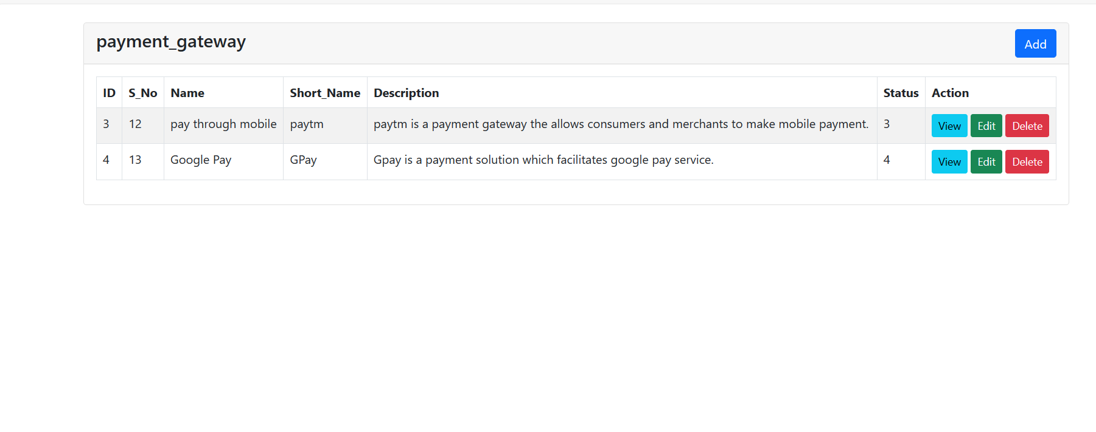
FORM DESIGN:-

Slide 20
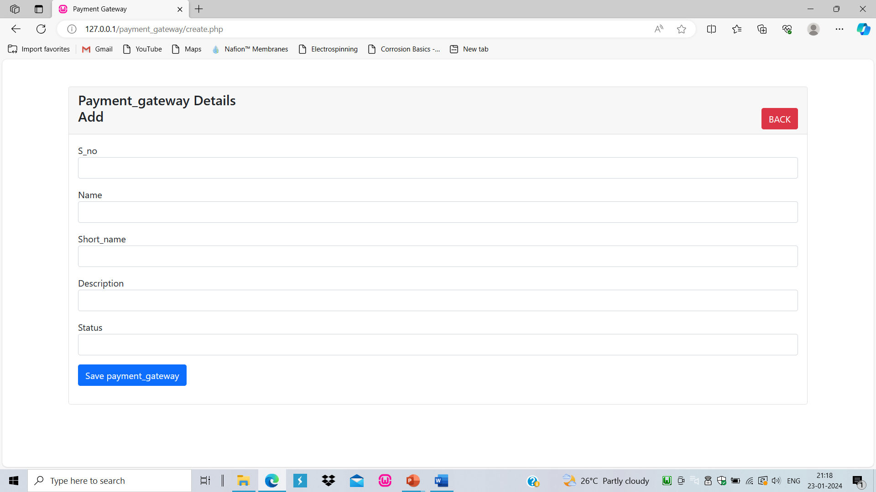
FORM DESIGN:-
TABLE ADD

Slide 21
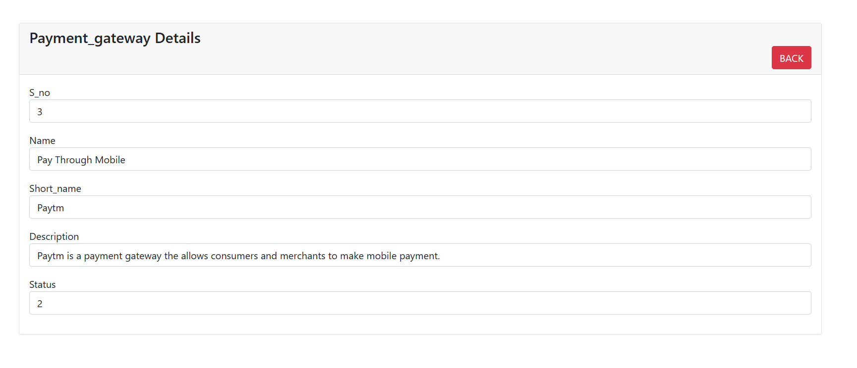
FORM DESIGN:-
TABLE VIEW

Slide 22
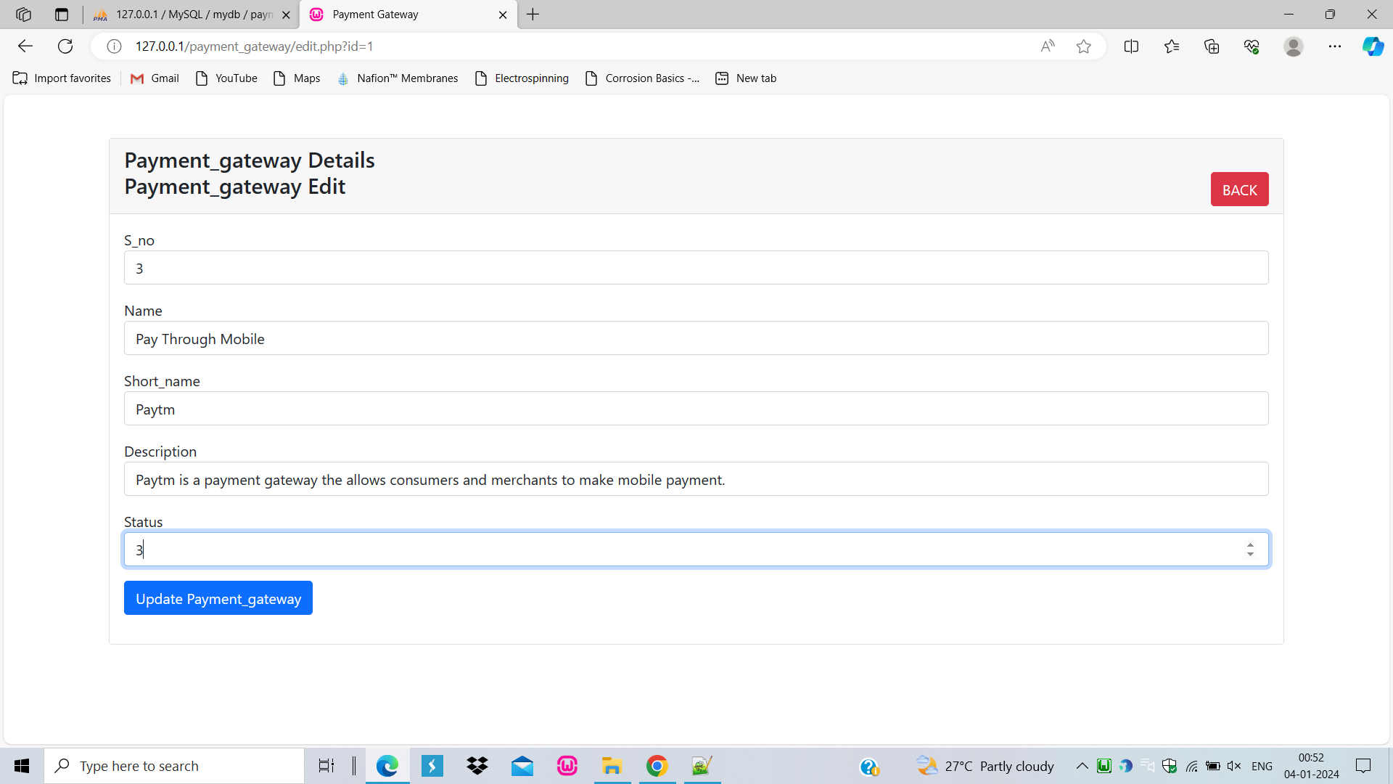
FORM DESIGN:-
TABLE EDIT

Slide 23
THANK YOU…

