Slide 1
Predicting which country to choose for residence
Coursera_Capstone Project - Aruljothi Thirumoorthi

Slide 2
Predicting a place for residence between Chicago and Toronto city
Generally, places are valued by various metrics. We consider number of Indian Restaurants available in both cities.
Predicting place for residence help people decide where to live.
Target Indian Restaurants to analyze
Tourists have interest as well.

Slide 3
Data Acquisition and Cleaning
Chicago city data are scraped from webpage.
In total there were 246 rows and 4 features in the raw dataset.
Toronto city data was scraped from webpage and file.
In total there were 287 rows and 5 features in the raw dataset.
Duplicate, similar or not assigned datas were dropped.
Cleaned data is then used to analyze.

Slide 4
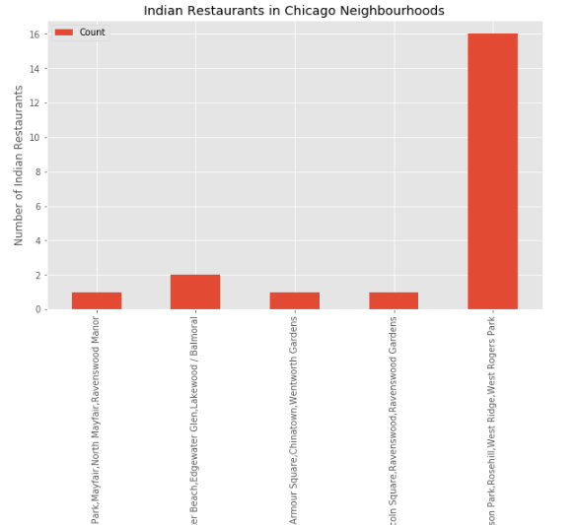
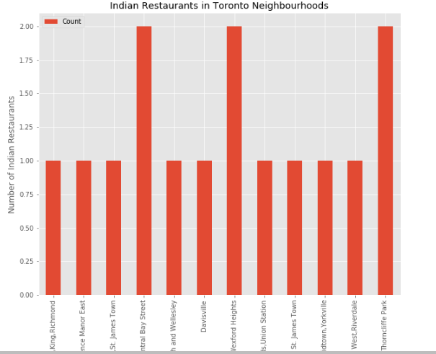
Chicago city has more Indian Restaurant

Slide 5
Conclusion and Discussion
Built useful models to predict which city is better to choose.
Accuracy of the model has room for improvement.
Capture more metrics about both city.
Ideas include:
Population
Crime rate
Housing Price
Commute

