Slide 1
SQL
Created by: Arul kumar
Date: 06-05-2020

Slide 2
Topic to Cover
Creating Database
Creating Table
Primary Key is used to identify a unique record in a table
Foreign key
Creating constrains

Slide 3
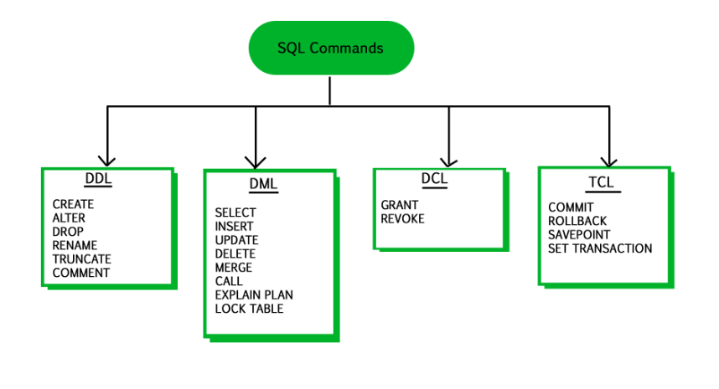
SQL Commands Data Definition Language, Data Manipulation Language, Transaction Control Language, and Data Control Language.

Slide 4
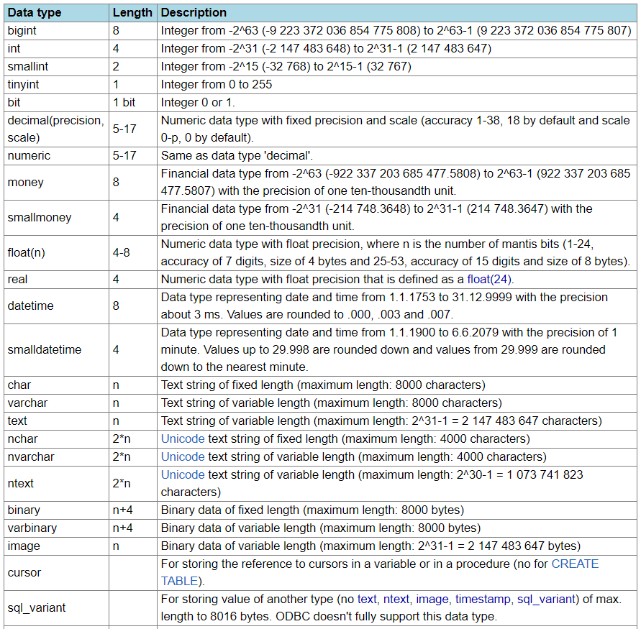
SQL Data type

Slide 5
Creating Person table
Create table person(ID int, Name varchar(10), Email_ID nvarchar(50), Gender_ID int not null)
insert into person values
(1,'Arul','Arul@gmail.com',2),
(2,'Mahesh ','Mahesh @gmail.com',3),
(3,'Raghu','Raghu@gmail.com',1),
(4,'Biswa','Biswa@gmail.com',null),
(5,'Viki ','Viki @gmail.com',2),
(6,'Harish','Harish@gmail.com',null)

Slide 6
Constraints
Constraints are used to limit the type of data that can go into a table. This ensures the accuracy and reliability of the data in the table. If there is any violation between the constraint and the data action, the action is aborted.
NOT NULL - Ensures that a column cannot have a NULL value
UNIQUE - Ensures that all values in a column are different
PRIMARY KEY - A combination of a NOT NULL and UNIQUE. Uniquely identifies each row in a table
FOREIGN KEY - Uniquely identifies a row/record in another table
CHECK - Ensures that all values in a column satisfies a specific condition
DEFAULT - Sets a default value for a column when no value is specified
INDEX - Used to create and retrieve data from the database very quickly

Slide 7
Adding Foreignkey constrain
Alter table tblPerson add constraint tblPerson_GenderId_FK FOREIGN KEY (GenderId) references
Alter table [ForeignKeyTable ] add constraint ForeignKeyTable_ForiegnKeyColumn_FK FOREIGN KEY (ForiegnKeyColumn) references PrimaryKeyTable (PrimaryKeyColumn)

Slide 8
Altering existing column with null
Should replace the previous null with 0
Syntax:
Update [table_name] set [column_name] = 0 where [column_name] is null
Add not null constrain:
Alter table[table_name] alter column [Column name] data_type not null
Unique Key:
If we already have Primary key but we still dosent want any duplicate record in to other column.
Then unique key is the solution. There can be multiple unique key can be used for a table.
Primary key dosent allow nulls. But Unique key allow only one null.
Alter table [Table_name] add constraints [Contstraint names] Unqiue [column name]

Slide 9
Group by
The GROUP BY statement groups rows that have the same values into summary rows
The GROUP BY statement is often used with aggregate functions (COUNT, MAX, MIN, SUM, AVG) to group the result-set by one or more columns.
Group By Syntax:
SELECT column_name(s) FROM table_name WHERE condition GROUP BY column_name(s) ORDER BY column_name(s);

Slide 10
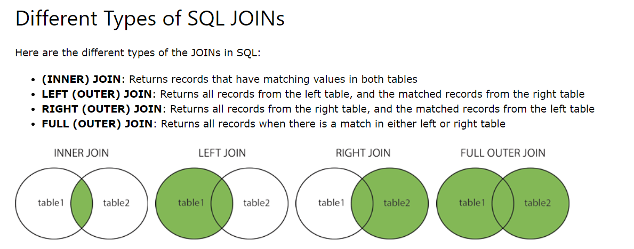
Joints

Slide 11
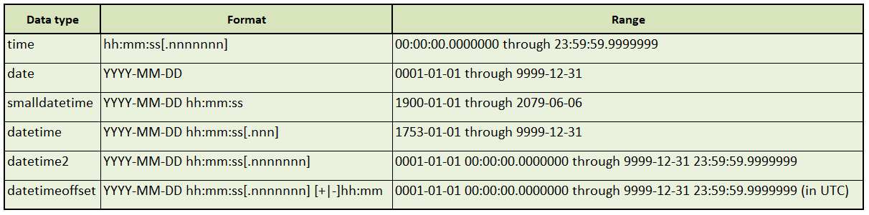

Date function in SQL
Select GETDATE()
Select SYSDATETIME() – Same as Getdate but will get more fractional precision

Slide 12
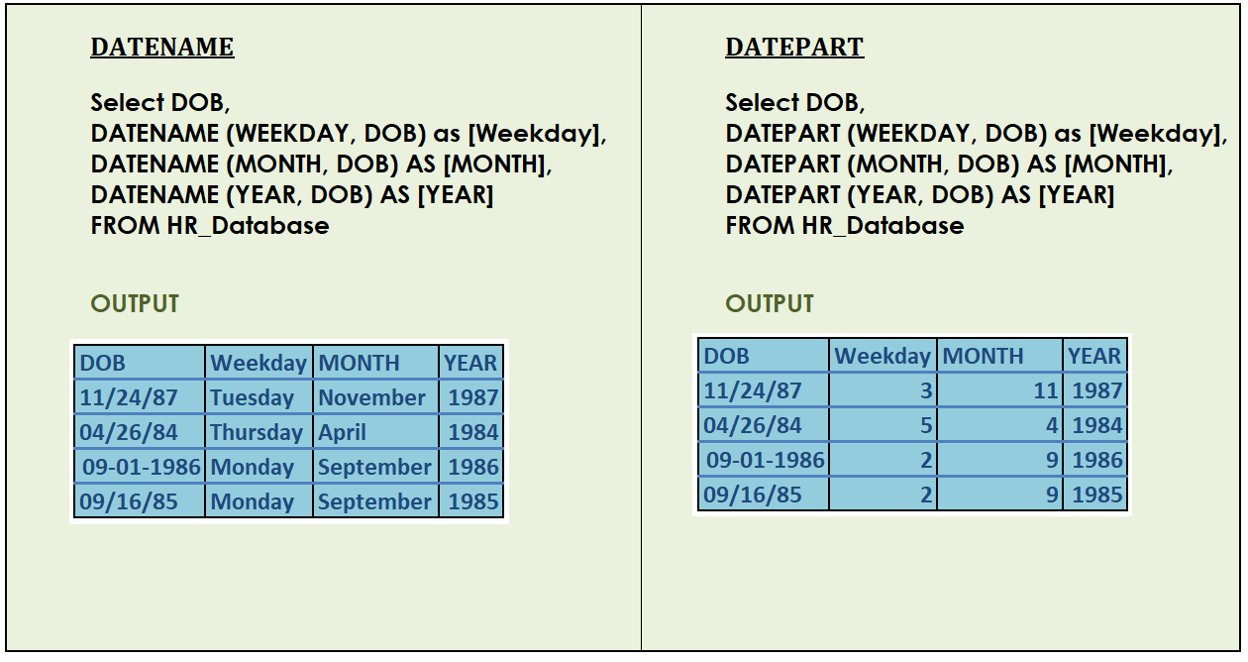
Date function in SQL-1
DATENAME: Will return the character value for the given date.
DATEPART : will split the date in to day|month|year

Slide 13
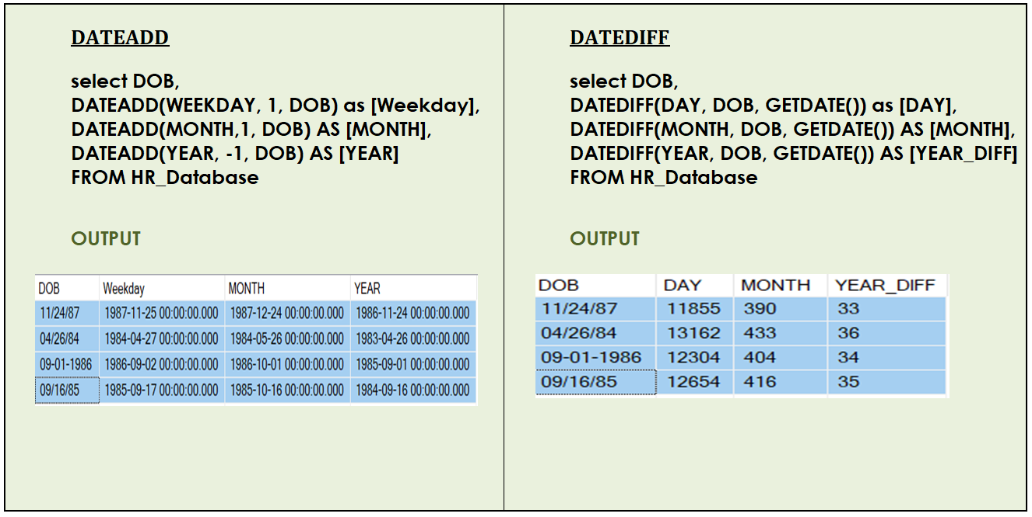
Date function in SQL-2

Slide 14
Questions on Date functions:
People who have joined company in the same day or month or year?
People who have joined between 2 given date?
People who joined in the same month and day not the year?
People who joined in the same year?

Slide 15
String Functions

Slide 16
INDEX
Index is used by SQL to retrieve record by specifically going to the row address for the given condition instead of reading all rows.
How to create an index ?
Cerate INDEX [Index_name] ON table_name [column_name Asc|Desc]
How to check the created index ?
Expanding the Index folder inside the table folder structure.
How to drop an index?
Drop index [table_name.Index_name]

Slide 17
Clustered index
Reference : https://www.youtube.com/watch?v=NGslt99VOCw&t=731s
What is clustered index ?
A clustered index will determine the physical order of the table.
Eg: For primary key column. Even if we give the ID value in jumbled form it will take in ascending order
Note: 1 clustered index can contain multiple column. Those kind are called composite index.
How to create a clustered index ?
Create CLUSTERED INDEX [CL_index] on table_name (Column1 desc, column 2 asc)
How to Drop an index ?
Alter table Table_name
Drop Index [Index_name] on Table_name
What is non clustered index ?
A Non clustered index is analogous to a text book index. The data is stored in 1 place and the index is place in a seperate place.
How to create a Non clustered index ?
Create Noncluster index [NC_index_table_name] on table_name(column_name)
How to drop an index ?
Alter table Table_name
Drop Index [Index_name] on Table_name

Slide 18
Rank function
Dense Rank
Dense_rank() over (Order by Id desc)
Order by clause is must. It determines on which column it need to use Dense_rank
Note: if 2 iD with same value. It will assign same rank for both the ID
Row_number:
Row_number() over (Order by Id desc)
Note: If 2 ID with same value. It will result in 1 and 2
Rank
Rank Over (order by ID desc)
Note: if 2 ID with same value. It will assign the same value but it will skip the next next.

Slide 19
Bulk Insert
Why Bulk insert is used ?
To import a table from csv | text

Slide 20
Difference Btw Where and Having Clause
Where Clause:
1. Where clause cannot used with aggregate
2. Where clause will come before group by
Having Clause:
1. Will do aggregation after the calculation.

Slide 21
Date Time functions

Slide 22
Temporary Tables

Slide 23
View Limitation

Slide 24
CTE

Slide 25
Data Base Normalization

Slide 26
Co-related sub quries

Slide 27
Except & Not in ( difference )

Slide 28
Where and Having clause( difference )

Slide 29
Lead & Lag function

Slide 30
Cast & Convert Function

