Slide 1
Employee Data Analysis using Excel
STUDENT NAME: ARULMOZHI
REGISTER NO:FBE33B874FC0F38918A4B5272631AEDB,312208646
DEPARTMENT: B.COM(GENERAL)
COLLEGE: MEENAKSHI COLLEGE FOR WOMEN

Slide 2
PROJECT TITLE
Employee analysis based on specific department

Slide 3


AGENDA
Problem Statement
Project Overview
End Users
Our Solution and Proposition
Dataset Description
Modelling Approach
Results and Discussion
Conclusion
3/21/2024 Annual Review

Slide 4

PROBLEM STATEMENT
The primary challenge is to identify performance gaps and satisfaction levels within specific departments. Without a clear analysis, organizations face difficulties in optimizing employee productivity, retaining talent, and ensuring balanced workloads.

Slide 5

PROJECT OVERVIEW
Employee analysis in a specific department involves evaluating key metrics such as performance, productivity, and engagement. This includes assessing individual and team contributions to departmental goals, identifying skills gaps, and understanding workload distribution. Turnover rates, employee satisfaction, and professional development opportunities are also examined.

Slide 6

WHO ARE THE END USERS?
HUMAN RESOURCE DEPARTMENTS
MANAGEMENT AND LEADERSHIP
TEAM LEADERS AND SUPERVISORS
EMPLOYEES
EXECUTIVE LEADERSHIP
BUSINESS ANALYSTS
RECRUITERS

Slide 7

OUR SOLUTION AND ITS VALUE PROPOSITION
FILTERING- REMOVE VALUES
PIVOT TABLE - SUMMARY OF
EMPLOYEE PERFORMANCE
PIE CHART- FINAL REPORT

Slide 8
Dataset Description
● EMPLOYEE DATA SET- NAN MUDHALVAN PORTAL
9 FEATURES IN EXCEL:
EMPLOYEE ID- ALPHANUMERIC(TEXT)
NAME- ALPHABETICAL(TEXT)
GENDER- ALPHABETICAL(TEXT)
DEPARTMENT - ALPHABETICAL(TEXT)
SALARY - NUMERICAL
START DATE - ALPHANUMERIC(TEXT)
FTE- NUMERICAL
EMPLOYEE TYPE- ALPHABETICAL(TEXT)
EMPLOYEE LOCATION- ALPHABETICAL(TEXT)
● 3 FEATURES USED: DEPARTMENT - ALPHABETICAL(TEXT)
FTE- NUMERICAL
EMPLOYEE TYPE- ALPHABETICAL(TEXT

Slide 9

THE "WOW" IN OUR SOLUTION
❖ Our solution stands out by providing a detailed, department-specific analysis that not only highlights performance metrics but also uncovers hidden patterns and correlations.
❖ This approach empowers organizations to make informed decisions that drive tangible improvements in employee satisfaction and productivity.
3/21/2024 Annual Review
9

Slide 10
MODELLING
● STEP -1 DOWNLOAD THE EMPLOYEE DATASET AND OPEN THE EMPLOYEE DATASET IN EXCEL.
● STEP -2 SELECT THE ENTIRE DATA AND CLICK ON DATA AND CLICK ON FILTER OPTION.
● STEP -3 FILTER FTP FROM A TO Z ORDER.
● STEP -4 SELECT THE ENTIRE DATA AND CLICK ON INSERT AND CLICK ON PIVOT TABLE TO CREATE PIVOT TABLE.
● STEP -5 DRAG THE NEEDED DATA AND CREATE A PIVOT TABLE.
● STEP -6 SELECT THE PIVOT TABLE AND CLICK ON INSERT.
● STEP-7 NOW CLICK ON THE CHART THAT YOU WANT.
● STEP -8 THE CHART IS CREATED.
10

Slide 11
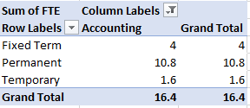
RESULTS
1.TABLE
11

Slide 12
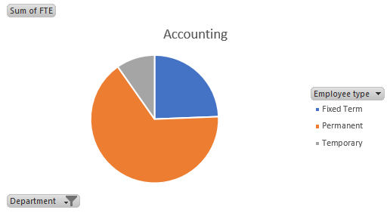
2. PIE CHART

Slide 13
conclusion

