Slide 1
Kafka Sink

Slide 2
Agenda
Introduction to Kafka Sink connector.
Demo setup – Kafka Cluster & Kafka Connect.
Microsoft SQL – Demo
File writing – Demo
Performance Consideration.
Conclusion

Slide 3
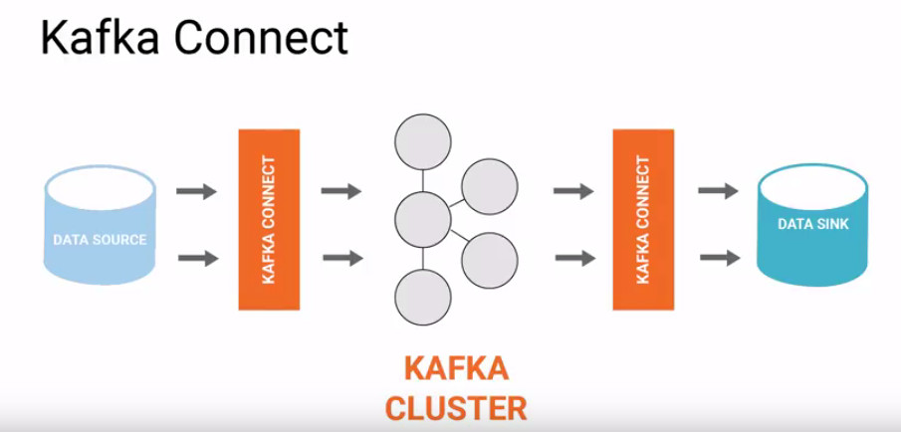
Architecture – Kafka Sink
Kafka is a distributed streaming Platform Designed to handle real-time data feeds with high throughout and fault tolerance. It is built on a distributed architecture that enables scalability, reliability and fault tolerance.

Slide 4
Kafka Sink Connector
Kafka Sink Connector is to Facilitate the integration of kafka with external Systems by enabling the transfer of data from Kafka Topics to these System.
Data Transfer.
Real-Time data Processing.
Streamline Architecture.
Scalability and Flexibility.
Data Consistency and Reliability.
Integration with Ecosystem.

Slide 5
Benefits of Sink
Data Transfer:
Enable the seamless transfer of data from kafka topics to external system such as databases, data warehouses , search engines and messaging systems.
This Allows Organizations to leverage Kafka’s capabilities for ingesting and processing data from various sources and the efficiently deliver it to downstream system for further analysis or action.
Real- Time Data Processing:
Supports real-time data processing by providing a continuous flow of data from kafkaTopics to external systems without significant latency.
This enables organizations to make timely decisions and response quickly to events as they occur, enhancing operational efficiency and agility.

Slide 6
Benefits of Sink
Streamlining Architecture:
By Sink integration, Organizations can streamline their architecture and eliminate the need for custom-Built solutions or manual data transfer processes.
This simplifies the overall data pipeline and reduces maintenance efforts, resulting in cost savings and improved scalability.
Scalability and Flexibility:
Kafka Sink connector are highly scalable and can handle large volume of data, Making them suitable for enterprise-level deployments.
They also offer flexibility in terms of configuring data delivery options, including batch processing, continuous streaming, and fault tolerance, to meet varying business requirements.

Slide 7
Benefits of Sink
Data Consistency and Reliability:
It provides DC and Reliability by providing fault-tolerant delivery mechanisms and built-in error handling capabilities.
This helps maintain data integrity and ensures that all generated in kafka topics is reliably delivered to the target systems, even in the event of failure or network disruptions.
Integration with Ecosystem:
Kafka Sink connector integrate seamlessly with kafka ecosystem and are supported by wide range of connectors developed by both the community and Third-party vendors.
This Allows organizations to leverage existing connectors to integrate kafka with virtually any external system, maximizing interoperability and compatibility.

Slide 8
Types
Database Sink Connectors :
These connectors write data from Kafka topics to relational databases such as MYSQL, Microsoft SQL server, PostgresSQL and Oracle.
Examples include JDBC sin connector, Debezium connector for database CDC (Change data Capture), and Confluent’s kafka connect connectors for various databases.
File Sink Connectors:
File Sink Connector write data from Kafka topics to files stored in filesystem such as local disk or disturbed file systems like HDFS(Hadoop Distributed File system) or Amazon S3.
File Stream Sink Connector and HDFC sink Connector
Database Sink Connectors
File Sink Connectors

Slide 9
Types
Cloud Storage Sink Connectors:
These connectors write data from kafka topics to cloud storage services such as Amazon s3, Google cloud storage, or Azure blob storage.
Example include – Confluent’s Kafka connect connectors for cloud storage.
Search Index Sink Connectors:
These Connectors index data from Kafka Topics into search engine such as ElasticSearch, Apache Solr, or Amazon Elasticsearch service.
Elasticsearch Sink Connector and Solr Sink Connector.
Message Queue Sink Connectors:
These Connectors write data from Kafka Topics to message Queue or Pub/Sub system suc as Rabbit MQ, Amazon SQS, or Google Cloud Pub/Sub.
RabbitMQ Sink Connector, GCP Pub/Sub Sink Connector
Cloud Storage Sink Connectors
Search Index Sink Connectors
Message Queue Sink Connectors

Slide 10
Types
Metrics Sink Connector :
These Connectors write Kafka Metrics data(Such as Producer/Consumer throughout, lag, etc.) to Monitoring systems like Prometheus, InfluxDB or Grafana.
Example include –InfluxDB Sink Connector and Prometheus Sink Connector.
Custom Sink Connector :
Organizations can also Develop Custom Sink connectors tailored to their specific use cases and integrate kafka with proprietary or niche systems not covered by existing connectors.
Custom Connectors offer Flexibility and can be implemented using kafka Connect API.
Metrics Sink Connector
Custom Sink Connector

Slide 11
Command Used for Demo session
To execute Zookeeper service:
C:\kafka\bin\windows\zookeeper-server-start.bat C:\kafka\config\zookeeper.properties
To Execute Broker Service:
C:\kafka\bin\windows\kafka-server-start.bat C:\kafka\config\server.properties
Topic creation:
C:\kafka\bin\windows\kafka-topics.bat --create --bootstrap-server localhost:9092 --replication-factor 1 --partitions 3 --topic sampleSinkTopic
To Execute Consumer Service:
C:\kafka\bin\windows\kafka-console-consumer.bat --topic sampleSinkTopic --bootstrap-server localhost:9092 --from-beginning
To Execute Kafka Connect Service:
C:\kafka\bin\windows\connect-standalone.bat C:\kafka\config\connect-standalone.properties C:\kafka\config\connect-mssql-source-query-CCIR_DV.properties
To Execute Kafka Sink Service – For DataBase Sink
C:\kafka\bin\windows\connect-standalone.bat C:\kafka\config\connect-standalone.properties C:\kafka\config\connect-mssql-source-query-CCIR_DV.properties C:\kafka\config\connect-Database-sink.properties

Slide 12
Demo
Database Sink Connectors
File Sink Connectors

Slide 13
Thank you
Arulprakash E
Team Transformers.
DC India Engagement Session - Feb 2024

