Slide 1

LIGHTWEIGHT TEXTURE-BASED DEFECT DETECTION USING MULTI-SCALE LBP, GLCM AND SVM ON MVTEC AD DATASET
REVIEW-1 PROJECT PROPOSAL
PROJECT TEAM
REGISTER NUMBERS
[Insert Team Members]
[Insert Register Numbers]
DEPARTMENT
INSTITUTION
[Insert Department]
[Insert Institution]
COURSE / SUBJECT
[Insert Course or Subject]
Manus AI | 2026
Notes:
We are looking at our proposal for lightweight texture-based defect detection. And we want to establish our team and project scope right from the start. Let's move straight into the core problem we are trying to solve.

Slide 2

PROBLEM STATEMENT
Industrial inspection must detect small, subtle deviations reliably and consistently. Manual inspection is often slow, inconsistent, and difficult to scale, while heavy deep-learning systems can be computationally expensive and less transparent.
FORMAL PROBLEM STATEMENT
"Develop a lightweight and interpretable machine-vision system capable of detecting industrial surface defects using classical texture descriptors and machine learning while maintaining a balance between accuracy, computational efficiency, and interpretability."
INDUSTRIAL IMAGE
FEATURE EXTRACTION
SVM CLASSIFICATION
NORMAL / DEFECTIVE
Page 2 | Review-1 Project Proposal
Notes:
Manual industrial inspection is slow, inconsistent, and hard to scale. But heavy deep learning models often demand too much compute and lack transparency. So our formal goal is building a lightweight and interpretable vision system that balances accuracy, efficiency, and clarity. And that brings us to why we chose a classical approach.

Slide 3

JUSTIFICATION AND MOTIVATION
TEXTURE ANALYSIS
EFFICIENCY & SCALE
INTERPRETABILITY
LBP captures local transitions while GLCM summarizes statistical relationships (contrast, energy, homogeneity).
SVM offers effective boundaries with low compute. Multi-scale analysis captures defects at varying spatial sizes.
Unlike black-box models, texture descriptors have clear physical meanings, crucial for industrial quality assurance.
DIMENSION
DEEP-LEARNING APPROACH
PROPOSED CLASSICAL APPROACH
Computation
GPU-intensive training and inference
CPU-friendly feature extraction & SVM
Interpretability
Learned representations are opaque
Explicit descriptors with clear meanings
Training
High complexity (tuning, augmentation)
Compact pipeline with explicit engineering
Understanding
Implicit feature learning
Local patterns and statistics are explicit
Deployment
Requires specialized accelerators
Suitable for lightweight/embedded prototypes
Page 3 | Review-1 Project Proposal
Notes:
We aren't using deep learning here because classical texture descriptors offer unmatched interpretability and CPU-friendly execution. LBP captures local spatial patterns, while GLCM adds statistical co-occurrence measures. And combining them gives us a robust feature set for a support vector machine. Let's look at the foundational literature that supports this design.

Slide 4

LITERATURE SURVEY I: FOUNDATIONS
AUTHOR / YEAR
METHOD / CONTRIBUTION
DATASET
KEY FINDING
RESEARCH GAP
Haralick et al. (1973)
GLCM Statistical Descriptors
Photomicrographs, Satellite Imagery
Established computable spatial-dependency features for texture classification.
Not evaluated on modern industrial anomaly benchmarks.
Ojala et al. (2002)
Multiresolution LBP
Texture Classification
LBP histograms provide compact, rotation-invariant local texture representation.
Scale selection remains application-dependent for industrial defects.
Cortes & Vapnik (1995)
Support Vector Networks
General Classification
Introduced maximum-margin learning with nonlinear kernel capabilities.
Requires carefully engineered features for specific domains.
Bergmann et al. (2019)
MVTec AD Benchmark
Industrial Objects & Textures
Introduced a realistic multi-category benchmark with pixel-precise ground truth.
Initial baselines focused on detection rather than comparative feature analysis.
Bergmann et al. (2021)
Extended MVTec AD Analysis
MVTec AD
Detailed 15 categories and 73 anomaly types; compared deep vs. classical methods.
Deep methods outperformed classical ones, motivating refined lightweight studies.
Page 4 | Review-1 Project Proposal
Notes:
Our foundation rests on decades of proven texture analysis combined with a modern industrial benchmark. Haralick and Ojala gave us the statistical and local binary tools we still rely on today. And Bergmann's MVTec AD dataset gives us the rigorous testing ground we need. Let's examine how recent research builds on this context.

Slide 5

LITERATURE SURVEY II: MODERN CONTEXT
AUTHOR / YEAR
METHOD
DATASET
KEY FINDING
LIMITATION / RESEARCH GAP
Defard et al., 2021 [6]
PaDiM: Patch Distribution Modeling
MVTec AD
Used CNN patch embeddings and Gaussian modeling for localization.
Relies on deep CNN features; not a lightweight classical study.
Roth et al., 2022 [7]
PatchCore
MVTec AD
Achieved state-of-the-art using representative nominal patch features.
High memory bank requirements; lacks classical interpretability.
Ibrahim & Tapamo, 2024 [8]
Vision-Based Surface Survey
Steel Products
Organized statistical, spectral, and ML approaches for steel inspection.
Scope limited to steel surfaces; lacks MVTec AD comparative framework.
Cao et al., 2024 [9]
Visual Anomaly Survey
General AD
Synthesized challenges and prospects across the visual AD field.
Broad survey; lightweight classical pipelines remain underexplored.
IDENTIFIED RESEARCH GAP
Modern industrial anomaly detection is dominated by deep learning representations. There is a significant lack of systematic comparative studies evaluating the progression from single-scale LBP to multi-scale LBP and hybrid LBP+GLCM features on realistic industrial benchmarks like MVTec AD.
Page 5 | Review-1 Project Proposal
Notes:
Recent literature is heavily dominated by heavy deep learning methods like PaDiM and PatchCore. But those heavy models leave a clear research gap for lightweight, interpretable alternatives. So our work steps in to systematically evaluate classical feature combinations on MVTec AD. And that benchmark is what we'll explore next.

Slide 6

DATASET ANALYSIS: MVTEC AD
MVTec AD is the primary benchmark for industrial anomaly detection, mimicking real-world inspection scenarios with high-resolution images and pixel-precise ground truth.
5,354
15
70+
1,888
TOTAL IMAGES
CATEGORIES
ANOMALY TYPES
DEFECT SAMPLES
MVTec AD DATASET
SUITABILITY FOR THIS PROJECT
Object Categories (10)
Texture Categories (5)
Contains realistic industrial defects (scratches, dents, structural changes).
Normal Training Set
Diverse texture patterns ideal for LBP and GLCM evaluation.
Enables meaningful comparison between local and statistical features.
Defective Test Set
High-resolution data supports multi-scale analysis.
Anomaly Masks (GT)
Standardized benchmark allows for research-oriented validation.
Page 6 | Review-1 Project Proposal
Notes:
MVTec AD gives us a realistic industrial testing ground with thousands of high-resolution images across diverse categories. Building on our review of modern anomalies, this benchmark lets us rigorously test classical texture descriptors against actual defects and pixel-precise ground truths. We use its structured object and texture classes to map normal training samples directly against defective test instances. And this prepares us to evaluate both local patterns and statistical features under controlled conditions. Let's look at how we structure the processing pipeline for these images.

Slide 7
PROPOSED METHODOLOGY
MVTEC AD IMAGE INPUT
High-resolution industrial surface samples
PREPROCESSING
Grayscale Conversion | Normalization | Noise Reduction
BRANCH 1
BRANCH 2
BRANCH 3
Single-Scale LBP
(Baseline)
Multi-Scale LBP
(Improved)
Multi-Scale LBP + GLCM
(Advanced)
FEATURE ENGINEERING
Concatenation | Normalization | Selection (PCA / SelectKBest)
SVM CLASSIFIER
Linear / RBF Kernel Optimization
* Reproducibility Note: Fixed preprocessing, documented train/test protocol, and consistent feature scaling across all pipelines.
NORMAL / DEFECTIVE
Page 7 | Review-1 Project Proposal
Notes:
Following our dataset analysis, we design a single architecture that scales across three distinct feature pipelines. We start with grayscale conversion and normalization, then feed the image into three separate branches of texture extraction. These branches range from single-scale LBP up to a hybrid multi-scale LBP and GLCM combination. After feature engineering and dimensionality reduction, a support vector machine makes the final normal or defective classification. And we maintain strict reproducibility through fixed preprocessing and consistent feature scaling. This modular setup allows us to directly compare the expressive power of each pipeline.

Slide 8

EXPERIMENTAL PIPELINES
PIPELINE 1: BASELINE
PIPELINE 2: IMPROVED
PIPELINE 3: ADVANCED
Input Image
Input Image
Input Image
Grayscale Conversion
Grayscale Conversion
Grayscale Conversion
Single-Scale LBP
Multi-Scale LBP
Multi-Scale LBP + GLCM
Histogram Features
Concatenated Histograms
Feature Selection (PCA)
SVM Classifier
SVM Classifier
SVM Classifier
CORE RESEARCH QUESTION
"Does increasing texture representation from single-scale LBP → multi-scale LBP → LBP + GLCM improve defect classification performance while maintaining computational efficiency?"
Page 8 | Review-1 Project Proposal
Notes:
Building directly on our methodology, our experimental framework isolates the exact value of scale and feature fusion across three pipelines. Pipeline one establishes our single-scale baseline using simple histogram features. Pipeline two introduces multi-scale LBP to capture patterns across different spatial resolutions. Pipeline three combines multi-scale LBP with GLCM statistical descriptors alongside feature selection. So our core research question asks whether this progression improves defect classification while keeping things efficient. And that brings us to the specific algorithms and metrics we use to evaluate them.

Slide 9

ALGORITHM SELECTION AND EVALUATION
ALGORITHM RATIONALE
EVALUATION METRICS
COMPONENT
SELECTION RATIONALE
Accuracy:
Overall classification correctness.
LBP
Captures local texture patterns; computationally efficient and rotation-robust.
Precision & Recall:
Reliability vs. sensitivity to defects.
F1-Score:
Harmonic mean for balanced performance.
GLCM
Extracts statistical characteristics: Contrast, Correlation, Energy, and Homogeneity.
Confusion Matrix:
Structural analysis of error types.
SVM
Effective for structured features; supports linear/nonlinear boundaries; lightweight.
CONCEPTUAL EVALUATION FRAMEWORK
MODEL PIPELINE
ACCURACY
PRECISION
RECALL
F1-SCORE
Single-scale LBP + SVM
To be evaluated
To be evaluated
To be evaluated
To be evaluated
Multi-scale LBP + SVM
To be evaluated
To be evaluated
To be evaluated
To be evaluated
Multi-scale LBP + GLCM + SVM
To be evaluated
To be evaluated
To be evaluated
To be evaluated
Page 9 | Review-1 Project Proposal
Notes:
With our experimental pipelines defined, we select each algorithm for a specific role in the representation-to-decision chain. Local binary patterns capture neighborhood structures efficiently, while gray-level co-occurrence matrices add statistical measures like contrast and homogeneity. Support vector machines then handle the structured feature vectors using either linear or nonlinear boundaries. We evaluate performance using accuracy, precision, recall, and the F1-score to balance false positives and false negatives. Because this is a proposal stage, our comparative evaluation table outlines the metrics we will populate as experiments run. And this structured metric framework leads directly into our research contributions.

Slide 10

RESEARCH NOVELTY & CONTRIBUTION
01
02
03
MULTI-SCALE REPRESENTATION
HYBRID FEATURE FUSION
FEATURE SELECTION ANALYSIS
Systematic comparison of single-scale vs. multi-scale LBP to capture defects appearing at different spatial resolutions.
Combining LBP (local texture transitions) with GLCM (global statistical relationships) for a richer descriptor set.
Investigating the impact of PCA and SelectKBest on classification efficiency and redundancy reduction.
04
05
LIGHTWEIGHT ARCHITECTURE
COMPARATIVE EXPERIMENTAL FRAMEWORK
Proposing a CPU-friendly alternative to GPU-intensive deep learning for constrained industrial deployment contexts.
A controlled, research-oriented protocol quantifying the performance gains from baseline LBP to advanced hybrid feature pipelines on the MVTec AD benchmark.
INTERPRETABILITY
COMPUTATIONAL COST
Page 10 | Review-1 Project Proposal
Notes:
Our contribution isn't just applying an existing descriptor. We've built a controlled comparative framework to measure what each feature adds. And building on how we select our metrics, we can now isolate the exact value of multi-scale representation and feature fusion. We systematically test whether combining LBP with GLCM justifies its extra computational weight. And this lets us offer a transparent, CPU-friendly alternative without claiming it beats heavy deep learning everywhere. Let's look at how we plan to execute this timeline.

Slide 11
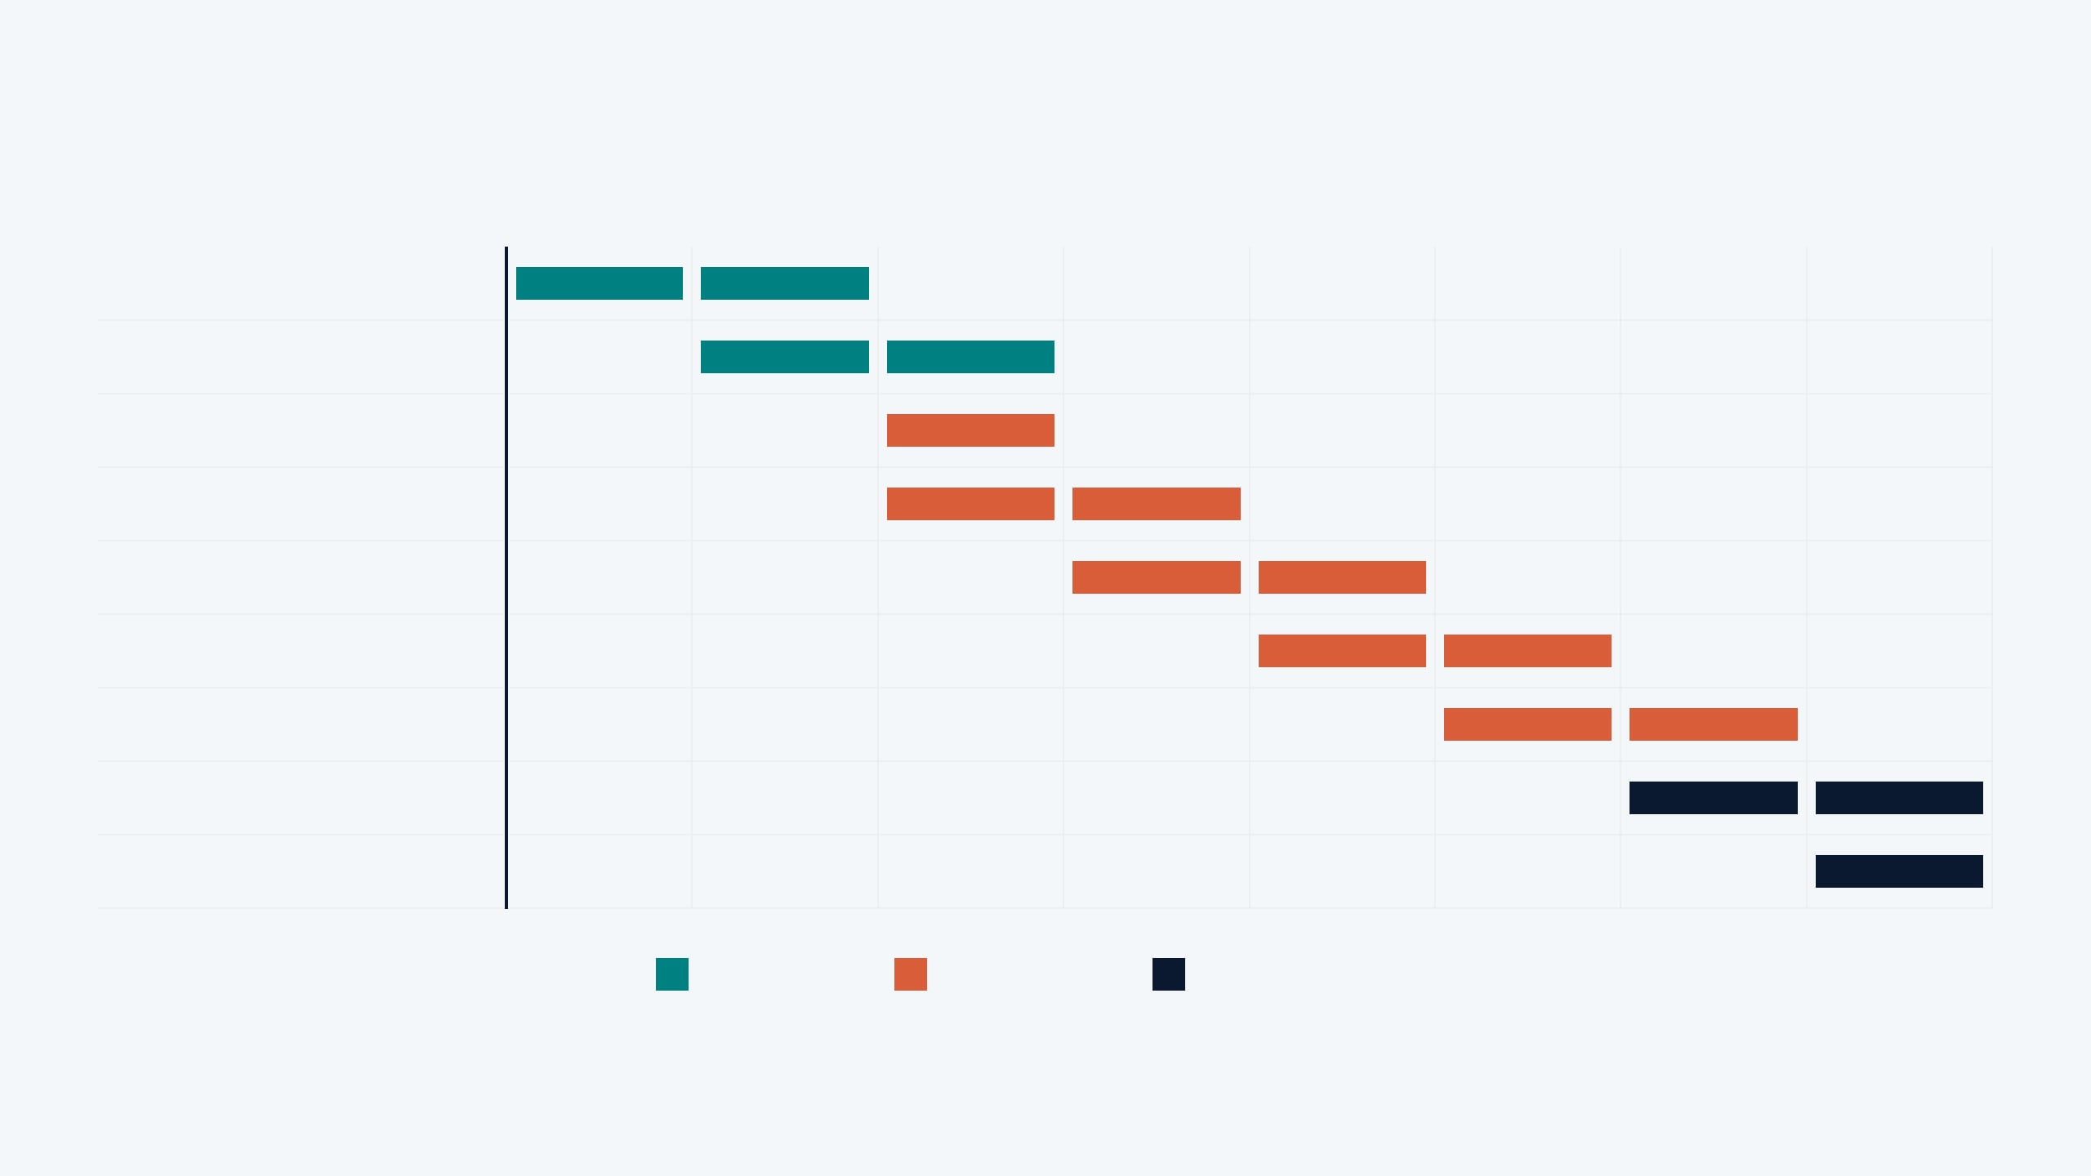
PROJECT WORK PLAN
PROJECT PHASE
M1
M2
M3
M4
M5
M6
M7
M8
1. Literature Survey
2. MVTec AD Preparation
3. Preprocessing Implementation
4. Single-Scale LBP Baseline
5. Multi-Scale LBP Model
6. GLCM + Feature Fusion
7. SVM Training & Selection
8. Evaluation & Analysis
9. Documentation & Delivery
Foundation
Development
Evaluation & Delivery
Page 11 | Review-1 Project Proposal
Notes:
We have structured our project into three clear phases to ensure steady and rigorous progress. Foundation work covers our literature review and dataset preparation on MVTec AD. Then we move into development, building our pipelines from single-scale LBP up to the hybrid GLCM fusion. And finally, evaluation and delivery tie everything together with rigorous cross-validation and metrics. Let's turn to what we expect to achieve with this plan.

Slide 12
EXPECTED RESULTS & CONCLUSION
EXPECTED OUTCOMES
CONCLUSION
A working lightweight industrial defect classification pipeline on MVTec AD.
"The project investigates whether carefully designed classical texture descriptors can provide an accurate, efficient, and interpretable alternative for industrial defect detection on the MVTec AD dataset."
Quantitative comparison of single-scale vs. multi-scale LBP performance.
Evaluation of LBP + GLCM feature fusion effectiveness.
Analysis of SVM kernel (Linear vs. RBF) performance trade-offs.
FUTURE SCOPE
Detailed metrics: Accuracy, Precision, Recall, F1-score, and Confusion Matrices.
Extend binary classification to pixel-level anomaly localization.
Evaluate category-wise robustness across all 15 MVTec AD classes.
Insight into the trade-off between feature complexity and computational cost.
Investigate adaptive scale selection for LBP based on texture density.
Compare against compact deep-learning baselines under matched compute budgets.
Page 12 | Review-1 Project Proposal
Notes:
Because we are at the proposal stage, these are strictly expected outcomes rather than final claims. We anticipate a fully functional, lightweight classification pipeline that balances accuracy with low compute costs. We want to quantify the exact trade-offs between linear and RBF SVM kernels across our feature sets. And looking ahead, we plan to extend this binary work into pixel-level localization and adaptive scale selection. Thank you for your time, and we welcome your feedback.

