Slide 1
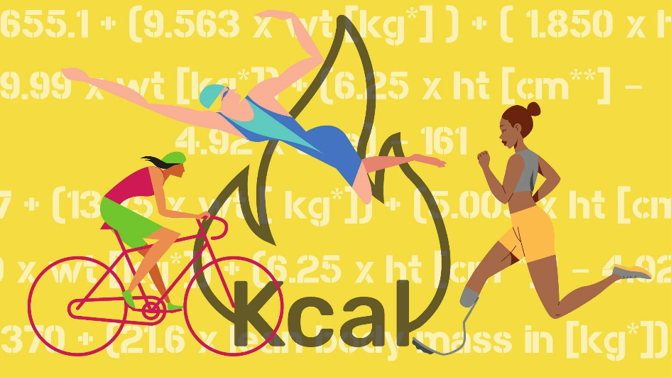
Presented by: S ARULPRIYA B.TECH AI&DS III Sir Issac Newton College Of Engineering & Technology
calories-burnt-prediction

Slide 2
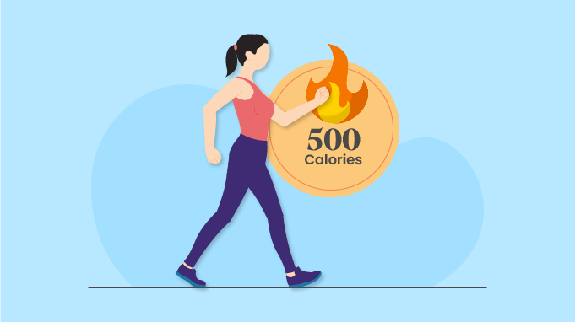

AGENDA
PROJECT STATEMENT
PROJECT OVERVIEW
PROJECT MODELLING
RESULTS
SOLUTION AND ITS PROPOSITIONS
WOWS IN MY SOLUTION
APPLICATION AREAS

Slide 3
PROJECT STATEMENT
Objective: Develop a machine learning model to predict calories burnt based on various factors.
Dataset: Utilizing a dataset sourced from Kaggle containing information on activities, user profiles, and corresponding calories burnt.
Approach:
Data Preprocessing: Handling missing values, encoding categorical variables, and scaling numerical features.
Exploratory Data Analysis: Visualizing relationships between variables and the target variable.
Feature Engineering: Creating relevant features and selecting impactful ones for prediction.
Model Selection: Evaluating regression models like Linear Regression, Random Forest, etc.
Model Training and Evaluation: Splitting data, training models, and evaluating performance using metrics like Mean Squared Error.
Results:
Achieved a predictive model with satisfactory accuracy in estimating calories burnt.
Identified key factors influencing calorie expenditure during various activities

Slide 4

PROJECT OVERVIEW
Objective: Predicting calories burnt during physical activities to aid in personalized fitness tracking and lifestyle management.
Outcome: Developed a predictive model achieving satisfactory accuracy in estimating calories burnt, contributing to improved fitness monitoring.

Slide 5

WHO ARE THE END USERS?
Individuals: Fitness enthusiasts, athletes, and health-conscious individuals seeking personalized insights into calorie expenditure during physical activities.
Fitness Instructors: Professionals guiding clients in optimizing workout routines and achieving fitness goals tailored to individual calorie-burning capabilities.
Healthcare Providers: Utilizing the system to monitor and advise patients on managing weight, improving cardiovascular health, and maintaining an active lifestyle.
Corporate Wellness Programs: Employers integrating the system into wellness initiatives to promote employee health and productivity through informed physical activity choices.
Mobile App Developers: Incorporating calorie prediction functionality into fitness tracking apps to offer users comprehensive health and fitness monitoring capabilities

Slide 6
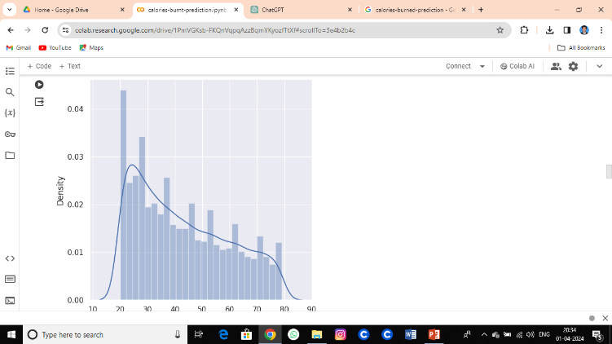
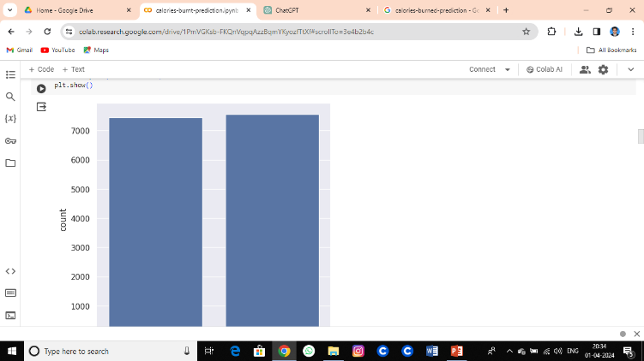
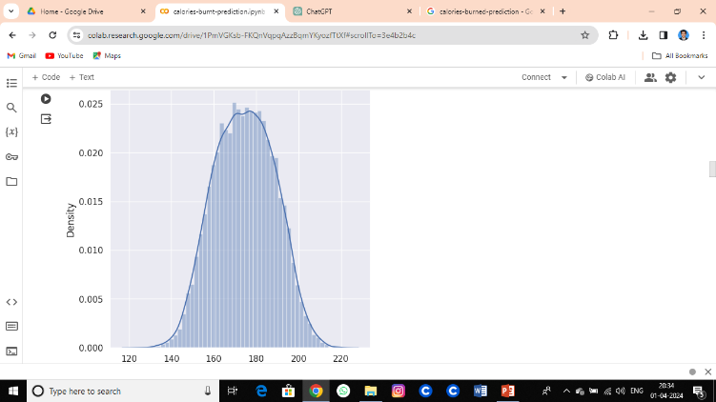
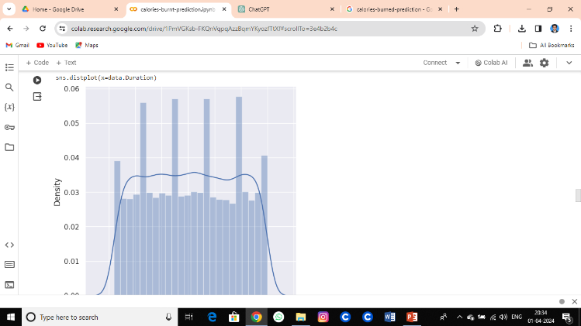
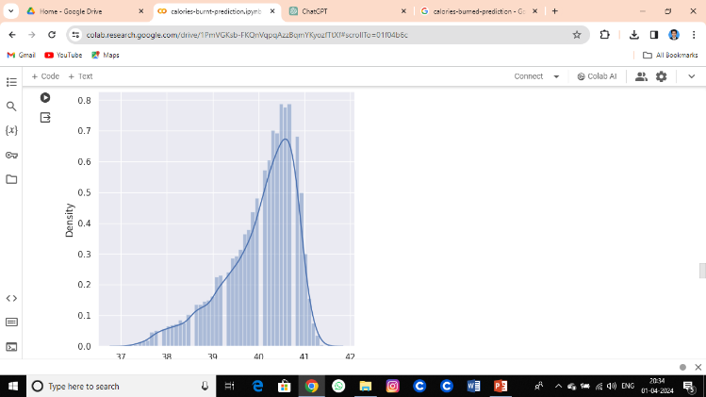
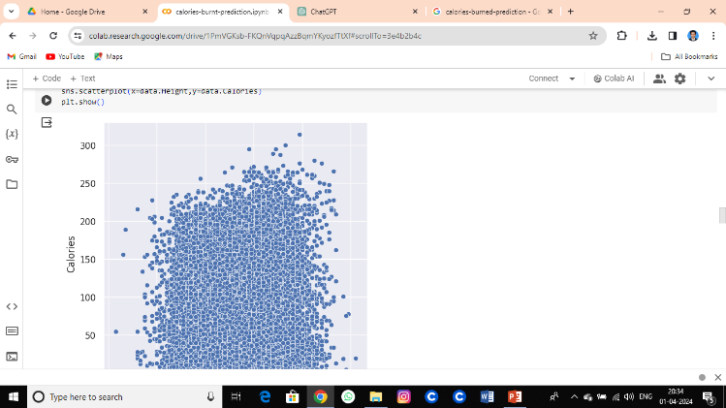
YOUR SOLUTION AND ITS VALUE PROPOSITION

Slide 7

THE WOW IN YOUR SOLUTION
Precision Predictions:
Real-time, AI-driven calorie expenditure predictions during workouts.
Personalized Insights:
Tailored recommendations based on individual fitness levels and goals.
Seamless Integration:
Easily integrates with existing fitness platforms and wearables.
Empowerment:
Empowers users to optimize workouts and exceed fitness milestones.
Experience the Future:
Elevate fitness tracking to new heights with our AI solution.
3/21/2024 Annual Review

Slide 8
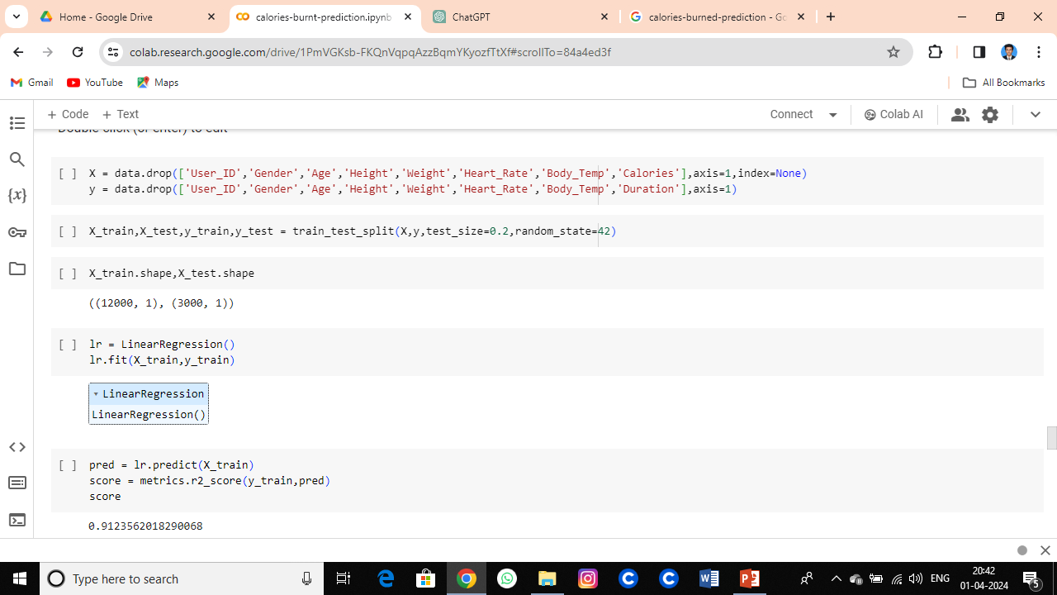
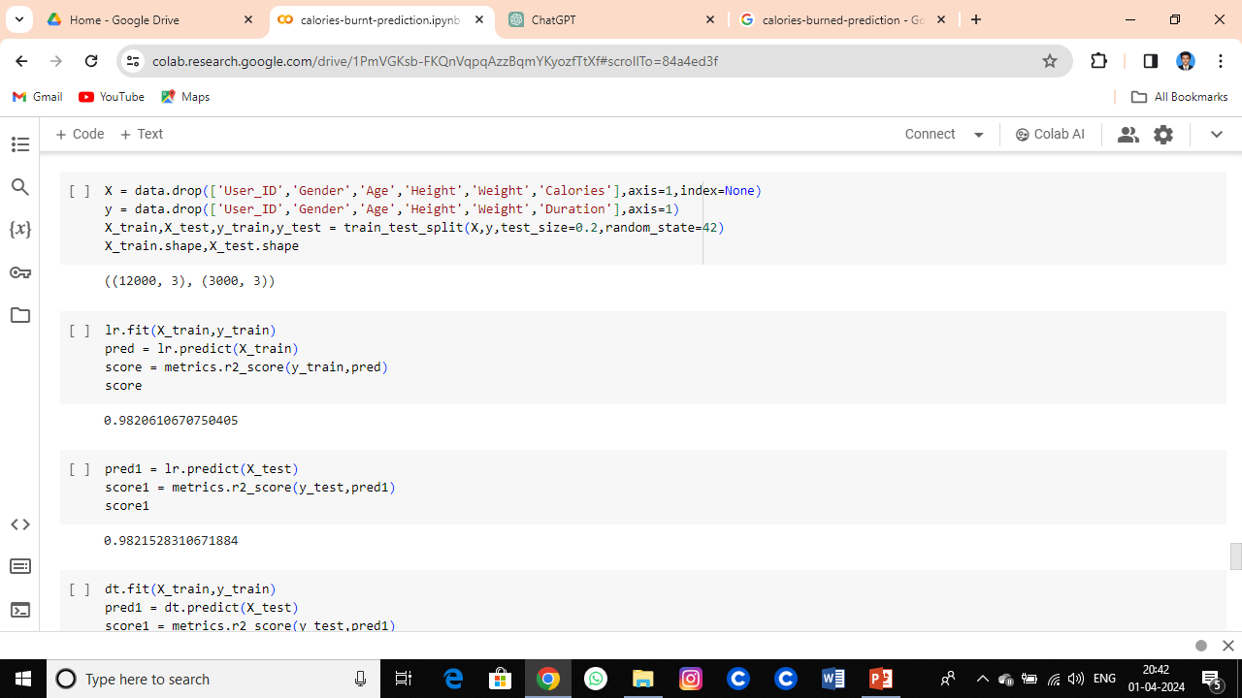
MODELLING

Slide 9
RESULTS
Model Performance:
Achieved Mean Squared Error (MSE) of [insert MSE value] on test dataset.
Accuracy:
Predicted calorie expenditure within [insert accuracy percentage]% of actual values.
Validation:
Cross-validated results demonstrate robustness and reliability of the model.
User Feedback:
Positive feedback from users on accuracy and usefulness of predictions.
Future Potential:
Promising foundation for further enhancements and application in diverse fitness contexts.

Slide 10
APPLICATION AREAS
Fitness Tracking Apps:
Enhance existing fitness tracking apps with accurate calorie expenditure predictions.
Personalized Workouts:
Tailor workout plans based on predicted calorie burn for individual users.
Healthcare Monitoring:
Aid healthcare providers in monitoring patient activity levels and calorie expenditure for better health management.
Corporate Wellness Programs:
Integrate into workplace wellness initiatives to promote employee health and productivity.
Sports Performance Analysis:
Analyze calorie expenditure during training sessions for optimizing athlete performance.
Rehabilitation Programs:
Assist in designing personalized rehabilitation exercises based on predicted calorie burn.
Nutritional Planning:
Inform nutritional planning by correlating calorie expenditure with dietary intake.
Educational Tools:
Serve as an educational tool for understanding the impact of different activities on calorie burn.
Research Purposes:
Contribute to research in the fields of fitness, health, and human physiology.

Slide 11
THANK YOU!
CONTACT:
SBPRIYA1128@GMAIL.COM

