Slide 1
Operating Systems Project
Dynamic Priority CPU Scheduling
Implementing MLFQ in xv6
Team members
[Name 1] [Name 2] [Name 3]
Q0 · 4 ticks
Register numbers
[Reg. No. 1] [Reg. No. 2] [Reg. No. 3]
Q1 · 8 ticks
Department / College
[Department], [College]
Q2 · 16 ticks
Course
Operating Systems
Built on MIT xv6-riscv · github.com/Arumparithi42/xv6-mlfq-scheduler
Notes:
Introduce the team. The project replaces the round-robin scheduler of MIT xv6-riscv with a three-level Multilevel Feedback Queue (MLFQ) and evaluates it with controlled experiments.

Slide 2
Problem Statement
Original xv6 scheduler
Limitations
Round robin over the process table
Running process gives up the CPU on every timer tick (1-tick quantum)
No notion of priority: every process is treated the same
A short job arriving under load shares the CPU equally and takes several times longer
An I/O-bound process waits behind every CPU-bound process after each wakeup
Switches every tick even when nothing more urgent is waiting
Any priority scheme must still prevent starvation
Objective: implement a three-level MLFQ in xv6 with dynamic priorities, preemption and aging, and measure it against the original round robin with identical instrumentation.
Dynamic Priority CPU Scheduling: Implementing MLFQ in xv6
2
Notes:
Stock xv6 runs every RUNNABLE process in turn and preempts on every tick. It cannot tell interactive work from long computation, so short and I/O-bound jobs wait behind CPU-bound ones. The goal: favour short and I/O-bound work without starving long jobs, and measure the effect.

Slide 3
What is MLFQ?
Multilevel Feedback Queue: priority is learned from how a process uses the CPU
New process
1
New processes start in Q0
Q0 — Highest priority — 4 ticks
Higher-priority queues are selected first
2
used full quantum
aging
3
Same-priority processes share the CPU (FIFO, round-robin-like)
Q1 — Medium priority — 8 ticks
(50 ticks without running)
used full quantum
4
A process that uses its whole quantum moves down one level
Q2 — Lowest priority — 16 ticks
5
Aging moves long-waiting processes upward
Dynamic Priority CPU Scheduling: Implementing MLFQ in xv6
3
Notes:
Three queues: Q0 has the highest priority. A new process starts in Q0 and is assumed to be interactive. If it keeps using its whole quantum it is demoted. Quanta are 4, 8 and 16 ticks, i.e. 40, 80 and 160 ms with our 10 ms tick. Aging promotes a process that has not run for 50 ticks.

Slide 4
MLFQ Scheduling Policy
As implemented in kernel/sched.c
Condition | Action
New process | Starts in Q0 (tail of the queue)
Quantum expires in Q0 | Q0 → Q1, fresh quantum
Quantum expires in Q1 | Q1 → Q2, fresh quantum
Quantum expires in Q2 | Remains in Q2 with a fresh quantum (tail of Q2)
Not run for 50 ticks (waiting) | Promoted one level through aging
Higher-priority process RUNNABLE | Preemption at the next tick (keeps its place and remaining quantum)
Same priority | FIFO order: round-robin-like sharing
4 ticks
Q0 quantum
8 ticks
Q1 quantum
16 ticks
Q2 quantum
50 ticks
Aging threshold
10 ms
Quantum = CPU time used at a level; it is not reset by sleeping, so a process cannot keep Q0 by sleeping just before its quantum ends.
1 tick
Dynamic Priority CPU Scheduling: Implementing MLFQ in xv6
4
Notes:
The whole policy in one table. Quanta 4/8/16 ticks, i.e. 40/80/160 ms. Aging threshold 50 ticks = 500 ms. The quantum counts CPU time only and is not reset by sleeping, which prevents gaming. In our implementation aging counts time since the process last ran, so a process that slept for a long time can also move up.

Slide 5
Behaviour of Different Types of Processes
CPU-bound
Continuously consumes its quantum → demoted one level each time
Q0
Q1
Q2
I/O-bound
Blocks before its quantum ends → stays at high priority (Q0) and preempts lower levels when it wakes
RUN
SLEEP
WAKE
RUN
Long-waiting
Not run for 50 ticks → promoted one level (aging), again after another 50
Q2
Q1
Q0
Dynamic Priority CPU Scheduling: Implementing MLFQ in xv6
5
Notes:
CPU-bound jobs sink to Q2, where the 160 ms quantum gives them few context switches. I/O-bound jobs never use a full quantum, so they stay in Q0 and preempt lower levels when they wake up. A job starved in a low queue is promoted by aging.

Slide 6
Implementation
Policy in a new file kernel/sched.c; hooks in proc.c and trap.c
sched_select()
sched_tick()
// kernel/param.h
#define Q0_QUANTUM 4
#define Q1_QUANTUM 8
#define Q2_QUANTUM 16
#define AGING_THRESHOLD 50
Picks the RUNNABLE process with the highest priority, oldest first in its queue (FIFO); applies aging during the scan
Called on every timer interrupt: charges CPU time, demotes when the quantum expires, preempts if a higher level is waiting
age()
proc_setstate()
Queues without lists: level p->priority + position p->qseq in the process table
Locking: one process lock at a time, as in original xv6
Baseline: make SCHED=RR builds the original round robin
Moves a process up one level for every 50 ticks since it last ran
Every state change goes through it: accounts CPU / wait / sleep time exactly
Dynamic Priority CPU Scheduling: Implementing MLFQ in xv6
6
Notes:
The four key functions. sched_select replaces the choice in the scheduler loop; sched_tick decides on each timer tick whether the running process must yield; age implements starvation prevention; proc_setstate is the single place where state changes are timestamped. Queues are implicit: the smallest (priority, qseq) is the head of the highest non-empty FIFO queue. New system calls: getprocstat, waitstat, schedinfo, schedtrace.

Slide 7
Process Statistics
Measured with the RISC-V time counter at every state change; reported in microseconds
Metric | Meaning
creation time (ctime) | first becomes RUNNABLE
first run (first_run) | first dispatch
completion (etime) | calls exit()
CPU time | time RUNNING
waiting time | time RUNNABLE
sleeping time | time SLEEPING (blocked)
response time | first_run − ctime
turnaround time | etime − ctime
Metric | Meaning
longest wait | longest single RUNNABLE period
CPU time per level | CPU time in Q0, Q1, Q2
dispatches | times given the CPU
quantum expirations | used a full quantum
preemptions | a higher level became RUNNABLE
sleeps | times blocked
demotions | moves down (quantum expiry)
promotions | moves up (aging)
Formulas
response = first_run − ctime
turnaround = etime − ctime
turnaround = cpu_time + wait_time + sleep_time
cpu_time = level_time[0] + level_time[1] + level_time[2]
The identities hold exactly: every moment is charged to one state (checked by schedtest). Same code for MLFQ and the RR baseline.
Dynamic Priority CPU Scheduling: Implementing MLFQ in xv6
7
Notes:
Every state change reads the RISC-V time counter (10 MHz on QEMU virt) and charges the elapsed time to the state being left. So CPU + wait + sleep adds up exactly to turnaround. The same accounting code is used in the round-robin baseline, which makes the comparison fair.

Slide 8
Experimental Setup
xv6-riscv
QEMU 8.2.2 (virt)
Program / command | Used for
schedtest | Automated functional tests (fork/exit/wait/kill, demotion, aging, preemption…)
cpubench [ms] | CPU-bound workload (runs forever without an argument)
iobench [n] [us] | I/O-bound workload: short CPU burst, then block for one tick
schedtime | Runs a command (or -n copies) and prints its scheduling statistics
mlfqexp <exp> | Controlled experiments: single, multi, mixed, aging
Ctrl-P | Process list with queue level, CPU/wait time, demotions, promotions
RISC-V
1 CPU
ICOUNT=1
1 tick = 10 ms
ICOUNT=1: QEMU's deterministic instruction-count clock, so runs are reproducible
3 repetitions per experiment; they differed by at most 31 µs
Same tree, same instrumentation for MLFQ and RR (make SCHED=RR)
Dynamic Priority CPU Scheduling: Implementing MLFQ in xv6
8
Notes:
All experiments run on one emulated RISC-V CPU under QEMU with the deterministic clock (make qemu ICOUNT=1), so results are reproducible; 3 repetitions differed by at most 31 microseconds. Workloads are defined by the CPU time they need, measured by the kernel.

Slide 9
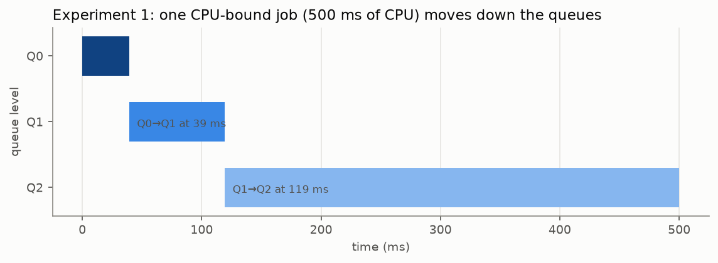
Demotion and Same-Level Scheduling
Experiment 1 — one CPU-bound job (500 ms of CPU)
Same level: FIFO sharing
P1
P2
P3
P1
P2
P3
each turn = one full quantum of the level (160 ms in Q2)
MLFQ ≠ Round Robin: round-robin-like sharing only among processes at the same level
Experiment 2 (3 × 400 ms jobs): all go Q0 → Q1 → Q2 and take turns A, B, C
Dispatches: 12 (MLFQ) vs 123 (RR)
Mean turnaround: 1081.1 ms (MLFQ) vs 1194.4 ms (RR)
Q0 → Q1 after 39.2 ms of CPU; Q1 → Q2 after a further 80.1 ms
Alone on the CPU: 5 dispatches under MLFQ vs 51 under RR
Ctrl-P while cpubench runs (fields abridged):
cpubench Q1 qused=17 cpu=52 disp=2 demote=1 promote=0
cpubench Q2 qused=71 cpu=349 disp=4 demote=2 promote=0
Dynamic Priority CPU Scheduling: Implementing MLFQ in xv6
9
Notes:
Experiment 1 shows exact demotion times: 39.2 ms and 80.1 ms, the configured 40 and 80 ms within half a tick. With three equal CPU-bound jobs they take turns in FIFO order with the quantum of their level. Round robin switches every tick (123 dispatches); MLFQ needs 12.

Slide 10
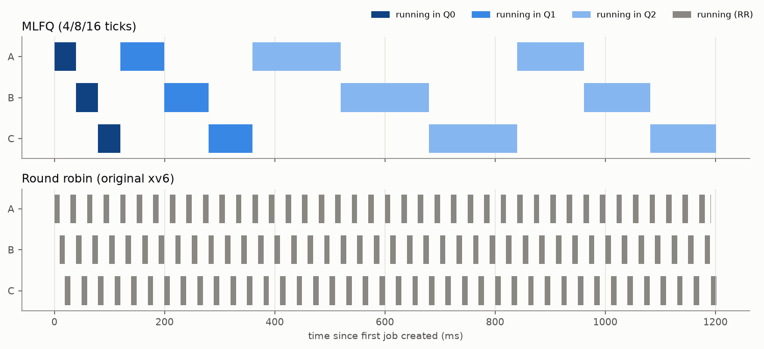
Experiment 2 — Three CPU-Bound Jobs: Timeline
400 ms of CPU each, arriving together; colour = queue level while running
MLFQ: slices of 40, 80, 160 ms in Q0, Q1, Q2
No promotions: each job waits at most 320 ms (< 500 ms threshold)
RR: 1-tick slices, jobs finish together
Finish-time spread: 240.0 ms (MLFQ) vs 11.6 ms (RR)
Dynamic Priority CPU Scheduling: Implementing MLFQ in xv6
10
Notes:
Measured timeline from the kernel's event trace. MLFQ runs the jobs in FIFO order with long slices; round robin interleaves them every tick. Round robin is fairer at a fine time scale, MLFQ has fewer switches and lower mean turnaround for these equal jobs.

Slide 11
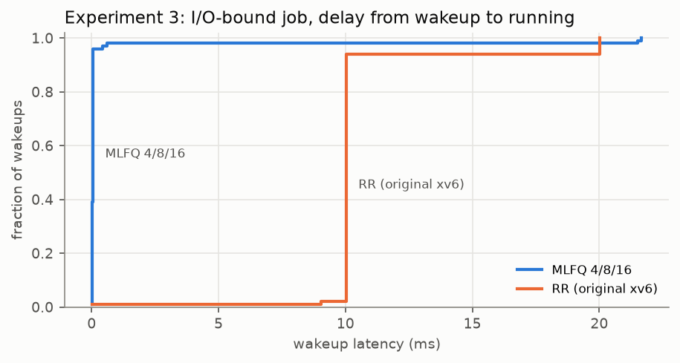
Experiment 3 – I/O-Bound Job Wakeup Latency
Delay from each wakeup until the I/O-bound job gets the CPU (100 wakeups)
Wakeup latency (ms) | MLFQ 4/8/16 | RR
median | 0.05 | 10.02
95th percentile | 0.05 | 20.03
max | 21.67 | 20.03
I/O job (ms) | MLFQ 4/8/16 | RR
waiting time | 126.8 | 1079.7
turnaround | 1119.8 | 2080.8
Inference: MLFQ gives the I/O-bound job much lower wakeup latency and faster response; it stays in Q0.
Workload: two 1000 ms CPU-bound jobs + I/O job (100 × 1 ms CPU + 1-tick sleep) + two 30 ms short jobs
Dynamic Priority CPU Scheduling: Implementing MLFQ in xv6
11
Notes:
The I/O job wakes 100 times. Under MLFQ it preempts the running CPU-bound job at the same tick: median 0.05 ms, which is the emulated cost of the interrupt and context switch. Under RR it waits one or two other jobs' ticks: 10 to 20 ms. The few long MLFQ delays (max 21.67 ms) happen at start-up, while a long job was still in Q0 and so could not be preempted by the I/O job.

Slide 12
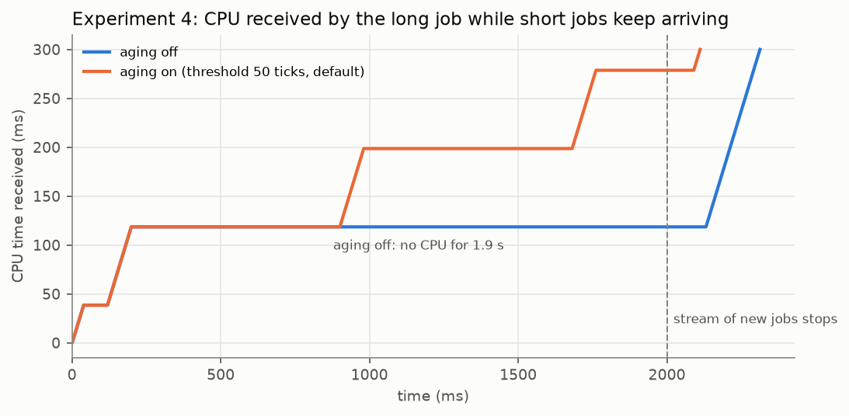
Experiment 4 – Aging and Starvation Prevention
AGING OFF
AGING ON (50 ticks)
1931.9 ms
701.1 ms
longest wait
longest wait
0
2
promotions
promotions
Long job (ms) | Turnaround | Longest wait | Promotions
Aging off | 2312.8 | 1931.9 | 0
Aging on (50) | 2111.5 | 701.1 | 2
RR | 854.3 | 20.1 | –
Setup: a 300 ms long job + a stream of 100 ms short jobs (two at a time, for 2 s)
Short jobs finish within Q0/Q1, so Q0/Q1 are never empty; the long job is forced to wait in Q2
Aging promotes a long-waiting process and reduces prolonged waiting, preventing starvation.
Dynamic Priority CPU Scheduling: Implementing MLFQ in xv6
12
Notes:
Without aging the long job gets no CPU at all for 1.9 s, until the stream stops. With the default threshold of 50 ticks (500 ms) it is promoted twice; its longest wait is 701.1 ms, the threshold plus the time waiting in Q1 behind stream jobs. Aging bounds waiting, not turnaround: under RR the long job finishes at 854.3 ms because everyone shares equally.

Slide 13
MLFQ vs Original xv6 Round Robin
Same source tree, same timer (10 ms) and same measurement code
 | MLFQ (4/8/16 ticks) | Original xv6 RR
Priority levels | 3 (Q0, Q1, Q2) | None
Quantum behaviour | 4 / 8 / 16 ticks; preempted only on expiry or by a higher level | 1 tick; switches on every tick
CPU-bound processes | Demoted to Q2; few context switches (12 vs 123 dispatches, Exp. 2) | Share equally; switched every tick
I/O-bound response | Median wakeup latency 0.05 ms (Exp. 3) | Median wakeup latency 10.02 ms
Aging | Promotion after 50 ticks without running | Not applicable
Starvation | Bounded by aging: longest wait 701.1 ms (Exp. 4) | Longest wait 20.1 ms (no priorities)
Same-level scheduling | FIFO, one full level quantum per turn | Process-table order, 1 tick per turn
Neither is universally better: MLFQ favours short and I/O-bound work; a long job competing with a stream of short jobs finishes later than under RR (2111.5 ms vs 854.3 ms, Exp. 4).
Dynamic Priority CPU Scheduling: Implementing MLFQ in xv6
13
Notes:
Objective comparison of the measured behaviour. MLFQ wins for short and I/O-bound work and needs fewer switches; round robin gives every job an equal share at a fine time scale, which is better for a long job competing with many short ones.

Slide 14
Results — Key Findings
Measured: MLFQ 4/8/16 vs original xv6 round robin
3.6×
≈ 2×
0.05 ms
faster service for short jobs
faster I/O-bound turnaround
median I/O wakeup latency
turnaround 31.1 ms vs 112.8 ms; response 1.0 ms vs 19.6 ms
1119.8 ms vs 2080.8 ms
vs 10.02 ms under RR (100 wakeups)
≈ 1 %
2
12 vs 123
change for CPU-bound jobs
promotions by aging
dispatches (3 CPU-bound jobs)
mean turnaround 2129 ms vs 2113 ms (+0.8 %)
longest wait 701.1 ms vs 1931.9 ms without aging
up to tenfold fewer context switches
Dynamic Priority CPU Scheduling: Implementing MLFQ in xv6
14
Notes:
Short jobs: 3.6 times faster turnaround (Exp. 3). I/O-bound job: about 2 times faster turnaround and 0.05 ms median wakeup latency. CPU-bound jobs change by about 1 percent. Aging: two promotions bound the long job's wait to 701.1 ms instead of 1931.9 ms. Context switches: 12 vs 123 for three CPU-bound jobs.

Slide 15
Conclusion and Future Work
Conclusion
Future work
MLFQ with 3 levels (4/8/16 ticks) implemented in xv6-riscv
CPU-bound processes are gradually demoted Q0 → Q1 → Q2
I/O-bound and short jobs receive much better response
Higher-priority processes preempt lower-priority ones
Aging (50 ticks) promotes long-waiting processes
Exact statistics allow quantitative evaluation vs original RR
Per-level run queues for O(1) selection; per-CPU queues
Periodic global priority boost, compared with aging
setpriority() / nice system call
Precise timed sleep (no wakeup of pause() on every tick)
Lottery / stride scheduling on the same benchmarks
Measurements on real RISC-V hardware
Notes:
Summarise: the implementation keeps xv6's structure and locking, passes the upstream usertests on 1 and 3 CPUs plus our 13 scheduler tests, and the experiments quantify the benefits and the cost. Future work items are those listed in the project documentation.

