Slide 1



22CSP72 – PROJECT WORK II
PHASE I REVIEW
Evidence-Based Fake News Detection with Calibrated Scoring
Date : 10-10-2026
Team Number : CO5
Team Guide : Ms. M. Kannukkiniyal
Team Members :
Mugilan K S (23CSR138)
Nandha Kumar S (23CSR140)
Nandhini A (23CSR141)
Notes:
Good morning. We are Team CO5. Our project checks whether a news story is supported by independent evidence, instead of judging it by how it is written.

Slide 2

PROBLEM STATEMENT & OBJECTIVES
Fake news detectors judge an article by its wording, its headline and whether it names sources, and the writer controls all of these. When we tested our earlier pipeline with invented stories in calm newsroom style, they averaged 7.3 out of 10 and four of six deceptive items read as credible.
01
02
03
Evidence Over Style
Independent Sources
Catch False Premises
Decide a story by what independent sources report, not by how it is written.
Shared owners, wire copies and reprints count once: five copies are one source.
Check named people against Wikipedia to expose an invented role or office.
04
05
06
Verify the Publisher
Calibrated Verdict
Honest Abstention
Identify the outlet from its web address, so a copycat site cannot borrow a name.
Measured likelihood ratios give a probability of fabrication that matches outcomes.
Refuse input with nothing to check; report a failed search as "could not verify".
Notes:
The writer controls every style signal, so a careful fake passes a style-based detector. We saw this in our own earlier pipeline. The six objectives follow from that.

Slide 3
LITERATURE SURVEY
Reference | What They Did | What's Missing
Braun et al., ICML 2025 (DEFAME, base paper) | Multimodal fact-checking agent that plans web and image searches and writes a justified verdict | Does not weigh source credibility; no probability
Verma, arXiv 2026 | Audited the ISOT corpus: the subject field alone gives F1 = 1.000 | High benchmark accuracy reflects corpus artefacts
Chen & Shu, ICLR 2024 | Showed LLM-written misinformation is harder to detect | Style-based detectors miss fluent fakes
Hu et al., AAAI 2024 | LLM rationales guide a small fake news classifier | Still judges the article text alone
Wang et al., ACM Web 2024 | LLM weighs competing crowd reports about a claim | Needs many reports for each claim
Schlichtkrull et al., NeurIPS 2023 | AVeriTeC: real-world claims paired with web evidence | A benchmark, not a reader-facing tool
Lin et al., PNAS Nexus 2023 | Combined six rating sets into one score for 11,520 news domains | Rates outlets, not individual stories
Notes:
DEFAME is our base paper. The others show why style-based detection fails and what is missing for a reader-facing tool.

Slide 4
BASE PAPER: DEFAME vs PROPOSED SYSTEM
Braun et al., "DEFAME: Dynamic Evidence-based FAct-checking with Multimodal Experts", ICML 2025
Aspect | DEFAME (ICML 2025) | Proposed System
Evidence | Web search, image search, reverse image search, geolocation | News index, Wikipedia entries, publisher record, domain registration
Source credibility | Not weighed; relies on the search engine | Publisher identified by web address; 90 curated and 11,520 rated domains
Independence | Not considered | Shared owners, wire copies and reprints merged
Output | One of four labels with a written justification | Verdict, calibrated probability, the rule that fired and quoted grounds
Missing evidence | "Not enough information"; re-plans up to three times | Refuses uncheckable input; CANNOT VERIFY with the reason
Failed check | Not separated from "no evidence" | Reported as "verification unavailable", never as absence
Model and cost | GPT-4o; about 4 min and 13 US cents per claim | 9 of 10 model tasks on a local 8B model; 22 to 112 s per article
Notes:
DEFAME is the closest published system. We keep its evidence-first approach and add what a public tool needs. We did not run DEFAME on our cases, so this compares design and documented behaviour.

Slide 5
RESEARCH GAP
Gap in existing work
How the proposed system closes it
Writing signals the author controls can make a fake look credible
Style may only count against a story, never for it
Retrieved articles are counted, so syndicated copies inflate support
Shared owners, wire copies and reprints count as one source
The outlet is taken from the name the page gives itself
Publisher read from the web address; lookalike sites flagged
A false premise describes an event nobody reports, so search finds nothing
Named people checked against their Wikipedia entries
Hand-picked weights give scores that are not probabilities
Likelihood ratios measured on labelled data, then calibrated
A failed or empty search is shown as evidence against the story
Failed search reported as unavailable; the system abstains
Notes:
Each gap on the left is answered by one part of the system on the right.

Slide 6
SYSTEM ARCHITECTURE
Client: React 19 single-page application
External services
Front page with trust stamps
Article page
Check Anything
Compare Coverage
Reader dashboard
NewsAPI news index
API: Express 5 on Node.js 24
Accounts (JWT, bcrypt)
Access control (JWT or key)
Link guard (no private addresses)
NDJSON progress stream
Report cache (14 days, complete only)
Wikipedia API
Analysis agents
Ingestion: page reader, OCR, captions
Admissibility gate
Claim extraction
Language detection
Corroboration search
Relevance gate
Independence analysis
Stance judgement
RDAP domain registries
Premise check (Wikipedia)
Publisher identity and domain age
Writing checks (4)
Weight of evidence and verdict rules
YouTube captions
Language-model gateway: task routing, retry and back-off, JSON repair
Ollama, Llama 3.1 8B (9 tasks)
NVIDIA NIM (premise check)
Google Gemini (fallback)
Rule-based fallback analysers
Publisher web pages
Data
MongoDB: users, history, activity, report and summary cache
Outlet ratings: 90 curated, 11,520 rated domains
Ownership map
Measured evidence weights and routing table
Notes:
Five layers. The client streams results as each check finishes. Every model call goes through one gateway that routes each task to the provider measured best for it. External services are reached only by the analysis agents.

Slide 7
PROCESSING PIPELINE
Article link: publisher page
Pasted text
Screenshot: Tesseract OCR
YouTube video: caption track
Normalise
title, text, source, provenance; language
Admissibility gate
needs an anchor (name, place, number, date), 40+ characters, 8+ words
no
Refused
reader told what is missing
Claim extraction: up to two claims, 3 to 4 search terms each; English terms added for other languages
Corroboration
Premise check
Publisher identity
Writing checks
Search the news index, own outlet excluded
Relevance gate: must share a name, place or figure
Merge shared owners, wire copies, reprints
Stance: supports or contradicts
Resolve up to two named subjects
Fetch the Wikipedia entry
Admit a conflict only if: same subject, cannot both be true, story's own voice, quoted line
Outlet from the web address, never the page name
Rating: 90 curated, else 11,520 rated domains
Impersonation flag; RDAP domain age under 90 days
Clickbait in the headline
Slanted or one-sided language
Persuasion techniques (SemEval)
Transparency checklist; each quotes its span
Weight of evidence: prior from the publisher band → each observation as a likelihood ratio in decibans → writing checks clamped at max(0, W) → correlated checks damped × 0.379, capped at 8 dB → isotonic calibration → clamp applied again
Verdict rules R0 to R9
ordered; the first match decides and is named
Report: verdict, probability of fabrication, grounds and quoted text; streamed as each check ends; cached only when every check ran
Notes:
One request end to end. The gate runs before anything expensive. The four channels run in parallel. Writing checks may only add suspicion. The verdict comes from ordered rules, and the report streams to the reader as each part finishes.

Slide 8
WEIGHT-OF-EVIDENCE SCORING
Each observation becomes a likelihood ratio, in decibans
Prior by publisher band
Λ(o) = P(o | fabricated) / P(o | genuine)
W(o) = 10 log₁₀ Λ(o)
Publisher band | Prior
Strong factual record | 0.02
Ordinary record | 0.06
Unrated outlet | 0.15
Poor record or impersonating | 0.25
Social media post | 0.35
Evidence adds up in log-odds
logit P(fabricated | O) = logit π + Σ W(o)
One-sided rule for what the author controls
W†(o) = max(0, W(o))
Ratios estimated on 119 labelled ISOT articles with a Jeffreys prior and shrunk to the cautious end of a 95% interval. Isotonic calibration fitted on held-out data, then the one-sided rule is applied again. Priors are declared, not measured.
Correlated writing checks are damped
mean r = 0.55 over 4 checks → 1.52 effective checks
summed weight × 0.379, capped at 8 dB
Notes:
The scoring model. Each observation is a measured likelihood ratio, not a hand-picked weight. The one-sided rule means good writing can never buy trust. The priors are declared and labelled as such.

Slide 9
VERDICT ENGINE
Rule | Condition (first match decides) | Verdict shown
R0 | The publisher is a known satirical outlet | SATIRE
R1 | Two or more independent outlets contradict a claim | FAKE (false)
R2 | One independent outlet contradicts a claim | FAKE (likely false)
R3 | A reference entry contradicts the story's premise | FAKE (likely false)
R4 | The search could not run, or the story is newer than the news index | CANNOT VERIFY
R5 | No checkable claim is left after extraction | NOT A FACTUAL CLAIM
R6 | Two or more independent outlets support the claims | REAL (confirmed)
R7 | One independent outlet supports the claims | REAL (likely true)
R8 | High-impact claim, uncorroborated, three or more risk signals | FAKE (likely false)
R9 | None of the above | CANNOT VERIFY
Input that fails the admissibility gate is refused before these rules run. Each verdict also caps the score shown, so an unconfirmed story can never read as trustworthy.
Notes:
The verdict says what has been established; the probability says how likely fabrication is. An uncorroborated story can have a low probability and still be CANNOT VERIFY.

Slide 10
MODULES OF THE PROJECT
Built by Review 2
Added for Review 3
News platform: feed, login, history, dashboard
Clickbait, bias, persuasion and transparency checks
Cross-source claim verification
Multi-provider AI gateway with failover
Compare Coverage page
Analyse any article by link
Rule-based fallback analysers
Evidence-first verdict engine (R0 to R9)
Weight-of-evidence scoring with calibration
Source independence analysis
Premise check against Wikipedia
Publisher identity from the web address, 11,520 rated domains, domain age
Check Anything: text, screenshot, YouTube, Tamil
Admissibility gate for uncheckable input
Local model routing: 9 of 10 tasks on Ollama
API access control and link guard
182 backend and 14 frontend tests
Notes:
Left: what was in place at Review 2. Right: what was built since, all complete and tested.

Slide 11
RESULTS: HELD-OUT EVALUATION
120 held-out ISOT articles; source hidden, agency tags removed
Accuracy is the same to within one article (114 vs 115 of 120). Calibration error when the system accuses fell from 0.267 to 0.152, 43% lower. Turning the one-sided rule off raises ROC-AUC to 0.983 but accusing ECE to 0.191.
Notes:
Same 120 held-out ISOT articles, same check outputs, two scoring rules. Accuracy is the same to within one article. Where the system accuses, its stated probability is now much closer to the truth.

Slide 12
ADVERSARIAL & PUBLISHER TESTS
0 of 6
6 of 6
2% → 33%
deceptive items rated credible
baseline: 4 of 6
verdicts as expected
0 of 2 genuine reports condemned
fabricated story on a copycat BBC site
probability of fabrication
Lookalike publishers: identity from the page name vs from the web address
Address | By page name | By web address
bbc-breaking-news.xyz, calling itself "BBC News" | BBC News, 9/10 | No rating; impersonation flagged
bbc-world.com | BBC News, 9/10 | No rating
bbc.news-today.com | BBC News, 9/10 | No rating
reuters-updates.info, calling itself "Reuters" | Reuters, 9.5/10 | No rating; impersonation flagged
YouTube channel named "Associated Press" | AP, 9.5/10 | No rating
Notes:
ISOT fakes are crude, so we wrote careful fabrications. The baseline believed four of six; the proposed rule believed none. A copycat BBC page no longer inherits the BBC rating.

Slide 13
END-TO-END TESTING
No. | Input | Expected | Result | Decided by | Time
1 | Pasted text | REAL | REAL | 5 independent outlets | 100 s
2 | News link | REAL | REAL | 3 independent outlets | 33 s
3 | Screenshot | REAL | REAL | 5 independent outlets | 112 s
4 | Tamil text | REAL | REAL | 4 independent outlets | 30 s
5 | YouTube video | REAL or CANNOT VERIFY | CANNOT VERIFY | No coverage found | 55 s
6 | Pasted text | FAKE | FAKE | Premise contradicted | 22 s
7 | Screenshot | FAKE | FAKE | Premise contradicted | 30 s
8 | Pasted text | CANNOT VERIFY | CANNOT VERIFY | No coverage found | 25 s
9 | Pasted text | CANNOT VERIFY | CANNOT VERIFY | No coverage found | 28 s
10 | Pasted text | Refused | Refused | A question | < 1 s
11 | Screenshot | Refused | Refused | A call to action | < 1 s
12 | News link | Refused | Refused | Site blocks reading | < 1 s
11 of 12 matched exactly. The AP video, mostly a French interview, found no matching coverage on that run and returned CANNOT VERIFY; it was not called false.
Notes:
Twelve cases through the running application on 4 October 2026, every input type and every verdict. Midway the internet dropped; every affected case said "verification unavailable", none was called false.

Slide 14
PERFORMANCE & MODEL ROUTING
9 of 10
model tasks run on the local GPU
1.47 s
until the first check is on screen
2.7 ms
to return a cached report
182 + 14
backend and frontend tests passing
* Routed to NVIDIA NIM: the local model missed the known contradiction in 3 of 3 runs.
Notes:
Each task ran three times on each provider. The local model was faster everywhere and the most reliable at claim extraction, but it missed the false premise every time, so that one task goes to NIM.

Slide 15
GIT TRACKING & DOCUMENTATION
Repo URL: github.com/Arumuganandhini/FakeNews_Detection
Repository
Documentation
main: stable project
project: development branch
API keys, .env files and datasets excluded
Every change committed and pushed
Backend and frontend tests run on every change
Project report in the college format: 6 chapters, appendix, references, SDG page (56 pages)
docs/measurements.md: every result with the command that reproduces it
backend/eval: held-out, adversarial and end-to-end test scripts
Automated tests: 182 backend, 14 frontend, all passing
Notes:
All code is on GitHub. Every number in the report can be reproduced by a script in backend/eval.

Slide 16
SDG GOALS ADDRESSED
Reliable verification that any reader can check, without removing or blocking content.
SDG 16
SDG 4
SDG 9
Peace, Justice and Strong Institutions
Quality Education
Industry, Innovation and Infrastructure
Target 16.10, public access to information: every verdict comes with its reason, the outlets involved and quoted text. Impersonating pages are flagged; opinion is not judged.
Quoted evidence shows readers how to judge a story themselves, building media literacy instead of asking for blind trust.
Verification at low cost: nine of ten model tasks run on a laptop GPU, and Tamil and other Indian-language input is accepted.
Notes:
SDG 16 is the main goal, through target 16.10 on public access to information.

Slide 17

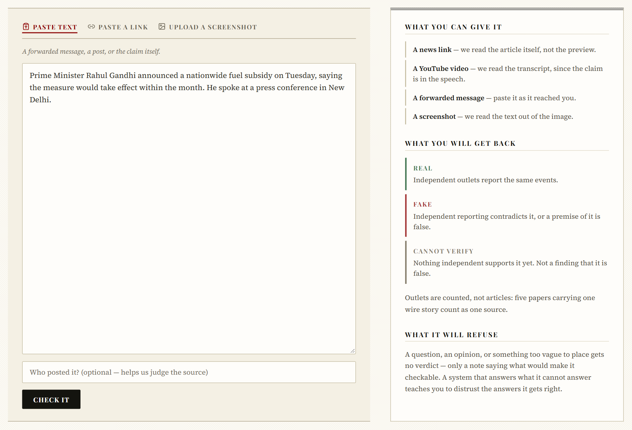
OUTPUT
Front page with trust stamps
Check Anything page
Notes:
The front page stamps each story from the cache or the publisher rating. Check Anything accepts text, a link or a screenshot.

Slide 18
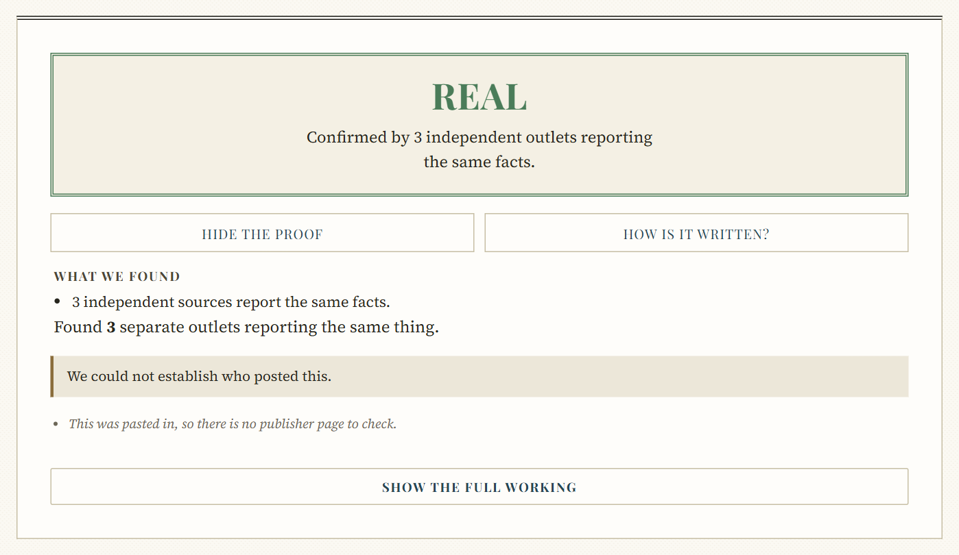
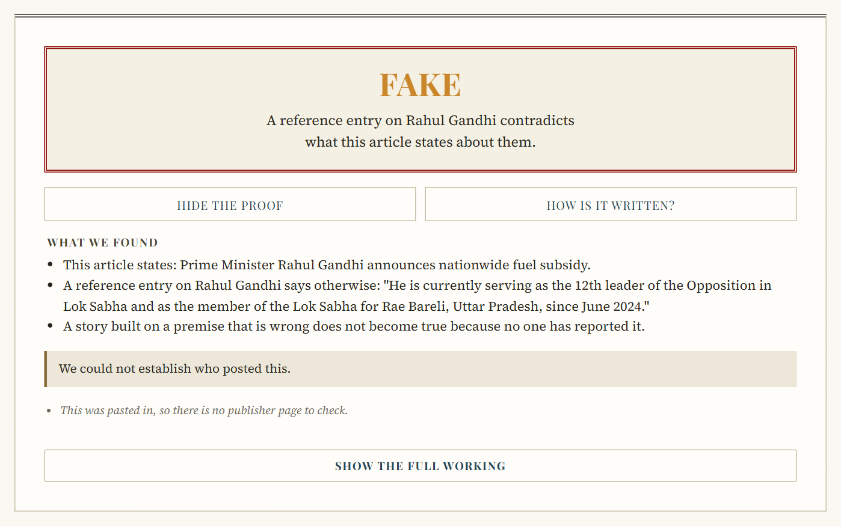
OUTPUT
Verdict: genuine report confirmed
Verdict: false premise refuted
Notes:
A genuine report confirmed by three independent outlets, and the "Prime Minister Rahul Gandhi" story refuted by the line quoted from his Wikipedia entry.

Slide 19


OUTPUT
Article page
Coverage comparison
Notes:
The article page shows the verdict above the story. The comparison lays out how different outlets cover one event.

Slide 20
CONCLUSION, FUTURE WORK & THANK YOU
Conclusion
A story is judged by independent evidence, not by its writing. On 120 held-out articles the system matched the baseline's accuracy and cut calibration error on accusations by 43%. It rated none of six careful fabrications as credible and gave an acceptable verdict in all twelve end-to-end cases.
Future Work
Grow the labelled corpus beyond 239 articles so the priors can be measured; hand-check 30 live claims; collect ratings for regional Indian outlets; read full articles with natural-language inference; add image forensics as one more observation.
THANK YOU
A live demo is available for the panel.
Notes:
To close: the system judges a story by evidence, abstains when it cannot decide, and the results bear that out. A live demo is ready.

