Slide 1



22CSP72 – PROJECT WORK II
PHASE II REVIEW
AI-Powered News Trust and Credibility Analysis Platform
Date : 12-09-2026
Team Number : CO5
Team Guide : Ms. M. Kannukkiniyal
Team Members :
Mugilan K S (23CSR138)
Nandha Kumar S (23CSR140)
Nandhini A (23CSR141)

Slide 2

PROBLEM STATEMENT & PHASE II OBJECTIVES
Existing fake news detectors only say “Fake” or “Real” — no explanation, no evidence, and often overconfident scores. Phase I built a four-checker explainable pipeline. Phase II asks: is the explanation itself trustworthy, and does it survive the real world?
01
02
03
Six-Angle Analysis
No Invented Scores
Graceful Degradation
Every article checked from 6 independent angles, not 4.
Never produce a score for a check that did not run.
Keep working when the AI service is slow, busy, or withdrawn.
04
05
Full Article Analysis
Live Visibility
Judge the real article, not the 200-character feed preview.
Fast enough to use, with results visible while analysis runs.

Slide 3
LITERATURE SURVEY
Reference | What They Did | What's Missing
Shu et al., KDD 2021 | Explains detection via user comments | Needs social comments; can't check source
Ahmed et al., ISDDC 2022 | ML on 44,000 ISOT articles | Fake/Real label only; no explanation
Da San Martino et al., SemEval 2022 | Labels 14 propaganda techniques | Research task only; no reader-facing tool
Thorne et al., NAACL 2023 | Verifies claims via FEVER dataset | Wikipedia evidence only; not live news
Wang et al., ACM Web 2024 | LLM weighs competing crowd reports | Requires many reports per claim
Guo et al., ICML 2025 | Proved neural networks are overconfident | Fix rarely applied in fake news systems

Slide 4
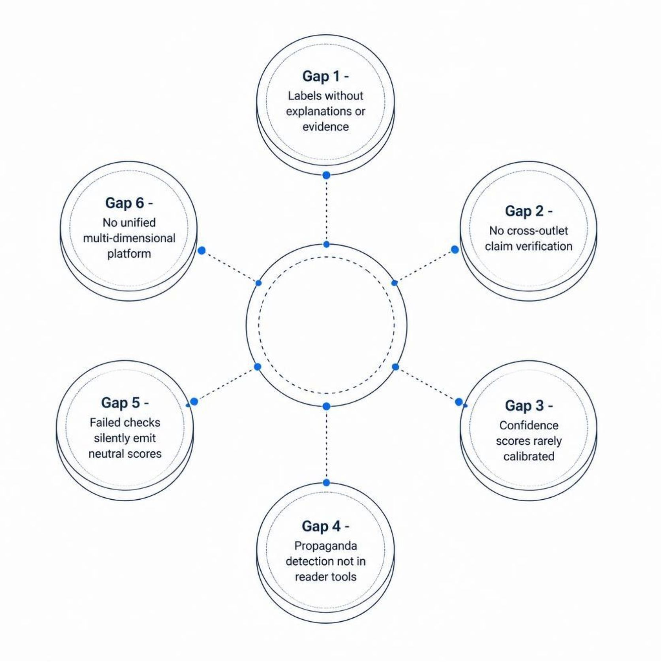
RESEARCH GAP
Despite significant prior work, no single published system combines all the capabilities our platform delivers.
Labels without explanations or evidence
Rarely cross-checks claims against other outlets
Confidence scores are rarely calibrated or honest
Propaganda detection exists in research, not in tools
Failed checks silently emit neutral scores
No platform unifies all seven analysis dimensions

Slide 5
SYSTEM ARCHITECTURE
A six-checker parallel pipeline with an intelligent AI Gateway and a transparent Trust Score Engine.
Article Input
Fetcher & Auth
Six Checkers
Trust Score
The AI Gateway (NVIDIA NIM + Google Gemini) handles provider failover and falls back to word-pattern analysis. Results are cached for instant re-opening.

Slide 6
PROPOSED WORK & INNOVATION
The Trust Score Engine remains our core contribution. Phase II additions:
Honest Stand-Down
No Invented Scores
Graceful Degradation
Checks with no evidence contribute nothing; weight redistributes so percentages total exactly 100.
Removed a defect where failed checkers returned neutral 5/10, masking unchecked articles.
Lexicon and pattern analysis takes over when AI is unreachable; the report states this explicitly.
Provider Independence
Span-Level Evidence
AI behind a gateway; withdrawn or congested providers no longer stop the system.
Every flagged sentence and persuasion technique is quoted from the article.

Slide 7
MODULES OF THE PROJECT
Phase I — Core Platform
News platform (feed, login, history, quizzes) — DONE
Source reputation database (~120 outlets) — DONE
Clickbait and bias checkers with highlighting — DONE
Cross-source claim verification with links — DONE
Trust Score Engine + explainable report — DONE
Testing framework for accuracy — DONE
Phase II — New Capabilities
Source Transparency checker — DONE
Persuasion Technique detector (SemEval) — DONE
Multi-provider AI gateway with failover — DONE
Offline fallback analysers — DONE
Compare Coverage page — DONE
Analyze Any Article by link — DONE
Personal reading dashboard — DONE

Slide 8
IMPLEMENTATION & INTERMEDIATE RESULTS
Key Findings
Accuracy improved: 82% → 91%
Removing any checker reduces accuracy
Every checker contributes to the overall result
Results are now visible while analysis is running
Previously analysed articles can be reopened instantly using cached results
Resilience test (AI off):
  Fabricated article → 2.3/10
  Ordinary reporting → 9.8/10
Grounding Test
  9/9 quoted sentences were genuinely present in the article
Removing any checker lowered accuracy — every module contributes. Re-running on the current six-checker pipeline is the next step.

Slide 9
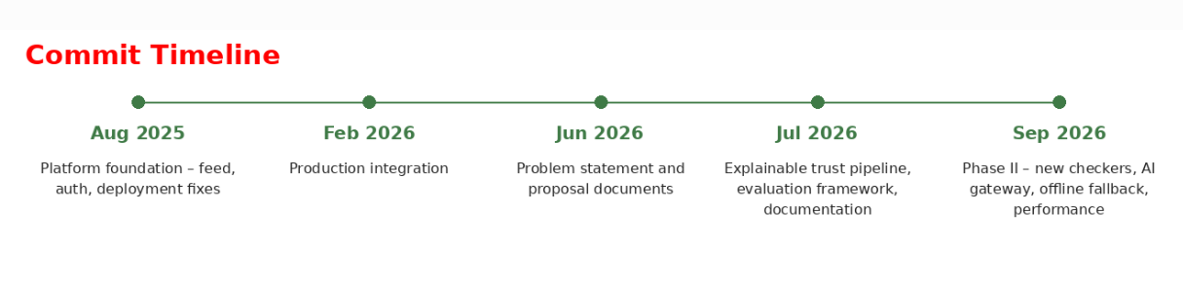
GIT TRACKING & PAPER DRAFT
Repository
Paper Draft Status
github.com/Arumuganandhini/FakeNews_Detection
main — stable project
project — development branch
API keys and datasets excluded
Located in docs/paper :
Title, abstract, and introduction — written
Methodology covers all six checkers and calibration — written
Results section holds real measured numbers — written
Remaining sections to be completed after benchmark re-run
Repo Url:

Slide 10
SDG GOALS ADDRESSED
The platform's mission of verifiable, explainable news trust aligns with four UN Sustainable Development Goals.
SDG 16: Institutions
SDG 9: Innovation
Counters misinformation and builds public trust in accountable, transparent information sources.
Applies AI innovation, a six-checker pipeline with gateway failover, to a real public-interest problem.
SDG 4: Media Literacy
SDG 17: Partnerships
Evidence-quoted, explainable reports teach readers to evaluate news critically, not just accept a label.
Open-source repository and shared datasets invite collaboration on public verification tools.

Slide 11
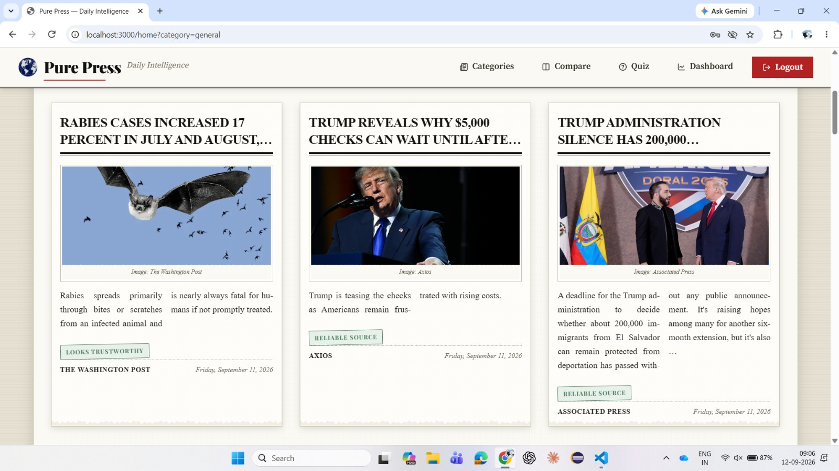
OUTPUT

Slide 12
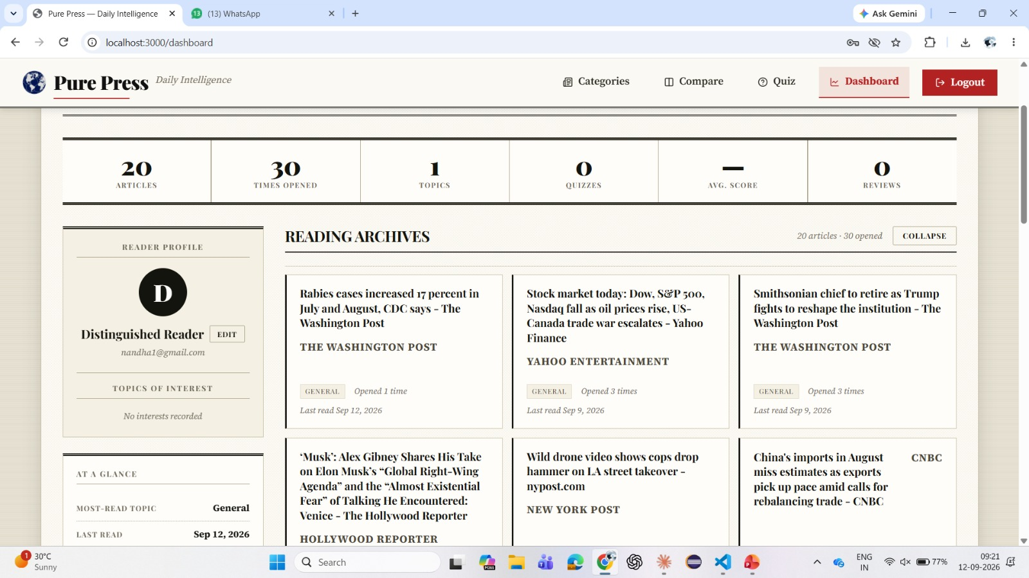
OUTPUT

Slide 13
PHASE III PLAN & THANK YOU
Reading Trust History
A chart showing how reliable the news a user reads has been, week by week. Data is already stored; only the chart is new.
Self-Learning Outlet Ratings
Our database covers ~120 outlets, so smaller sites show “no reliability record.” Phase III builds ratings from articles already analyzed — coverage grows automatically.
THANK YOU
Phase II scope is complete. A live demo is available for the panel.

