Slide 1
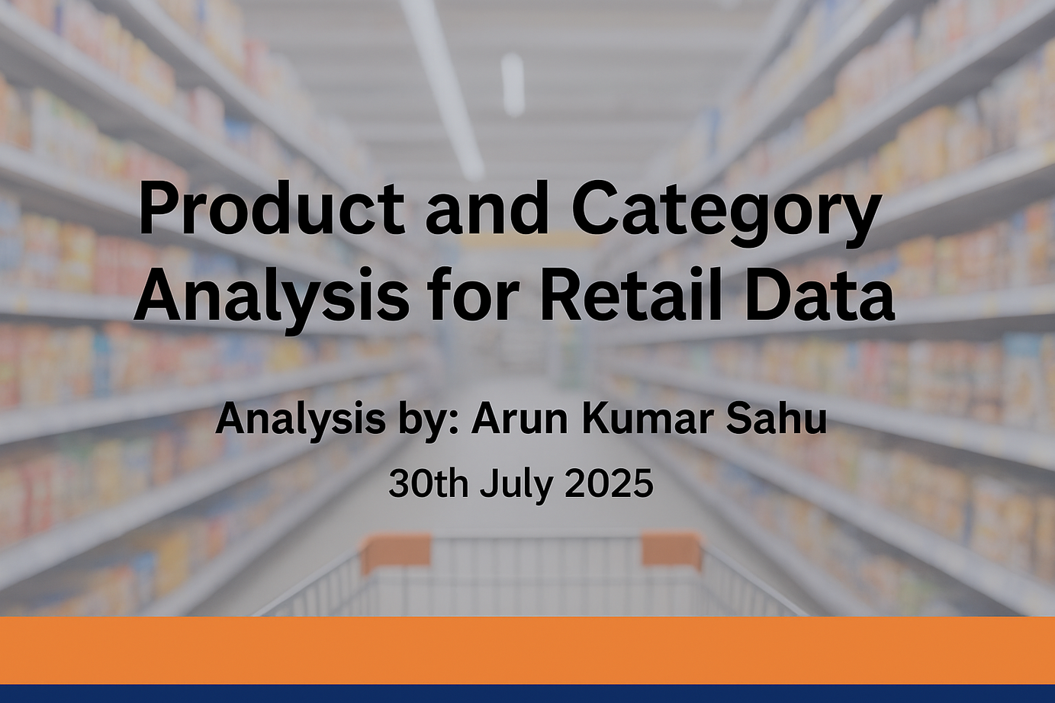

Slide 2
INTRODUCTION & OBJECTIVE
The retail company operates across multiple product categories and warehouses.
This analysis, conducted using SQL and Power BI, aims to identify opportunities for improving pricing, ratings, and stock management.
Objectives:
Identify top-performing and premium-priced products
Analyze product ratings, reviews, and stock correlation
Evaluate warehouse performance and return policy efficiency

Slide 3
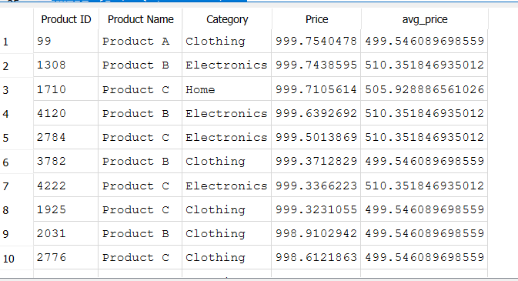
SQL INSIGHTS SUMMARY
High-Priced Products by Category
Identified products priced above category average; mainly from select suppliers.

Slide 4
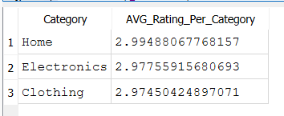
SQL INSIGHTS SUMMARY
Top-Rated Categories
Electronics and Home Appliances achieved the highest ratings.

Slide 5
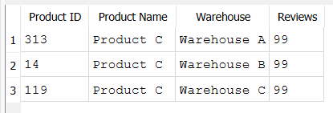
SQL INSIGHTS SUMMARY
Most Reviewed Products per Warehouse
Warehouse 2 shows highest engagement.

Slide 6
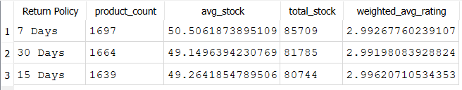
SQL INSIGHTS SUMMARY
Return Policy Analysis
Longer return windows boost customer trust but slow stock turnover.

Slide 7
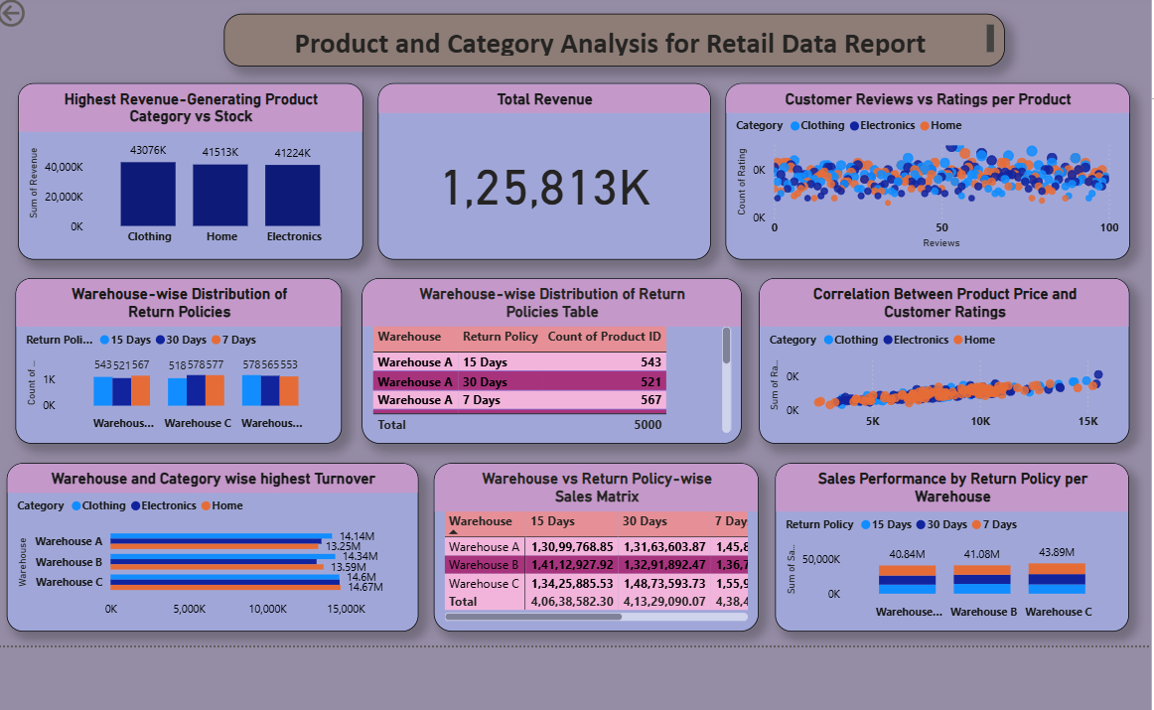
POWER BI VISUAL INSIGHTS

Slide 8
KEY FINDINGS & BUSINESS INSIGHTS
Clothing, Home, and Electronics drive maximum revenue.
Mid-priced products gain better ratings compared to premium ones.
Warehouse 1 achieves highest turnover efficiency.
7-day return policy performs best for high turnover products.
Strong correlation found between reviews and ratings - engagement drives higher sales.

Slide 9
CONCLUSION
This SQL and Power BI analysis provided actionable insights for operational efficiency.
Optimize inventory levels for low-turnover categories.
Align premium pricing with customer perception.
Standardize return policies to streamline stock flow.
Promote mid-priced, highly rated products to boost customer satisfaction.
Overall, this project demonstrates a data-driven approach to enhancing retail decision-making.

