Slide 1

Sandboxed Code Executor
Running AI-written Python safely: how it works, how it protects you, and how to run it
agent-lab | Project 4
Notes:
This deck explains Project 4 of agent-lab: a sandbox that lets an AI agent write and run Python without endangering the machine it runs on.

Slide 2




AI can write code, but running it is risky
Ask an assistant “what was our best sales month? draw me a chart” and it writes Python. Something has to run that code, and the code is untrusted.
Read your files
SSH keys, source code, documents
Steal secrets
It may be buggy, or hijacked by prompt injection hidden in a file or web page the AI read.
API keys in environment variables
Use the internet
Goal: code goes in, results come out, and nothing inside can touch your computer.
Send your data anywhere
Exhaust the machine
Endless loops, memory and process bombs
Notes:
The core problem: LLM-written code must be treated as hostile. These four harms are what the sandbox prevents.

Slide 3



The solution: a safe room with three building blocks
Like a bank’s cash-counting machine behind thick glass: pass work through a slot, get a receipt back, never reach inside.
Agent
Sandbox
Executor service
Asks the AI for code, runs it, shows the AI the result, repeats until there is an answer.
Runs one piece of code inside a throwaway, locked-down Docker container.
A web server that owns the sandbox, so the agent never controls Docker directly.
agentkit/agents/
agentkit/sandbox/
services/executor/
Notes:
Three parts: the agent loop, the sandbox itself, and an optional executor service for production.

Slide 4
The big picture
DockerSandbox
throwaway container (default)
writes Python
User asks a question
AI agent
run_python tool
Sandbox interface
RemoteSandbox
HTTP to executor (production)
LocalSubprocessSandbox
UNSAFE, tests only
Result: status, output, charts
short summary back to the AI
Notes:
The agent writes code through the run_python tool. The sandbox interface hides which backend runs it. Docker is the default, Remote is for production, Local is only for tests because it has no isolation.

Slide 5

How one run works
From the AI’s reply to a checked result

Slide 6
The journey of one piece of code
1
2
3
4
AI replies
Agent checks it
Limits checked
Wait for a slot
with a tool call written as JSON
broken reply? the AI is told and retries
too much code or files: status rejected
4 running at once, 16 queued, then busy
5
6
7
8
Fresh container
Code goes in
Runner runs it
Host double-checks
new one per run, every lock switched on
via stdin: no folders are shared
with a timer; collects output and charts
secret code, format, sizes; container deleted
Notes:
Eight steps. The important ideas: nothing is shared with the container except stdin, and the host never trusts what comes back.

Slide 7






Inside the container: what runner.py does
Writes main.py and input files into /workspace
The container’s filesystem
Runs the code with a timer (default 10 s)
/
read-only
/workspace
64 MB RAM disk, wiped after run
Keeps the first and last 32 KB of output
main.py, data.csv
your code and inputs
Collects real files from output/ (no shortcuts)
output/chart.png
returned as artifacts
Kills every leftover background process
/tmp
32 MB RAM disk, no programs
/opt/runner
read-only runner
Prints ONE result line tagged with a secret code
Notes:
runner.py uses only the Python standard library. The container root is read-only; only two small RAM disks are writable, and both disappear when the container is deleted.

Slide 8
The host trusts nothing that comes back
The AI’s code runs as the same user as the runner, so it could try to fake the result. Every result passes five checks:
1
2
3
4
5
Read at most 20 MB
Find the secret code
Strict format
Re-apply size caps
Clean names and types
then kill the container
a random nonce per run
unknown fields rejected
output, files, counts
safe names, MIME allow-list
Pass: a clean ExecutionResult
Fail: status sandbox_error, raw output never shown
Proven by a test: fake results written by the code are ignored, and floods are capped.
Notes:
Rule 2 of the design: everything coming out of the sandbox is untrusted. A forged line lacks the nonce, so it is ignored.

Slide 9

Safety layers
Many independent walls: if one fails, the others still hold

Slide 10



Defence in depth: walls inside walls
Your computer
Internet
Throwaway container: no network, read-only, limits
Normal user 10001, no special powers
Your files
blocked
Your passwords and keys
AI’s code
Other users’ runs
Notes:
Three nested walls: the host, the container, and an unprivileged user. Each one blocks the targets on the right independently.

Slide 11






Every danger has a specific stopper
Read your files
Steal secrets
Use the internet
Infinite loop
No shared folders; system files read-only
Only 4 harmless settings passed in
--network none: localhost only
Inner timer + outer container kill
Use all memory
Fork bomb
Fill the disk
Print gigabytes
512 MB, no swap, big allocations fail fast
At most 64 processes
Tiny RAM disks: 64 MB and 32 MB
Keeps only first + last 32 KB
Become root
Leave a process
Sneak files via shortcuts
Come back next run
Normal user, all powers dropped
Leftovers killed, container deleted
Only real, ordinary files returned
Brand-new container every time
Notes:
Twelve dangers and the layer that stops each one. The full list with Docker flags is in docs/SECURITY.md.

Slide 12
Fail closed: if anything is missing, refuse
Docker running?
Image present?
Limits enforceable?
Runtime installed?
yes
yes
yes
yes
Run the code
no
no
no
no
Refuse to run: SandboxUnavailableError, with a fix-it message
Never falls back silently to the unsafe local mode. The local backend will not even start without allow_unsafe=True.
Notes:
Health checks run before code executes. A missing image gives an actionable message: run docker build -t agentkit-sandbox:dev sandbox_image/.

Slide 13

The agent and production setup
How the AI loop works, and why Docker lives on its own machine

Slide 14
How the agent thinks: a bounded loop
Valid tool call?
Task + files
Ask the AI for the next step
Run code in the sandbox
Give the AI a short summary
run_python
invalid
final_answer
no: next step
Return answer, charts, transcript
Tell the AI what was wrong
Step limit reached? (6)
Stop: step limit reached
Only two tools are allowed: run_python and final_answer. Errors show the AI the last lines of the traceback, the most useful part.
Notes:
Every step is recorded: code, status and duration. Charts made in one step become files later steps can use.

Slide 15
Production: Docker lives on its own machine
What the service answers
Agent machine
Dedicated executor machine
200
result returned
AI agent
Executor service (FastAPI)
401
missing or wrong token
DockerSandbox
413
HTTPS +
token
body too large
RemoteSandbox
422
badly formed request
Docker + janitor
429
busy, retry later
Whoever controls Docker controls the whole machine, so the agent never touches it.
503
Docker not ready
Notes:
RemoteSandbox retries only when the connection was never made, so a run is never executed twice.

Slide 16
Every result has one of seven statuses
ok
Code finished normally
print(1+1)
error
Code crashed or exited with an error
1/0
timeout
Ran too long and was killed
while True: pass
oom
Used too much memory
b'a' * 2_000_000_000
output_limit
Sent back far too much data
flooding the output
rejected
Broke a limit before running
11 input files
sandbox_error
The machinery itself failed
garbage result line
Notes:
The status is decided by the host, not the code. Example code on the right triggers each status.

Slide 17

Tested against real attacks
15/15
137
1
attacks blocked
tests passed
fresh container per run
Read host files
Read env vars
Network access
Infinite loop
Allocate 2 GB
Fork bomb
Fill disk
Print 100 MB
Write system dirs
Privilege escalation
Symlink artifact
Ignore SIGTERM
Background process
Forge result
Persist between runs
Notes:
python demo_attacks.py runs all fifteen attacks; pytest -m docker asserts the same rows.

Slide 18

Run it yourself
Commands and the output you should expect

Slide 19
Set up in three steps
Needs Python 3.10+ and Docker (Docker Desktop on Windows and macOS). Start Docker first.
1
Install
2
Build the image
3
Run the tests
py -3.12 -m venv .venv
.\.venv\Scripts\Activate.ps1
pip install -e `
".[dev,sandbox,service]"
docker build -t \
agentkit-sandbox:dev \
sandbox_image/
pytest
pytest -m docker
Windows shown; on macOS/Linux use
Expect, after a few minutes:
Expect:
source .venv/bin/activate
...agentkit-sandbox:dev done
137 passed, 3 skipped
Notes:
Without Docker, plain pytest still passes the 111 unit tests and skips the Docker tests with a reason.

Slide 20
Watch the attacks get blocked
> python demo_attacks.py
attack status result
read host files ok BLOCKED
read host env vars ok BLOCKED
network (DNS + TCP) ok BLOCKED
infinite loop timeout BLOCKED
allocate 2 GB oom BLOCKED
fork bomb timeout BLOCKED
fill disk (1 GB) ok BLOCKED
print 100 MB ok BLOCKED
write /usr, /etc, /opt ok BLOCKED
privilege escalation ok BLOCKED
artifact symlink ok BLOCKED
ignore SIGTERM timeout BLOCKED
leave background process ok BLOCKED
forge runner output error BLOCKED
15/15 attacks blocked
Runs 15 kinds of hostile code inside the sandbox and checks each result.
“ok” in the status column is fine: the code ran but could do no harm.
Times vary by machine. The script exits with an error if anything gets through.
Notes:
This is the real output captured on the build machine, with the time column removed for space.

Slide 21
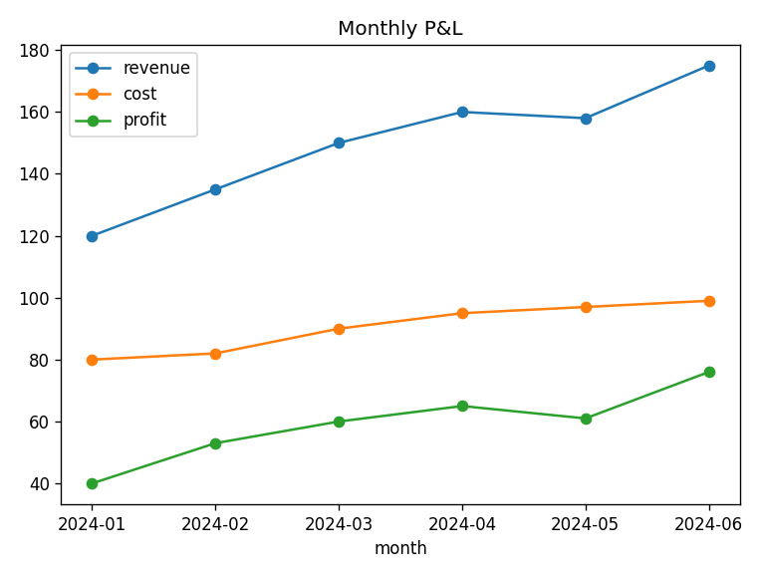
Watch the agent analyse a CSV and draw a chart
> python demo_sandbox.py
step 1: run_python -> error
KeyError: 'profit' (deliberate bug)
step 2: run_python -> ok
mean profit: 59.17
best month: 2024-06 profit 76
step 3: final_answer
answer: Profit grew from 40 to 76;
June was the best month.
saved artifact pnl.png (38179 bytes)
The “AI” is scripted, so no API key is needed. It makes a mistake first so you can see it recover.
pnl.png: the chart the sandboxed code produced
Notes:
The chart on the right was generated inside the Docker sandbox by the demo and returned as an artifact.

Slide 22
Run the executor web service
Terminal 1: start the service
$env:AGENTKIT_EXECUTOR_TOKEN = "my-secret-token"
uvicorn services.executor.app:app --port 8080
Terminal 2: send code
curl.exe -X POST http://localhost:8080/v1/executions `
-H "Authorization: Bearer my-secret-token" -H "Content-Type: application/json" `
-d '{\"code\": \"print(sum(range(10)))\"}'
Expected answer
{"status":"ok","exit_code":0,"stdout":"45\n","backend":"docker",
"limits":{"isolated":true,"network":"none","memory_mb":512, ...}}
No token gives 401. Without AGENTKIT_EXECUTOR_TOKEN the service refuses to start.
Notes:
On macOS or Linux use export AGENTKIT_EXECUTOR_TOKEN=... and plain curl. GET /readyz returns {"status":"ready"} when Docker and the image are available.

Slide 23
Common problems and fixes
You see | Fix
Docker daemon is not reachable | Start Docker Desktop and wait until it is running
sandbox image ... not found | docker build -t agentkit-sandbox:dev sandbox_image/
Image build: Read timed out | Slow network; run the build again
Docker tests show as skipped | Docker is off or the image is missing; the reason says which
Each run takes 5+ seconds | Normal on Docker Desktop: fresh container plus pandas import
Runner copy test fails | Copy agentkit/sandbox/runner.py to sandbox_image/ and rebuild
Notes:
These are the problems actually hit while building the project, including the PyPI timeout during the image build.

Slide 24
Key takeaways
Isolation comes from the container, never from reading the code
Everything coming out of the sandbox is checked before it is trusted
Many independent walls, and it refuses to run if any is missing
Learn more: docs/GUIDE.md and docs/SECURITY.md
Notes:
Known limits: containers share the host kernel, so use gVisor or microVMs for untrusted multi-tenant use, and remember the Docker socket equals root.

