Slide 1
ICT80004 Internship Project – Client Update (Weeks 1–5)
Benchmarking & Securing LLMs Against Prompt Injection Attacks
Arun Ragavendhar Arunachalam Palaniyappan

Slide 2
Context & Problem
LLMs can be tricked by malicious prompts (prompt injection).
Problem: These attacks override intended instructions → risky outputs.
Goal: Create systematic test suite + defenses to secure CSIRO platform.
Importance: OWASP lists Prompt Injection as top security risk for LLMs.

Slide 3
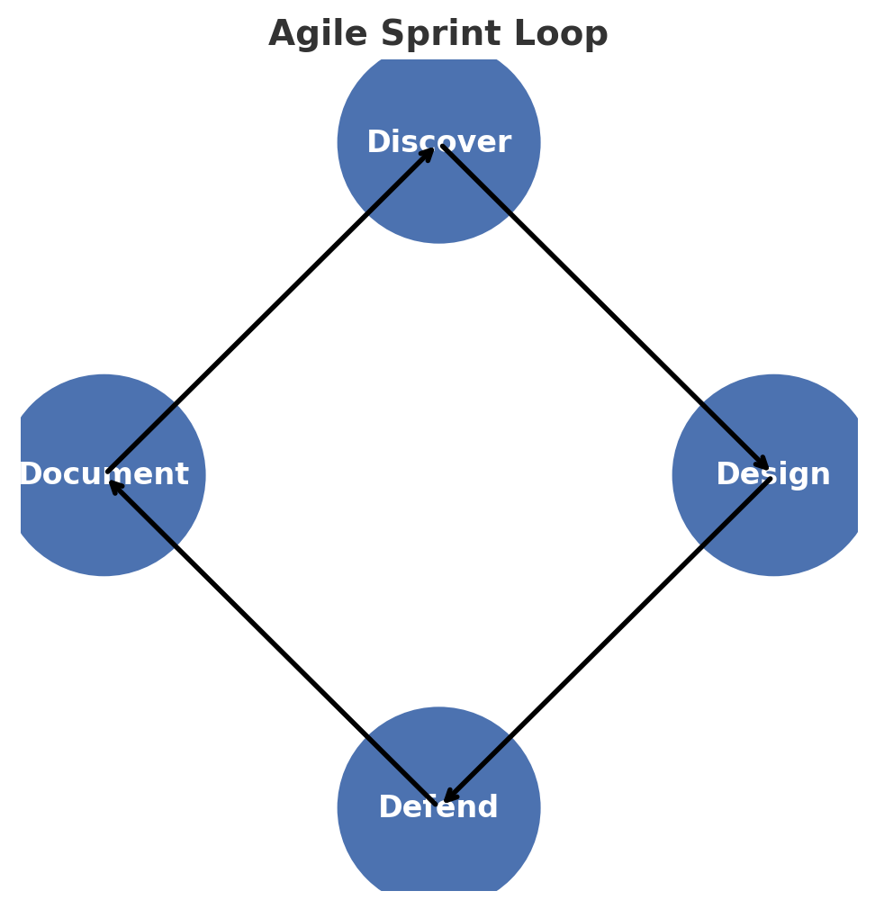
Approach
Short Agile sprints (2 weeks) with loop: Discover → Design → Defend → Document.
Focus tasks: Summarisation and Question Answering (QA).
Placement testing: attacks inserted at start, middle, end of content.
Defenses tested: boundary awareness, reminders, light guards, fine-tuning (if essential).

Slide 4
Week 1 Work
Read two papers: SStuBs (LLM bugs) and Chain-of-Thought prompting.
Prepared PPT highlighting vulnerabilities & initial defenses.
Client/team discussion set direction towards prompt injection focus.
Received 5 new papers covering indirect attacks, structured queries, systematic analysis.

Slide 5
Week 2 Work
Completed BIPIA study: defined attack types (task-irrelevant, task-relevant, targeted).
Found injection placement critical (end most dangerous).
Analysed HOUYI framework: context inference + 3-part payload (framework, separator, disruptor).
Reviewed Security Perspective: input/output filters + probes → continuous monitoring.
Studied StruQ defense: separates control vs. data channels using structured queries.
Started Systematic Analysis: linked architectures to vulnerability types.

Slide 6
Week 3 Work
Finished Systematic Analysis paper → model-specific weaknesses & defenses.
Mapped findings to design of our test suite.
Started practical tests: injected vulnerable code snippets into GPT, Grok, Llama, etc.
Began comparative table of results; documented full methodology for reproducibility.

Slide 7
Week 4 Work
Completed comparative testing across GPT-4/5, Grok, Gemini, Llama-3, DeepSeek.
Vulnerabilities tested: integer overflow, null pointer, array out-of-bounds, divide by zero, SQL injection.
Recorded differences in how models fix/respond to vulnerabilities.
Compared prompting strategies: CoT, Action, Debate, Encouragement → Debate/Encouragement safer.
Drafted taxonomy of attack categories vs. failure modes, linking to prompt injection risks.
Produced consolidated Vulnerable Code Testing Report.

Slide 8
Insights & Learnings
LLMs behave differently depending on model and prompting style.
BIPIA finding confirmed: stronger models can be more vulnerable.
StruQ defense promising but optimisation-based attacks still effective (TAP, GCG).
Debate and encouragement prompting often yielded more reliable and safer responses.
Taxonomy helps classify attacks, linking coding flaws to prompt injection behaviours.

Slide 9
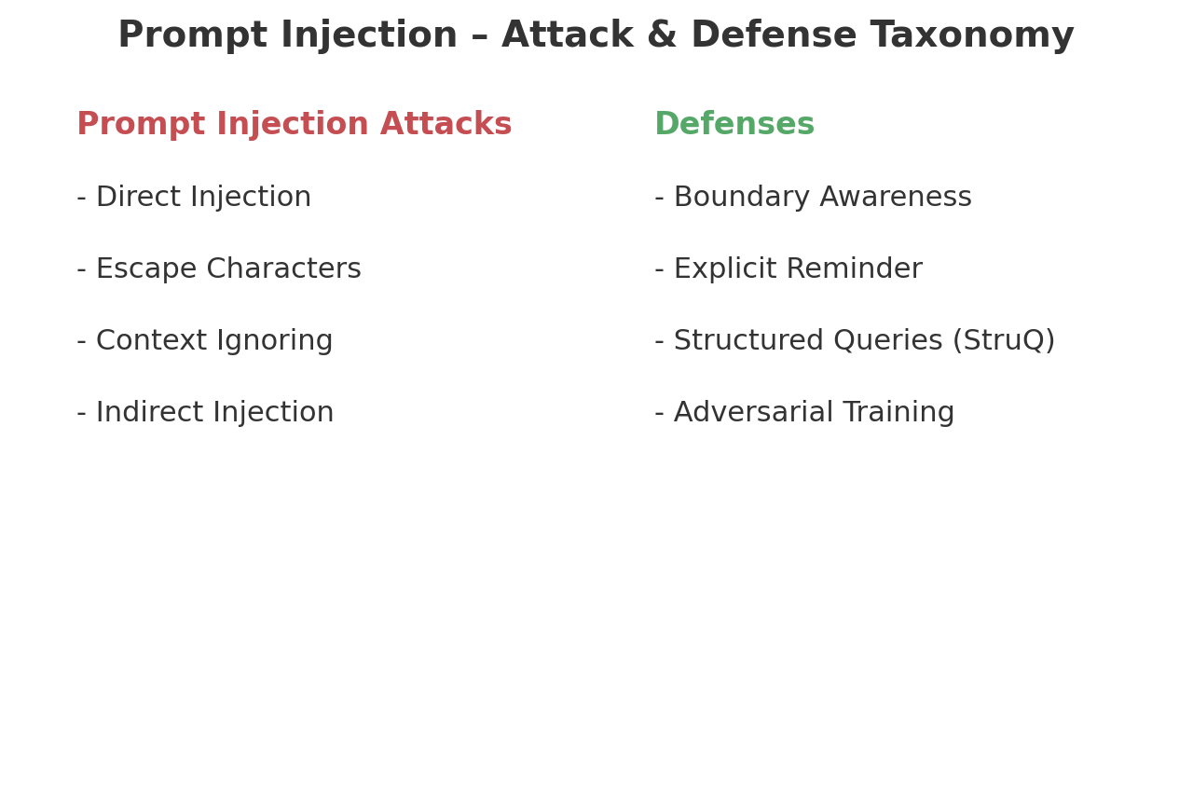
Systematization of Social Engineering Attacks
Analysed 9 key tactics: baiting, pretexting, impersonation, reciprocity, authority, social proof, urgency, story/empathy, reverse SE.
Mapped how these tactics translate into prompt injection styles (e.g., urgency → force model to rush outputs).
Learned: placement matters (start/mid/end) and framing strongly alters outcomes.
Inference: taxonomy of tactics provides structured way to design, test, and defend against social-engineering style attacks in LLMs.
Next: expand cases per tactic, align with summarisation/QA tasks, refine failure/defense mapping.

Slide 10
Discussion Points for Client
Feedback on taxonomy: does mapping social-engineering tactics cover all realistic risks?
Prioritisation of LLMs for testing: should focus be on CSIRO’s main platform models first?
Agree on evaluation metrics: Attack Success Rate, quality preservation, efficiency.
Advice on scope: test black-box defenses only, or explore structured (StruQ-style) defences too?
Confirm ethical guardrails for generated prompts and data handling.

