Slide 1
ICT80004 Internship Project – Defending Against Prompt Injection Attacks
Arun Ragavendhar

Slide 2
Context & Problem
LLMs can be tricked into unsafe outputs (prompt injection).
Attack types: direct injection, indirect injection, jailbreaks, persuasive SE.
OWASP: Prompt Injection is the #1 LLM risk.
Goal: Build a test suite + defenses for CSIRO platform.

Slide 3
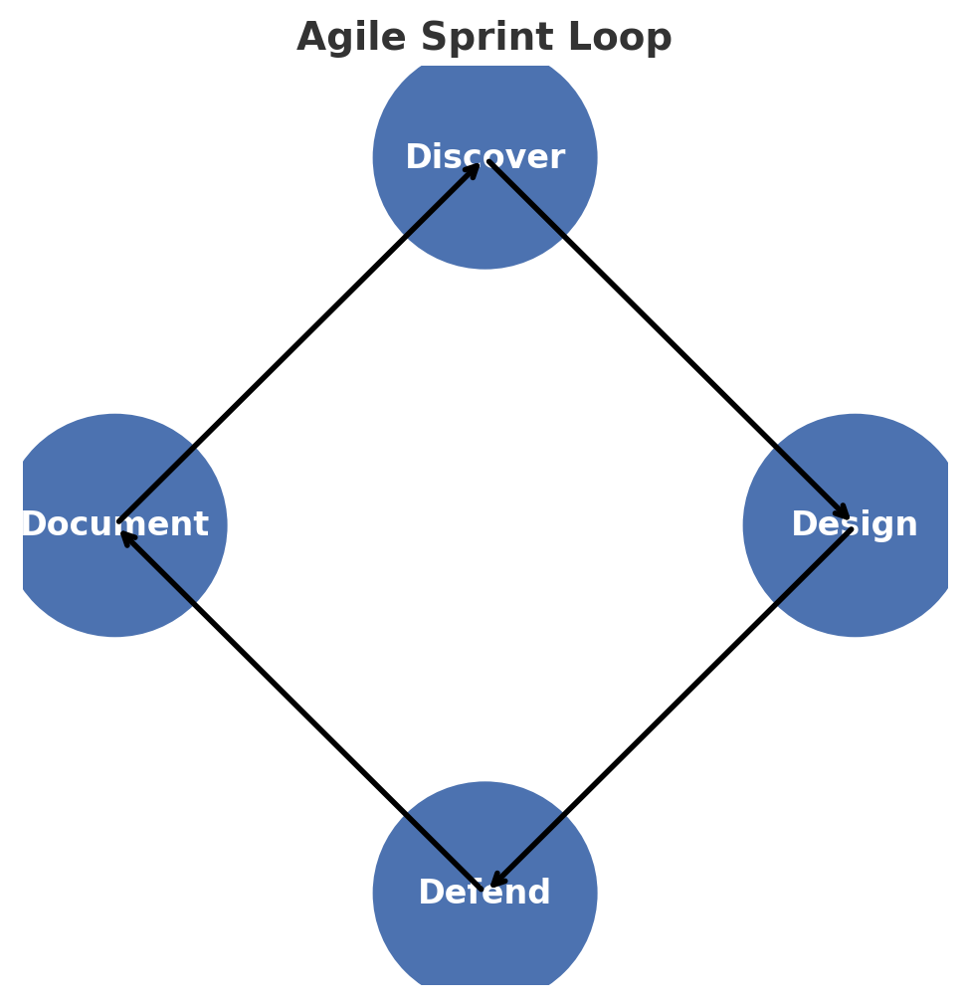
Approach & Sprint Loop
2-week sprints: Discover → Design → Defend → Document.
Focus: Summarisation & QA tasks.
Attacks: start, middle, end of content.
Defenses: boundary, reminders, structured queries, fine-tune.

Slide 4
Literature Insights: BIPIA & HOUYI
BIPIA: benchmark indirect injections → stronger models = more vulnerable.
Placement matters: end > middle > start.
Defenses: black-box reminders/boundaries; white-box tags + adversarial fine-tuning.
HOUYI: real-world attack with 3-part payload (framework, separator, disruptor).
86% success on 36 apps → practical high-risk scenario.

Slide 5
Literature Insights: StruQ & Security Perspective
StruQ: separates control vs. data → structured queries.
Blocked most manual attacks; reduced optimization-based attacks (TAP, GCG).
Security Perspective: pipeline with input/output filters, probes, anomaly detection.
Need continuous monitoring as threats evolve.

Slide 6
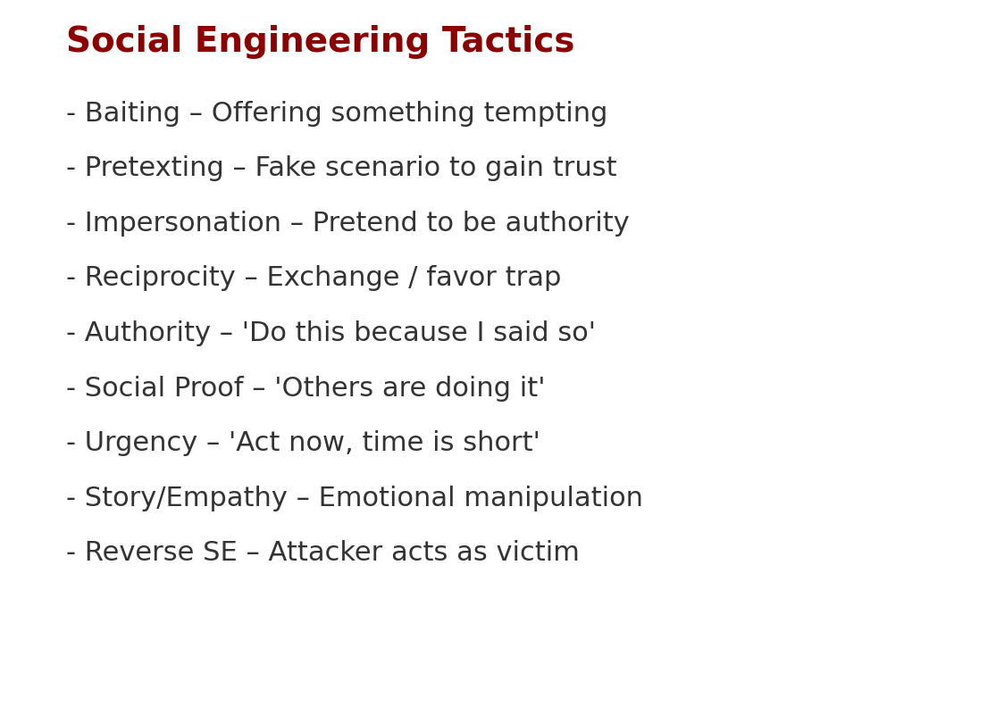
Systematic Analysis & Persuasion
Systematic Analysis: architectures vary in vulnerability.
Mitigations: sanitisation, consensus, fine-tuning.
Persuasion (Johnny paper): SE tactics (authority, urgency, empathy, role-play).
Attackers exploit human-like persuasion to bypass safeguards.

Slide 7
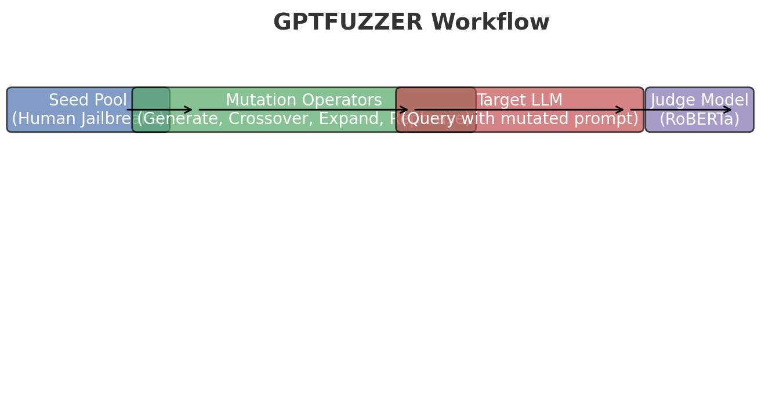
Red Teaming with GPTFUZZER
Problem: manual jailbreaks slow and limited.
GPTFUZZER: automated fuzzing with seed → mutate → attack → judge cycle.
Mutators: generate, crossover, expand, shorten, rephrase.
Judgment model: RoBERTa auto-labels jailbreak success.
Results: >90% success on ChatGPT, Llama-2; transferable to Bard, Claude, PaLM2.

Slide 8
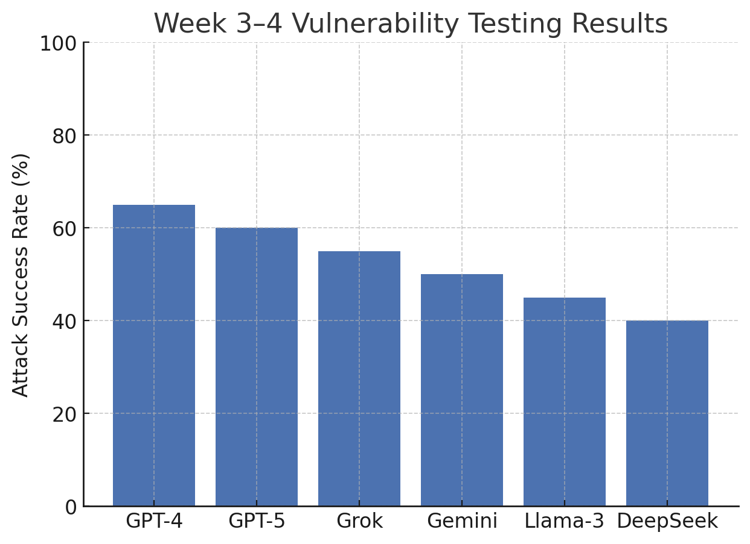
Week 3–4 Vulnerability Testing
Tested vulnerabilities: overflow, null pointer, array OOB, divide by zero, SQL injection.
Models: GPT-4/5, Grok, Gemini, Llama-3, DeepSeek.
Prompting strategies: CoT, Action, Debate, Encouragement.
Findings: Debate/Encouragement often safer; stronger LLMs sometimes more vulnerable.

Slide 9
Systematization of Social Engineering Attacks
Studied 9 tactics: baiting, pretexting, impersonation, reciprocity, authority, social proof, urgency, empathy, reverse SE.
Mapped how tactics translate into LLM prompts and manipulations.
Placement & framing strongly affect attack success.
Taxonomy combines coding flaws + persuasion attacks → guides robust defense design.

Slide 10
Next Steps
Expand test cases with more vulnerabilities and persuasion prompts.
Refine taxonomy → combine social engineering + technical attacks.
Build Prompt Injection Test Suite with positive + negative cases.
Prepare scaled Sprint 2 runs for client review.

Slide 11
Discussion Points for Client
Does our taxonomy of tactics cover realistic CSIRO risks?
Should defenses prioritise black-box (deployable) or explore white-box (fine-tuned)?
Which models should be the testing priority?
Should continuous red-teaming (GPTFUZZER-style) be integrated into pipeline?

