Slide 1
Database details
Table name – User
Column names
Column name | Data type | Column type
LoginId | varchar(30) | Primary key
password | varchar(20) | Required
usertype | varchar(10) | Required

Slide 2
Cont…
Table name –Patient
Column name | Data type | Column type
PatientId | varchar(10) | Primary key
Name | varchar(30) | Required
Address | varchar(50) | Optional
Email_id | varchar(20) | Required
Mob_no | int(20) | Required
DateofBirth | varchar(20) | Required
Gender | varchar(10) | Required
info_type | varchar(30) | Required

Slide 3
Cont…
Table name -Doctor
Column name | Data type | Column type
Doc_id | varchar(10) | Primary key
Name | varchar(30) | Required
Salary | varchar(10) | Optional
Mob_no | int(20) | Required
Specialisation | varchar(20) | Required
Email_id | varchar(20) | Required

Slide 4
Cont…
Table name – Cons_Request
Column name | Data type | Column type
Req_id | varchar(10) | Primary key
PatientId |  | Foreign key
Doc_id |  | Foreign key
illness_type | varchar(30)
symptoms | varchar(30) | Required
Doc_comments | varchar(50)
patient_comments | varchar(50)
old_prescription
new_prescription |  | Required
Req_status | varchar(30) | Required

Slide 5
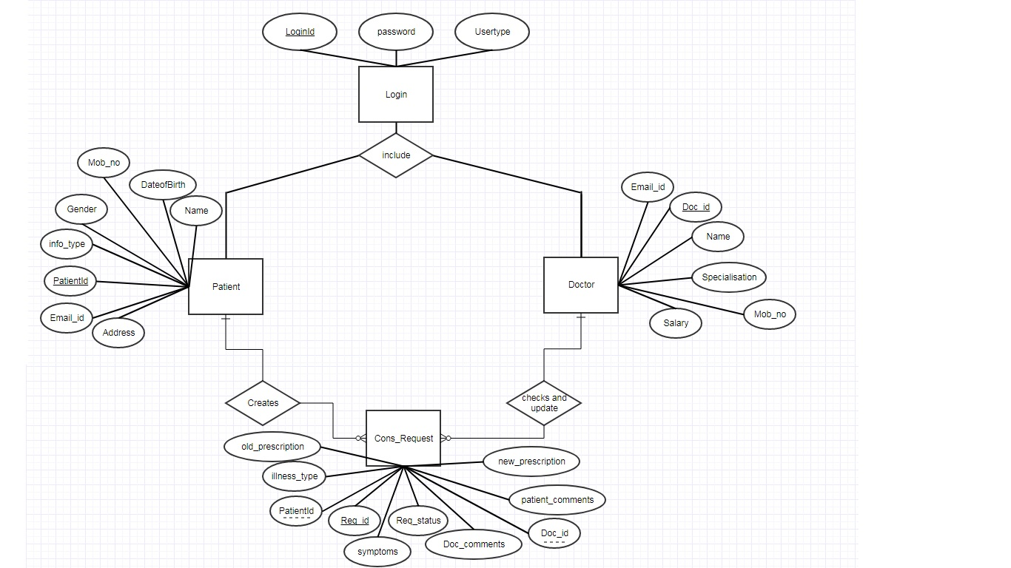
ER Diagram for Online Medical System

