Slide 1

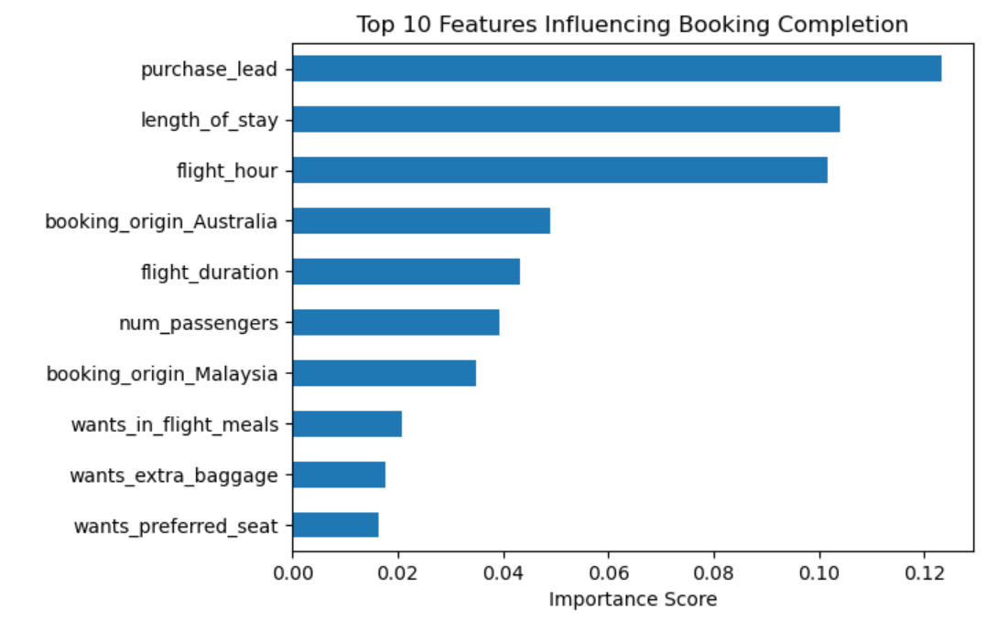
Predicting Customer Booking Behaviour – British Airways
Using historical booking data and machine learning
Objective
To predict whether a customer will complete a booking using historical booking data and identify the key drivers influencing booking behaviour.
Approach
Explored and prepared a dataset of 50,000 customer booking records
Encoded categorical variables and addressed class imbalance
Trained a Random Forest classification model
Evaluated performance using stratified 5-fold cross-validation
Model Performance
Accuracy: ~85% (inflated due to class imbalance)
Cross-validated F1-score: ~0.19
Recall for booked customers: ~11%
Cross-validation ensured robust and consistent results
Model prioritises identifying booking drivers rather than maximising raw accuracy due to class imbalance.
Key Insights
Earlier booking lead times strongly increase booking likelihood
Longer stays are more likely to result in completed bookings
Flight timing and booking origin influence customer decisions
Ancillary preferences have limited impact compared to planning behaviour

