Slide 1

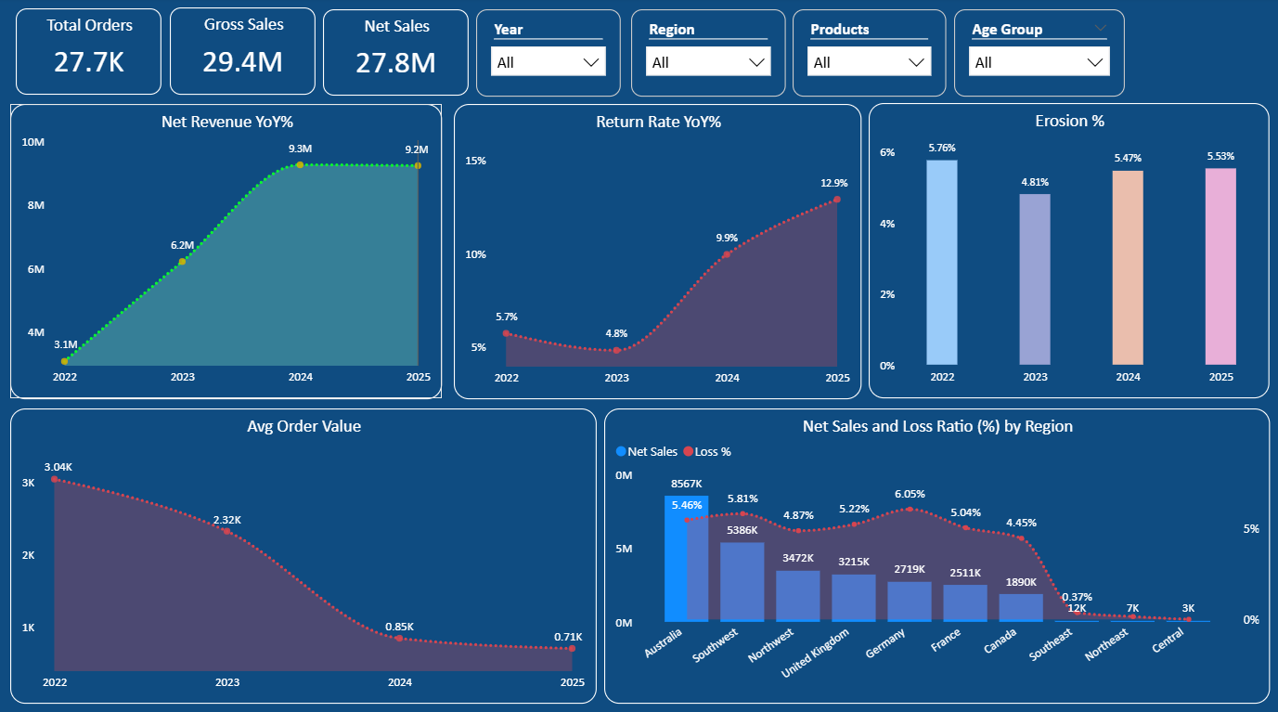
📌 EXECUTIVE OVERVIEW

Slide 2
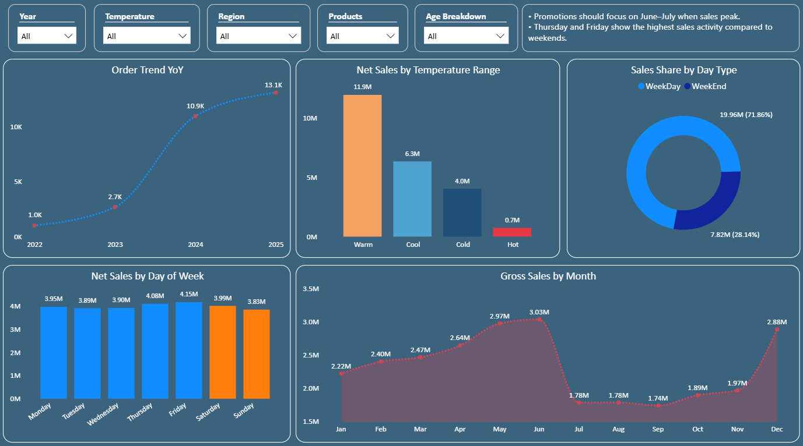
📈 Sales Trend & Seasonality Sales

Slide 3

Executive Summary
Provided recommendations for product improvement and promotion
📌 Executive Overview
📈 Sales Trend & Seasonality sales.
Presented by :
Arun M

Slide 4
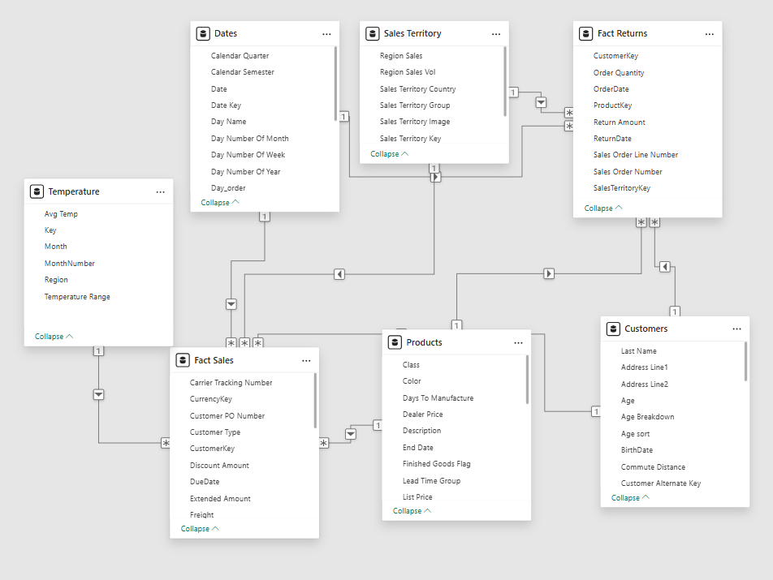
Star Schema
This is primarily a Star Schema with two fact tables (Sales and Returns) connected to multiple dimension tables like Customers, Products, and Dates. Some dimensions are slightly normalized, making it a hybrid star-snowflake model.

Slide 5
📌 EXECUTIVE OVERVIEW

Slide 6
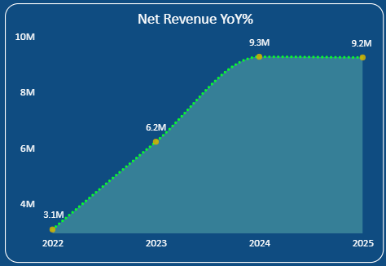
Q1. Are we growing profitably, not just growing revenue?
Net revenue grew significantly from 3.1M (2022) to 9.3M (2024), indicating strong business growth. However, revenue slightly plateaued in 2025 (9.2M), suggesting growth may be stabilizing.
Dax Measure - >
Gross Sales = SUM('Fact Sales'[Sales Amount])
Total Discount = SUM('Fact Sales'[Discount Amount])
Total Return Amount = SUM('Fact Returns'[Return Amount])
Net Sales = [Gross Sales] - [Total Discount] - [Total Return Amount]

Slide 7
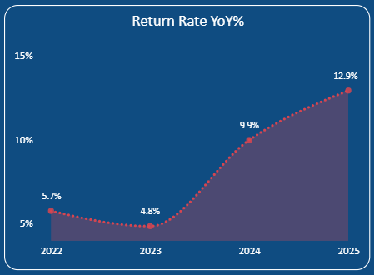
Q2. Is return rate increasing faster than sales?
Return rate improved slightly in 2023, but increased sharply to 12.9% by 2025, indicating potential issues with product quality or customer expectations.
Dax Measure - >
Return Rate = DIVIDE([Total Return],[Total Order])

Slide 8
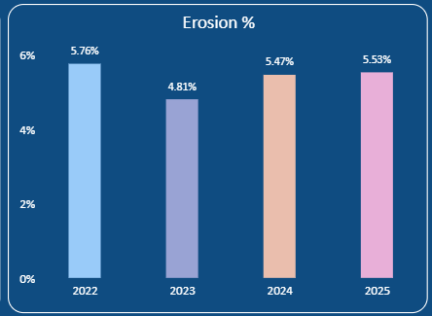
Q3. Are discounts and returns eroding net sales?
Sales erosion reduced in 2023, but increased again to around 5.5% by 2025, indicating that discounts and product returns are continuing to impact net sales.
Dax Measure - >
Erosion Amount = [Total Discount]+[Total Return Amount]
Erosion % = DIVIDE([Erosion Amount], [Gross Sales])

Slide 9
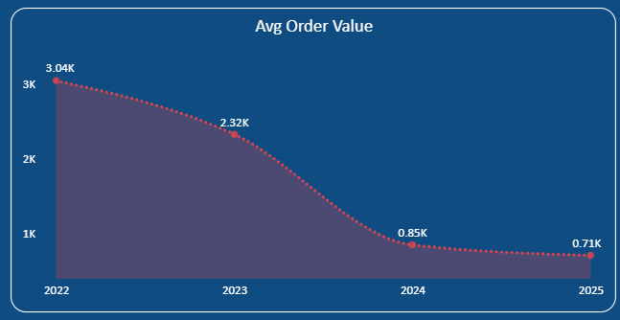
Q4. Is average order value improving or declining?
The value decreased continuously from 3.04K in 2022 to 0.71K in 2025. The largest drop happened between 2023 and 2024. This indicates customers are spending less per order over time. Average order value is declining significantly year by year.
Dax Measure - >
AOV = DIVIDE([Net Sales],[Total Order])

Slide 10
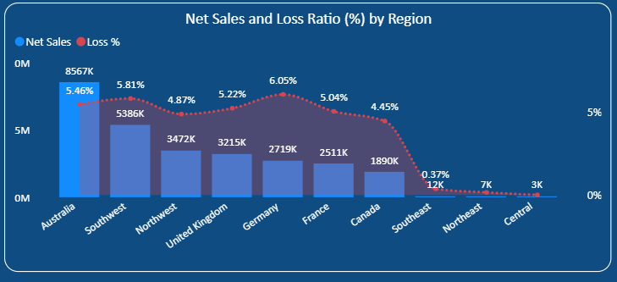
Q5. Which regions contribute most to net sales vs losses?
Australia drives the most revenue with controlled losses. Germany & Southwest need attention due to higher loss %. Smaller regions contribute very little to both sales and losses
Dax Measure - >
Net Sales = [Gross Sales] - [Total Discount] - [Total Return Amount]
Loss % = DIVIDE([Erosion Amount],[Gross Sales])

Slide 11
📈 Sales Trend & Seasonality Sales

Slide 12
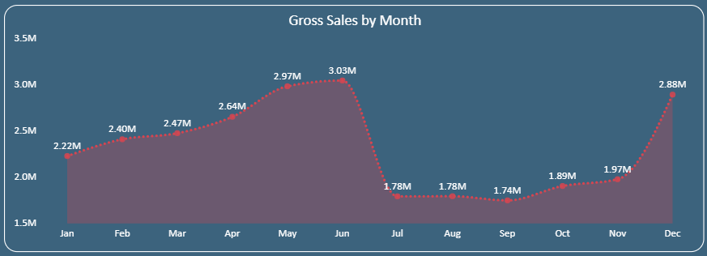
Q6. Which months consistently perform best and worst?
Best: May & June (peak ~3M) and December (recovery spike).
Worst: July–September (~1.7–1.8M) showing a clear dip after peak months.
Dax Measure - >
Net Sales = [Gross Sales] - [Total Discount] - [Total Return Amount]

Slide 13
Q7. Are sales patterns seasonal or random?
Clearly seasonal → steady growth from Jan → June, sharp drop in mid-year (Jul–Sep), then recovery towards year-end. Not random.
Dax Measure - >
Net Sales = [Gross Sales] - [Total Discount] - [Total Return Amount]

Slide 14
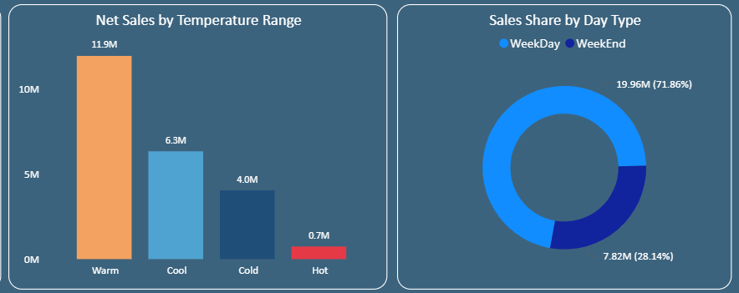
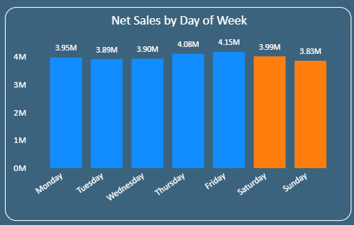
Q8. Do external factors (temperature, weekdays/weekends) impact sales?
Yes → Warm temperature contributes highest sales (~11.9M).
Weekdays (~72%) dominate vs weekends (~28%), especially Thu–Fri peaks.
Dax Measure - >
day_type = IF(WEEKDAY(Dates[Date],2) <= 5, "WeekDay","WeekEnd")

Slide 15
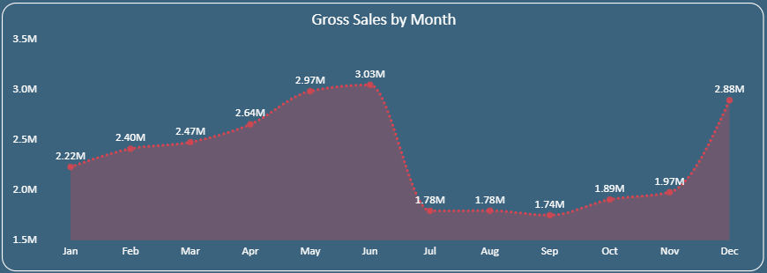
Q9. When should we plan promotions and staffing?
High demand (May–June, Dec): increase staffing, ensure availability.
Low demand (Jul–Sep): push promotions/discounts to boost sales.

Slide 16
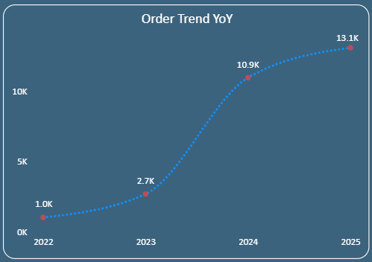
Q10. Are recent trends improving or declining compared to last year?
Strong upward trend → Orders increased from ~1K (2022) to ~13K (2025), showing consistent growth and improving performance.
Dax Measure - >
Total Order = DISTINCTCOUNT('Fact Sales'[Sales Order Number])

