Slide 1
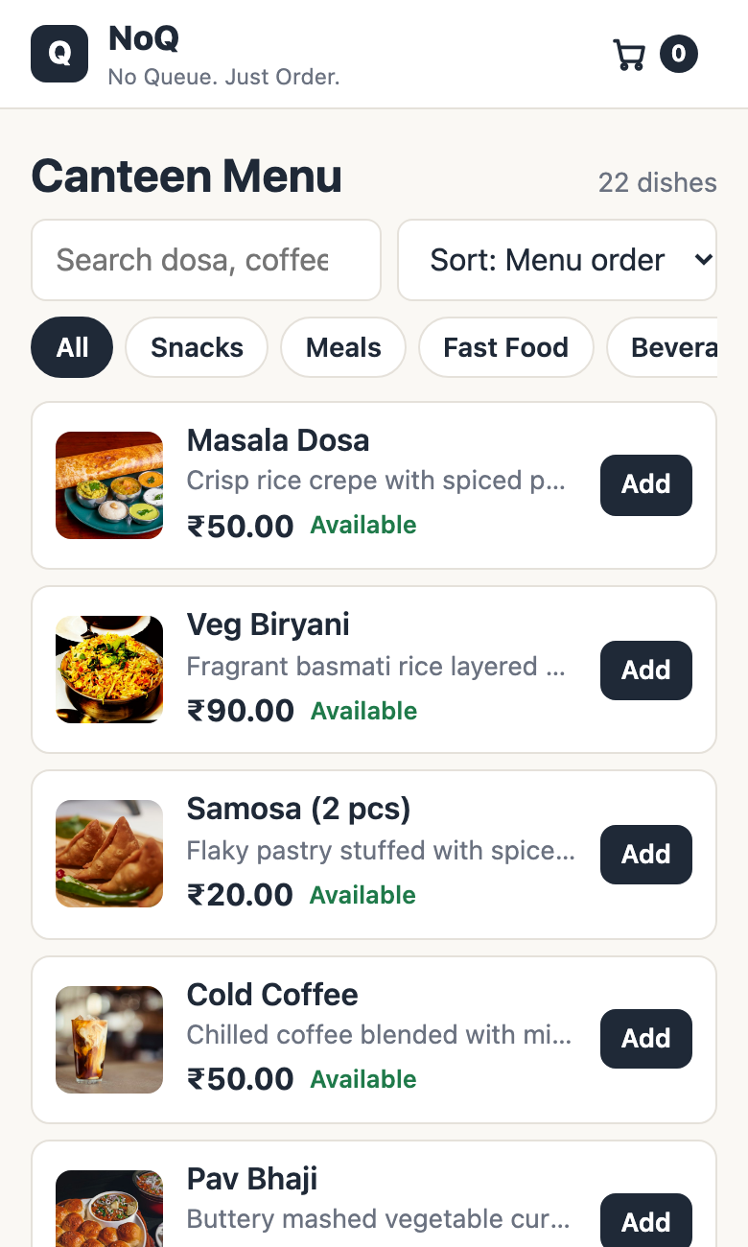
IT23502 · WEB PROGRAMMING · MINI PROJECT
NoQ
No Queue. Just Order.
A smart canteen pre-ordering and pickup system that moves the queue from the counter to the phone.
TEAM
Harish M
Arun M
Sreeram Santhosh
2024115118
2024115098
2024115126
Notes:
Good morning. We are Harish, Arun and Sreeram. Our Web Programming mini project is NoQ, "No Queue. Just Order." It is a smart canteen pre-ordering system: students order from their phone, the kitchen and counter each get one screen, and the student collects with a secret pickup code. The next 12 slides cover the problem, the architecture, what each component does, the key code, and how we tested it.

Slide 2





The canteen counter is the bottleneck
01 · THE PROBLEM
At peak hours a student burns a good part of the break standing in three separate queues.
1
2
3
Wait to order
Wait to pay
Wait to collect
Orders are taken verbally at one counter, one student at a time.
Payment is another line, while staff juggle orders from memory.
Then a third wait for the food, with no signal for when it is ready.
Items sell out while people queue
No record of what sells best
Students reach the front only to hear the dish is finished.
Nothing is captured, so the kitchen cannot plan what to cook.
Notes:
The problem is simple and every one of us has lived it. At peak time the counter is the bottleneck: students wait to order, wait again to pay, and wait a third time to collect. Meanwhile dishes sell out while people are still in line, and the canteen has no record of what actually sells. NoQ attacks all of this by moving ordering to the phone.

Slide 3



Order ahead. Collect with a code
02 · THE SOLUTION
Students order from their seat. The kitchen and the counter each get exactly one screen.
1
2
3
4
Order
Cook
Get alerted
Collect
Browse the live menu, add to cart, place the order. No account needed.
The kitchen sees it within 10 seconds and taps Ready for Pickup.
A notification service is told; the customer page turns READY FOR PICKUP.
Staff check the 6-digit code, record the payment and hand the food over.
Customer
Kitchen
Counter staff
Browses, orders, gets a code. Never logs in.
Owns the food: availability and Ready for Pickup.
Owns the money: OTP check, payment, handover.
Notes:
Our solution is a three-actor system. The customer orders ahead and gets an order reference plus a six-digit pickup code. The kitchen sees incoming orders and taps Ready for Pickup. The counter staff verify the code, record the cash payment and hand over the food. Each role has exactly one job and one page, and the server refuses anything outside it - the customer never needs an account.

Slide 4
One monolith, one microservice
03 · ARCHITECTURE
BROWSER
noq-app · Spring Boot · :8080
Customer pages
menu · cart · order status
Caffeine cache
menu · 60 s TTL
Spring Security
form login · Basic · roles · 401/403
Controllers
MVC pages + REST /api
Services
@Transactional business rules
JPA + Hibernate
repositories · HQL
MySQL 8
noq_db
Kitchen & Staff
Thymeleaf + vanilla JS
SQL
Postman
JSON + HTTP Basic
Error handler
uniform JSON errors
Notification service
separate app :8081
POST after commit
LoggingAspect (AOP) wraps every service call
Notes:
This is the shape of the system. Browsers - the customer pages, the Kitchen and Staff pages, and Postman for API testing - all enter through Spring Security, which decides who may do what. Inside noq-app, controllers hand requests to transactional services. Services use a Caffeine cache for the menu, and JPA with Hibernate to talk to MySQL. A LoggingAspect wraps every service method. The one thing outside is the notification service, a separate Spring Boot app on port 8081 that the main app calls over HTTP after an order is committed. So: a modular monolith plus one microservice.

Slide 5








What each component does
04 · COMPONENTS
Controllers
Spring Security
Services
JPA + Hibernate
@Controller serves the Thymeleaf pages (/, /cart, /staff). @RestController serves JSON under /api.
Form login for pages, HTTP Basic for the API. Roles KITCHEN and STAFF, JSON 401 / 403.
All business rules inside @Transactional: checkout, status changes, payments, pickup OTP.
Spring Data repositories, two HQL queries, entities mapped to MySQL tables.
Caffeine cache
LoggingAspect (AOP)
Error handler
Notification service
Menu and popular items cached for 60 s. Cleared right after an order commits.
@Around every service method: logs the time taken and any failure.
One @RestControllerAdvice turns every failure into a uniform JSON error (400 to 409).
Separate Spring Boot app on :8081. Receives the "order ready" event over REST.
Notes:
Walk across the grid. Controllers: two kinds - MVC controllers return Thymeleaf pages, REST controllers return JSON. Security sits in front of both. Services hold every business rule and every transaction. Repositories and Hibernate turn Java objects into MySQL rows, and we use HQL for two queries. Caffeine caches the menu for 60 seconds. The logging aspect is Spring AOP. The error handler gives one uniform JSON error shape. And the notification service is the separate microservice.

Slide 6
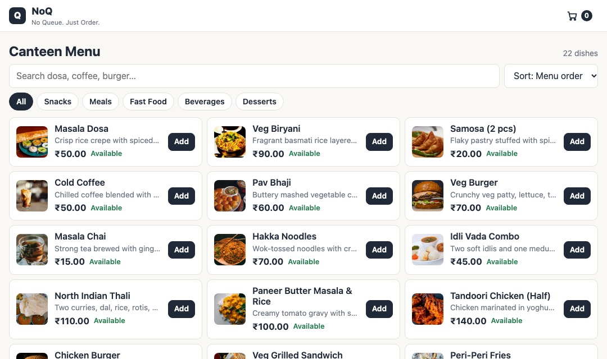
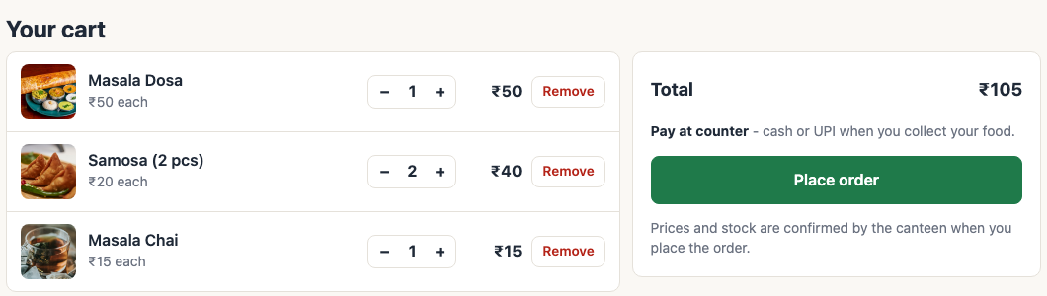
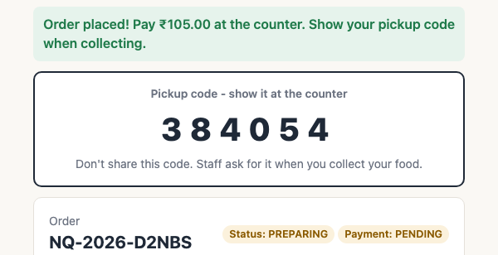
Customer: browse, order, get a code
05 · CUSTOMER SIDE
1 Browse
2 Cart · 3 Confirm
Search, filter and sort. Menu is cached; sold-out dishes are greyed out.
Cart lives in the browser. Confirmation shows the reference and a one-time code.
Notes:
This is the real running site. On the left, the menu: search, category chips, sort, and an Add button; dishes the kitchen marks unavailable are greyed out. Top right is the cart - kept in the browser only until checkout. Bottom right is the confirmation screen after Place order: the order reference, the total, the status PREPARING, and the six-digit pickup code, shown once. The page keeps polling every five seconds, so it turns to READY FOR PICKUP on its own. Payment is at the counter.

Slide 7
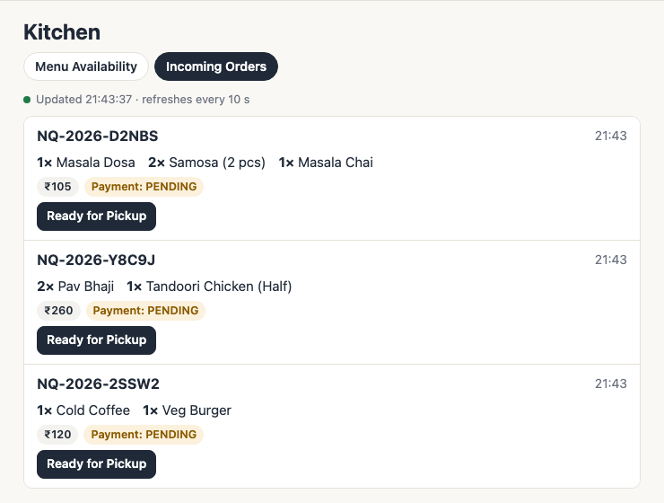
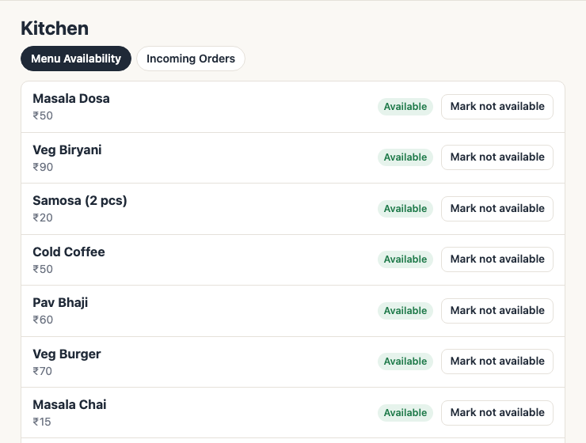
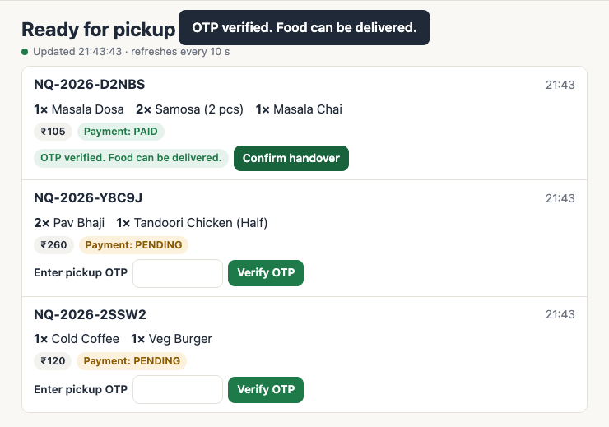
Kitchen cooks, staff hand over
06 · KITCHEN AND STAFF
PREPARING
READY_FOR_PICKUP
COLLECTED
Kitchen: Ready for Pickup
Staff: verify OTP, then handover
Incoming Orders
Menu Availability
OTP check
Kitchen: one button per order, list refreshes every 10 s.
Kitchen: one switch per dish, enforced at checkout.
Staff: right OTP records the payment, then Confirm handover.
Notes:
Food status and payment status are kept separate. An order is born PREPARING. The kitchen user sees only PREPARING orders and taps Ready for Pickup - that is the only transition the kitchen can make. The staff user sees only READY orders. They type the customer pickup code; if it is right, the cash payment is recorded and Confirm handover turns the order COLLECTED. Wrong codes are rejected and attempt-limited. The kitchen also has a Menu Availability tab to mark a dish unavailable, which is enforced at checkout.

Slide 8
The server decides, never the browser
07 · CODE: CHECKOUT
OrderService.placeOrder()
1
Never trust the browser
@Transactional
public OrderPlacedResponse placeOrder(PlaceOrderRequest request) {
rejectIfAlreadySubmitted(idempotencyKey); // double click -> 409
for (var entry : quantities.entrySet())
addLineToOrder(order, entry.getKey(), entry.getValue());
order.setTotalAmount(subtotal); // computed on server
order.setPickupOtpHash(pickupCodes.hash(otp)); // BCrypt only
orderRepository.save(order); // cascades items
Price, stock and availability are re-read from MySQL, not from the page or the cache.
2
Lock the row
SELECT ... FOR UPDATE: two buyers of the last samosa queue up. The second gets a clean 409.
3
One transaction
OrderService.addLineToOrder() (simplified)
MenuItem item = menuItemRepository.findWithLockById(id) // FOR UPDATE
.orElseThrow(() -> ApiException.badRequest("no such item"));
if (!item.isAvailable())
throw ApiException.conflict(item.getName() + " is not available");
if (quantity > item.getAvailableQuantity())
throw ApiException.conflict(
"Only " + item.getAvailableQuantity() + " left");
item.reduceStock(quantity); // also bumps popularityCount
Stock, order and order lines commit together, or not at all.
4
No double orders
A UNIQUE idempotency key turns a double click into a 409, not two orders.
Notes:
This is the heart of the backend. placeOrder is one transaction. For every line, addLineToOrder loads the dish with a pessimistic write lock - SELECT FOR UPDATE - so two students buying the last samosa cannot both win; the second gets a 409 conflict. The price comes from the database, the total is computed on the server, and the pickup code is hashed with BCrypt, so even the database never stores the real OTP. An idempotency key with a UNIQUE constraint makes double-clicks harmless. Code is lightly simplified from OrderService.java for the slide.

Slide 9
Ready? Notify only after the commit
08 · CODE: MICROSERVICE CALL
1
Kitchen taps Ready
OrderStatus.canMoveTo()
PATCH /api/orders/{ref}/status
public boolean canMoveTo(OrderStatus next) {
return switch (this) {
case PREPARING ->
next == READY_FOR_PICKUP || next == CANCELLED;
case READY_FOR_PICKUP -> next == COLLECTED;
case COLLECTED, CANCELLED -> false;
2
Rules checked
canMoveTo() allows only legal moves
3
Commit, then call
NotificationClient.onOrderReady() (simplified)
AFTER_COMMIT listener POSTs to :8081
@TransactionalEventListener(phase = TransactionPhase.AFTER_COMMIT)
public void onOrderReady(OrderReadyEvent event) {
try {
restClient.post().uri("/api/notifications/order-ready")
.body(Map.of("orderReference", event.orderReference(),
"eventType", "ORDER_READY"))
.retrieve().body(Map.class);
} catch (RestClientException e) {
log.warn("Notification service unavailable", e.getMessage());
}
4
Customer sees it
Open page polls and turns READY
Notifier down? A warning is logged and the order still becomes READY.
Notes:
Two small pieces of code show the microservice integration. First, OrderStatus.canMoveTo is the single place that defines legal status changes - PREPARING can go to READY_FOR_PICKUP or CANCELLED, READY can only go to COLLECTED. Second, when the kitchen marks an order ready, the service publishes an event, and NotificationClient listens with AFTER_COMMIT. That means the HTTP call to port 8081 happens only if the database commit succeeded, and if the notification service is down we just log a warning with a two-second timeout - the order is never blocked. The limitation: it is synchronous with no retry; a message broker would fix that and is listed as future work.

Slide 10



Roles, OTP and integrity
09 · SECURITY AND INTEGRITY
Role | Login | Allowed
Customer | None | View menu, place an order, read own order with the pickup code
KITCHEN | kitchen | Kitchen page, dish availability switch, Ready for Pickup
STAFF | staff | Verify OTP, record counter payment, confirm handover
Pickup OTP
Passwords
SecureRandom, 6 digits, BCrypt-hashed, shown once. Five wrong tries lock it.
Staff passwords are BCrypt hashes. Form login for pages, HTTP Basic for the API.
Concurrency
Input and forms
Server-enforced
Row lock at checkout, @Version optimistic lock as a safety net. Conflicts return 409.
@Valid DTOs reject bad input with 400. CSRF on pages; session cookie SameSite=Lax.
Each login can only do its own job. Anything else returns 403 JSON, and a missing login returns 401, not a redirect.
Notes:
Security has two parts. Access control: customers need no login; the kitchen login and the staff login each see only their own page and API calls, enforced in SecurityConfig - the wrong role gets a JSON 403. Data protection: the pickup code is generated with SecureRandom, stored only as a BCrypt hash, shown once, and limited to five wrong attempts. Staff passwords are BCrypt too. For integrity we use row locks plus an optimistic version column, validated DTOs, and CSRF protection on the HTML forms.

Slide 11
Five tables, one inheritance tree
10 · DATA MODEL
MENU_ITEM
ORDER_ITEM
CUSTOMER_ORDER
PAYMENT
id PK
name
price
available_quantity
available
active
popularity_count
version
id PK
order_id FK
menu_item_id FK
item_name_snapshot
unit_price_snapshot
quantity
line_total
id PK
order_reference UK
pickup_otp_hash
status
payment_status
total_amount
idempotency_key UK
version
id PK
order_id FK
payment_type CASH
amount
status
received_by
1 : N
N : 1
1 : N
Snapshots
Payment inheritance
Fifth table: staff_user
Item name and price are copied into each order line, so later menu changes never rewrite history.
Abstract Payment, subclass CashPayment, SINGLE_TABLE with a payment_type column. Another way to pay = one more subclass.
Holds the two BCrypt staff accounts. Menu and accounts load from data.sql (INSERT IGNORE), so restarts never duplicate rows.
Notes:
Four main tables plus staff_user. A menu item appears in many order lines; an order has many lines and can have payment attempts. Two details worth mentioning. First, order lines snapshot the dish name and price at order time. Second, Payment uses Hibernate inheritance - one table, with a discriminator column - so adding online payment later is one more subclass. The schema is created by Hibernate on first start and seeded from data.sql. Staff accounts live in staff_user with BCrypt password hashes.

Slide 12
Tested, and mapped to the syllabus
11 · TESTING AND SYLLABUS
32
Unit | Concept | Where in NoQ
IV | Spring Boot + MVC | HomeController > MenuService > index.html
IV | JPA / Hibernate + HQL | entity/, repository/, 2 HQL queries
IV | Inheritance mapping | Payment > CashPayment (SINGLE_TABLE)
IV | Session / Transaction, DI | ConceptDemoService, /api/demo endpoints
IV | AOP + caching | LoggingAspect, Caffeine @Cacheable
V | REST API | GET, POST, PATCH; codes 200 to 409
V | Validation + errors | @Valid DTOs, GlobalExceptionHandler
V | Microservice | notification service via RestClient
automated tests
JUnit 5 + MockMvc, H2 database
35
Postman requests
with automatic assertions
2
Spring Boot apps
ports 8080 and 8081, built with Maven
Notes:
Evidence that it works: 32 automated tests pass on the in-memory H2 profile, plus a 35-request Postman collection with assertions. On the right is the syllabus mapping. Unit IV: Spring Boot and MVC, JPA and Hibernate with two HQL queries, inheritance mapping with Payment and CashPayment, Session and Transaction and dependency injection demos, AOP and caching. Unit V: a REST API with proper status codes, validation with uniform JSON errors, and the notification microservice. We also verified the full flow live: place, ready, OTP, payment, handover.

Slide 13
Limits today, next steps
12 · NEXT STEPS
Counter payment only
Add an online gateway as one more Payment subclass, confirmed by webhook.
Thank you
Questions?
Polling every 5 to 10 s
Server-Sent Events or WebSockets for instant updates.
Harish M
Notification only logged
Real SMS / push, with a message broker for retries.
2024115118
Arun M
2024115098
No customer accounts
Optional login with order history and favourites.
Sreeram Santhosh
2024115126
Notes:
To be honest about limits: payment is at the counter only, status updates use polling, the notification is only logged, and there are no customer accounts. Each has a clear next step: an online gateway as another Payment subclass, server-sent events, SMS or push through a broker, and optional login. That is NoQ. Thank you - we are happy to take questions, and we can run the live demo: place an order, mark it ready as kitchen, then verify the OTP as staff.

