Slide 1
Budget in the Education Sector in the Indian Economy (2015–2025)
Presented by:
Apurav(202311014)
Date:
17 April 2025

Slide 2
Overview of Education Budget
Financial Year | School Education | Higher Education (₹ crore) | Total Allocation (₹ crore) | % Increase from Previous Year
2015–16 | 43,554 | 28,840 | 72,394 | 5.33%
2016–17 | 46,356 | 33,330 | 79,686 | 10.1%
2017–18 | 50,000 | 34,000 | 84,000 | 5.4%
2018–19 | 52,000 | 37,000 | 89,000 | 6.0%
2019–20 | 56,000 | 38,000 | 94,000 | 5.6%
2020–21 | 59,845 | 39,455 | 99,300 | 5.6%
2021–22 | 54,873 | 38,351 | 93,224 | -6.1%
2022–23 | 63,449 | 40,829 | 1,04,278 | 11.9%
2023–24 | 68,805 | 44,094 | 1,12,899 | 8.3%
2024–25 (BE) | 73,008 | 47,620 | 1,20,628 | 6.8%
2025–26 (BE) | 78,572 | 50,078 | 1,28,650 | 6.7%

Slide 3
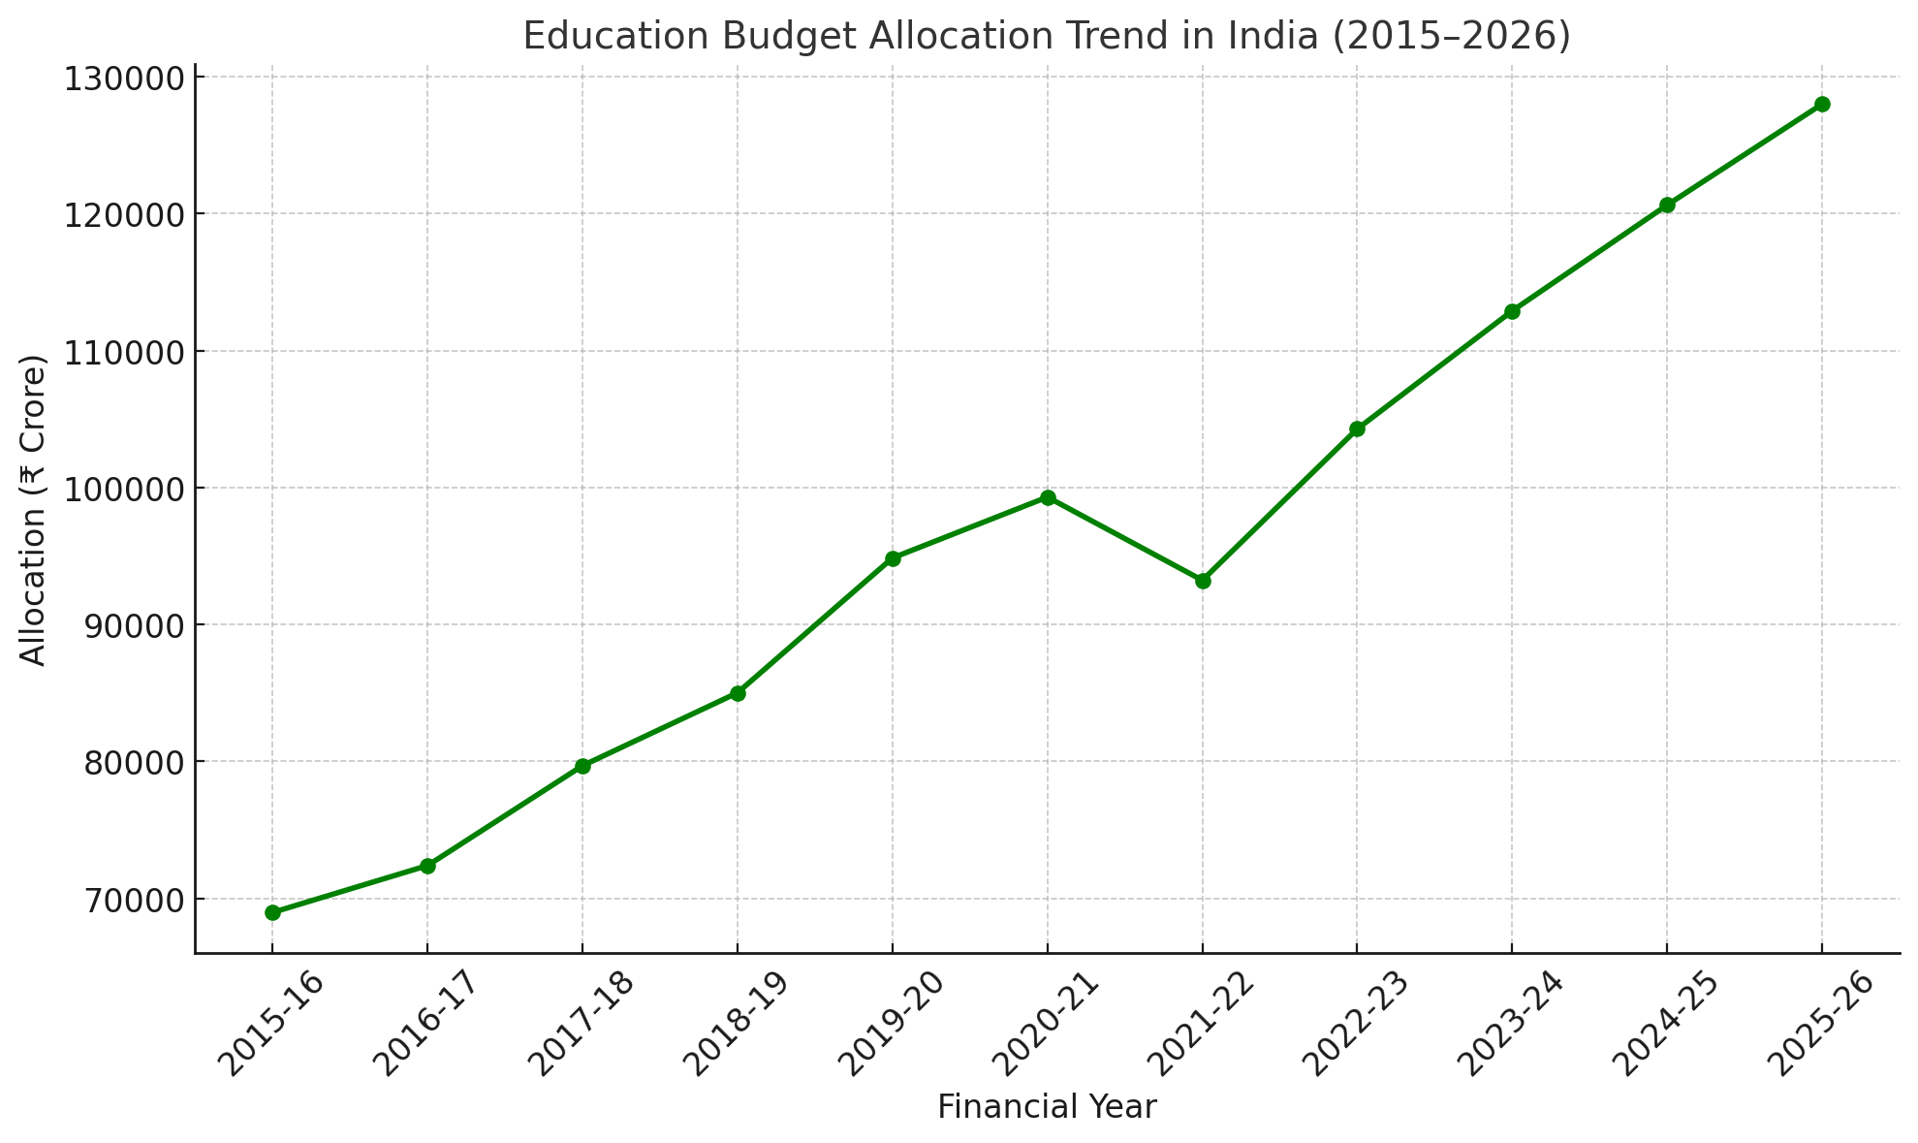
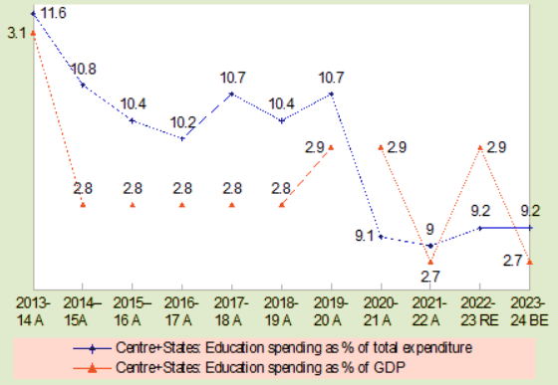
Budget Allocation trends

Slide 4
Observation with reason
Observations:
The total education budget has grown from ₹72,394 crore in 2015–16 to ₹1,28,650 crore in 2025–26, marking a significant rise over the decade.
Throughout the decade, school education has consistently received a larger share of the education budget compared to higher education.
In the fiscal year 2021–22, there was a noticeable decrease in the total education budget allocation, dropping by approximately 6.1% compared to the previous year.
Reasons:
This upward trend reflects the government's commitment to enhancing educational infrastructure, implementing schemes like Samagra Shiksha Abhiyan, and promoting digital learning initiatives.
government's focus on foundational education, aiming to improve literacy rates
The COVID-19 pandemic necessitated a reallocation of government resources towards health and emergency services, leading to reduced funding for the education sector.

Slide 5
Major Schemes & Reforms
Samagra Shiksha Abhiyan (SSA):
  Integrated scheme for school education from pre-primary to Class XII.
  Allocation of ₹37,383 crore in 2022–23, a 20% increase over the previous year.
PM SHRI Schools:
  Launched in 2022 to develop over 14,500 model schools.
  Total budget outlay of ₹27,360 crore over five years.

Slide 6
Major Schemes & Reforms (Contd.)
Rashtriya Uchchatar Shiksha Abhiyan (RUSA):
  Centrally Sponsored Scheme for funding state higher educational institutions.
  Funding pattern: 60:40 between Centre and States for general category states.
National Education Policy (NEP) 2020:
  Comprehensive framework for education reforms.
  Emphasis on holistic, flexible, multidisciplinary education.
  Total budget outlay of ₹27,360 crore over five years.

Slide 7
Thankyou

