Slide 1


AtliQ Hardware
FINANCE & SUPPLY CHAIN ANALYTICS
MYSQL
AtliQ Hardware operates across multiple markets and sales channels in the consumer electronics industry, generating large volumes of sales, customer, product, and forecast data. This project translates 12 business requests 10 in Finance & Sales Analytics and 2 in Supply Chain into reusable SQL based reporting solutions.
AtliQ Hardware | Finance & Supply Chain Analytics | Arun R

Slide 2

Project Objectives
Analyze Performance
Evaluate sales, customer, market, and product performance across fiscal periods.
Build Repeatable Reports
Develop reusable Finance & Sales reports using SQL, stored procedures, and functions.
Actual vs. Forecast
Evaluate supply chain performance by comparing actual demand against forecasts.
Business Insights
Translate SQL outputs into actionable, business-focused insights for stakeholders.
AtliQ Hardware | Finance & Supply Chain Analytics | Arun R

Slide 3
Project Scope at a Glance
12
10
Business Requests
Finance & Sales
Total ad hoc analytical requests addressed across finance and supply chain
Requests focused on revenue, customer, and product performance analytics
2
5
Supply Chain
SQL Techniques
Requests evaluating forecast accuracy and demand planning
CTEs, window functions, joins, and stored procedures applied
AtliQ Hardware | Finance & Supply Chain Analytics | Arun R

Slide 4
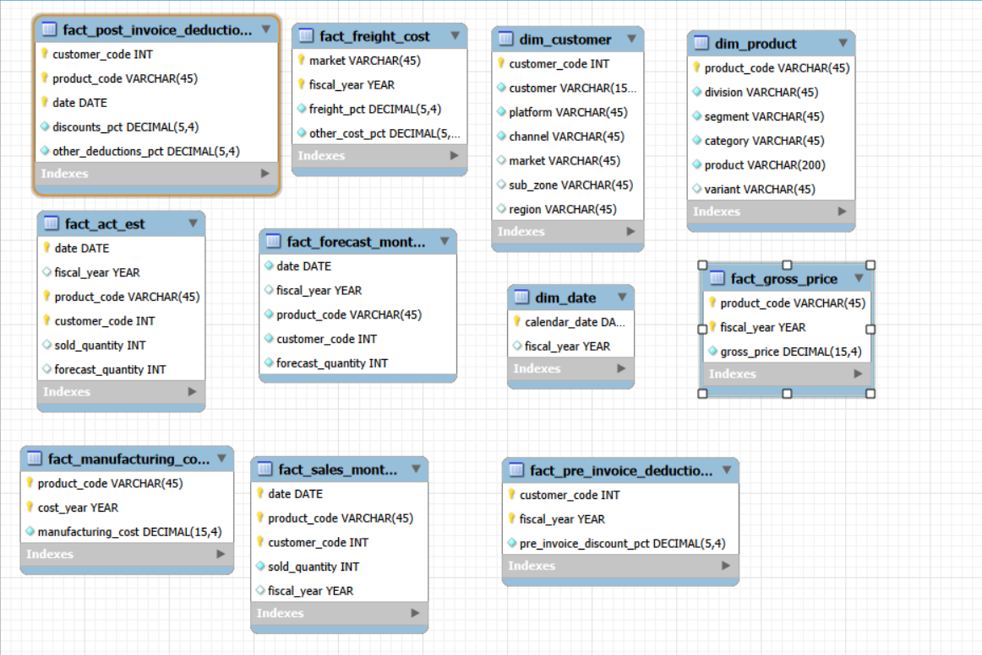
ER Diagram — Data Model Overview
AtliQ Hardware | Finance & Supply Chain Analytics | Arun R

Slide 5
Finance Analytics — Croma India
REQUEST #1
As a product owner, I want to generate a report of individual product sales(aggregated on a monthly basis at the product code level) for Croma India customers for FY = 2021 so that i can track individual product sales and run further product analytics on it in excel.
Month
Product Name
Variant
Sold Quantity
Gross Price / Item
Gross Price Total
AtliQ Hardware | Finance & Supply Chain Analytics | Arun R

Slide 6
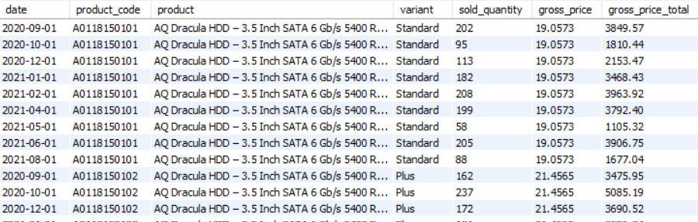
Request #1 — SQL Implementation & Output
SQL Query
Output Preview
SELECT s.date,
s.product_code,
p.product,
p.variant,
s.sold_quantity,
g.gross_price,
ROUND(s.sold_quantity * g.gross_price, 2)
AS gross_price_total
FROM fact_sales_monthly s
JOIN dim_product p
ON s.product_code = p.product_code
JOIN fact_gross_price g
ON g.fiscal_year = get_fiscal_year(s.date)
AND g.product_code = s.product_code
WHERE customer_code = 90002002
AND get_fiscal_year(s.date) = 2021
LIMIT 1000000;
Query joins three tables, filters for Croma India (customer_code = 90002002), and calculates gross price totals per product per month in FY 2021.
AtliQ Hardware | Finance & Supply Chain Analytics | Arun R

Slide 7
Finance Analytics — Croma India
REQUEST #2
As a product owner, I need an aggregate monthly gross sales report for Croma India customer so that I can track how much sales this particular customer is generating for AtliQ and manage our relationships accordingly, The report should have the following fields
Month
Total gross sales amount to Croma India
in this month
AtliQ Hardware | Finance & Supply Chain Analytics | Arun R

Slide 8
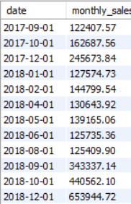
Request #2 — SQL Implementation & Output
SQL Query
Output Preview
SELECT
s.date,
SUM(ROUND(s.sold_quantity*g.gross_price,2)) as monthly_sales
FROM fact_sales_monthly s
JOIN fact_gross_price g
ON g.fiscal_year=get_fiscal_year(s.date) AND g.product_code=s.product_code
WHERE
customer_code=90002002
GROUP BY date;
Query joins three tables, filters for Croma India (customer_code = 90002002), and calculates gross price totals per product per month in FY 2021.
AtliQ Hardware | Finance & Supply Chain Analytics | Arun R

Slide 9
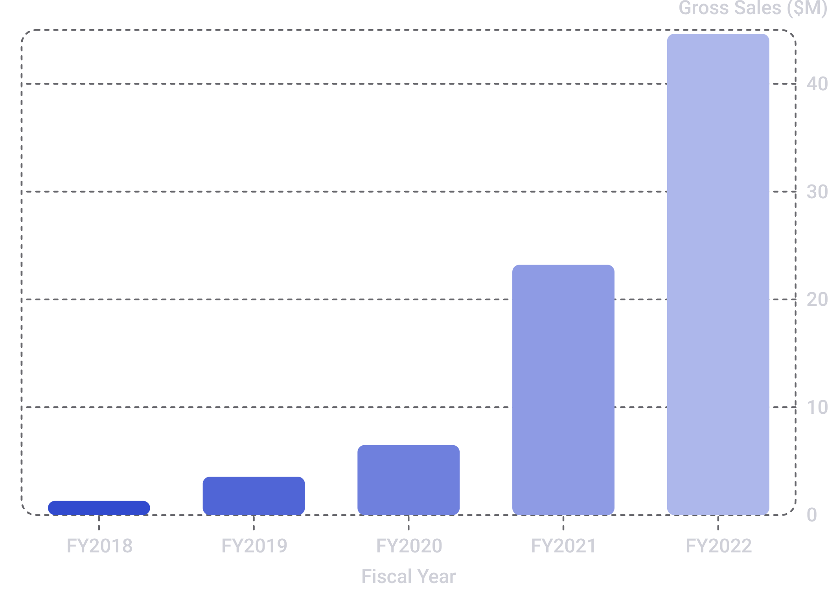
Croma India — Yearly Gross Sales (FY 2018–2022)
REQUEST #3
As a product owner, I need an aggregate monthly gross sales report for Croma India customer so that I can track how much sales this particular customer is generating for AtliQ and manage our relationships accordingly, The report should have the following fields
REQUE #3
Key Insight
Croma India's gross sales grew from $1.32M in FY2018 to $44.64M in FY2022 — an approximate 33.7× increase over five fiscal years. The steepest acceleration occurred between FY2020 and FY2022, signaling a rapidly scaling customer relationship.
SELECT get_fiscal_year(date) AS fiscal_year,
SUM(ROUND(sold_quantity * g.gross_price, 2))
AS yearly_sales
FROM fact_sales_monthly s
JOIN fact_gross_price g
ON g.fiscal_year = get_fiscal_year(s.date)
AND g.product_code = s.product_code
WHERE customer_code = 90002002
GROUP BY get_fiscal_year(date)
ORDER BY fiscal_year;

Slide 10
Reusable SQL Automation
get_monthly_gross_sales_for_customer
get_market_badge
Parameterized Top-N procedures
Fiscal-year and fiscal-quarter functions
Reusable logic reduces repetitive query modification and supports more efficient reporting.
AtliQ Hardware | Finance & Supply Chain Analytics | Arun R

Slide 11
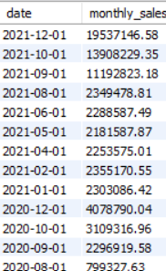
Request #4
As a product owner, I need an aggregate monthly gross sales report for Croma India customer so that I can track how much sales this particular customer is generating for AtliQ and manage our relationships accordingly, The report should have the following fields
Month
Output Preview
Total gross sales in that month from a given Customer
AtliQ Hardware | Finance & Supply Chain Analytics | Arun R

Slide 12

Request #5
Create a stored proc that can determine the market badge based on the following logic,If total sold quantity > 5 million that market is considered Gold else it is Silver
Output Preview
My input will be,
1.Market :- India
2.fiscal year:- 2021
AtliQ Hardware | Finance & Supply Chain Analytics | Arun R

Slide 13
Finance Analytics — Advanced Analysis
Top markets, products and customers by net sales
Top 10 markets by percentage of net sales
Regional customer contribution to net sales
Top-performing products within each division
Top 2 markets within every region by gross sales
AtliQ Hardware | Finance & Supply Chain Analytics | Arun R

Slide 14
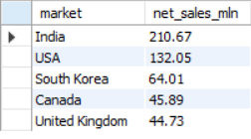


Request #6
As a Product Owner, I want a report for top markets, products, customers by net sales for a given financial year so that I can have a holistic view of our financial performance and can take appropriate actions to address any potential issues.
we will probably write stored proc for this as we will need this report going forward as well.
1.Report for top markets.
2.Report for top products
3.Report for top customers.

Slide 15
Request #7
AS a Product owner, I want to see a bar chart report for FY =2021 for top 10 markets by % net sales. It should look something like this.( import and add bar chart)
SQL Query
Output Preview
WITH cte1 AS (
SELECT
customer,
ROUND(SUM(net_sales) / 1000000, 2) AS net_sales_mln
FROM net_sales s
JOIN dim_customer c
ON s.customer_code = c.customer_code
WHERE s.fiscal_year = 2021
GROUP BY customer
)
SELECT
*,
net_sales_mln * 100 / SUM(net_sales_mln) OVER () AS pct_net_sales
FROM cte1
ORDER BY net_sales_mln DESC;

Slide 16
Request #8
As a product owner, I want to see region wise(APAC, EU, LTAM, etc.) % net sales breakdown by customers in a respective region so that I can perform my regional analysis on financial performance of the company
the end result should be pie charts in the following format for the FY= 2021. builder reusable asset that we can use the contact the analysis for the any financial year.
Output Preview

Slide 18
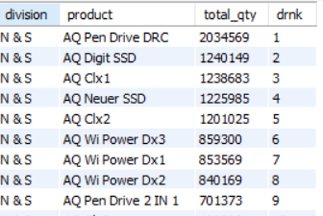
Request #9
Write a stored proc for getting TOP n products in each division by their quantity sold in a given financial year. For example, below would be the result for FY = 2021.
CREATE PROCEDURE `get_top_n_products_per_division_by_qty_sold`(
IN in_fiscal_year INT,
IN in_top_n INT
)
BEGIN
WITH cte1 AS (
SELECT
p.division,
p.product,
SUM(s.sold_quantity) AS total_qty
FROM fact_sales_monthly s
JOIN dim_product p
ON p.product_code = s.product_code
WHERE s.fiscal_year = in_fiscal_year
GROUP BY
p.division,
p.product
),
cte2 AS (
SELECT
*,
DENSE_RANK() OVER (
PARTITION BY division
ORDER BY total_qty DESC
) AS drnk
FROM cte1
)
SELECT *
FROM cte2
WHERE drnk <= in_top_n;
END;
Output Preview

Slide 19
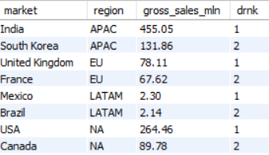
Request #10
Retrieve the top 2 markets in every region by their gross sales amount in FY=2021.
WITH cte1 AS (
SELECT
c.market,
c.region,
ROUND(SUM(s.gross_price_total) / 1000000, 2) AS gross_sales_mln
FROM gross_sales s
JOIN dim_customer c
ON c.customer_code = s.customer_code
WHERE s.fiscal_year = 2021
GROUP BY
c.market,
c.region
),
cte2 AS (
SELECT
*,
DENSE_RANK() OVER (
PARTITION BY region
ORDER BY gross_sales_mln DESC
) AS drnk
FROM cte1
)
SELECT *
FROM cte2
WHERE drnk <= 2;
Output Preview
AtliQ Hardware | Finance & Supply Chain Analytics | Arun R

Slide 20

Supply Chain Analytics
REQUESTS #11 & #12
FORECAST ACCURACY
Two supply chain requests evaluate forecast accuracy by comparing forecasted vs. actual demand at the product and market level, identifying gaps to improve inventory planning and reduce stockouts or overstock situations.
AtliQ Hardware | Finance & Supply Chain Analytics | Arun R

Slide 21
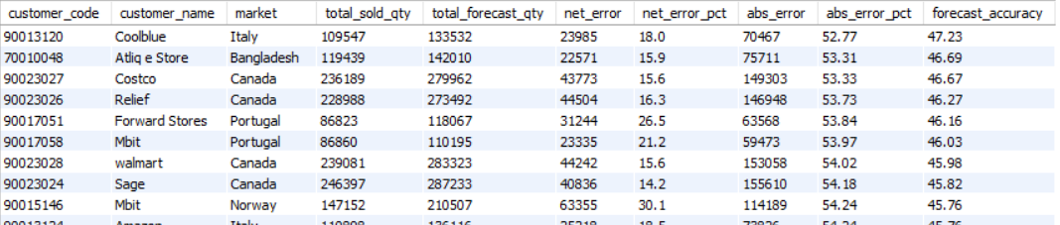
Request #11
As a product owner, I need an aggregate forecast accuracy report for all the customers for a given fiscal year so that i can track the accuracy of the forecast we make for these customers.
The reports should have the following fields.
1.Customer Code, Name, Market
2.Total Sold Quantity
3.Total Forecast Quantity
4.Net Error
5.Absolute Error
6.Forecast Accuracy %
Output Preview
AtliQ Hardware | Finance & Supply Chain Analytics | Arun R

Slide 22
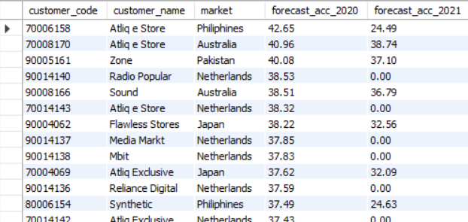
Request #12
The supply chain business manager wants to see which customers’ forecast accuracy has dropped from 2020 to 2021. Provide a complete report with these columns: customer_code, customer_name, market, forecast_accuracy_2020, forecast_accuracy_2021
AtliQ Hardware | Finance & Supply Chain Analytics | Arun R

Slide 23
Key Business Insights
Croma India showed substantial gross sales growth from FY2018 to FY2022.
Customer-level reporting can be automated through reusable stored procedures.
Top-N and regional analysis helps identify major financial contributors.
Forecast accuracy analysis highlights customers that may need closer planning review.
AtliQ Hardware | Finance & Supply Chain Analytics | Arun R

Slide 24
Technical Skills Demonstrated
MySQL / SQL
Joins, Aggregations, CASE, CTEs and Subqueries
Window Functions and DENSE_RANK()
Stored Procedures and User-Defined Functions
Fiscal-year / fiscal-quarter logic
Finance, Sales and Supply Chain Analytics
Forecast Accuracy & Business Reporting
AtliQ Hardware | Finance & Supply Chain Analytics | Arun R

Slide 25
Business Value
Converted business requirements into measurable analytical outputs.
Reduced repetitive manual SQL work through reusable procedures.
Created standardized market performance classification.
Made financial contribution visible across customers, products, markets and regions.
Created a framework to identify forecast accuracy issues.
AtliQ Hardware | Finance & Supply Chain Analytics | Arun R

Slide 26
Thank You!
AtliQ Hardware | Finance & Supply Chain Analytics | Arun R

