Slide 1


Image Shearing: A Visual Introduction
Explore image shearing, a key technique in image processing.
Learn its definition, types, applications, and how to implement it.
by Arun Sankar

Slide 2

Understanding Shear Transformation
Definition
Distorts images by shifting points proportionally along axes.
Horizontal Shear
Pixels shift horizontally based on their vertical position.
Vertical Shear
Pixels shift vertically based on their horizontal position.
Mathematics
Shear described by matrices Hs (horizontal) and Hv (vertical).

Slide 3
Horizontal Shear in Detail
Formula
Parameter
Effect
x' = x + shx * y, y' = y
shx controls horizontal shear strength; example value 0.5
Image slants to the side, with horizontal offsets growing vertically.

Slide 4
Vertical Shear in Detail
Formula
Parameter
Effect
y' = y + shy * x, x' = x
shy controls vertical shear strength; example value 0.5
Image stretches vertically, with offsets increasing horizontally.

Slide 5
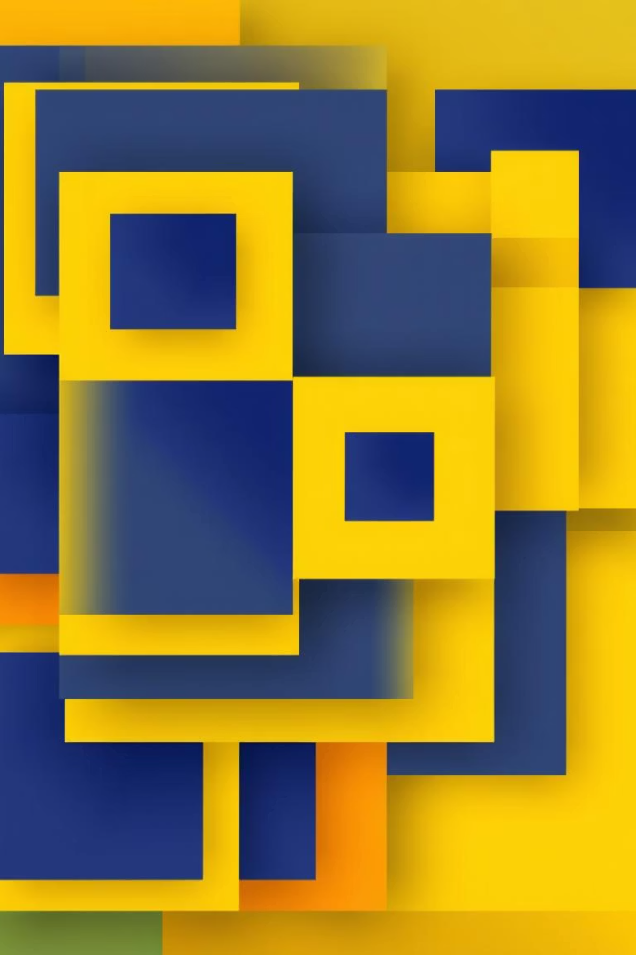
Combining Horizontal and Vertical Shear
1
Sequential Application
Applying both shears creates complex distortions.
2
Order Matters
Horizontal then vertical differs from vertical then horizontal.
3
Matrix Combination
Multiplying shear matrices forms final transformation.
4
Example
Applying shx=0.3 and shy=0.7 for combined effect.

Slide 6

Practical Applications of Image Shearing
Text Effects
Create slanted or italicized text styles.
Image Correction
Align images for registration and geometric fixes.
Artistic Effects
Produce creative distortions and visual effects.
Computer Vision
Correct geometric issues in vision applications.

Slide 7
Implementing Image Shearing
Libraries
Code Tips
Challenges
Use OpenCV, Pillow, or scikit-image for shearing.
Apply shear matrix with interpolation for smooth results.
Handle boundaries and avoid aliasing artifacts.

Slide 8
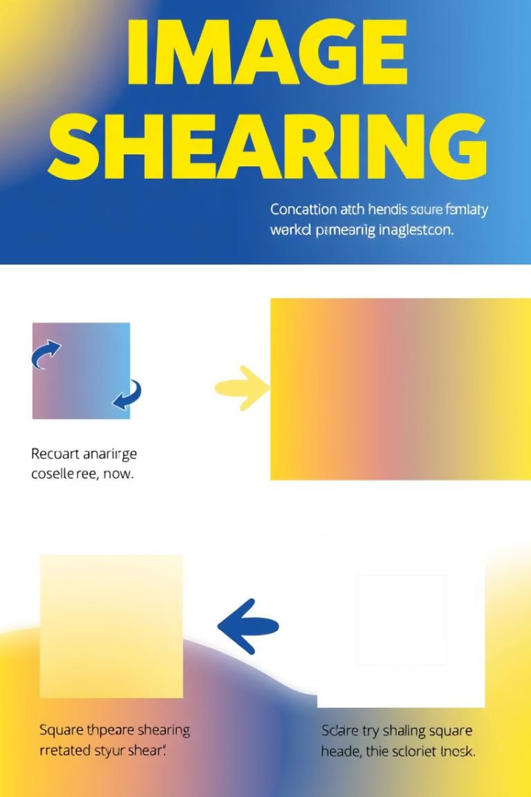
Summary and Next Steps
Key Takeaways
Shearing distorts images horizontally or vertically.
Further Study
Explore rotation and scaling transformations.
Resources
Check out tutorials, docs, and code examples.
Q&A
Open for your questions about shearing.

