Slide 1
CV5100 – MUDE Modeling, Uncertainty, and Data for Engineers Ch3 – Numerical Modelling
Course instructors:
Prof. Phanisri Pradeep Pratapa
Prof. Prakash Singh Badal
Prof. Sudheendra Herkal
Department of Civil Engineering
Indian Institute of Technology Madras
5 August 2025

Slide 2
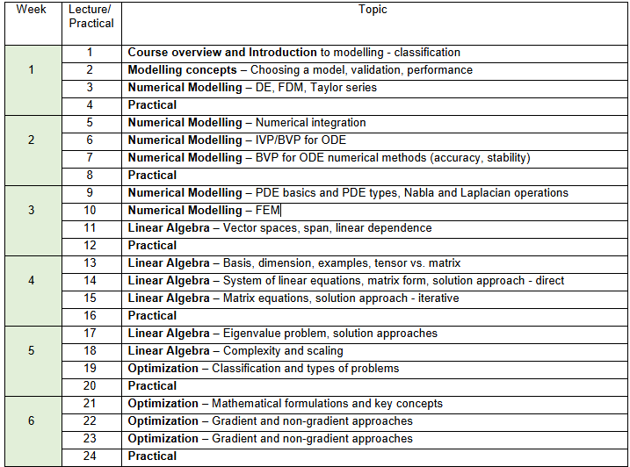
Numerical Modelling, Linear Algebra, Optimization

Slide 3
Outline
DEs in structural engineering
ODE types
Analytical vs. Numerical solutions
https://mude.citg.tudelft.nl/book/2024/modelling/overview.html

Slide 4
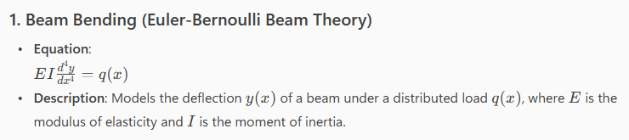
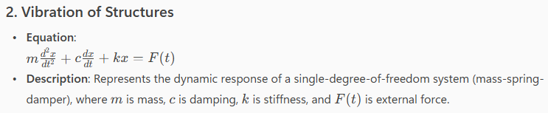
Differential Eqs in Struct Engg
DEs are mathematical models of a physical phenomenon
Examples:
Notes:
Need for computers…

Slide 5
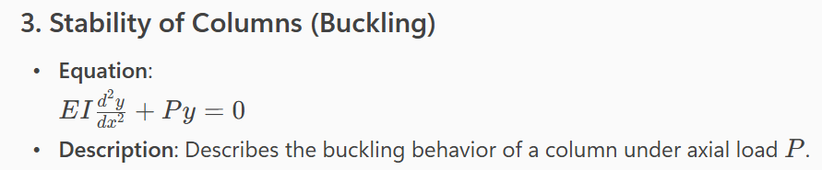
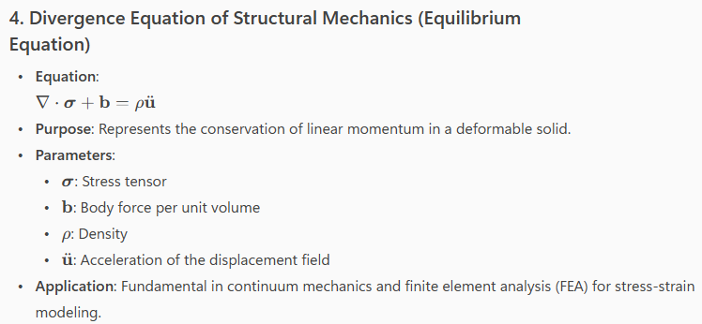
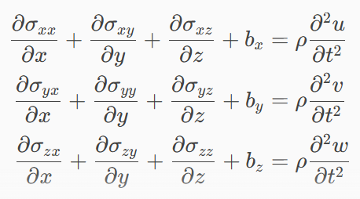
Differential Eqs in Struct Engg
DEs are mathematical models of a physical phenomenon
Examples:
Notes:
Need for computers…

Slide 6


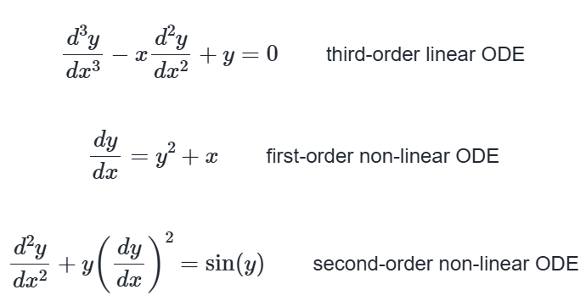
ODE vs. PDE
Identify and characterize the following DEs
Notes:
Need for computers…

Slide 7
Analytical vs. Numerical Solutions
Let us use the teachbook & live code
https://mude.citg.tudelft.nl/book/2024/numerical_methods/1-revision-of-concepts.html
Notes:
Need for computers…

