Slide 1
CV5100 – MUDE Modeling, Uncertainty, and Data for Engineers Ch2 – Modelling Concepts
Course instructors:
Prof. Phanisri Pradeep Pratapa
Prof. Prakash Singh Badal
Prof. Sudheendra Herkal
Department of Civil Engineering
Indian Institute of Technology Madras
30 July 2025

Slide 2
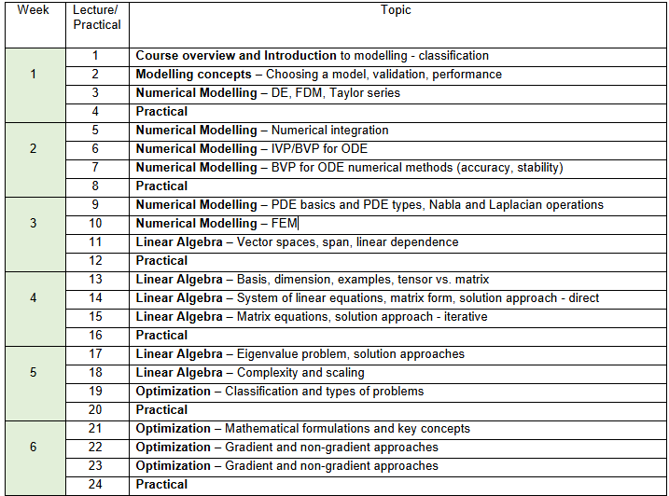
Numerical Modelling, Linear Algebra, Optimization

Slide 3
Outline
Model classification
Model decisions
Verificatio vs. Validation
Goodness of Fit (later..)
https://mude.citg.tudelft.nl/book/2024/modelling/overview.html

Slide 4
What is Modeling & Simulation?
Models: Used to understand/explain/predict something
Theoretical, Mathematical, Numerical, Computational, Statistical, Phenomenological, …
Simulation: Re-creating a system, (or) a process, (or) a phenomenon, (or) a problem by using a model.
e. g. A computer simulation of a car crash is based on the mathematical model that is used to represent the structural behavior of the chassis.
Ref: https://altairuniversity.com/wp-content/uploads/2017/07/modal_anim.gif
Notes:
https://altairuniversity.com/26269-learn-structural-analysis-with-optistruct/

Slide 5
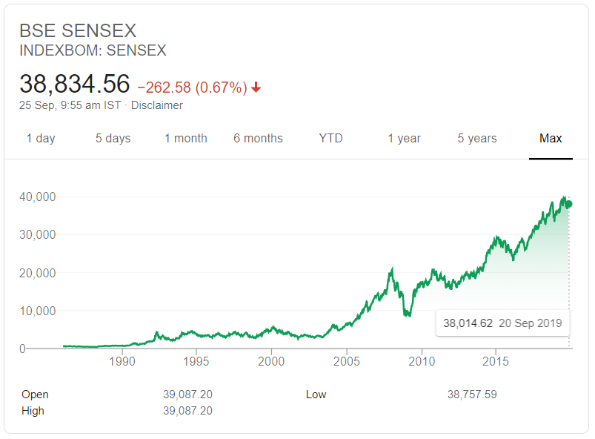
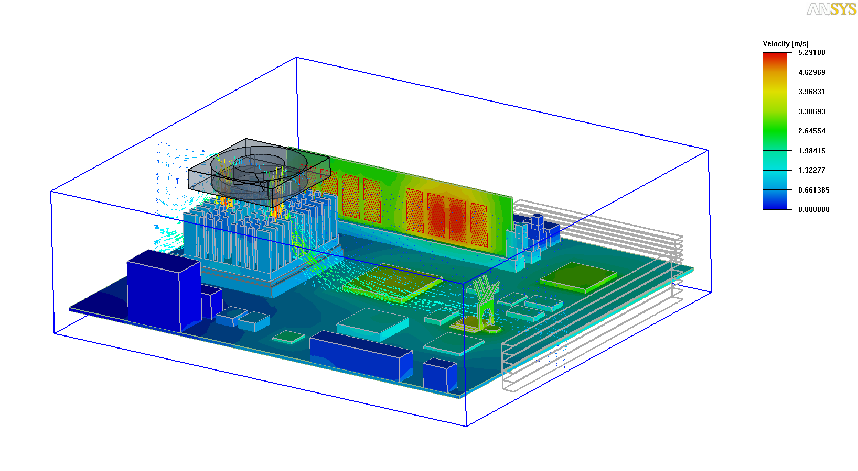
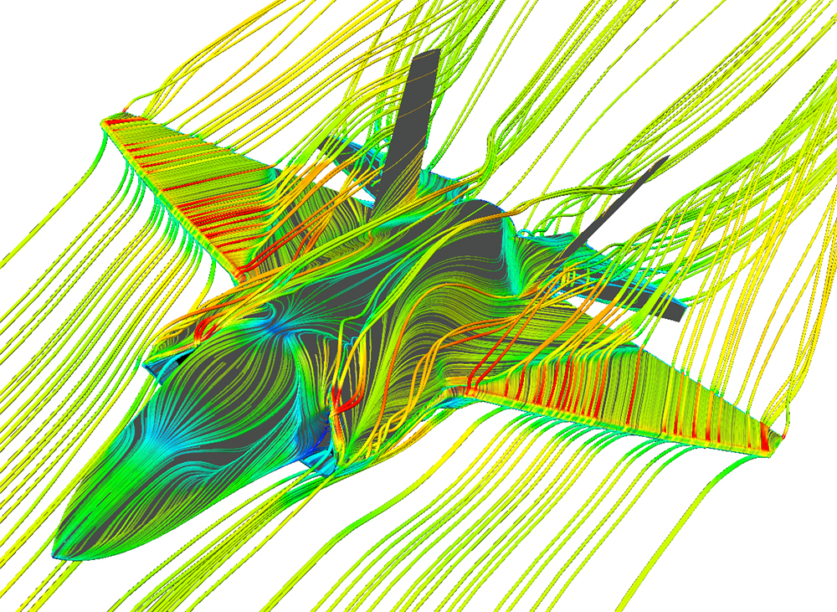
Examples of Modeling & Simulation
Weather forecast
Financial Engineering
Atomic/Molecular interactions
Thermal analysis
Fluid mechanics
Structural analysis
Ref: https://www.ansys.com/blog/5-factors-define-aerospace-and-defense-industry-trends
https://www.finiteelementanalysis.com.au/featured/dcir-analysis-of-pcb-in-ansys-siwave/

Slide 6

Model Classification
Conceptual Models – high level abstraction
e.g. Visual representation of a framework, graphical or causal loop diagrams
Mechanistic Models – first principle based, mathematical
e.g. Newton's laws, elastic spring model
Phenomenological Models - experimental observations + mathematical/mechanics
e.g. drag force formula using drag coefficient
Data-based – Only based on observed data
e.g. Forces on a wall due to waves
Notes:
Need for computers…

Slide 7
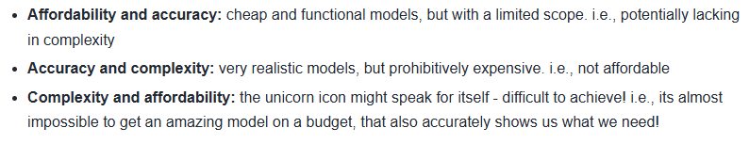
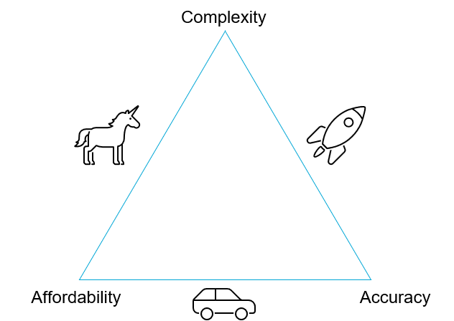
Model – Trade offs
Notes:
Need for computers…

Slide 8
Model decisions
Dynamic vs. Static models
Linear vs. Non-linear models
Time-invariant vs. Time-variant models
Deterministic vs. Stochastic models
Dynamic equilibrium equation
Superposition; Initial conditions
Life cycle behavior; Climate change; Temporary structures
Concrete cube strength; Steel elastic modulus; Dimension measurement
Notes:
Need for computers…

Slide 9
Verification vs. Validation
Verification is the process of checking whether the model is correctly implemented with respect to the original conceptual model. It should answer the question: Have we built the model right?
e.g. You want to model a truss structure. You model it as a 2D (plane) truss. Verify the accuracy. How? By checking for errors in calculations (or) using alternative methods to arrive at the same solution values, for the 2D truss that you modeled.
Validation is the process of testing the ability of the model in answering the research questions as best as possible. It should answer the question: Have we built the right model?
e.g. You want to model a truss structure. You realize that the structure needs a 3D model and the 2D model is not correct representation (for example, if you consider lateral restraint or buckling effects). This needs a fundamental change in the model so that you use the "right model".
Notes:
Need for computers…

Slide 10
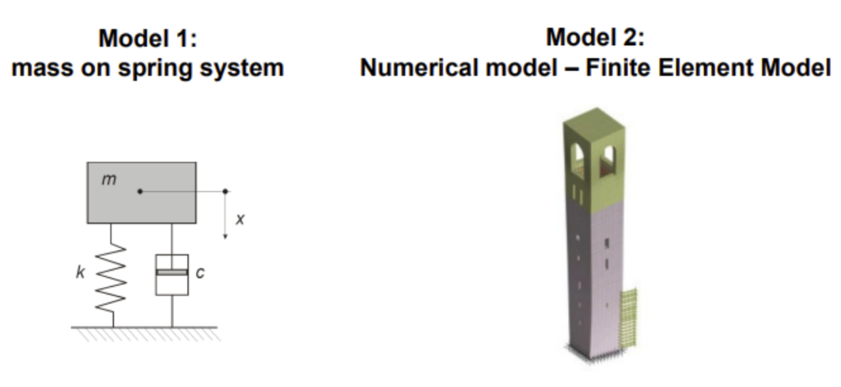
Which of the two models is valid?
Consider two models for some real structure.
Depends on the aspect of interest? (e.g. natural frequency, deformations)
Notes:
Need for computers…

