Slide 1
Advanced Banking
Analytics
and
Predictive Modeling
Arunkumar T

Slide 2
CONTENTS
Introduction
Problem Statement
Preprocessing
Regression Model
Classification Model
Clustering Based on Banking Behaviour
Insights

Slide 3
Utilized clustering techniques
K-means for targeted marketing based on customer banking behaviors. Developed a robust credit scoring model using k Neighbours classifier
to assess loan applicants' creditworthiness. Built regression model using Random Forest regressor to predict KPIs and enhance risk management for strategic planning and financial optimization.
INTRODUCTION

Slide 4
Problem Statement 1. The objective of this project is to leverage advanced data analytics techniques, including classification, regression, and clustering, to extract valuable insights and enhance decision-making processes within the banking sector.
2. The project aims to address various aspects of banking operations, such as customer segmentation, credit risk assessment, and performance prediction.
3. This project aims to demonstrate the power of advanced analytics in optimizing various facets of banking operations, ultimately contributing to the overall success and sustainability of the financial institution

Slide 5
1.Dataset has 1,00,000 rows and 28 columns. 2.some values are missing in 2 column continuously. 3.entire dataset is preprocessed including 1.treating missing values, 2.removing duplicate values, 3.Treating outlier, 4.Encoding categorical column, 5.scaling the dataset.
Preprocessing

Slide 6
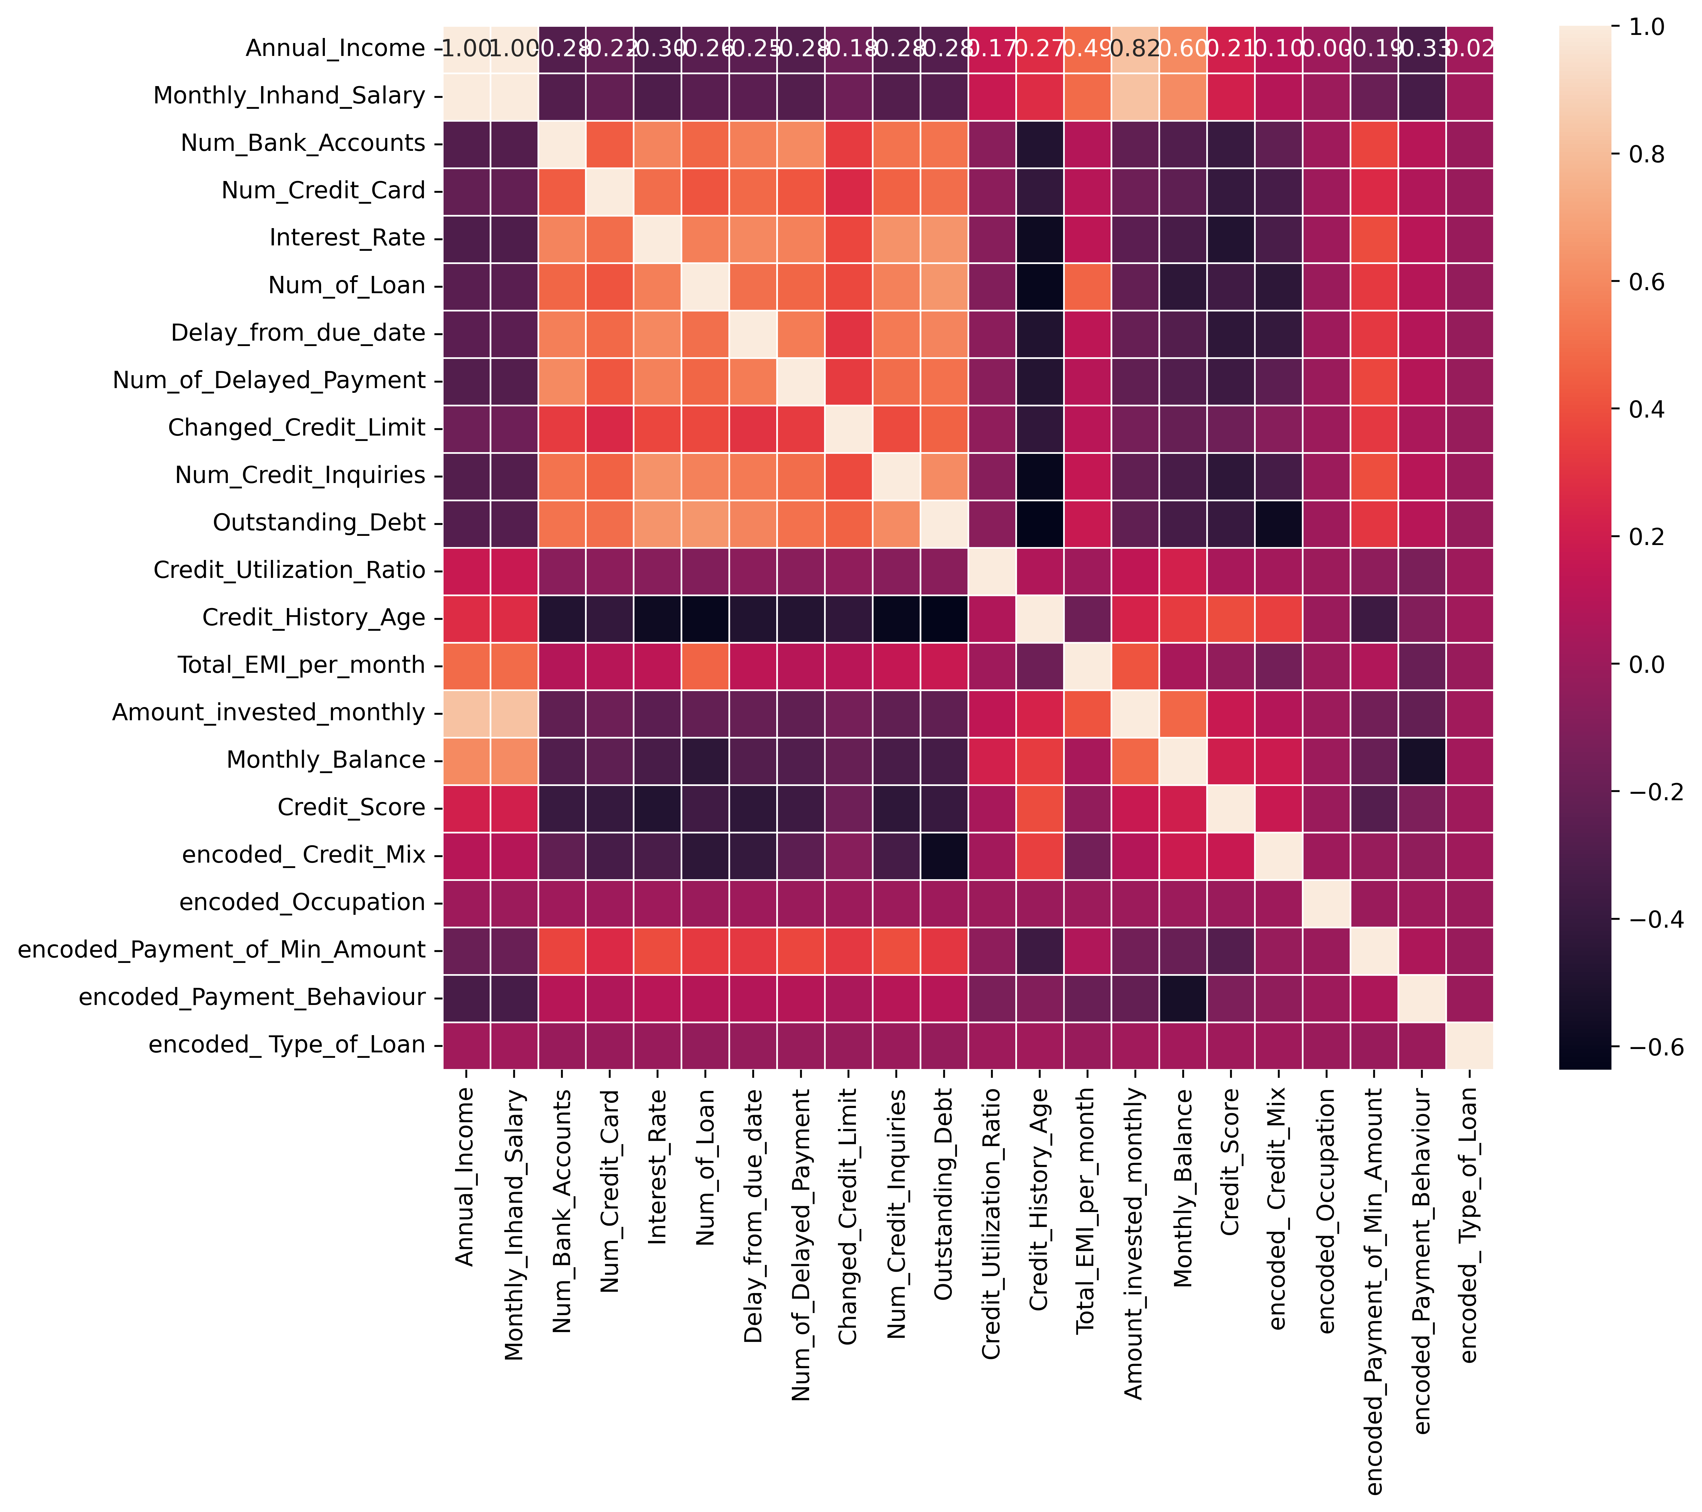
Co-relation

Slide 7
classification Model
Target column: Credit score
The aim of building this classification model is to prediction the credit score
Since the target column is categorical classification models are used.
Initially the data is split and trained with various classification models to select a model which provide maximum accuracy of prediction.
Model with maximum accuracy is used model for prediction

Slide 8
Performance Metrics
Model | Accuracy | Recall | Precision | F1-Score
Logistic Regression | 0.652263 | 0.670445 | 0.652263 | 0.657985
DecisionTree | 0.738906 | 0.738537 | 0.738906 | 0.738129
RandomForestClassifier | 0.741548 | 0.770197 | 0.741548 | 0.747222
GradientBoostingClassifier | 0.749127 | 0.764527 | 0.749127 | 0.752494
KNeighborsClassifier | 0.786458 | 0.785054 | 0.786458 | 0.785254

Slide 9
Credit Score Prediction
Annual Income: 300000
Monthly inhand Salary: 25000
Number of Bank Accounts:2
Number of Credit cards:2
Interest rate:6
Number of Loans:2
Average number of days delayed by the person:5
Number of delayed payments:5
credit limit:10
credit inquiries: 2
Outstanding Debt: 50000
Credit Mix (Bad: 0, Standard: 1, Good: 3) :1
Payment of Minimum Amount: 3000
Credit History Age: 2
monthly investment: 5000
Various payment behavior:['High_spent_Small_value_payments', 'Low_spent_Large_value_payments', 'Low_spent_Medium_value_payments', 'Low_spent_Small_value_payments', 'High_spent_Medium_value_payments', 'High_spent_Large_value_payments']
payment behavior: 2
Monthly Balance: 5000
Predicted Credit Score = ['Good']

Slide 10
Regression model
TARGET COLUMN: total Emi
THE AIM OF BUILDING THIS REGRESSION MODEL IS TO PREDICTION THE Total Emi.
SINCE THE TARGET COLUMN IS numerical REGRESSION MODELS ARE USED.
INITIALLY THE DATA IS SPLIT AND TRAINED WITH VARIOUS REGRESSION MODELS TO SELECT A MODEL WHICH PROVIDE MAXIMUM ACCURACY OF PREDICTION.
MODEL WITH MAXIMUM ACCURACY IS USED MODEL FOR PREDICTION

Slide 11
Performance Metrics
Model | Mean Absolute Error | Mean Square Error | R2 Score | Root Mean Square Error
DecisionTree Regressor | 4.072183 | 637.083318 | 0.925519 | 25.240509
RandomForest Regressor | 5.380453 | 349.282738 | 0.956658 | 18.689107
GradientBoosting Regressor | 18.913866 | 840.810510 | 0.852546 | 28.996733

Slide 12
Total Emi Prediction
Annual Income: 300000
Monthly inhand Salary: 25000
Number of Bank Accounts:2
Number of Credit cards:2
Interest rate:6
Number of Loans:2
Average number of days delayed by the person:5
Number of delayed payments:5
credit limit:10
credit inquiries: 2
Outstanding Debt: 50000
Credit Mix (Bad: 0, Standard: 1, Good: 3) :1
Payment of Minimum Amount: 3000
Credit History Age: 2
monthly investment: 5000
Various payment behavior:['High_spent_Small_value_payments', 'Low_spent_Large_value_payments', 'Low_spent_Medium_value_payments', 'Low_spent_Small_value_payments', 'High_spent_Medium_value_payments', 'High_spent_Large_value_payments']
payment behavior: 2
Monthly Balance: 5000
Credit Score(Bad: 0, Standard: 1, Good: 2) :1
Predicted Total EMI = [1119.92833114]

Slide 13
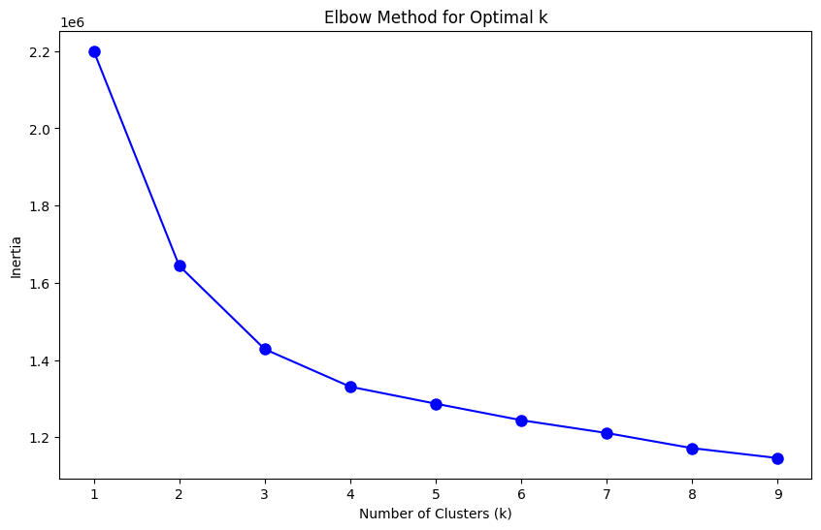
Clustering
With the given data the nominal way of clustering people based on behavior is found by using Elbow method
By the elbow method the nominal clustering should be 4
So the data is splitted into 4 clusters using K means Clustering

Slide 14
INSIGHTS
In the Classificarion model, training the data with various model is made.
Decision Tree classificier has 100% accuracy in train dataset but in testing dataset performs only 73%.
Reason: Over fitting the model.
Same in case for Regression model where R2 Score is 1 for training data in decision Tree.
But, What really matters, The model should perform well on test data with high performance metrics.
So, It decided to train model based on K Neighbors Classifier for classification problem.
It decided to train model based on RandomForest Regressor for Regression problem.
Based on trained models a Predictive Analysis made to prediction of Credit Score based in customers information.
Based on trained models a Predictive Analysis made to prediction of Total Emi based in customers information.

Slide 15
THANK YOU
Arunkumar T
Arun-kumarT (github.com)

