Slide 1
YouTube Data Harvesting and Warehousing using SQL and Streamlit .
Arunkumar T​

Slide 2


Agenda
Built a Streamlit Application
Able to Retrieve Youtube channel details.
Store the retrieved data into Mongodb.
Migrate data to MySQL.
Filter details using MySQL query.
A

Slide 3
Introduction
A simple Interactive Streamlit UI able to get the details of the Youtube channel of users choose and able to find answer to predetermined 10 Question about the channel of users choice.

Slide 4
Primary goals
Retriving Youtube data using API key

Slide 5
Stage I
Create a Youtube API Key from Youtube Documentation.
Using the generated Api Key , collect the data and store in a dictionary.
The aim of the project is to create four tables.
Channel related details.
Videos related details.
Playlist related details.
Comments related details

Slide 6
Stage II
Retrieved data get inserted into MongoDB

Slide 7
Stage II
Making connection with MongoDB with python program.
Then store data into database.
Then making connection with MySQL.
Insert the data from MongoDB into a MySQL table.
Then Querying in MySQL to obtain the required details about the database.

Slide 8
SQL Query Output need to displayed as table in Streamlit Application
1.What are the names of all the videos and their corresponding channels?
2. Which channels have the most number of videos, and how many videos do they have?
3. What are the top 10 most viewed videos and their respective channels?
4. How many comments were made on each video, and what are their corresponding video names?
5. Which videos have the highest number of likes, and what are their corresponding channel names?
6. What is the total number of likes and dislikes for each video, and what are their corresponding video names?
7. What is the total number of views for each channel, and what are their corresponding channel names? 8. What are the names of all the channels that have published videos in the year 2022?
9. What is the average duration of all videos in each channel, and what are their corresponding channel names?
10.Which videos have the highest number of comments, and what are their corresponding channel names?

Slide 9
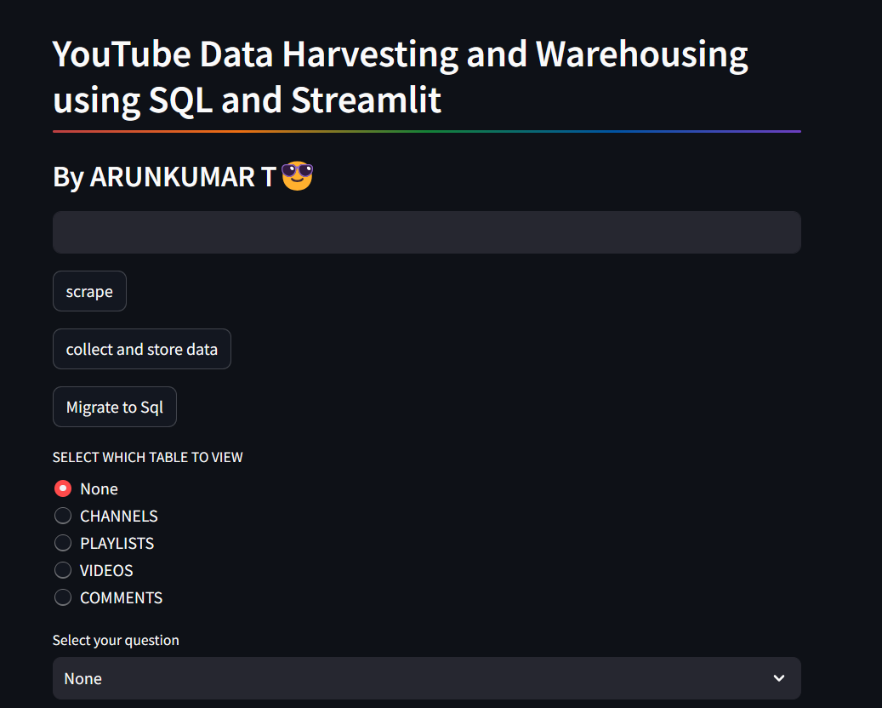
Areas of focus
F
Use Sreamlit to create a User Friendly UI.

Slide 10
Take away from the project
T
Get to know about basic working of api, here ability to gain access to obtain data from youtube.
Error Handling is important take away .
Throughout the project time period , I handled many error.
Ability to understand error and logical thinking to resolve the error.
From day 1- losing patience to remove error
To able to resolve error by myself in a matter of small time being.
Able to utilize knowledge from class in python code, Mongodb & MySQL.
Able to acquire new skill of creating a simple interactive UI using Streamlit.

Slide 11
Thank you
Arunkumar T
Arun-kumarT/Youtube-project: YouTube Data Harvesting and Warehousing using SQL and Streamlit (github.com)

