Slide 1
YouTube Data Harvesting and Warehousing using SQL and Streamlit .
Arunkumar T​

Slide 2


Agenda
Built a Streamlit Application
Able to Retrieve Youtube channel details.
Store the retrieved data into Mongodb.
Migrate data to MySQL.
Filter details using MySQL query.
A

Slide 3
Introduction
A project on collecting Youtube channel details with all basic informations. Then storing data into Mongodb and migrating data into MySQL database. My Querying in MySQL able to view required data.

Slide 4
Primary goals
Retriving Youtube data using API key

Slide 5
Stage I
Create a Youtube API Key from Youtube Documentation.
Using the generated Api Key , collect the data and store in a dictionary.
The aim of the project is to create four tables.
Channel related details.
Videos related details.
Playlist related details.
Comments related details

Slide 6
Stage II
Retrieved data get inserted into MongoDB

Slide 7
Stage II
Making connection with MongoDB with python program.
Then store data into database.
Then making connection with MySQL.
Insert the data from MongoDB into a MySQL table.
Then Querying in MySQL to obtain the required details about the database.

Slide 8
SQL Query Output need to displayed as table in Streamlit Application
What are the names of all the videos and their corresponding channels?
2. Which channels have the most number of videos, and how many videos do they have?
3. What are the top 10 most viewed videos and their respective channels?
4. How many comments were made on each video, and what are their corresponding video names?
5. Which videos have the highest number of likes, and what are their corresponding channel names?
6. What is the total number of likes and dislikes for each video, and what are their corresponding video names?
7. What is the total number of views for each channel, and what are their corresponding channel names? 8. What are the names of all the channels that have published videos in the year 2022?
9. What is the average duration of all videos in each channel, and what are their corresponding channel names?
10.Which videos have the highest number of comments, and what are their corresponding channel names?

Slide 9
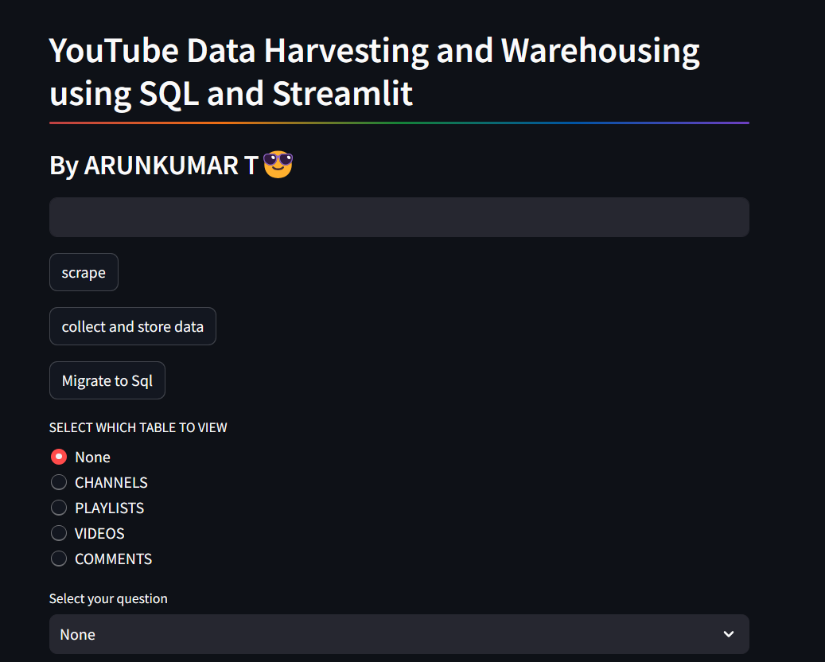
Areas of focus
F
Use Sreamlit to create a User Friendly UI.

Slide 10
Thank you
Arunkumar T
www.contoso.com

