Slide 1

A Presentation on Internship Work “WEB DEVELOPMENT”
PRESENTED BY | EXTERNAL GUIDE | INTERNAL GUIDE
NAME: Arun Reddy USN: 1MJ21CD006 | NAME: Mr. Eshwar Rao DESIGNATION: HR Manager ORGANIZATION: CODSOFT | NAME: Bharini prabhakar DESIGNATION: Assistance Prof ORGANIZATION: MVJCE
Approved by AICTE |Affiliated to VTU | Recognized by UGC with 2(f) & 12(B) status |Accredited by NBA and NAAC

Slide 2
Contents
About the Organization
About the Department
Task Performed
Reflection Notes
Conclusion
Reference
Approved by AICTE |Affiliated to VTU | Recognized by UGC with 2(f) & 12(B) status |Accredited by NBA and NAAC

Slide 3

About the Organization
cOdsoft
It sounds like CODSOFT has established itself as a prominent player in the web design and development industry, offering comprehensive solutions to clients worldwide. Your emphasis on conversion-based web design and lead-generating marketing strategies reflects a keen understanding of what it takes to succeed in the digital landscape. Your commitment to delivering high-quality solutions and services through a dedicated and qualified team is commendable. Having a strong infrastructure and a skilled team in place is crucial for ensuring timely delivery and maintaining client satisfaction. It's also impressive that you've been in the industry since 2012, showcasing your experience and expertise in providing web-based solutions to a diverse range of clients, from small to large enterprises. Continuing to focus on innovation and dependability will undoubtedly help CODSOFT maintain its position as a leader in the field. Your dedication to exceeding clients' expectations and providing quality support further reinforces your commitment to client satisfaction.
Approved by AICTE |Affiliated to VTU | Recognized by UGC with 2(f) & 12(B) status |Accredited by NBA and NAAC

Slide 4
About the Department
As a Web developer at CodSoft , I gained valuable hands-on experience in building and maintaining websites. I honed my skills in front-end technologies like HTML, CSS, and JavaScript, learning to create visually appealing and responsive interfaces. I also had the opportunity to work with frameworks such as React and Angular, applying them to develop dynamic web applications. Throughout my internship, I focused on optimizing website performance and ensuring compatibility across different browsers and devices. This experience laid a strong foundation for my career in web development, equipping me with practical knowledge and problem-solving abilities essential in this fast-paced industry. This internship experience not only sharpened my technical skills but also fostered my ability to work in a team-oriented environment and deliver high-quality solutions under deadlines.
Approved by AICTE |Affiliated to VTU | Recognized by UGC with 2(f) & 12(B) status |Accredited by NBA and NAAC

Slide 5
Task Performed
Internship Experience
Web Development intern
Duration:
1 Month
Technologies Used:
HTML, JavaScript, PHP, MySQL
PROJECT:
Calculator: A calculator is a fundamental tool for performing arithmetic operations. Building a calculator project is a common exercise for learning programming concepts and is a great way to get hands-on experience with user interface design, logic implementation, and handling user inputs. Building a calculator is a great project to understand the basics of programming, UI design, and event handling. It provides a foundation to build more complex applications in the future.
Approved by AICTE |Affiliated to VTU | Recognized by UGC with 2(f) & 12(B) status |Accredited by NBA and NAAC

Slide 6
Task Performed
Landing page: A landing page is a standalone web page created specifically for marketing or advertising campaigns. It's where visitors land after clicking on a link from an email, social media post, or advertisement. The main purpose of a landing page is to convert visitors into leads or customers by encouraging them to take a specific action, such as signing up for a newsletter, downloading an e-book, or making a purchase.
IMPLEMENTATION:
Project setup:
Create Project Directory: Organize your project files in a directory structure.
Initialize Version Control: (Optional) Use Git for version control.
HTML Structure:
Create index.html File: Set up the HTML file to define the calculator's structure.
Include elements such as a display screen and buttons for digits and operations.
Reference external CSS and JavaScript files.

Slide 7
Task Performed
JavaScript Logic:
Initialize variables for managing inputs and calculations.
Update the display based on interactions.
Testing:
Open the project in a browser.
Test each function and edge cases.
Ensure all buttons and operations work as expected.
Optimization:
Clean and organize the code.
Add comments for clarity.
Validate and ensure responsiveness.

Slide 8
Reflection Notes
Learning Experience:
During my internship in web development, I gained valuable hands-on experience in building and maintaining websites. I honed my skills in front-end technologies like HTML, CSS, and JavaScript, learning to create visually appealing and responsive interfaces. I also had the opportunity to work with frameworks such as React and Angular, applying them to develop dynamic web applications.
Front-End Development:Mastered the use of HTML and JavaScript to create interactive and user-friendly web interfaces.Gained experience in implementing responsive design principles to ensure the platform is accessible on various devices. Back-End Development:Learned to build robust and scalable server-side applications using PHP.Developed APIs to facilitate seamless communication between the front-end and back-end components of the application.Database Management:Acquired skills in managing and querying databases using MySQL.Implemented efficient data storage and retrieval mechanisms to support the platform’s functionality.
Approved by AICTE |Affiliated to VTU | Recognized by UGC with 2(f) & 12(B) status |Accredited by NBA and NAAC

Slide 9
Reflection Notes
Version Control:Gained proficiency in using Git for version control, enabling collaborative development and efficient project management.
Problem-Solving: Enhanced my problem-solving skills by tackling various technical challenges during the project.Team Collaboration: Improved my ability to work effectively in a team, collaborating with other developers to achieve project goals.Time Management: Developed better time management skills, balancing multiple tasks and meeting project deadlines.
Approved by AICTE |Affiliated to VTU | Recognized by UGC with 2(f) & 12(B) status |Accredited by NBA and NAAC

Slide 10
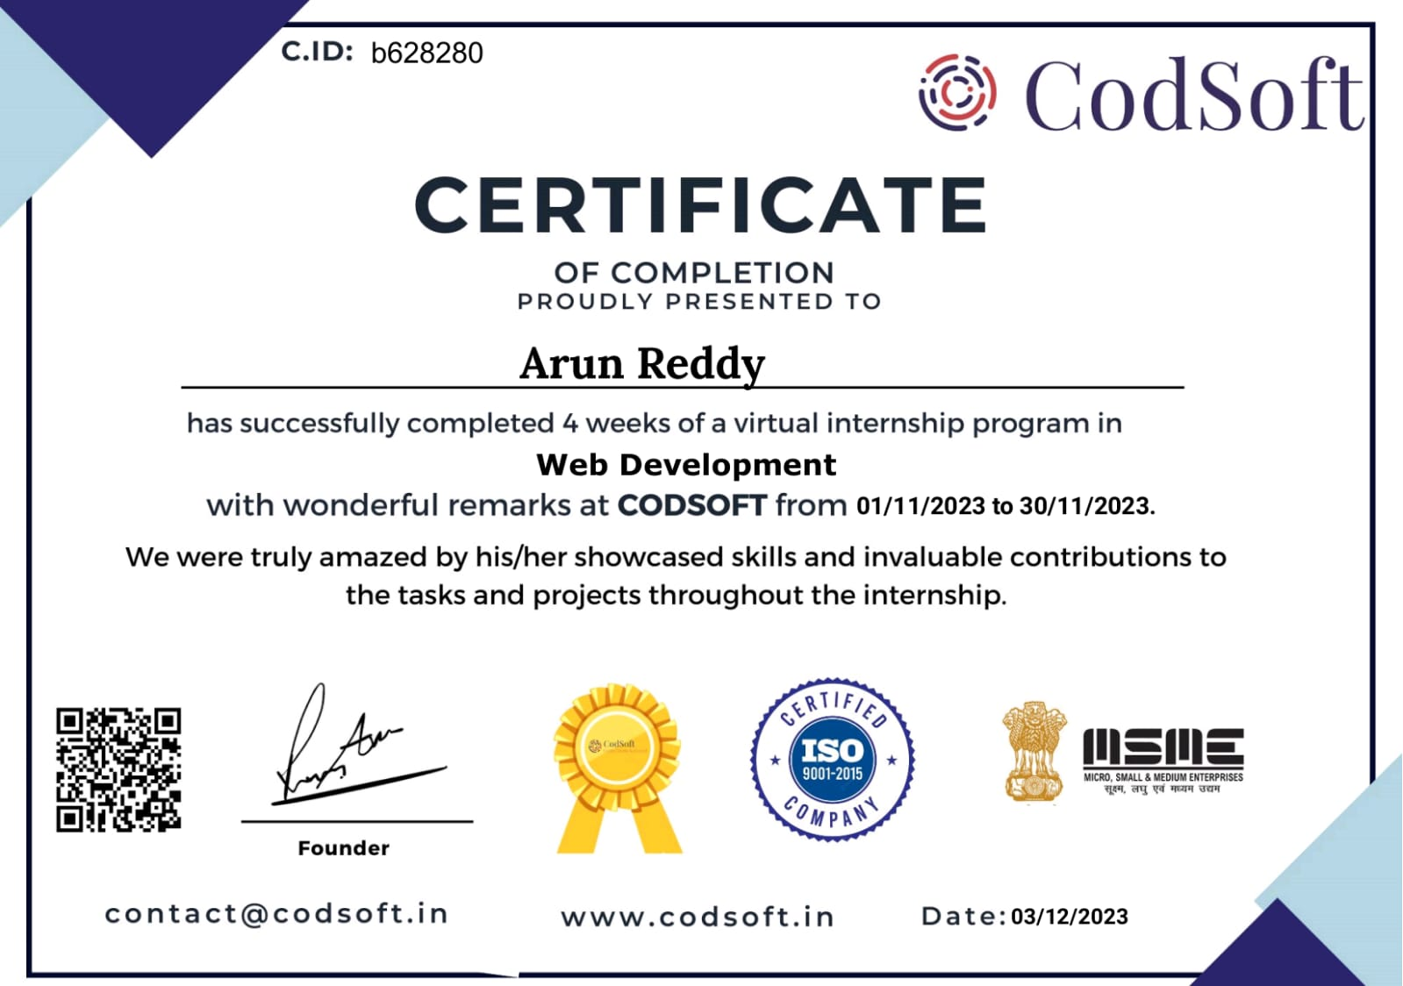
Certificate
Approved by AICTE |Affiliated to VTU | Recognized by UGC with 2(f) & 12(B) status |Accredited by NBA and NAAC

Slide 11
Conclusion
The development and implementation of the web development project at CODSOFT represent a significant milestone in the organization's commitment to leveraging data analytics for informed decision-making in healthcare management. Through the utilization of Tableau, a powerful data visualization tool, the project has successfully delivered a sophisticated platform that provides actionable insights into hospital readmission rates and occupancy levels. The Medical Dashboard serves as a vital tool for healthcare professionals at CODSOFT, offering a comprehensive view of patient readmission trends and hospital bed utilization. By harnessing advanced data visualization techniques and interactive features, the dashboard empowers users to optimize patient care and operational efficiency effectively. Despite the challenges and limitations inherent in dashboard development and implementation, such as cost considerations and learning curves, the benefits of the Medical Dashboard far outweigh the drawbacks. Its visual representation of complex healthcare data, user-friendly interface, and real-time updates ensure that healthcare professionals have access to timely and relevant information to make informed decisions. Looking ahead, CODSOFT remains committed to continuous improvement and innovation in healthcare analytics. Future iterations of the Medical Dashboard will focus on enhancing performance, expanding functionality, and integrating additional analytical tools to further empower healthcare professionals and drive positive outcomes for patients and the organization as a whole.

Slide 12
Reference
Websites:
www.codsoft.in
www.dynamicdrive.com
www.w3schools.com
Github link:
prgs/intership at main · Arun-reddy22/prgs (github.com)

