Slide 1

Banking AI Agent using Livekit
Design and Cost
The Presentation explains the Banking AI Assistant overall architecture, design and cost

Slide 2
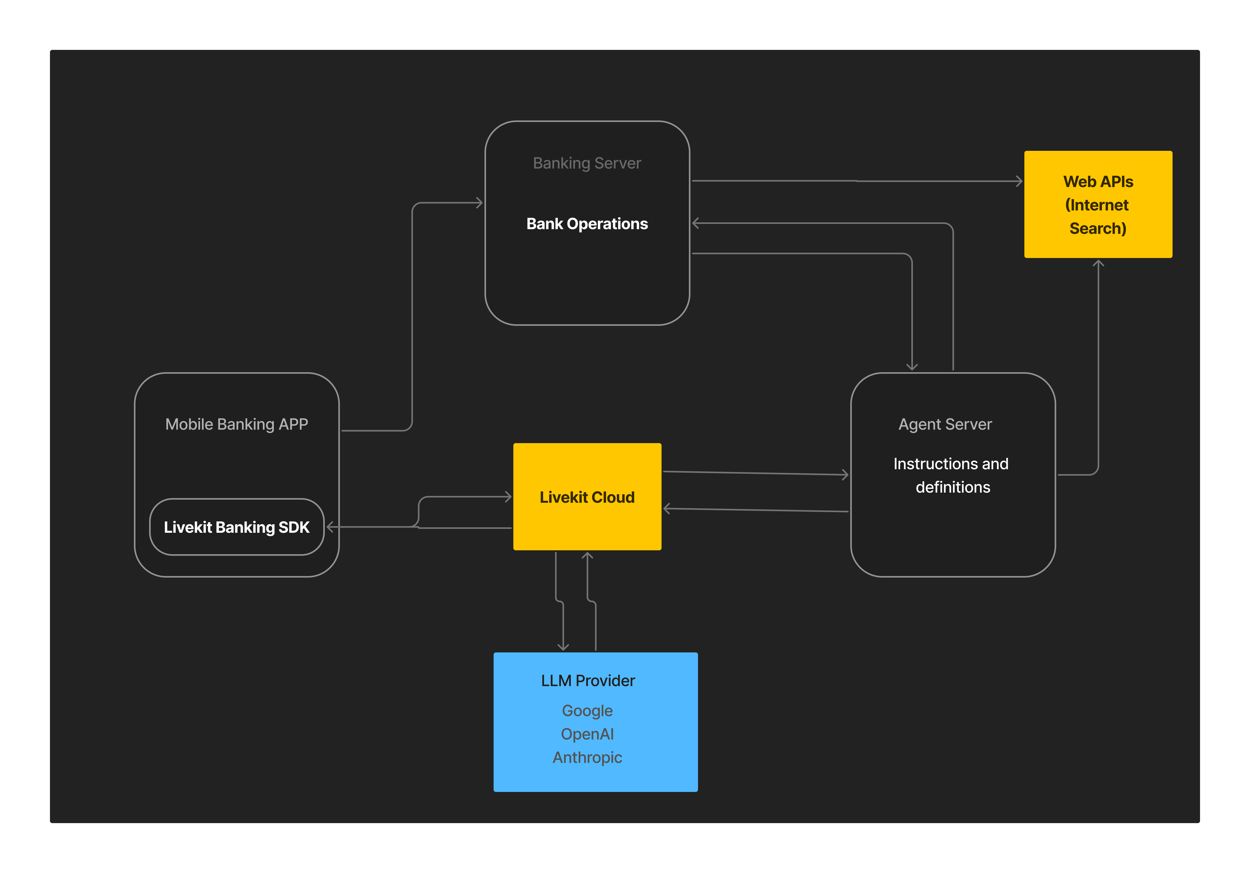
System Block Diagram

Slide 3
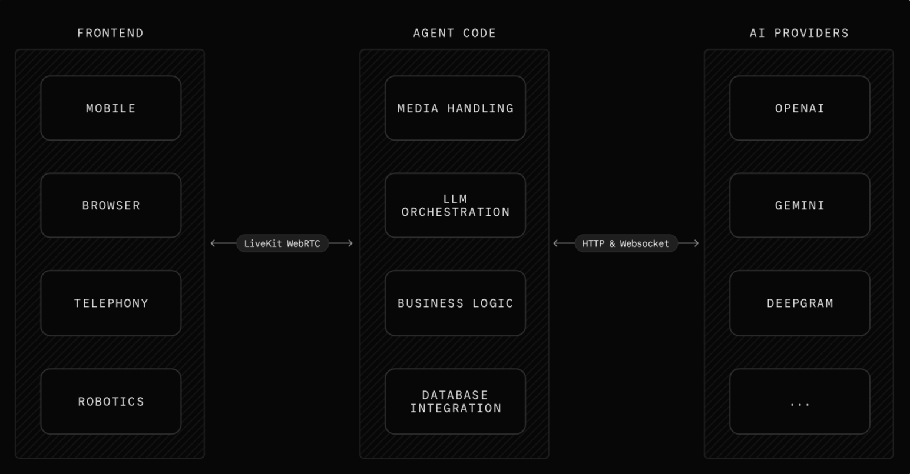
Framework Diagram

Slide 4
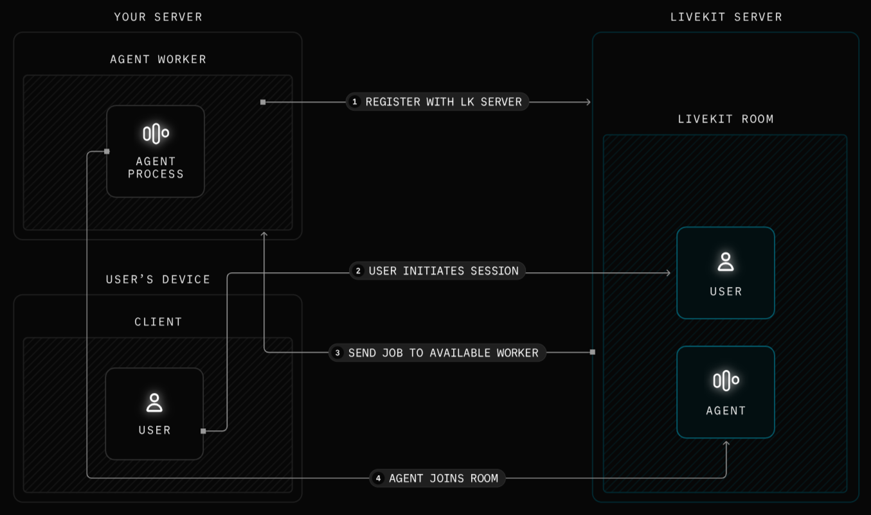
Agent Workflow

Slide 5
Monthly Cost Calculations
🧮 Assumptions:
Per user per month
Usage to Token
The Calculations assume an user uses total 30 mins of model usage per day.
• Usage: 30 minutes/day × 30 days = 900 minutes/month
• Token Rate: 3,000 tokens/minute → 2.7M tokens input + 2.7M output
Product | Input cost | Output cost | Caching cost | Total cost/user/month
Gemini 2.0 Flash | 2.7M × $0.70 = $1.89 | 2.7M × $0.40 = $1.08 | 5.4M × $0.175 = $0.95 | $3.92
OpenAI Realltime | 2.7M × $10 = $27.00 | 2.7M × $20 = $54.00 | Text Input/Output: $8.10, Caching: $1.62 | $90.72
OpenAI GPT-4o-mini | Text: $2.03, STT: $5.40, TTS: $33.02 |  |  | $40.45

