Slide 1
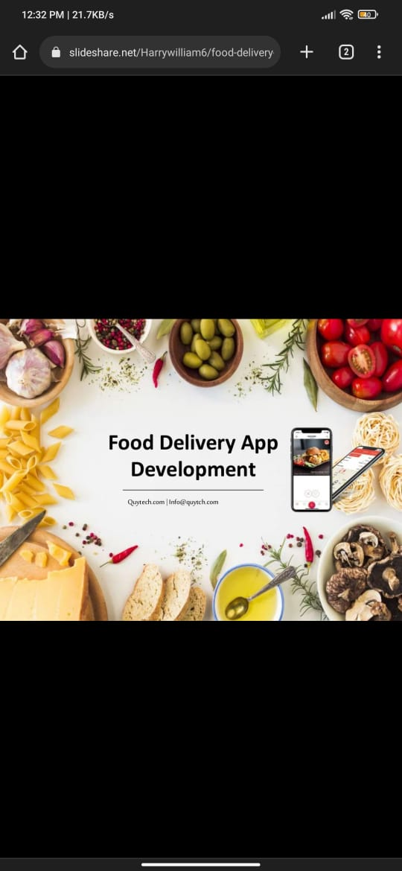

Slide 2
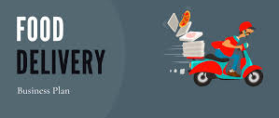
NAME:Arunkumar Nalluri Registration NO:192111419 Course Name AND Code: CSA3723 =Software Testing and testing design

Slide 3
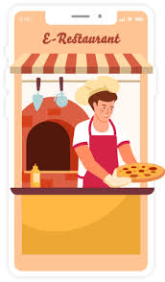
Table of contents:---
Introduction
Aim
Examples
About App --ZOMATO
How to use
Test cases
Positive AND Negative
Test scenario
Benefits
Payment Method
Conclusion

Slide 4

Introduction:---
Online food ordering is the process of ordering food, for delivery or pickup, from a website or other application. The product can be either ready-to-eat food (e.g., direct from a home-kitchen, restaurant, or a ghost kitchen) or food that has not been specially prepared for direct consumption (e.g., vegetables direct from a farm/garden, fruits, frozen meats. etc).

Slide 5
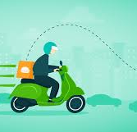
Aim:--- To check FOOD DELIVERY APPLICATION in Payment method AND Order details…

Slide 6
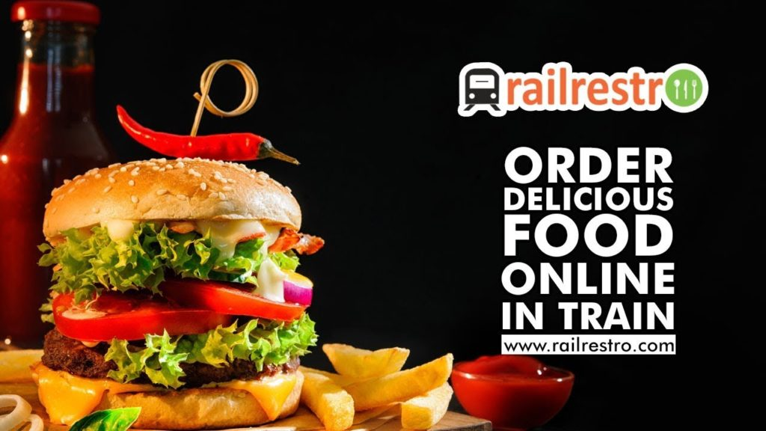
EXAMPLES:---- Zomato Swiggy Foodpanda Fassos Uber Eats……
This Photo by Unknown Author is licensed under CC BY-SA-NC

Slide 7
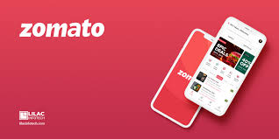
ZOMATO:------
Zomato (/zoʊmɑːtoʊ/) is an Indian multinational restaurant aggregator and food delivery company founded by Deepinder Goyal and Pankaj Chaddah in 2008.^{[4][5]} Zomato provides information, menus and user-reviews of restaurants as well as food delivery options from partner restaurants in select cities.^{[6]} As of 2019, the service is available in 24 countries and in more than 10,000 cities.[

Slide 8
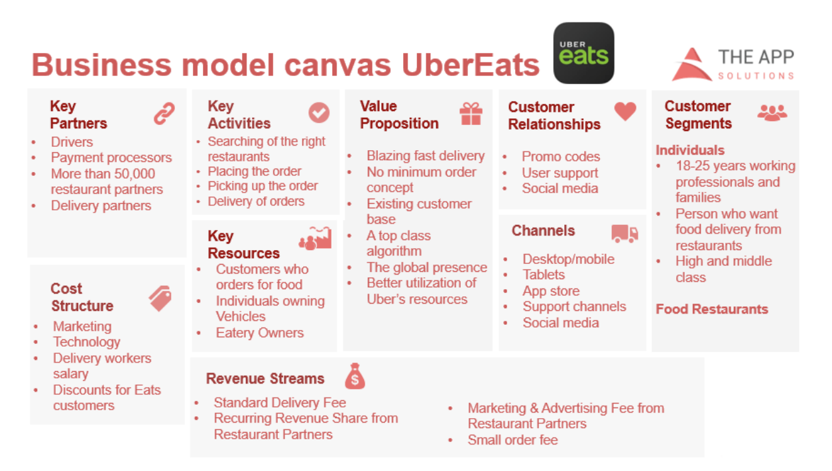
How to USE:-----
Track Food Delivery Industry Trends. ...
Choose Food Delivery Model. ...
Research target market. ...
Choose the main features of UberEats-like food delivery services. ...
Select the Technology Stack of Food Delivery App Development.

Slide 9
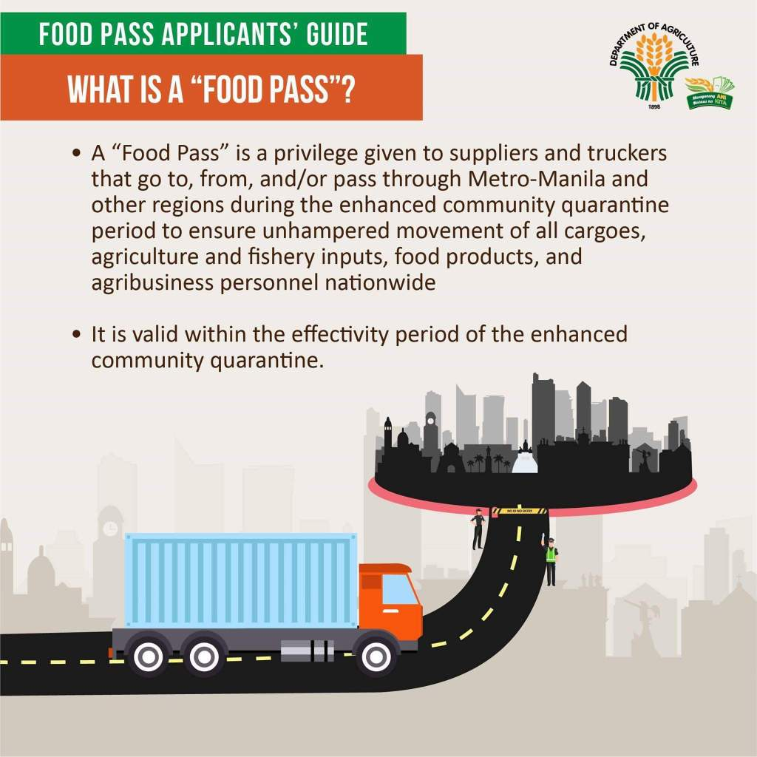
Test Cases:------
Positive Cases:-----
Verify users can log in to a Zomato account using a mobile number.
Verify users can log in via different options such as email and password, Facebook, or Google sign-in.
Verify users can create an account username and email.
Verify users can choose delivery locations upon successful registration.
Verify authentication is performed correctly when OTP is sent to the customer.
This Photo by Unknown Author is licensed under CC BY-ND

Slide 10
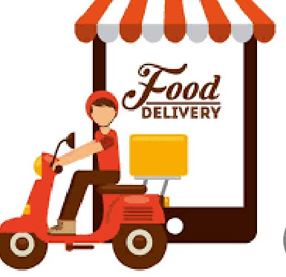
Negative:-----
Validation that billing discounts should be displayed on the home page.
Validation that past orders should be shown on the home page for quick delivery.
Validation that restaurants should be shown on the home page as per distance from the delivery location.
Validation that the right delivery location should be shown.
Validation that the filter and sort options should be provided on the home page. Filters options such as Cuisines and rating should be shown. Sorting of restaurants should be done as per sort criteria such as rating, delivery time, cost.
Validation that history and donate options should be shown on the home page.
This Photo by Unknown Author is licensed under CC BY-SA-NC

Slide 11
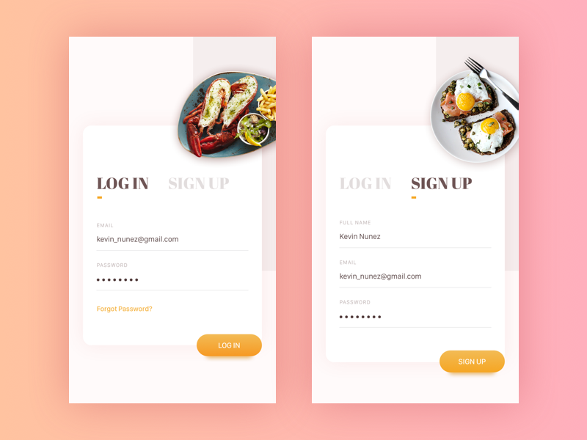
Test scenario:----
Functional testing includes various use cases such as:----
Installing and updating of food delivery application,
All fields and functionalities should work as per requirements,
The behaviour of the application when there is a new message or phone call
Behaviour of the application when there is a lack of internet
Verification of error messages when something is wrong with food delivery application
Verification that the application should not consume too much memory and space, etc.

Slide 12
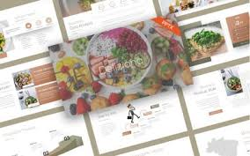
Benefits:-----
Ordering process is easy.
Exposure to new customers.
Online ordering is convenient.
More business opportunities.
Stay ahead of the competition.
Greater reach.
Better customer data…….

Slide 13
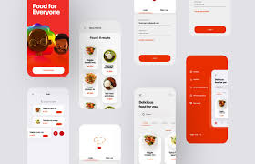
Payment Method:------
Restaurant search and discovery platform Zomato announced its partnership with Paytm on Friday, which would let users pay for their online orders using the Paytm Wallet, in addition to the existing payment options of credit/ debit cards, netbanking, and cash on delivery.

Slide 14
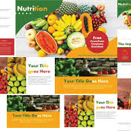
Conclusion:-----
Zomato’s digital marketing strategy is not only successful but also paves the way for other startups. While doing Zomato case study, we found that, It proves that digital marketing can contribute to a brand’s success and make it auniquename to reckon with. The company spends a fraction of traditional marketing budget on digital marketingand manages to resonate with billions of people out there.
While its digital marketing strategy and approach may change with time and situations, the company’s firm grasp on fundamentals and crystal-clear approach makes it easier to gain traction and customers’ attention.

Slide 15


