Slide 1

TEAM : PANTHERS
IDEA TITLE : TRAIN COLLISION AVOIDANCE SYSTEM
BY
ARUNACHALAM.R & PRITHIVI.K
III.BSC.IT

Slide 2
Introduction:
The train collision avoidance system is designed to prevent accidents and improve safety in railway operations.
It uses advanced technology and sensors to detect potential collisions and automatically apply emergency brakes to avoid accidents.
Benefits of the System:
Enhanced safety for passengers, crew members, and railway staff.
Reduction in train accidents and collisions, leading to fewer injuries and fatalities.
Improved efficiency and reliability of train operations.
Minimized disruptions and delays in train schedules.
Cost savings by preventing damage to trains and infrastructure.

Slide 3
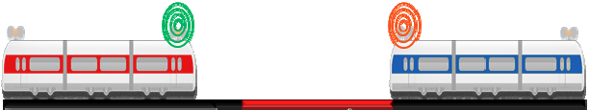


PROPOSED SYSTEM:
This TCAS (Train Collision Avoidance System) is used to detect train’s activity and prevent collision between trains or objects
RFID(Radio Frequency id) tags
are placed in trains and RFID
reader placed in railway tracks with unique id number respectively to
If both train enters the same track in opposite or one after other manner, this is found using the RFID technology. This scenario can be prevented by activating the emergency break.
track the activity of trains.

Slide 4
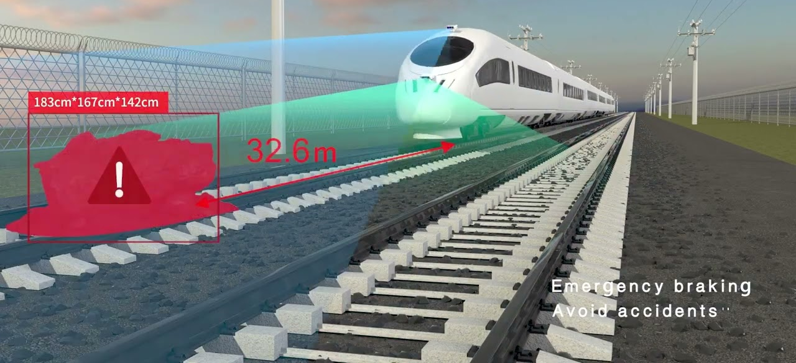
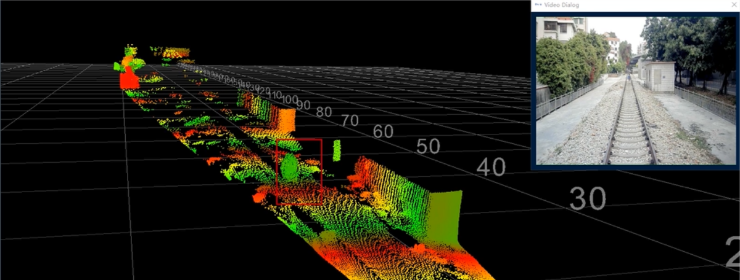
Laser and LiDAR sensors are set in front side of train used to detect, measure the obstacle distance and height.
Here a threshold distance is set, once the object distance is on or below the threshold value emergency is applied.

Slide 5
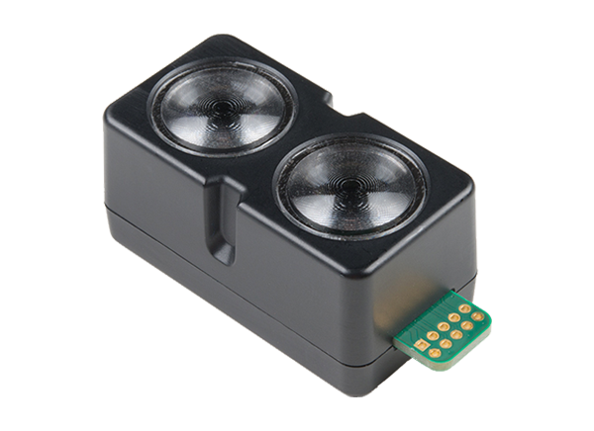
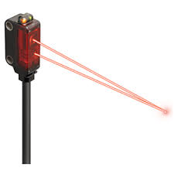

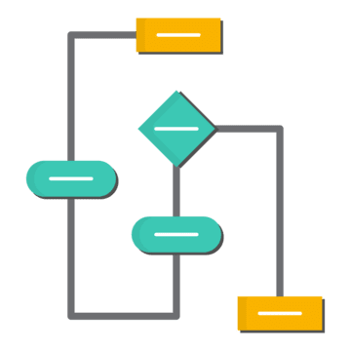
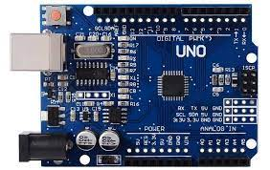
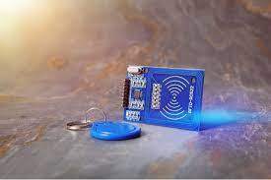
TECHNOLOGY STACK:
LiDAR Sensor
Laser Sensor
Arduino IDE
Arduino Uno
RF-id Tag
Algorithms

Slide 6
BLOCK DIAGRAM:
Micro Controller
RFID Transmitter
Sensor
RFID Reader
Actuators
Control Room
Break
Transceiver
Message

Slide 7
THANK YOU

