Slide 1

DATA ANALYSIS ON
AMCAT ANALYSIS
By : Arun Kumar Vollala

Slide 2
PROBLEM STATEMENT:
Analyze AMCAT test data to identify candidate performance trends, pinpoint strengths and weaknesses, and explore correlations with job success. Optimize the use of AMCAT scores in the hiring process for more effective candidate selection.
OBJECTIVE OF THE PROJECT:
Analyze AMCAT test data to identify candidate performance trends, pinpoint strengths and weaknesses, and explore correlations with job success. Optimize the use of AMCAT scores in the hiring process for more effective candidate selection.

Slide 3
KEY TASKS:
Data Collection
Data Cleaning
Descriptive Statistics
Data Analysis
Conclusion

Slide 4








LIBRARIES USED:
NumPy
Pandas
Beautiful Soup
Request
Matplotlib
RegEx
Seaborn

Slide 5
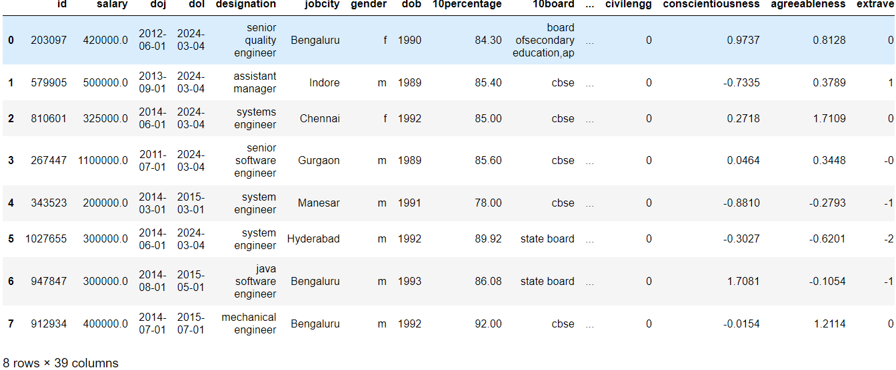
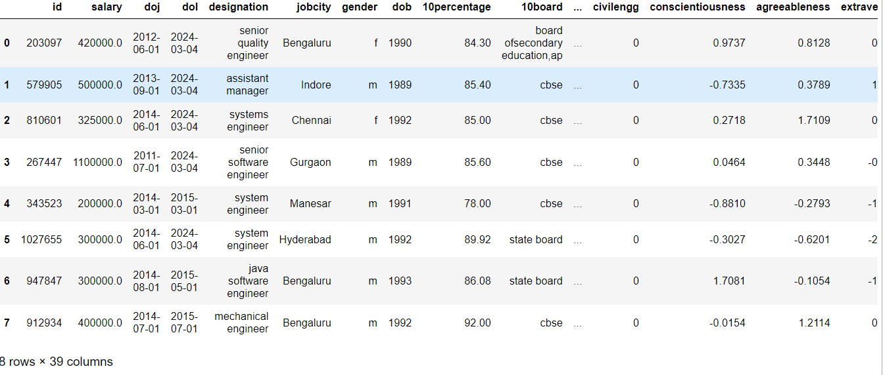
RAW DATA:
CLEAN DATA:

Slide 6
DATA CLEANING STEPS:
Identify the duplicate values and dropping the duplicate values
Checking for the missing values
Filling or dropping the missing values
Replacing the special characters and structural error with empty string
Data type conversion

Slide 7
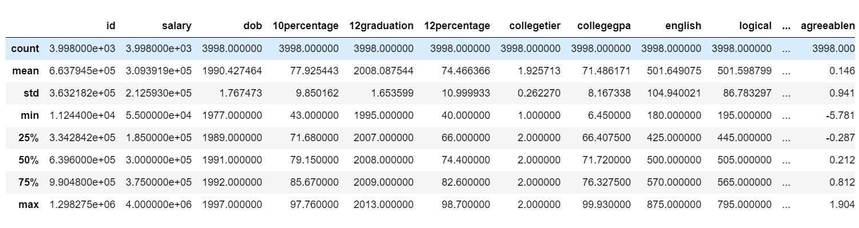
STATISTICAL ANALYSIS:

Slide 8
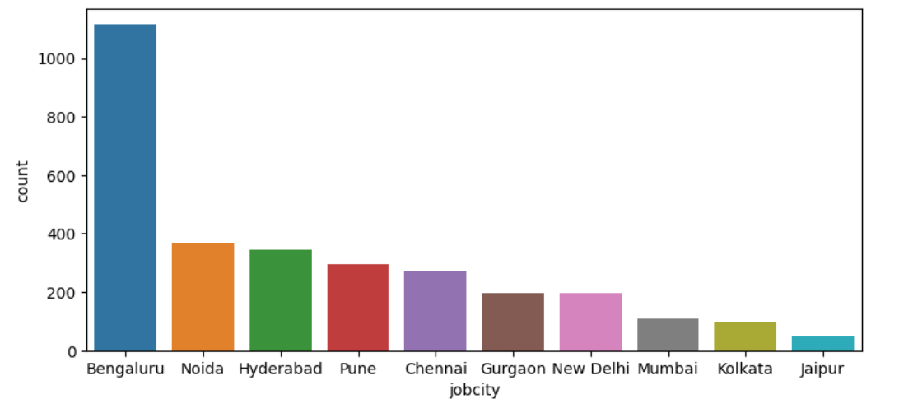
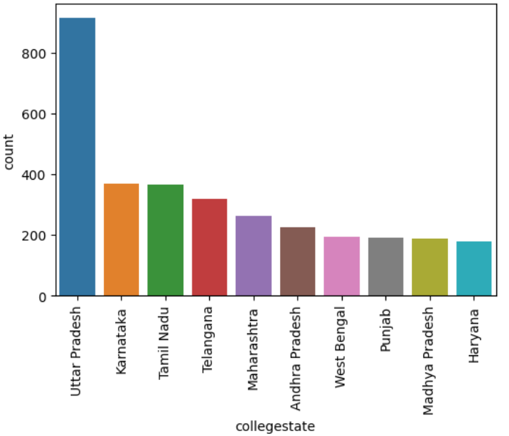
The highest occurring job city is Bangalore
UNIVARIATE ANALYSIS:
Count of Occurrence for Each Jobcity and College state
Highest number of candidates who took exam belong college state is uttarpradesh
Hightest occurring job city is Bengaluru

Slide 9
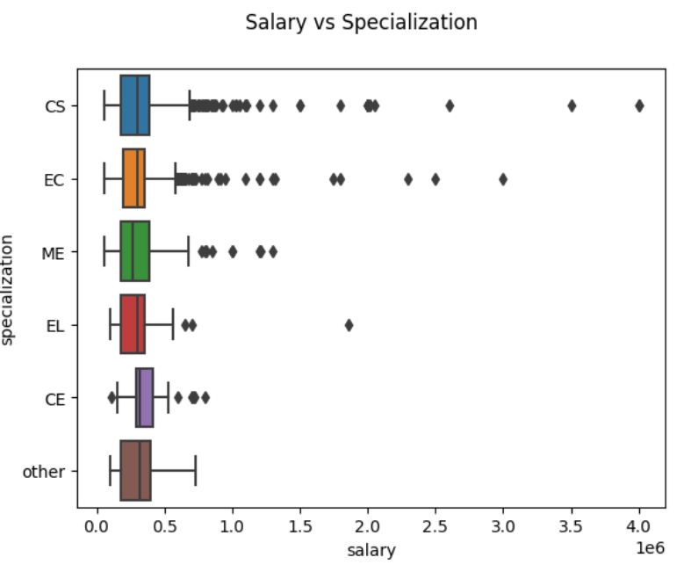
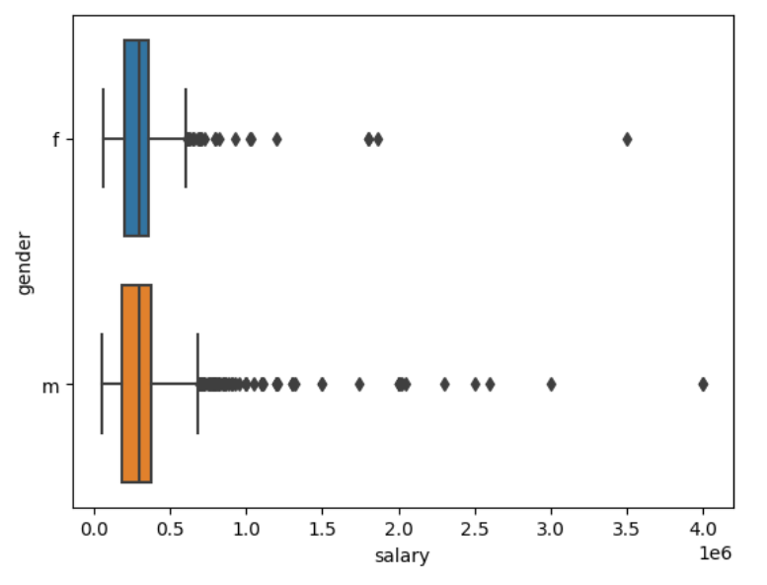
BIVARIATE ANALYSIS:
The median salary across all specializations is similar. However, individuals specializing in Computer Science/Electronics tend to have more instances of higher pay compared to other specializations
The median salary for both genders is comparable; however, there are more outliers in the male category, suggesting a higher proportion of males receiving higher pay.

Slide 10
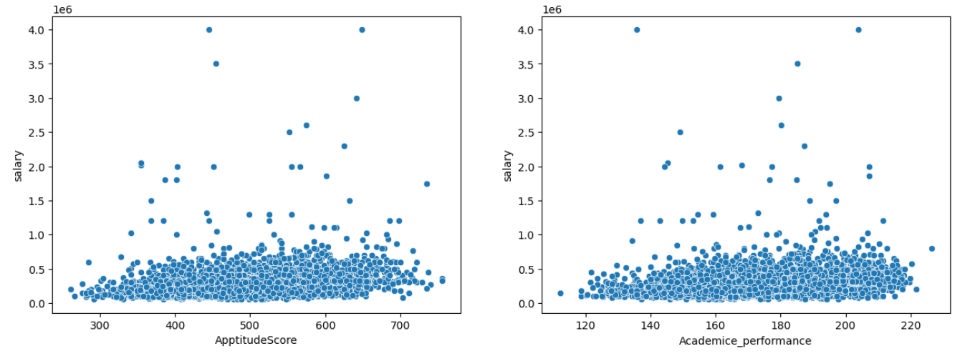
There is a positive correlation between salary and both Aptitude Score and Academic Performance

Slide 11
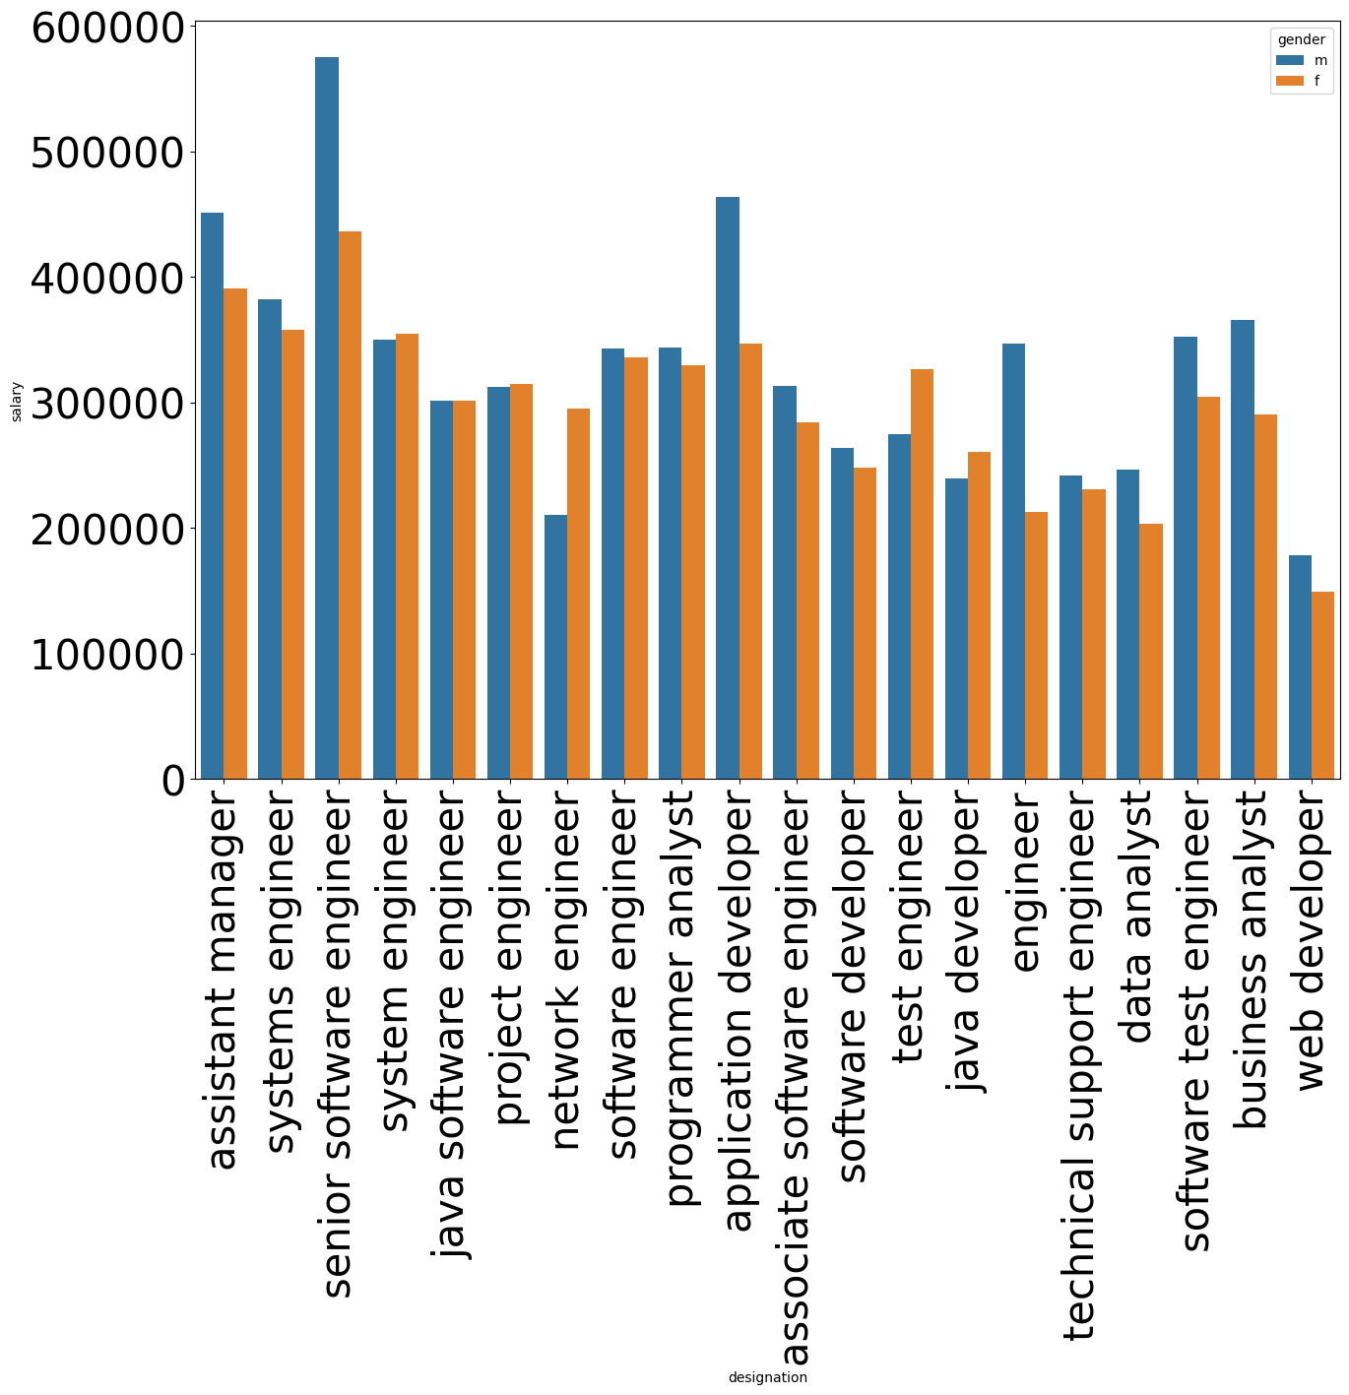
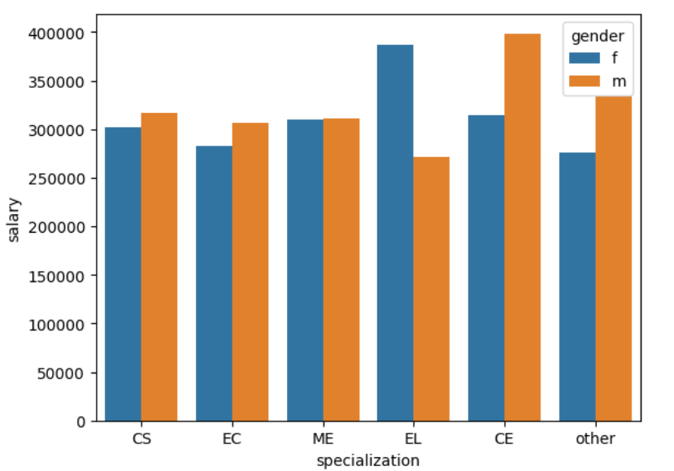
Men in Computer Science, Electronics, and CE earn slightly more than women in these specializations. However, women in other specializations earn significantly more than men in the same field
Mean salary in top roles is largely independent of gender; observed differences may be influenced by factors like experience and specialization

Slide 12
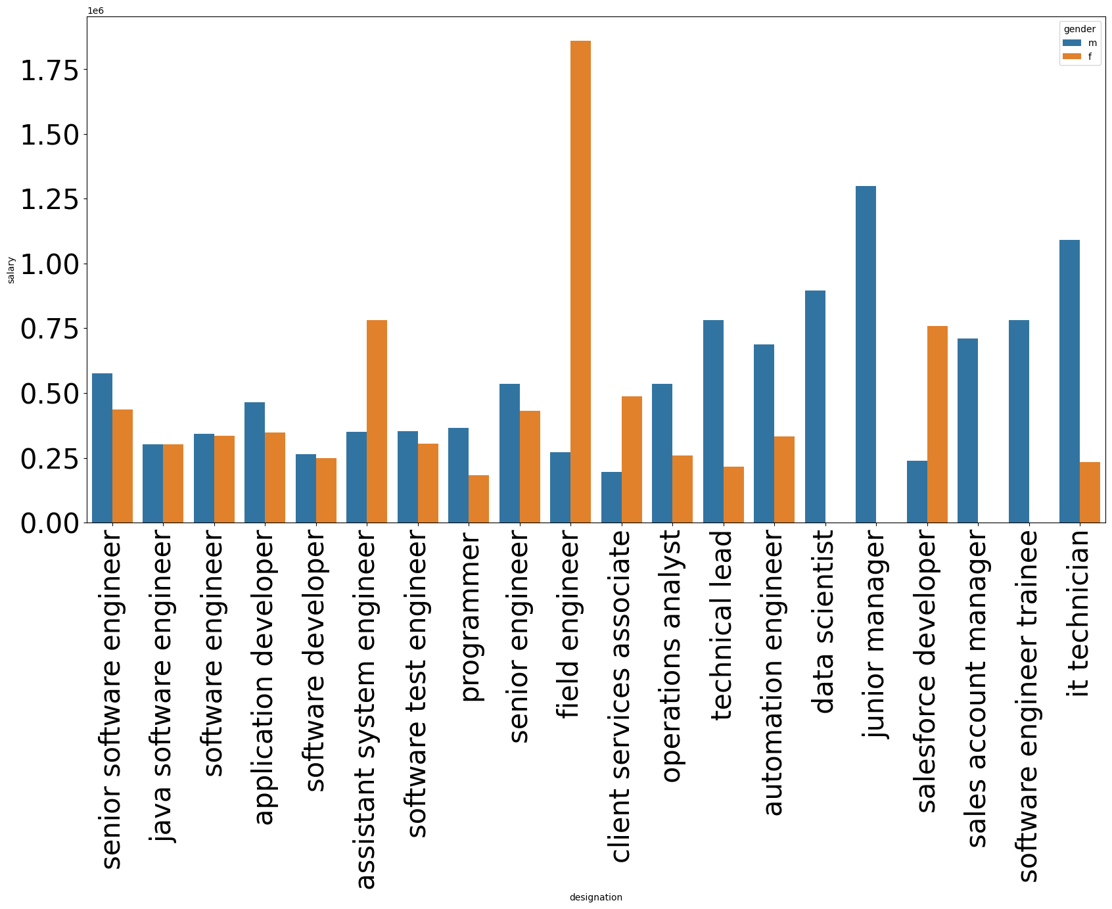
Mean salary for top roles is mostly gender-independent. Differences observed in some roles may be influenced by factors like experience and specialization; not necessarily indicative of gender-based pay discrepancies

Slide 13
Overall CONCLUSIONS:
Most of Amcat Aspirants are male working in IT domain with an experience
of around 5years with degree in Btech and specialization in Computer
Science/Information Technology from tier-2 college in Uttar Pradesh with an
average salary around 300k.
High paying jobs taken up by amcat aspirants are mostly from 'IT' Domain.

Slide 14


