Slide 1

Overall Agenda of Program
27th February 2026
Bootcamp day: preparation slides
Notebook Exercise
Hackathon Day: Problem statement introduction
Live Competition

Slide 2
DAY 1: Bootcamp
Date: 27th February (4-5 Hours)

Slide 3
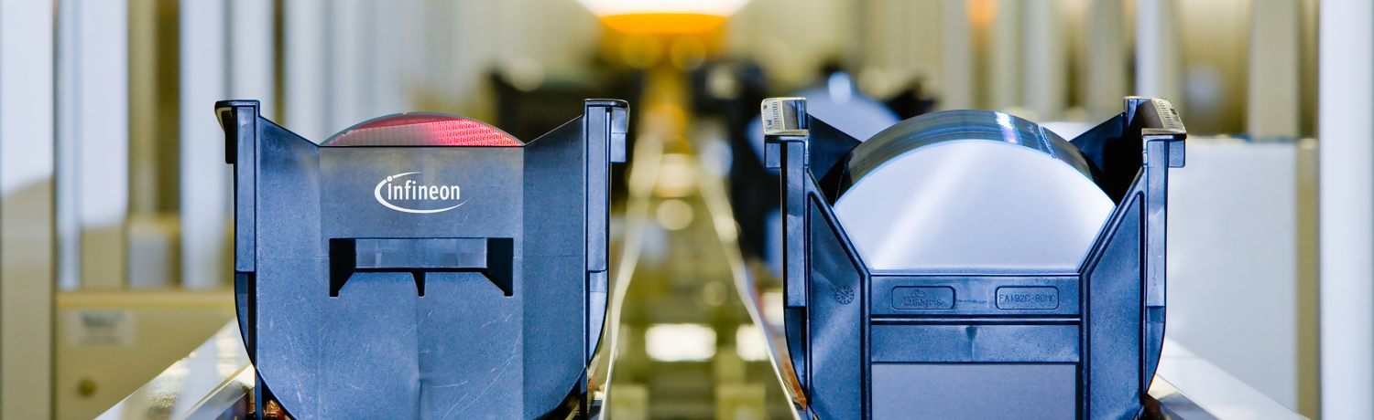
Agentic Bug Hunter
Jiwank Shukla (DES DTP DDA AIA)

Slide 4
Agenda
1
Introduction
2
Our Diverse Expertise in AI at Infineon
3
Understanding AI, ML, and DL
4
The Magic of Words: Exploring NLP
5
Generative AI & LLM’s
6
From LLM’s to Agentic Systems
7
References & Glossary

Slide 5
Agenda
1
Introduction
2
Our Diverse Expertise in AI at Infineon
3
Understanding AI, ML, and DL
4
The Magic of Words: Exploring NLP
5
Generative AI & LLM’s
6
From LLM’s to Agentic Systems
7
References & Glossary

Slide 6



Nice to meet you
Jiwank Shukla
Jiwank.Shukla@infineon.com
Designation - Senior Machine Learning Engineer
Ashutosh Bajpai
Ashutosh.Bajpai@infineon.com
Designation - Senior Machine Learning Engineer
Swaraj Badhei
Swaraj.Badhei@infineon.com
Designation - Senior Machine Learning Engineer

Slide 7
Agenda
1
Introduction
2
Our Diverse Expertise in AI at Infineon
3
Understanding AI, ML, and DL
4
The Magic of Words: Exploring NLP
5
Generative AI & LLM’s
6
From LLM’s to Agentic Systems
7
References & Glossary

Slide 8
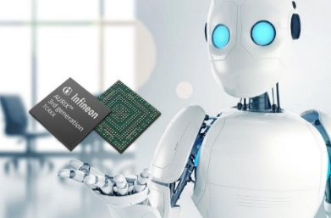
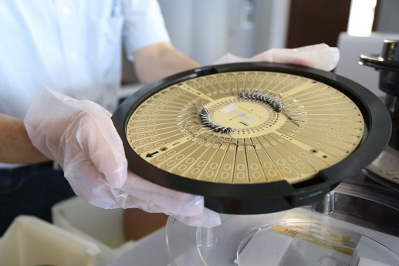
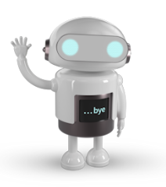
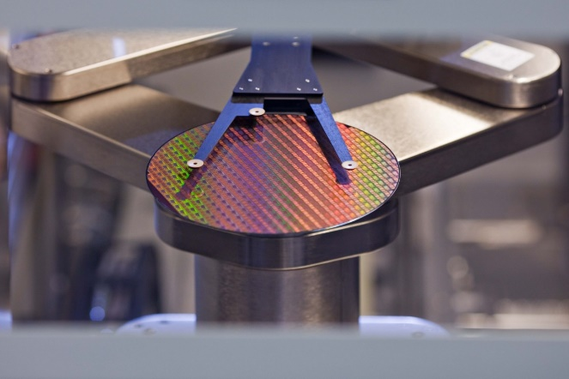
Our work at Infineon
Using the power of NLP* improve process Efficiency
Enabling CV* in Manufacturing
Using various NLP techniques to bring values from the textual and unstructured dataset from different domains.
Using CV techniques to automate & improve the decision making at the chip manufacturing process
Various applications:
Q&A Bot
Sentiment analysis
Search engines
Text analytics
Speech-to-Text etc.
Various applications:
Wafer crack detection
Wafer defect detection
Similar wafer images
Image generation etc.
NLP - Natural Language Processing
CV - Computer Vision

Slide 9
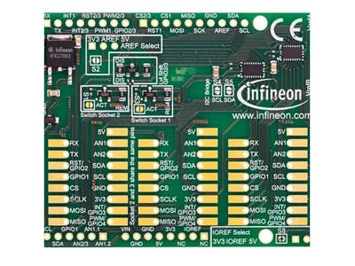
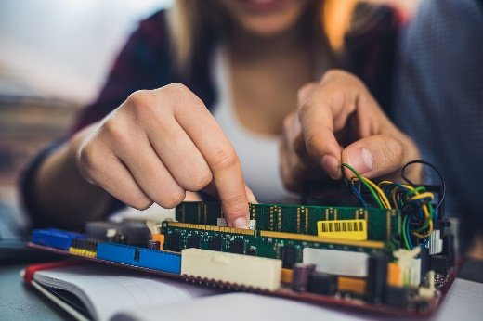
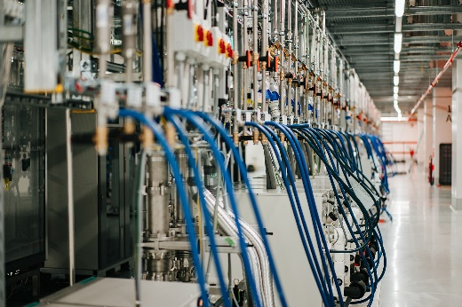
Our work at Infineon
Exploring the AI in EDA* to improve R&D Process
Bringing AI on Edge
Using AI/ML techniques to enhance the R&D Design, make the process more efficient, and improve the productivity of the designers
Providing the platform for our customers deploy the AI/ML* models on Infineon Products by automating the process of Quantization, Pruning etc.
In-house MLOps Infrastructure
Various applications:
Wake-word detection
Lidar object detection
Radar-based object detection
Image recognition etc.
Various applications:
Analog structure recognition
Congestion prediction
Anomalies detection
Developing the in-house MLOps Infrastructure to provide scalable infrastructure to develop and host AI/ML Models
EDA - Electronic Design Automation
AI/ML-Artificial Intelligence / Machine Learning

Slide 10
Agenda
1
Introduction
2
Our Diverse Expertise in AI at Infineon
3
Understanding AI, ML, and DL
4
The Magic of Words: Exploring NLP
5
Generative AI & LLM’s
6
From LLM’s to Agentic Systems
7
References & Glossary

Slide 11
Understanding AI, ML, and Deep Learning
Artificial Intelligence
Ability of machines to imitate human intelligence
Artificial
Intelligence
Machine Learning
Algorithms to incorporate intelligence into machine by automatically learning from data
Machine Learning
Deep Learning
Deep Learning
Algorithms that mimics human brain to incorporate intelligence into machines
Data Science
Data Science
DS is a field of study which combines Statistics and Math to extract meaningful insights from data.

Slide 12

Sub-domains of AI
Twitter User
Tweets, comments
No. of followers, retweets, likes
Images, videos
Natural Language Processing
Computer Vision
Data Science
Connects human language to computers and involves all kinds of text processing, analysis and generation.
Ex.
Sentiment analysis
Text generation
Handles the processing, analysis and generation of images and videos.
Ex.
Facial classification/detection
Image-to-image generation etc.
Opens the door to process and analyze huge amounts of data to extract useful insights from them.
Ex.
Recommendation systems
Social media analysis

Slide 13
Agenda
1
Introduction
2
Our Diverse Expertise at Infineon
3
Understanding AI, ML, and DL
4
The Magic of Words: Exploring NLP
5
Generative AI & LLM’s
6
From LLM’s to Agentic Systems
7
References & Glossary

Slide 14



Introduction to Natural Language Processing (NLP)
Human-To-Human Communication
Hey, what's your favorite movie?
Human brain Interprets the message and gives the response
Hmm, that's tough! I really like "The Shawshank Redemption". It's a great story about hope and redemption.
Human-To-Machine Communication
NLP allows the machine to understand & communicate with humans in Natural Language
Can you recommend a good movie to watch?
NLP
Based on your viewing history, I would suggest "The Shawshank Redemption" or "Forrest Gump". Which one do you prefer?

Slide 15


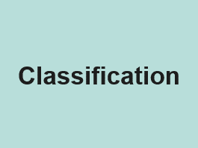
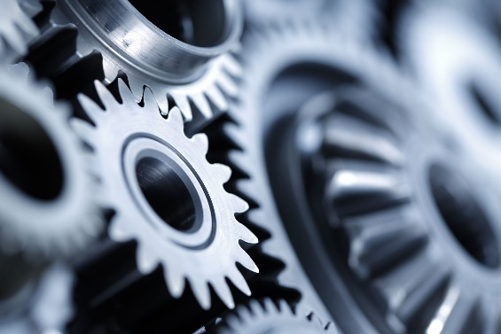
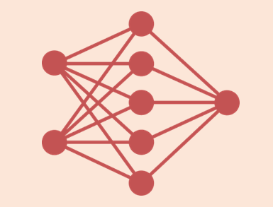


How does NLP work?
Applications
Exploratory Data Analysis
and
Pre-processing
Neural Network
Architectures
Let’s discuss this in detail
Textual / Speech Data
Outputs
[Reference1] [Reference2]

Slide 16
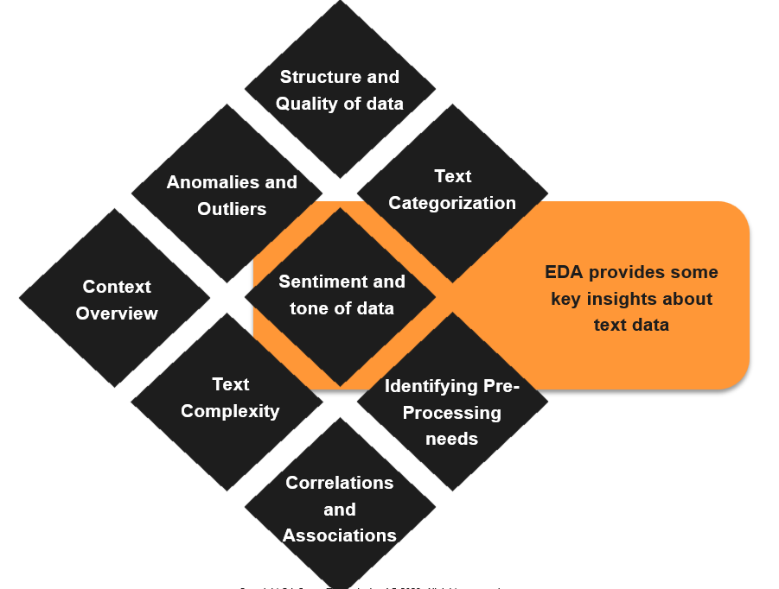

Exploratory Data Analysis
It is the process of examining, visualizing and summarizing textual data to uncover patterns, detect anomalies, and gain insights before applying advanced NLP techniques.

Slide 17
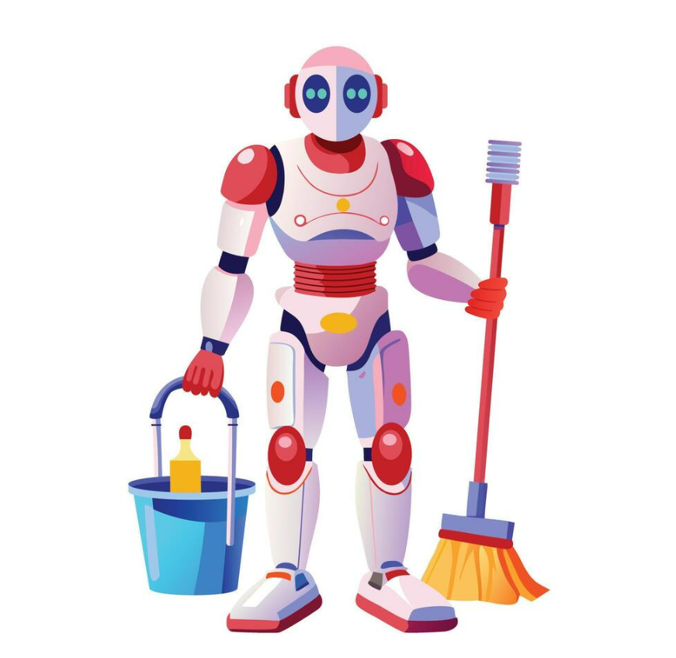
Text Pre-processing Techniques
“Jenna went back to University”
Normalize
“jenna went back to university”
Tokenize
<“jenna”, “went”, “back”, “to”, “university>
Remove
Stop Words
<“jenna”, “went”, “university>
Stem /
Lemmatize
<“jenna”, “went”, “university>

Slide 18
How does NLP work?
Applications
Exploratory Data Analysis
and
Pre-processing
Neural Network
Architectures
Textual / Speech Data
Let’s discuss this in detail
Outputs
[Reference1] [Reference2]

Slide 19
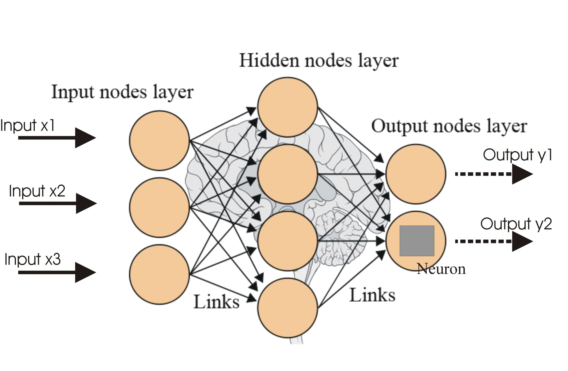
Neural Networks and its Working
Neural Network is a machine learning approach that models the human brain & consists of a number of artificial neurons
Neurons in NN’s tend to have fewer connections than biological neurons.
Knowledge about the learning task is given in the form of examples called training examples
An Activation function is applied to these inputs, which result in the activation level of the neuron.
Hidden Layers which sits between the input and output layer, is responsible for learning complex patterns and relationships in data
Each Neuron in NN receives a number of inputs
Weights and Bias are the parameters that help the network process data and produce accurate outputs.
[Reference]

Slide 20
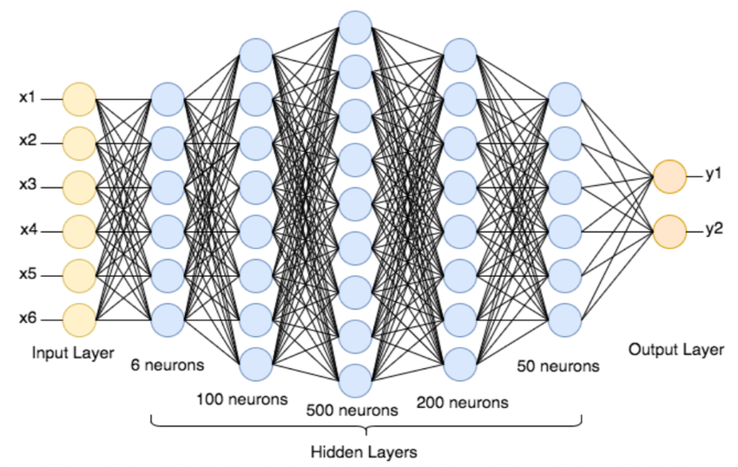
Deep Neural Network
[Reference]

Slide 21

Neural Network Architectures
Recurrent Neural Networks commonly used for sequential data processing. Unlike feed forward NN’s it process data across multiple time steps.
Long Short-Term Memory (LSTM) is a type of recurrent neural network (RNN) that can process and remember information over multiple time steps
Encoder-decoder are used to handle sequential data, specifically mapping input sequences to output sequences of different lengths, such as neural machine translation, text summarization, image captioning and speech recognition
Transformers are neural networks that learn context and understanding through sequential data analysis.

Slide 22

How does NLP work?
Applications
Exploratory Data Analysis
and
Pre-processing
Neural Network
Architectures
Textual / Speech Data
Let’s discuss this in detail
Outputs
[Reference1] [Reference2]

Slide 23

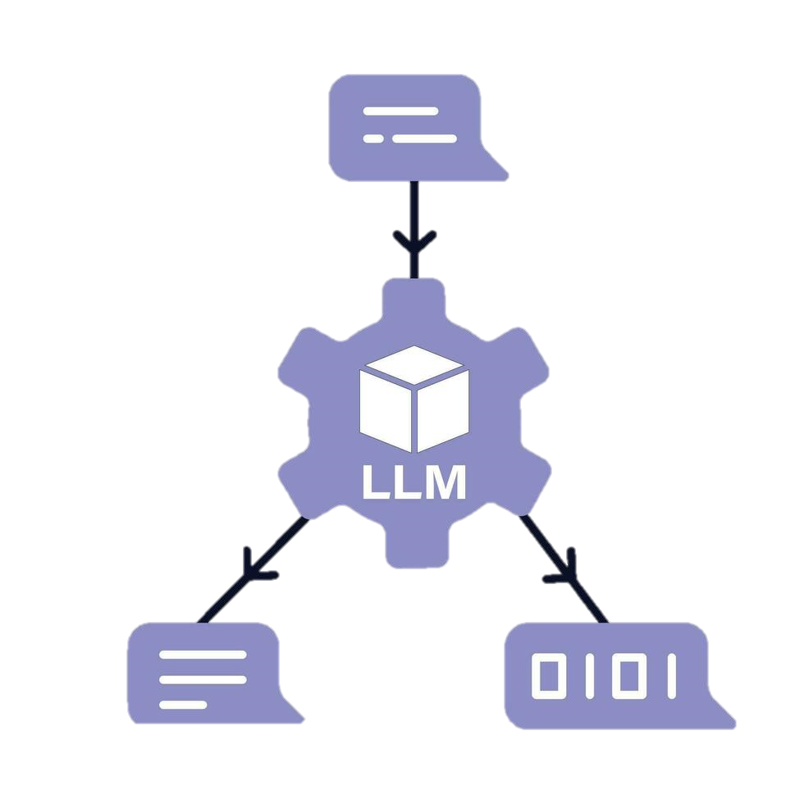
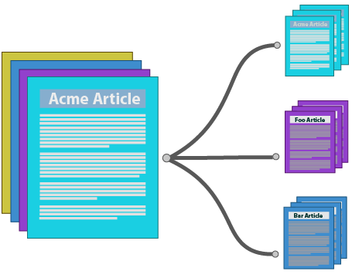
Common NLP Applications
Language Translation (ex- English to French)..
Text Translation
Spam detection,
Sentiment Analysis..
Chat Bots,
Summarization..
NLP
Applications
Text Classification
Text Generation
[Reference1] [Reference2] [Reference3]

Slide 24
Agenda
1
Introduction
2
Our Diverse Expertise at Infineon
3
Understanding AI, ML, and DL
4
The Magic of Words: Exploring NLP
5
Generative AI & LLM’s
6
From LLM’s to Agentic Systems
7
References & Glossary
Notes:
We have different applications of nlp but for each task we have to build a different model. Now what if I say we can have one model which can do all this . Here comes llms ans gen ai

Slide 25
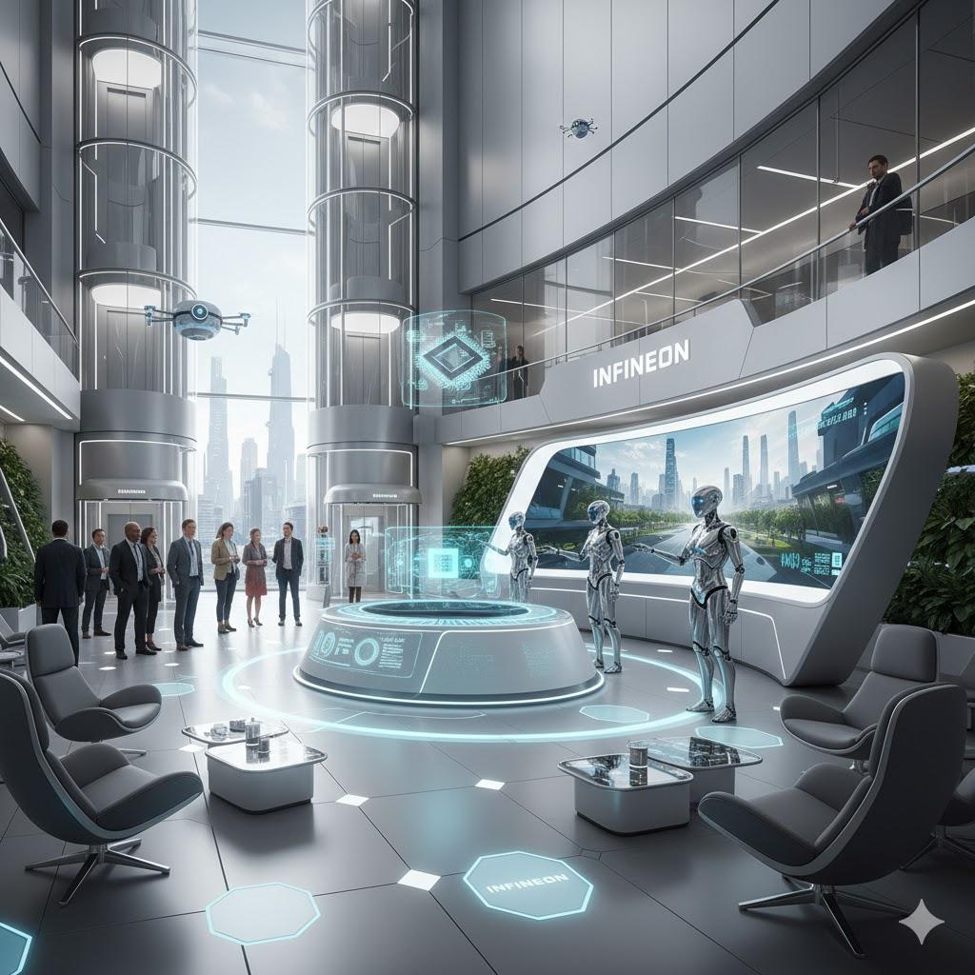




Generative AI
Generative AI is artificial intelligence capable of generating text, images, or other media, using generative models based on its training data.
Source: Created with Gemini, Prompt used – “How would Infineon be in next 15 years”
`
DATA
New Content
Model trained on large amount of data
Generative Model
Prompt to generate a text, image etc.
Text
Images
..
Notes:
As the name suggest generative means the capability to generate it’s a ai molde that can generate test images and many more based on the data its been trained on for eg.
Lets compare tradition ai and generative ai to see how it benefits us

Slide 26
Traditional AI Vs Generative AI
Traditional AI
Generative AI
Execute predefined tasks based on some rules
Creating new data samples that resemble real-world data
Objective
Supervised/ Rule Based learning
Unsupervised learning
Learning Approach
Data Requirements
Relies on labeled data for training
Requires Large datasets for training
Examples
Expert systems, Rule-base systems
ChatGpt, Gemini, Co-pilot

Slide 27
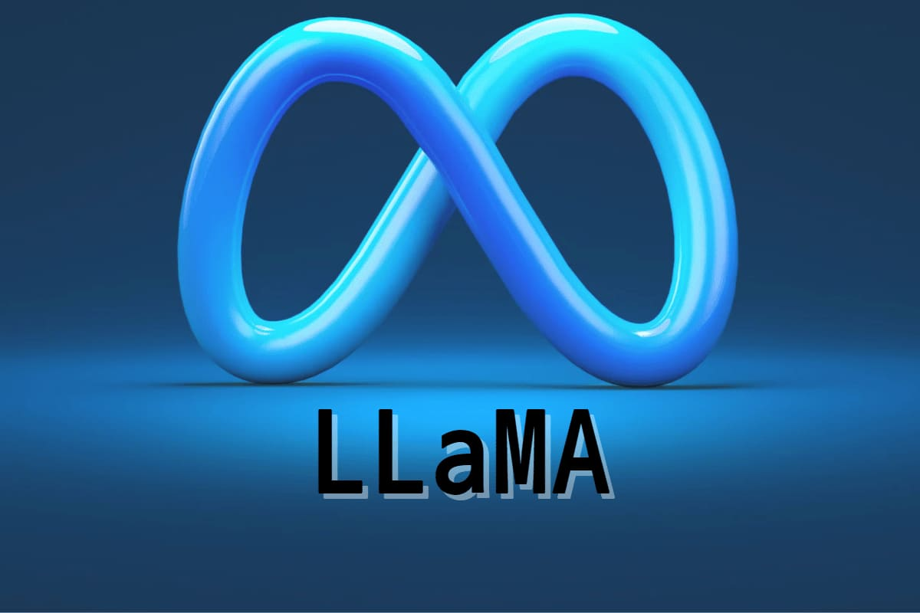
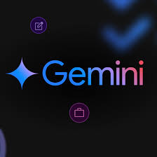


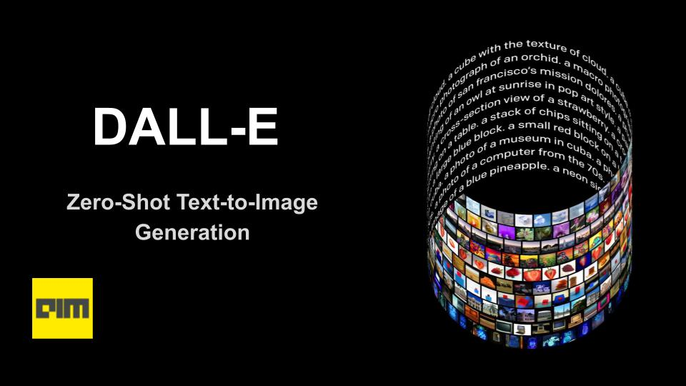
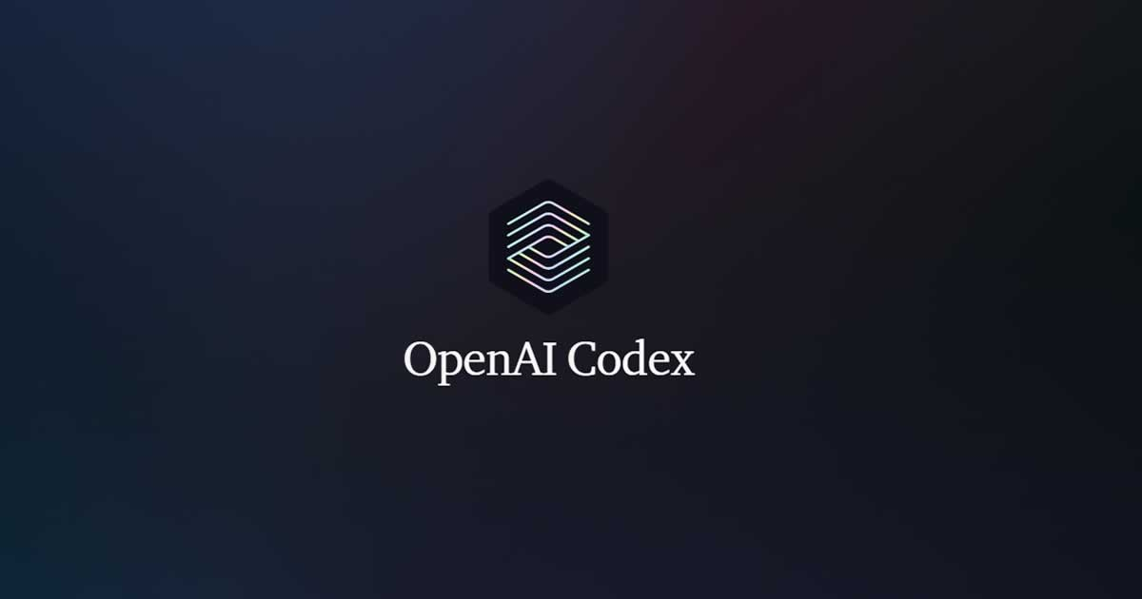
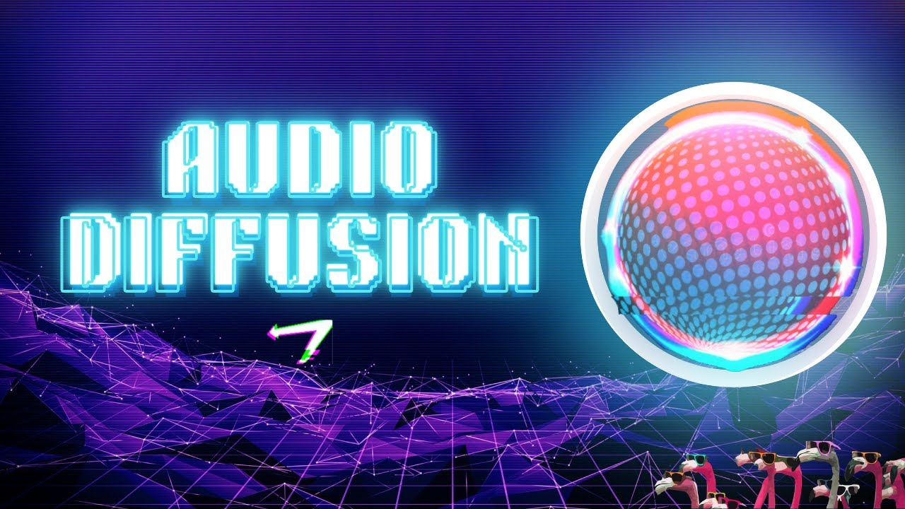
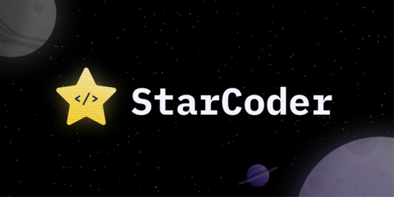

Types of Generative Models Based on data they generate from text input
Text-to-Text
Text-to-Image
ChatGPT
Bard
LLaMa (Meta)
PaLM2
Midjourney
DALL-E 3
Stable Diffusion
Imagen
Text-to-Code
Text-to-Audio
Codex
AphaCode
AutoLM
LukeBox

Slide 28
Large Language Models (LLM’s)
Large language models are AI models that can generate human-like text based on vast amounts of training data.
They are capable of understanding and producing natural language
Prompt
Model
Completions
Where is sun located in solar system?
The Sun is located at the center of the Solar System. It is a nearly perfect sphere of hot plasma, with internal convective motion that generates a magnetic field via a dynamo process.
LLM
* Model size corresponds to no. of parameters
*Context Window
~1k words
*Top n tokens predicted

Slide 29
Evolution of Large Language Models
1.8 T
1 T+
1.76 T
2000
RNN,
LSTMs
2020
GPT-3
175 B
110 M
65M
2025
GPT 5
Deepseek
Claude
Neural Network Based Model
2023
LLAMA,
Falcon,
GPT-4,
BARD
2024
GPT-MoE
GPT-4o
DataGemma
2018
Bert
2017
Transformers
1990
N –grams Models
T - Trillion
B - Billion
M - Million
1967
ELIZA
Rule Based Language Model

Slide 30





Use Cases of Generative AI
Gen AI
(use cases)
Text Generation
Image Enhancement
Audio Generation
Music Composition
Code generation
Bug Fixing
Visual Content
Chatbots
Summary Generation
Translation
Video Generation
Code Compilation

Slide 31
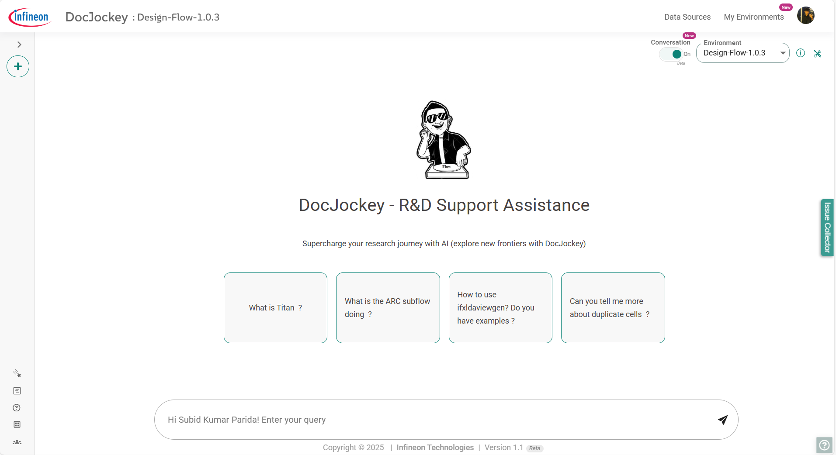
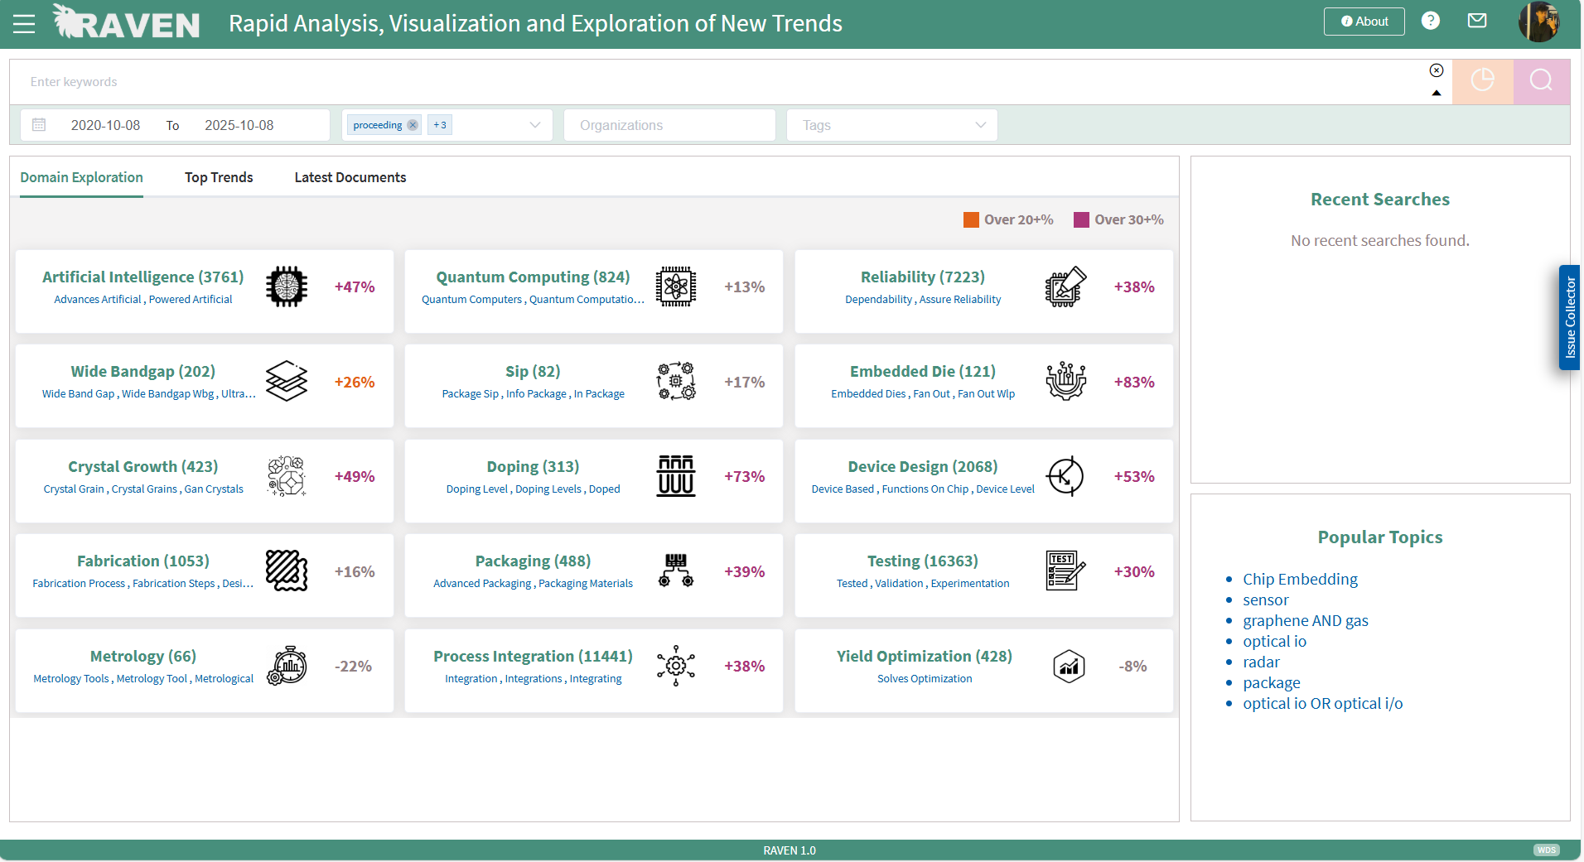
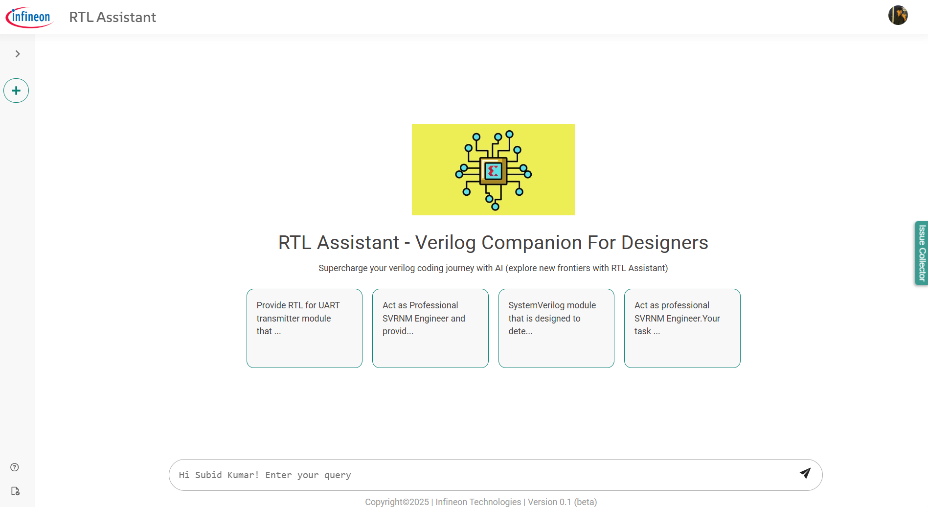
GenAI Use Cases @ IFX
At Infineon we have In-House Code Assistants, In-House Question answering Systems etc. empowered by LLM’s
Reference [1]

Slide 32
Agenda
1
Introduction
2
Our Diverse Expertise at Infineon
3
Understanding AI, ML, and DL
4
The Magic of Words: Exploring NLP
5
Generative AI & LLM’s
6
From LLMS to Agentic Systems
7
References & Glossary

Slide 33


From LLM’s to Agentic Systems
LLMs generate answers, but they aren’t inherently goal-directed or execution-capable. Agents add planning, tools, memory, and verification to deliver reliable outcomes.
Limitation that LLMS come with
Directionless by default: Respond to prompts, but don’t set or pursue goals
Weak multi-step planning: Struggle to decompose and adapt complex tasks
Stateless and context-limited: No persistent memory; bounded context windows
No built-in verification: Limited self-checks; hard to guarantee correctness/compliance
Poor constraint satisfaction: Difficulty with strict schemas, rules, and resource limits
No orchestration: Lacks scheduling, retries, error handling, and sub-task coordination
Unreliable outputs: Hallucinations; sensitive to phrasing; format inconsistency
Overloaded with tasks

Slide 34


Why Agents?
I assign tasks to agents and make sure they are executed in a proper structure
Tasks are now distributed among agents as per their expertise
Orchestrator/ Manager
Workflow is also well structured

Slide 35






How Agentic AI Systems Work: The Thinking-Acting Loop
1. PERCIEVE: Taking in the world
Agentic AI starts by gathering information from multiple sources – just like humans use their environment
2. THINKING: Reasoning and Planning
The AI analyses the situation, breaks down complex problems into steps, and creates a strategic plan to achieve its goal
4. LEARN: Getting Smarter Over Time
The system learns from outcomes, refines its strategies, and becomes more effective with each iteration.
3. ACT: Getting Things Done
Using tools and systems (often through MCP), the AI executes its plan – from simple tasks to complex multistep operations.
Key Characteristics
Goal-Oriented
Works Systematically towards specific objective
Autonomous
Operates independently once given a goal
Tool-Using
Leverages various capabilities through MCP
Adaptive
Learns and improves from experience

Slide 36





What is MCP (Model Context Protocol)?
MCP: The standardized bridge for context, tools, and data
Effortless Scaling
One connector infinite possibilities
Model Context Protocol
Future Proof
Add new tools without agent code
Data Sources
Cloud Services
Developer Joy
Build once, use everywhere
External Tools/
APIs
User Interfaces
Secure Design
Standardized Authentication
Agentic AI Layer
Reasoning
Acting
With MCP, agents no longer need custom integrations for each tool. Instead MCP abstracts and manages all external interactions, letting agentic AI systems scalpt, and coordinate effectively.
Planning
Autonomous AI Agents
Agents use MCP to discover and invoke external resources, enabling independent reasoning and action.

Slide 37



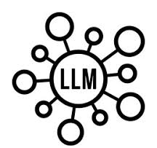





Essence of Problem Statement
Tasks
Retrieve relevant data from database
Process the data and find relevant answers
Format the resulted answer
Single LLM = Hallucination and low answer relevancy
LLM Agent + structured Tools = streamlined Process
I will retrieve the data
I will generate response based on logic applied
I will format the results

Slide 38







Getting started with NLP
spaCy - Provides pretrained models, include tokenization, part-of-speech tagging, named entity recognition.
LangGrapg - an open-source library used to build stateful, multi-actor applications with large language models (LLMs) by representing the application logic as a graph.
Genism - library for topic modelling and document similarity analysis.
LlamaIndex - Used for Data Ingestion, Data Indexing, Query Interface.
Pydantic - a Python library used for data validation, serialization, and settings management.
Langchain - Built for LLMs and can be used for GQA, summarization and much more.
Transformers (Hugging Face Transformers) - state-of-the-art deep learning models, provides a wide pretrained models for text classification, language generation etc.

Slide 39
Agenda
1
Introduction
2
What do we do @ Infineon ?
3
What is AI/ML/DL ?
4
NLP (Natural Language Processing)
5
Generative AI & LLM’s
6
From LLM’s to Agentic Systems
7
References & Glossary

Slide 40
Glossary
Short Form | Description
AI | Artificial Intelligence
ML | Machine Learning
CV | Computer Vision
NLP | Natural Language Processing
DL | Deep Learning
CNN | Convolutional Neural Network

Slide 41
References
https://medium.com/@prajwalkankate/what-is-genai-7e10f008e749
https://www.flaticon.com/free-icon/deep-learning_2103832
https://www.flaticon.com/free-icon/video-production_2471471
https://ur.javamem.com/pictures/coding-clipart
https://www.freepik.com/icon/limitation_8916262
https://en.wikipedia.org/wiki/Hallucination_%28artificial_intelligence%29
https://freebiehive.com/chat-gpt-logo-png/
https://mlmlovevs.live/product_details/4510993.html
https://www.pycodemates.com/2023/08/top-5-generative-ai-tools-and-uses.html#google_vignette\
https://datasciencedojo.com/blog/embeddings-and-llm/
https://www.freepik.com/icon/voice-command_1464780
https://www.analyticsvidhya.com/blog/2023/12/generative-ai-vs-traditional-ai/
https://d3i71xaburhd42.cloudfront.net/6825ba09383bc758f9a2feaebabe35a6cd4adc4c/1-Figure1-1.png
https://static.vecteezy.com/system/resources/previews/053/120/260/non_2x/a-flat-illustration-of-robot-maid-holding-broom-and-bucket-vector.jpg

Slide 42



Nice to meet you
Jiwank Shukla
Jiwank.Shukla@infineon.com
Designation - Senior Machine Learning Engineer
Subid Kumar Parida
subidkumar.parida-ee@infineon.com
Designation - Machine Learning Specialist
Pavan Kumar
apavan.kumar-ee@Infineon.com
Designation – Machine Learning Specialist

