Slide 1
Project Presentation
Project Presentation-1 B-TECH, ECE
Batch 2021

Slide 2
Group Details
Sl. No. | Reg. No. | Name of the student
1 | 21ETEC004303 | Arun Channappa Lamani
2 | 21ETEC004304 | Arun Kumar
3 | 21ETEC004305 | Ayan Khan S
4 | 21ETEC004323 | Naveen M

Slide 3
Design and Development of Master – Slave Controlling System for a Locomotive Application using RF.
Supervisors
Supervisor : Mr. Ambresh
Place of Work: RTC, Peenya

Slide 4
Outline
Title and Aim
Introduction
Existing Method
Block Diagram
Working
Objectives
Outcomes
Gantt Chart
References

Slide 5
Introduction
The railway sector is continuously evolving to meet the demands for safer, more efficient, and automated systems.
This project aims to address these challenges by developing a Master-Slave Controlling and Coordinating System using RF (Radio Frequency) communication.
In this system, a "master" locomotive wirelessly controls one or more "slave" locomotives using RF modules, ensuring braking, and acceleration. The RF communication eliminates the need for extensive wiring and allows real-time data transmission between locomotives.
Through the design, testing, and implementation of this RF-based control system, the project demonstrates a cost-effective solution.

Slide 6
Introduction
Wireless modules offer new opportunities for real-time control and data exchange across railway networks.
A master-slave configuration enables a central "master" unit to control multiple "slave" units, such as trains and signaling systems, ensuring synchronized and automated operations.
Wireless modules reduces infrastructure costs, simplifies maintenance, and increases the system’s flexibility for future expansion.
The master unit can communicate directly with each slave unit, allowing operators to manage railway functions.

Slide 7
Title : Design and Development of Master – Slave Controlling System for a Locomotive Application
Aim: To design and implement a Master-Slave control and coordination system for locomotives using RF (Radio Frequency) communication. The objective is to enhance automation, safety, and efficiency in locomotive operations by enabling wireless coordination and control between multiple locomotives.

Slide 8
Objectives
To perform literature on Master-Slave communication system and operation of locomotives used by Indian railways
To arrive at a functional block diagram along with conceptual design for master and slave system for a locomotive application
To develop a suitable architecture for interfacing microcontroller with Joystick and RF module for master unit and interfacing microcontroller with servomotor and LEDs for slave unit.
To develop prototype for the master and slave system and establish a communication between them
To test and evaluate the system for its effective functionality of Master-Slave for locomotive application

Slide 9
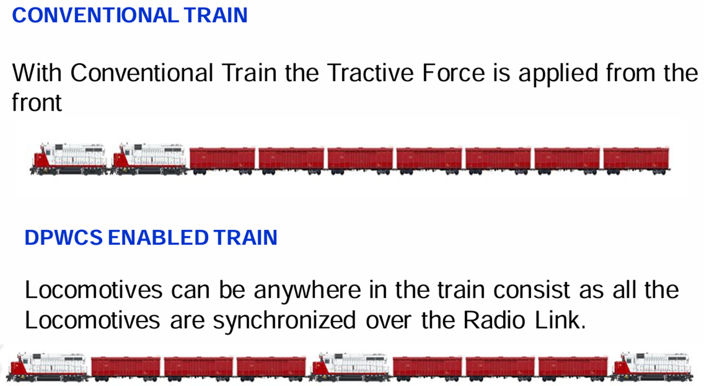
Existing Method
In a conventional train setup, all power and control are centralized in the lead locomotive, and any additional locomotives (typically called helper or trailing units) are controlled manually or by wireless . This approach has limitations, especially for longer trains.
Traditional Wired Communication
Challenges with Wired Systems
Limited Automation
Safety and Reliability Constraints

Slide 10
Implementation of Block Diagram
NRF24L01
module
NRF24L01
module
9V
Battery
Servo Motor
Master
Arduino Mega
Slave
Arduino Uno
LED
Joy stick
Push Button
9V
Battery

Slide 11
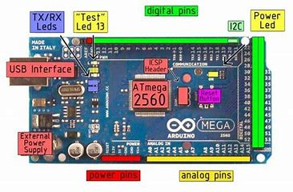
Arduino ATmega2560 (Master)
The Arduino Mega 2560 is a powerful microcontroller board based on the ATmega2560. It boasts 54 digital input/output pins, 16 analog inputs, 4 hardware serial ports (UARTs), a 16 MHz crystal oscillator, a USB connection, a power jack, an ICSP header, and a reset button. This board is ideal for complex projects requiring more I/O pins and memory than the standard Arduino Uno.

Slide 12
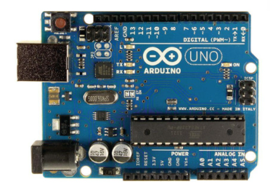
Arduino Uno (Slave)
The Arduino Uno is a microcontroller board based on the ATmega328P. In this setup, it serves as the "Master" device, receiving data from the slave and controlling the servo motor based on the input. It communicates with the Slave Arduino (Nano) via Radio Frequency, using an NRF24L01 module.

Slide 13
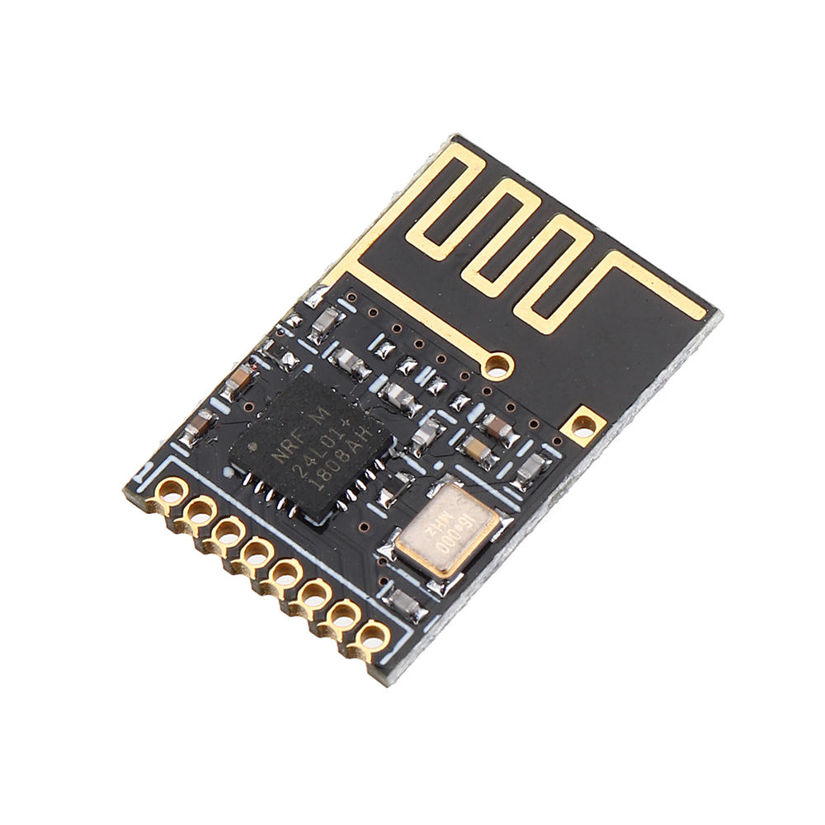
NRF24L01 Modules
NRF24L01 low power wireless radio frequency module, Uses 2.4GHz license-free ISM band, highest working data speed is 2Mbps, 125channels can reach different point or jump frequency communication needs, high efficiency GFSK modulation, anti-interfere. The operating voltage is 3.3 Volts. It covers a distance of 50-200 feet. It uses the SPI communication protocol.

Slide 14
Working
The provided block diagram illustrates a master-slave communication system using NRF24L01 modules. The master Arduino Mega, powered by a 5V battery, reads Joystick input and transmits commands to the slave Arduino Uno through the NRF24L01 module. The slave, also powered by a 5V battery, receives these commands and controls the connected devices like a servo motor and an LED. This system finds applications in locomotive control, enabling remote operation, monitoring, and coordination of multiple locomotives. Key considerations for locomotive applications include reliability, security, range, power efficiency, and environmental robustness.

Slide 15
Flow Chart
#include <SPI.h>
#include <nRF24L01.h>
#include <RF24.h>
RF24 radio(7, 8); // CE, CSN
const byte address[6] = "00001";
void setup()
{
radio.begin();
radio.openWritingPipe(address); radio.setPALevel(RF24_PA_MIN); radio.stopListening();
}
void loop() {
const char text[] = “Master-slave config"; radio.write(&text, sizeof(text));
delay(1000);
}
#include <SPI.h>
#include <nRF24L01.h>
#include <RF24.h>
RF24 radio(7, 8); // CE, CSN
const byte address[6] = "00001";
void setup() {
Serial.begin(9600);
radio.begin();
radio.openReadingPipe(0, address); radio.setPALevel(RF24_PA_MIN); radio.startListening();
}
void loop() {
if (radio.available()) {
char text[32] = "";
radio.read(&text, sizeof(text)); Serial.println(text);
} }

Slide 16
Results

Slide 17
Outcomes
To create a functional prototype Model
To publish the project report

Slide 18
Gantt Chart
Project Work (UG) 16 weeks
Week | 1 | 2 | 3 | 4 | 5 | 6 | 7 | 8 | 9 | 10 | 11 | 12 | 13 | 14 | 15 | 16
Major Activities
Literature survey
Design and simulation specifications
To design and simulate
To design and simulate
To design and simulate
Interim
To verify and compare
Report
Presentation

Slide 19
References
Singh, M., & Verma, R. (2019). Wireless Communication-Based Control of Multiple Locomotives Using RF Technology. International Journal of Advanced Railway Technology, 8(3), 113-119.
Zhang, L., & Wu, H. (2021). A Study on RF-Based Communication Systems for Synchronized Control in Railways. In Proceedings of the IEEE International Conference on Transportation Systems (pp. 123-128). IEEE.
Kumar, S., & Gupta, T. (2018). RF-Based Wireless Control for Locomotive Coordination. Journal of Railway Engineering and Technology, 5(2), 67-72.
Ma, J., Qiu, X., & Chen, Z. (2018, September). "Performance Analysis of Distributed Power Control in Freight Train Operation." IEEE Transactions on Intelligent Transportation Systems, 19(9), 2766-2775. IEEE.
Sharma, P., & Nair, A. R. (2020, May). "Design and Implementation of Wireless Control System for Distributed Locomotive Power." In 2020 International Conference on Advances in Railway Control and Safety (ICARCS) (pp. 25-30). IEEE.

Slide 20


