Slide 1
Project Presentation
Project Work-II B-TECH, ECE
Batch 2021

Slide 2
Group Details
Sl. No. | Reg. No. | Name of the student
1. | 21ETEC004303 | Arun Channappa Lamani
2. | 21ETEC004304 | Arun Kumar
3. | 21ETEC004305 | Ayan Khan
4. | 21ETEC004323 | Naveen M

Slide 3
Title of the Project
Development of YOLO based AI Model for Multi-Crop Disease Detection for Real-Time Implementation
Supervisors
Supervisor: Mr. Ambresh
Place of Work : RTC, Peenya

Slide 4
Outline
Title and Aim
Introduction
Objectives
Block Diagram or Concept
Results obtained after Training the model
Hardware Setup and Result
References

Slide 5
Title: Development of YOLO based AI Model for Multi-Crop Disease Detection for Real-Time Implementation
Aim: The project aims to develop an YOLO based AI-based model for real-time detection of multiple crop diseases using machine learning and image processing. It will help farmers identify diseases early, reducing crop losses and improving productivity. The system will be fast, cost-effective, and scalable for real-world applications. Ultimately, it will be integrated into a mobile or IoT-based platform for instant disease diagnosis.

Slide 6
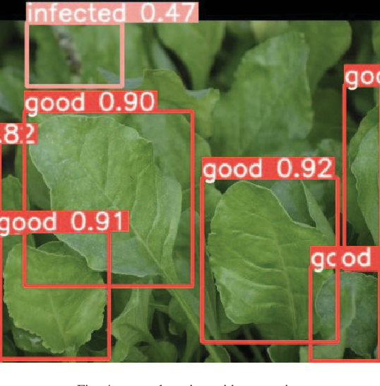
Introduction
Agriculture is a critical sector for global food security, but plant diseases significantly impact yield and quality.
Early disease detection is essential to prevent losses and improve productivity.
Traditional disease detection methods rely on manual inspection, which is time-consuming and prone to errors.

Slide 7
Introduction
Advances in Artificial Intelligence (AI) and deep learning provide an automated, efficient, and accurate approach for disease detection.
This project focuses on developing an AI-based model to detect diseases across multiple crops in real-time.
The system integrates computer vision, deep learning, and IoT-based deployment for real-time monitoring.
Farmers can receive real-time alerts and recommendations, enabling timely intervention and disease management.
The proposed model aims to enhance agricultural productivity and sustainability.

Slide 8
Objectives
To perform literature survey on crop disease detection and machine learning algorithms.
To develop multi crops image dataset and evaluate their performance Metrices
To develop a real time YOLO based AI model for accurate disease detection of multi crops in diverse environment
To implement the YOLO based AI model on embedded platform for real time validation
Test and optimize model accuracy and speed for practical agricultural applications.

Slide 9
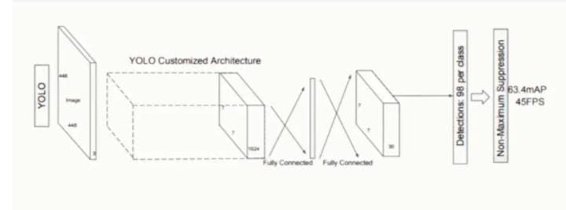
Block Diagram
Data Collection
Image annotation and preprocessing
Object detecting using Yolo model
Implementation in Raspberry pi board
Disease images

Slide 10
References
Pallagani, V., Khandelwal, V., Chandra, B., Udutalapally, V., Das, D., & P. Mohanty, S. (2019). dCrop: A Deep-Learning Based Framework for Accurate Prediction of Diseases of Crops in Smart Agriculture. 2019 IEEE International Symposium on Smart Electronic Systems (iSES) (Formerly iNiS). doi:10.1109/ises47678.2019.00020
Ouhami, M.; Hafiane, A.;Es-Saady, Y.; El Hajji, M.; Canals, R.Computer Vision, IoT and DataFusion for Crop Disease Detection Using Machine Learning: A Survey and Ongoing Research. Remote Sens.2021,13,2486. https://doi.org/10.3390/rs13132486

Slide 11
