Slide 1
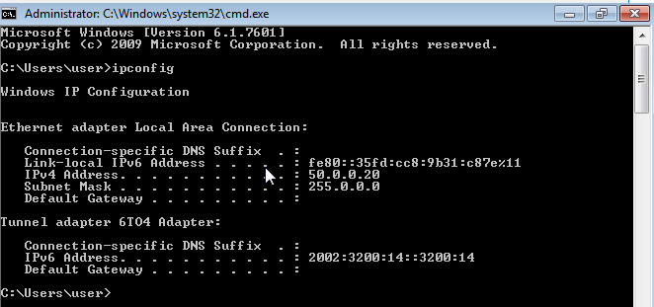
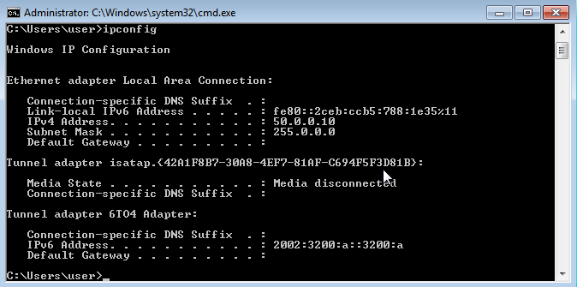
Step 1: Open ncpa.cpl using CMD
Step 2: Select Ethernet → Properties
Step 3: Select IPv4 → Properties
Step 4: Enter IP address and subnet mask
Step 5: Click OK and Close
Step 6: Verify using ipconfig
Item | Address
IP Address | 50.0.0.10
Subnet Mask | 255.0.0.0
Prefix | /8
Network / First IP | 50.0.0.0
Usable First IP | 50.0.0.1
Usable Last IP | 50.255.255.254
Broadcast / Last IP | 50.255.255.255
Total IPs | 16,777,216
Usable IPs | 16,777,214
Ip – 50.0.0.10 subnet - 255.0.0.0
Building 2
Building 2
Ip – 50.0.0.20 subnet - 255.0.0.0

Slide 2
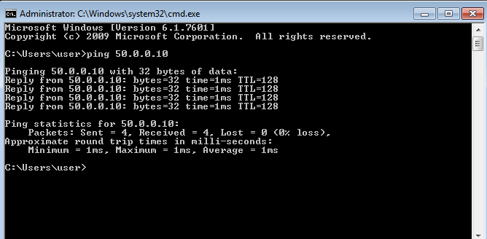
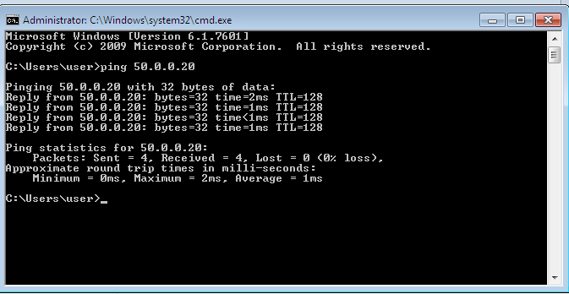
Output (Ping Test):
How it is works :
Ping Command: ping 50.0.0.20 from my PC.
ICMP Request: My PC sends an ICMP Echo Request to the destination.
Network Check: The PC checks the destination network and uses ARP to find the MAC address if required.
Data Transmission: The packet travels through Layer 2 (Data Link) and Layer 1 (Physical) to the destination.
ICMP Reply: The destination sends an ICMP Echo Reply back. If I receive the reply, basic network connectivity is working.

Slide 3
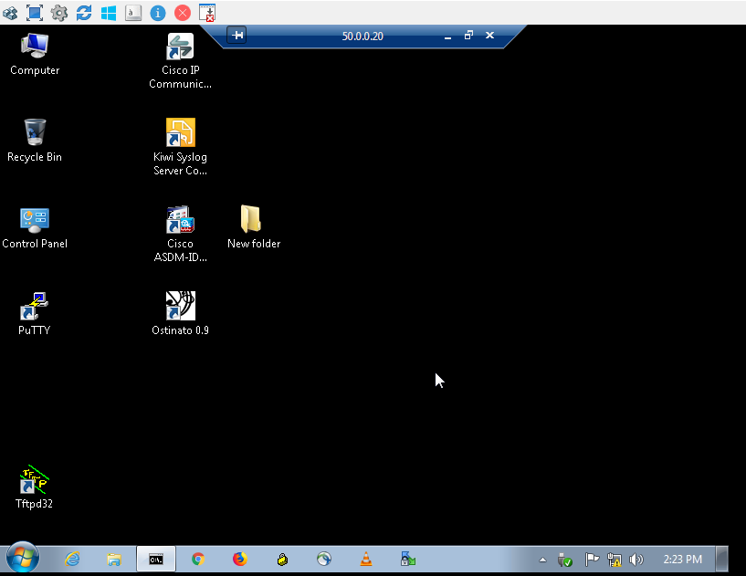
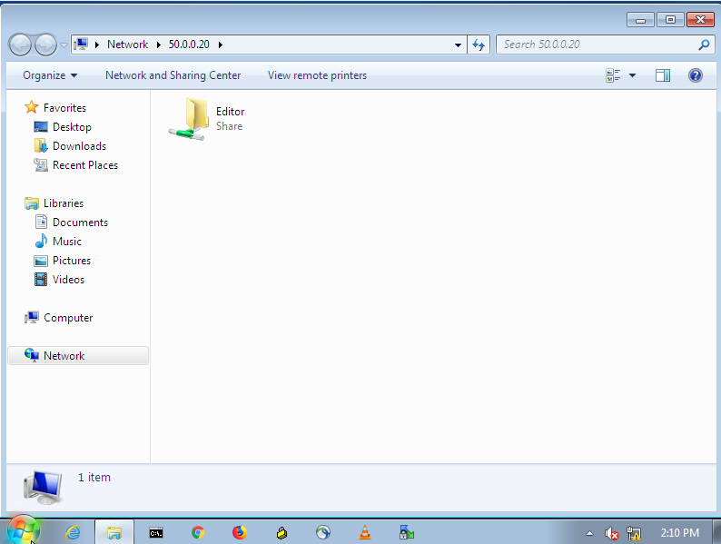
Share folder Output :
RDP Output :

