Slide 1
Coin Change DP
Arun Joshua Kennedy

Slide 2
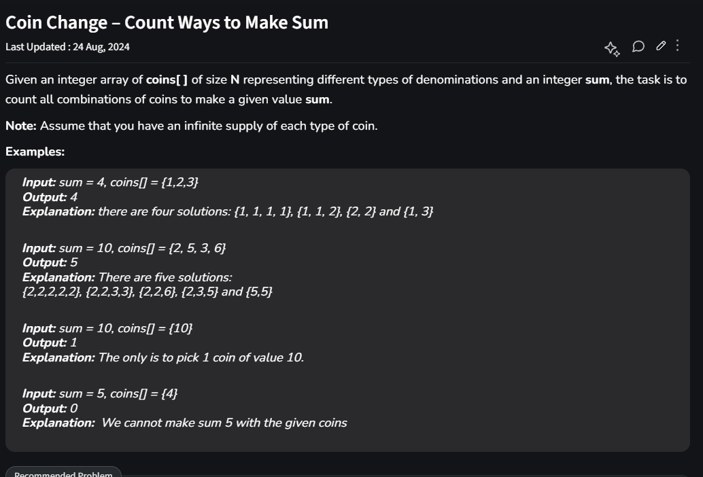
Geeks For Geeks
Count all combinations of coins to make a given value sum (target).

Slide 3
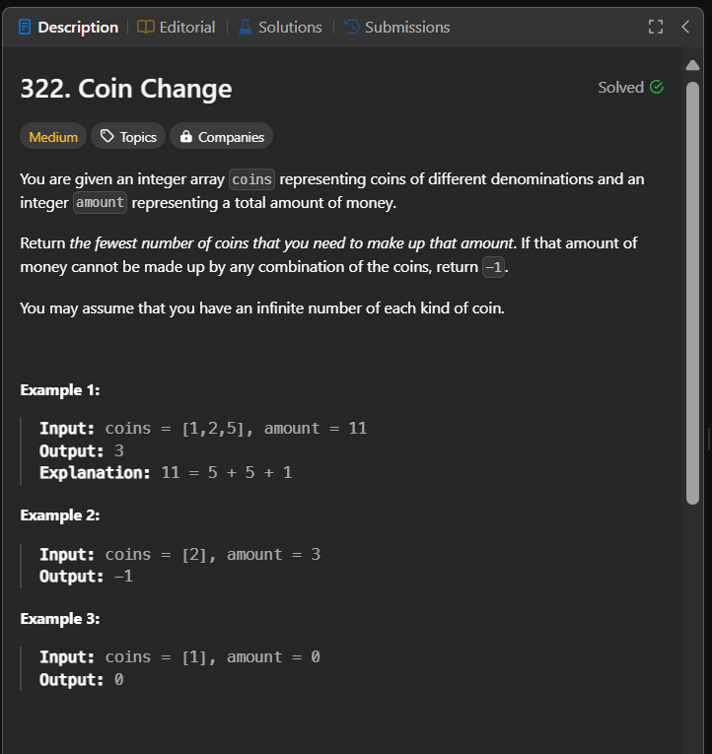
Leet Code
Fewest number of coins that you need to make up that amount (target).

Slide 4
Objective
Given a target and the coins. Check if it is possible to achieve the target amount with the coins provided.
We discuss 2 variants:
For each denomination infinite coins. Eg for [ 1, 2, 3] we can take infinite 1s, 2s and 3s, Repetitions will have no effect.
Finite coins for each denomination. Eg for [1, 2, 3] we can take each only once so here the maximum target is naturally 6. Repetitions will affect the outcome. Eg, [1, 2, 2, 3] can reach 8.

Slide 5
Infinite Coins Python code
def count(coins, n, target):
# Assuming coins does not contain any duplications
dp = [False] * (target + 1)
dp[0] = True # Base case
# Iterate through each coin
for i in range(n):
# Update possible sums from the coin value up to target
for j in range(coins[i], target + 1):
dp[j] |= dp[j - coins[i]]
return dp[target]

Slide 6
Infinite Coins
coins=[3, 5], n=2, target=6, dp=[True, False, False, False, False, False, False]
coins[i=0]=3, j=3, dp=[True, False, False, True, False, False, False]
coins[i=0]=3, j=4, dp=[True, False, False, True, False, False, False]
coins[i=0]=3, j=5, dp=[True, False, False, True, False, False, False]
coins[i=0]=3, j=6, dp=[True, False, False, True, False, False, True]
coins[i=1]=5, j=5, dp=[True, False, False, True, False, True, True]
coins[i=1]=5, j=6, dp=[True, False, False, True, False, True, True]
Is it possible to achieve the target 6: True
for i in range(n):
for j in range(coins[i], target + 1):
dp[j] |= dp[j - coins[i]]

Slide 7
Finite Coins Python Code
def count(coins, n, target):
dp = [False] * (target + 1)
dp[0] = True
for i in range(n):
for j in range(target, coins[i] - 1, -1):
dp[j] |= dp[j - coins[i]]
return dp[target]

Slide 8
Finite Coins
for i in range(n):
for j in range(target, coins[i] - 1, -1):
dp[j] |= dp[j - coins[i]]
coins=[3, 5], n=2, target=6, dp=[True, False, False, False, False, False, False]
coins[i=0]=3, j=6, dp=[True, False, False, False, False, False, False]
coins[i=0]=3, j=5, dp=[True, False, False, False, False, False, False]
coins[i=0]=3, j=4, dp=[True, False, False, False, False, False, False]
coins[i=0]=3, j=3, dp=[True, False, False, True, False, False, False]
coins[i=1]=5, j=6, dp=[True, False, False, True, False, False, False]
coins[i=1]=5, j=5, dp=[True, False, False, True, False, True, False]
Is it possible to achieve the target 6: False

Slide 9
Finite Coins eg2
coins=[3, 3, 5], n=3, target=6, dp=[True, False, False, False, False, False, False]
coins[i=0]=3, j=6, dp=[True, False, False, False, False, False, False]
coins[i=0]=3, j=5, dp=[True, False, False, False, False, False, False]
coins[i=0]=3, j=4, dp=[True, False, False, False, False, False, False]
coins[i=0]=3, j=3, dp=[True, False, False, True, False, False, False]
coins[i=1]=3, j=6, dp=[True, False, False, True, False, False, True]
coins[i=1]=3, j=5, dp=[True, False, False, True, False, False, True]
coins[i=1]=3, j=4, dp=[True, False, False, True, False, False, True]
coins[i=1]=3, j=3, dp=[True, False, False, True, False, False, True]
coins[i=2]=5, j=6, dp=[True, False, False, True, False, False, True]
coins[i=2]=5, j=5, dp=[True, False, False, True, False, True, True]
Is it possible to achieve the target 6: True

Slide 10
The net effect of the 2 Algorithms
To understand this let us take the coins = [3, 5] and target = 18
Infinite coins for each denomination we get:
dp=[True, False, False, True, False, True, True, False, True, True, True, True, True, True, True, True, True, True, True]
Finite coins we get:
dp=[True, False, False, True, False, True, False, False, True, False, False, False, False, False, False, False, False, False, False]

Slide 11
Summary
For Infinite coins of each denomination
for i in range(n):
# Update possible sums from the coin value up to target
for j in range(coins[i], target + 1):
dp[j] |= dp[j - coins[i]]
For Finite coins
for i in range(n):
for j in range(target, coins[i] - 1, -1):
dp[j] |= dp[j - coins[i]]

Slide 12
Thank You

Slide 13
References
Coin Change – LeetCode
Coin Change - Count Ways to Make Sum - GeeksforGeeks

Slide 14
Infinite Coins
coins=[3, 5], n=2, target=6, dp=[True, False, False, False, False, False, False]
coins[i=0]=3, j=3, dp=[True, False, False, -> True, False, False, False]
coins[i=0]=3, j=4, dp=[True, False, False, True, -> False, False, False]
coins[i=0]=3, j=5, dp=[True, False, False, True, False, -> False, False]
coins[i=0]=3, j=6, dp=[True, False, False, True, False, False, -> True]
coins[i=1]=5, j=5, dp=[True, False, False, True, False, -> True, True]
coins[i=1]=5, j=6, dp=[True, False, False, True, False, True, -> True]
Is it possible to achieve the target 6: True
for i in range(n):
for j in range(coins[i], target + 1):
dp[j] |= dp[j - coins[i]]

