Slide 1
Recipe Sharing Platform
with Meal Planner
Recipes
Database Systems Engineering and Distributed Backend Development
Meal plan
Grocery list
Y25 · 2026–2027 · Trimester 4
Thodeti Arun (2520030456) | Pavan (2520090200)
Notes:
Source: user-provided project abstract and presentation rules.

Slide 2
Problem statement
Recipes are often saved in scattered places.
Weekly meal planning takes time and repeated effort.
Ingredient lists are difficult to prepare across multiple recipes.
Need: one simple application for recipes, plans, and ingredients.
Recipe Sharing Platform with Meal Planner
02
Notes:
Source: user-provided project abstract and presentation rules.

Slide 3
Objectives
Provide accounts for creating, browsing, and sharing recipes.
Support recipe search by category and recipe details.
Organize selected recipes into a weekly meal plan.
Generate a grocery list from planned recipe ingredients.
Show nutrition information when available.
Recipe Sharing Platform with Meal Planner
03
Notes:
Source: user-provided project abstract and presentation rules.

Slide 4
Proposed system
An integrated web platform for recipe discovery, meal planning, and grocery preparation.
User account
Recipe management
Meal planner
Users can save and rate recipes for future use.
Recipe Sharing Platform with Meal Planner
04
Notes:
Source: user-provided project abstract and presentation rules.

Slide 5
System architecture
React.js
Frontend
Node.js +
Express.js
MongoDB
Database
Cloudinary
Images
Nutrition
API
The backend handles application requests and connects to storage and external services.
Recipe Sharing Platform with Meal Planner
05
Notes:
Source: user-provided project abstract and presentation rules.

Slide 6
Modules and functionalities
User registration and login.
Recipe creation with ingredients and instructions.
Recipe search, ratings, and saved recipes.
Weekly meal planner.
Grocery list generation.
Nutrition information through an external API.
Recipe Sharing Platform with Meal Planner
06
Notes:
Source: user-provided project abstract and presentation rules.

Slide 7
Frontend design
Home page
Recipe search
Categories
Featured recipes
Login / Registration
Account access
New user form
Recipe form
Ingredients
Instructions
Image upload
Dashboard
Saved recipes
Meal plan
Grocery list
Recipe Sharing Platform with Meal Planner
07
Notes:
Source: user-provided project abstract and presentation rules.

Slide 8
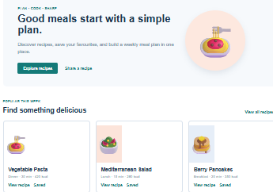
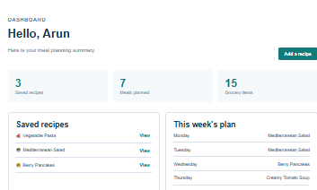
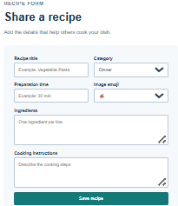
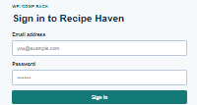
Frontend implementation screenshots
Inserting screenshots of the completed home page, forms, navigation, and dashboard.
.
Recipe Sharing Platform with Meal Planner
08
Notes:
Source: user-provided project abstract and presentation rules.

Slide 9
Database design
MongoDB stores user accounts, recipes, meal plans, and grocery lists.
Cloudinary stores recipe images outside the database.
The backend connects application requests to MongoDB and the Nutrition API.
Recipe Sharing Platform with Meal Planner
09
Notes:
Source: user-provided project abstract and presentation rules.

Slide 10
ER diagram
Recipe
Ingredient
User
Rating
Meal plan
Grocery list
Recipe Sharing Platform with Meal Planner
10
Notes:
Source: user-provided project abstract and presentation rules.

Slide 11
Database tables and schema
Proposed collections and key fields
Users
name
email
password
Recipes
title
ingredients
instructions
category
MealPlans
userId
week
recipes
GroceryLists
userId
items
Recipe Sharing Platform with Meal Planner
11
Notes:
Source: user-provided project abstract and presentation rules.

Slide 12
Sample database records
User
name: Arun
email: arun@example.com
Recipe
title: Vegetable Pasta
category: Dinner
MealPlan
week: 1
recipe: Vegetable Pasta
Recipe Sharing Platform with Meal Planner
12
Notes:
Source: user-provided project abstract and presentation rules.

Slide 13
Current progress and challenges
Project abstract submitted.
Technology stack identified.
Architecture and proposed data model prepared.
Frontend screenshots are pending.
Database tables and sample records are pending.
Implementation evidence is required for Review 2.
Recipe Sharing Platform with Meal Planner
13
Notes:
Source: user-provided project abstract and presentation rules.

Slide 14
Future work and conclusion
Build the frontend pages and navigation.
Implement the backend APIs and MongoDB collections.
Add Cloudinary image uploads and Nutrition API integration.
Capture evidence for the Review 2 demonstration.
The project aims to make recipe management, meal planning, and grocery preparation easier for users.
Recipe Sharing Platform with Meal Planner
14
Notes:
Source: user-provided project abstract and presentation rules.

