Slide 1
Arun N
2021506013
B.Tech Information Technology
Madras Institute of Technology
TNSDC - Machine Learning to
Generative AI
Final Project
DATE:04/04/2024

Slide 2
PROJECT TITLE
Image Caption
Generator using CNN and LSTM
GITHUB LINK:https://github.com/ArunAVFC/TNSDC-GenAi.git

Slide 3


AGENDA
Problem Statement
Project Overview
Objectives
End Users
Solution and Value Proposition
Model Explanation
Results
Conclusion
3/21/2024 Annual Review

Slide 4

PROBLEM STATEMENT
Generating descriptive captions for images presents a significant challenge in computer vision and natural language processing, particularly when aiming to capture the nuanced content of diverse visual scenes. Developing an effective image caption generator using deep learning techniques is essential for automating this process, enabling efficient and accurate creation of textual descriptions that enhance understanding and accessibility of visual content.

Slide 5

PROJECT OVERVIEW
Our project aims to develop an image caption generator using deep learning techniques, specifically Convolutional Neural Networks (CNNs) for extracting visual features and Long Short-Term Memory (LSTM) networks for generating descriptive captions. By integrating CNNs to analyze images and LSTM networks to process sequential data, we automate the process of generating accurate and contextually relevant descriptions.

Slide 6
OBJECTIVES
Develop a robust deep learning model capable of accurately generating descriptive captions for images.
Train the model on diverse datasets to ensure adaptability across different domains and content types.
Evaluate the performance of the model using established metrics to assess its effectiveness in generating coherent and relevant captions.

Slide 7

WHO ARE THE END USERS?
The proposed image caption generator targets a wide range of end users across various industries and applications, including social media platforms, e-commerce websites, accessibility tools, and educational resources.

Slide 8

YOUR SOLUTION AND ITS VALUE PROPOSITION
Our solution offers an automated and efficient method for generating descriptive captions for images, addressing the limitations of manual captioning. By employing deep learning techniques, the model can analyze visual content and generate accurate textual descriptions, thereby improving accessibility, searchability, and user engagement in image-centric
applications.

Slide 9
SYSTEM REQUIREMENTS
HARDWARE REQUIREMENTS
CPU: A multi-core processor (such as Intel Core i5 or higher) is recommended for efficient training and inference.
GPU (Optional): A dedicated graphics processing unit (GPU) from NVIDIA (such as GeForce GTX 1060 or higher) can significantly accelerate deep learning tasks, especially training large models like CNNs.
RAM: At least 8 GB of RAM is recommended for running deep learning frameworks and handling large datasets.
Storage: Sufficient disk space to store the dataset, trained models, and related files. SSDs are preferable for faster data access.

Slide 10
SYSTEM REQUIREMENTS
SOFTWARE REQUIREMENTS
.Python: Python 3.x installed with essential libraries such as NumPy, pandas, and Matplotlib.
Deep Learning Framework: TensorFlow or PyTorch for building and training the CNN model. The code provided in the project uses TensorFlow.
Image Processing Libraries: Libraries like OpenCV and PIL (Python Imaging Library) for image pre-processing and augmentation.
Development Environment: An integrated development environment (IDE) like Jupyter Notebook or PyCharm for coding and experimentation.
Additional Dependencies: Libraries such as scikit-learn, seaborn, and h5py may be required for data analysis, visualization, and model serialization

Slide 11
Algorithm:
The CNN extracts visual features from images, while the LSTM generates sequential captions based on these features, enabling accurate and contextually relevant image captioning.
Deployment:
The trained CNN model can be deployed across diverse environments like local machines, cloud platforms (Google Cloud, AWS, Azure), and edge devices (Raspberry Pi, NVIDIA Jetson), serialized in HDF5 format for easy sharing and storage.
Evaluation:
Utilizing split datasets for training, validation, and testing, the project evaluates the CNN model's performance using metrics like accuracy, precision, recall, and F1-score, offering insights into its classification capabilities.
Prediction:
This project predicts descriptive captions for images using deep learning techniques, enhancing accessibility and understanding of visual content across diverse applications.

Slide 12
MODELLING
1. Convolutional Neural Network (CNN):
In the ImageCaptionGenerator model, the CNN component is not explicitly defined but is represented by the pre-trained CNN feature extractor such as ResNet, VGG, or Inception. These pre-trained CNNs are typically trained on large-scale image classification tasks and have learned to extract high-level features from images effectively. By removing the fully connected layers of the CNN and using only the convolutional layers, we can obtain image features that are spatially meaningful and semantically rich. These features serve as the input to the LSTM network for caption generation.

Slide 13
MODELLING
2. Long Short-Term Memory (LSTM) Network:
The LSTM network is a type of recurrent neural network (RNN) designed to capture long-range dependencies and temporal dynamics in sequential data. In the ImageCaptionGenerator model, the LSTM is responsible for generating descriptive captions based on the extracted image features. The LSTM receives the image features as input, along with special start tokens representing the beginning of the caption sequence. It then iteratively generates the caption one word at a time, taking into account the context of previously generated words. This process continues until an end token is predicted or a maximum caption length is reached.

Slide 14
RESULTS
Evaluation of the image caption generator demonstrates its effectiveness in generating descriptive captions for a diverse range of images. Performance metrics such as BLEU score indicate the model's ability to produce captions that closely align with human-generated references, thereby validating its utility and reliability in real-world applications.

Slide 15
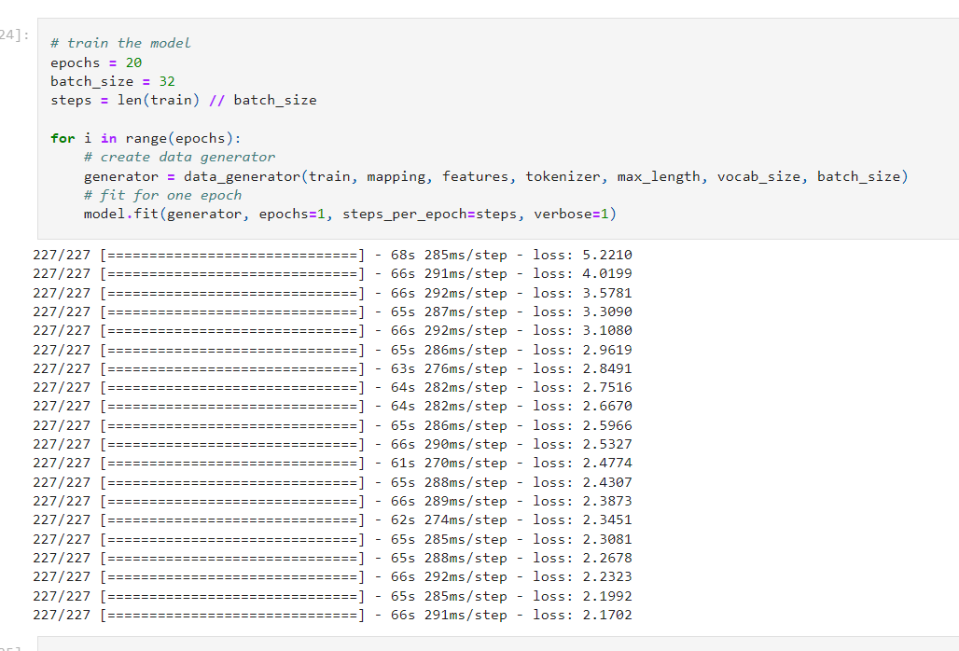
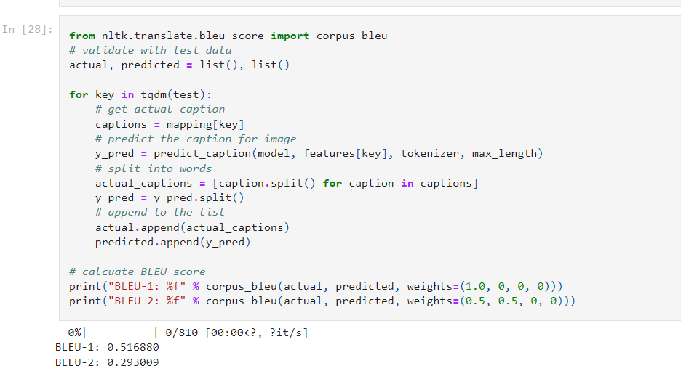
RESULTS

Slide 16
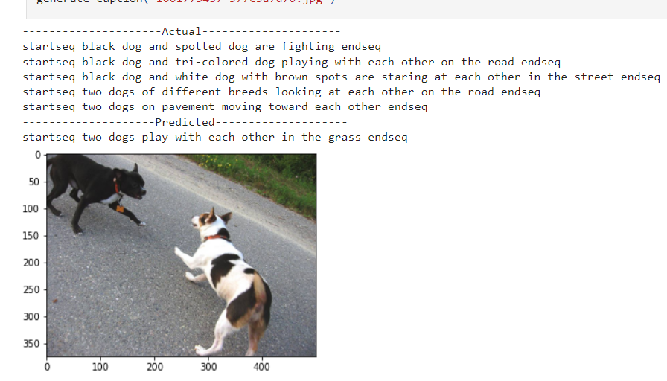
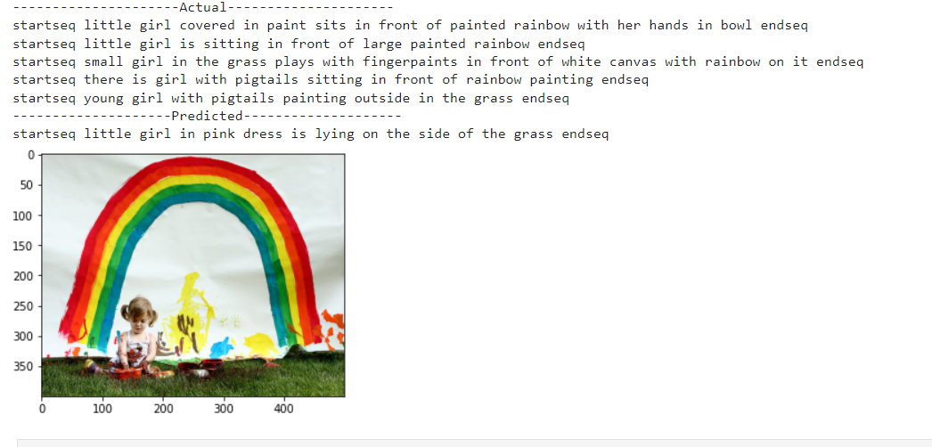
RESULTS

Slide 17
CONCLUSION
In conclusion, the developed image caption generator represents a significant advancement in automated image description, offering a scalable and accurate solution for generating textual captions. By streamlining the process of image captioning, our solution enhances accessibility, searchability, and user engagement across various domains, paving the way for further innovation in computer vision and natural language processing.
Reference:
GITHUB LINK:https://github.com/ArunAVFC/TNSDC-GenAi.git

