Slide 1

Classification of Jobs in High Performance Computing
Vaibhav Trivedi (G01009749)
Vamsi Krishna Reddicherla (G01039349)
Venkata jayendra kumar lade (G01046700)
Arun Reddy Bollam (G01040932)

Slide 2
Agenda
Problem Description
2
Dataset
3
Predictive Modeling
4
Conclusion
1

Slide 3
Problem Description
High Performance Computing is used to facilitate large scale computations in highly reliable and sophisticated environment.
It can handle a large number of programs simultaneously but to get the result in the most efficient manner, scheduling the jobs is very critical task.
Objective: To classify every jobs for scheduling purpose.

Slide 4
Dataset
R-package: “AppliedPredictiveModeling”
data(schedulingData)
Number of Instances: 4331
Number of Features: 7
Protocol – Type of Computation
Compounds – Number of data points for each job
InputFields – Number of characteristics being estimated
Iterations – Max iterations required
NumPending – Pending jobs at launch
Hour – Launch time
Day – Day of launch
Response variable: Class (VF – very fast, F – fast, M – Moderate, L - Long)

Slide 5
Logistic Regression?

Slide 6
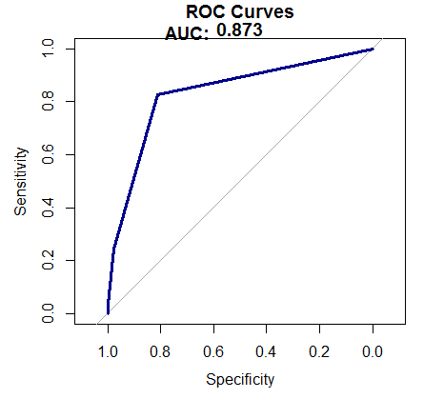
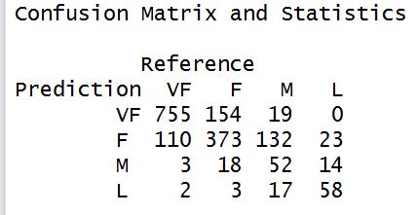
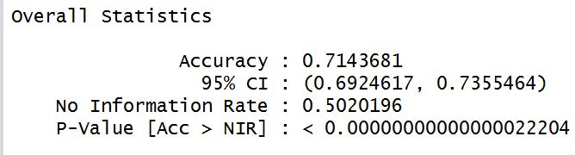
Multinomial Logistic Regression
Multinomial logistic regression is a classification method that
generalizes logistic regression to multiclass problems, i.e.
with more than two possible discrete outcomes.
Accuracy: 71.44%
AUC: 0.873

Slide 7
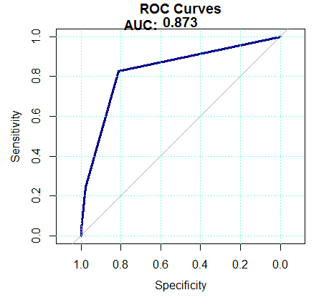
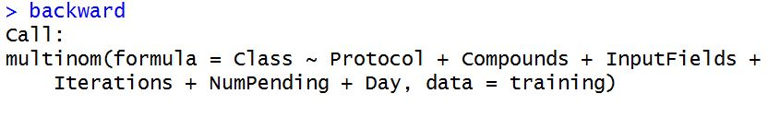
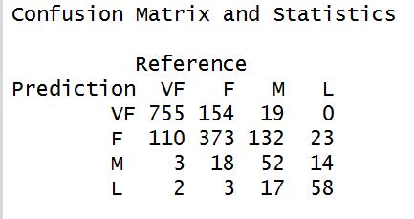
MLR – Backward Selection
Backward selection method on previously created
Multinomial Logistic Regression.
Accuracy: 71.44%
AUC: 0.873

Slide 8
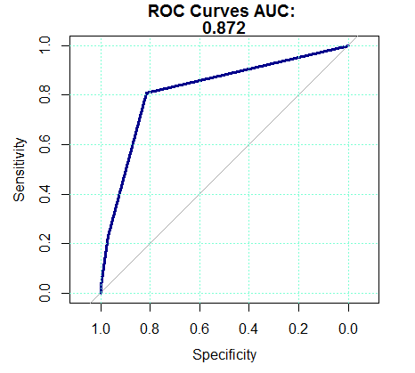
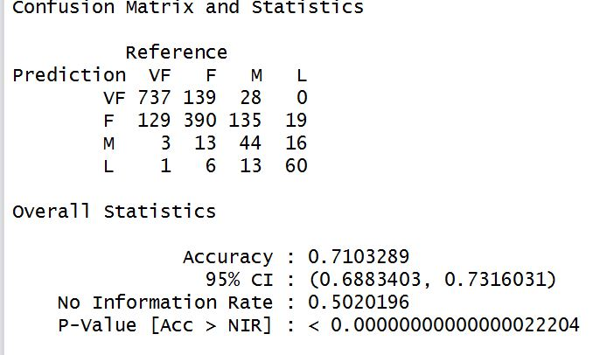
CART
Classification and Regression Trees
CART algorithm performs a recursive procedure by which the target variable is divided into various groups based on a decision rule that is designed to optimize the impurity measurement as each one of the successive groups are formed
Accuracy: 71.03%
AUC: 0.87

Slide 9
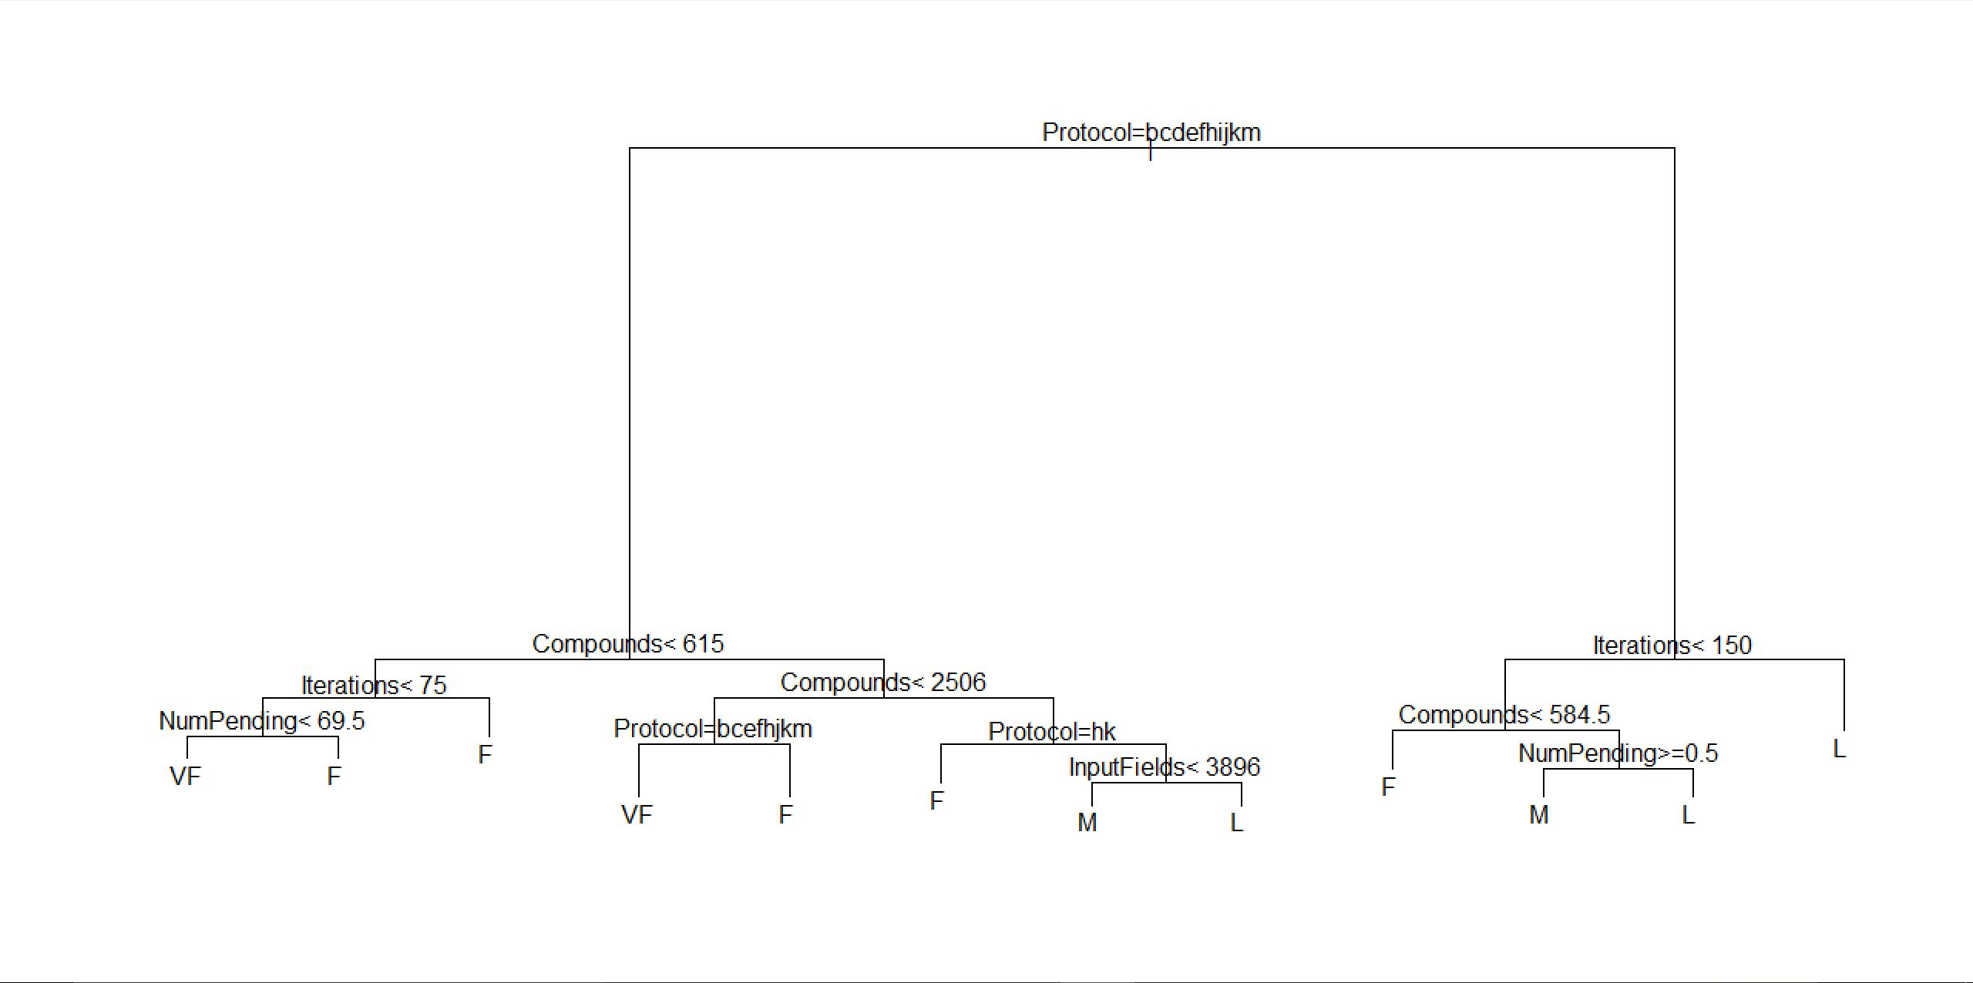
CART Tree

Slide 10
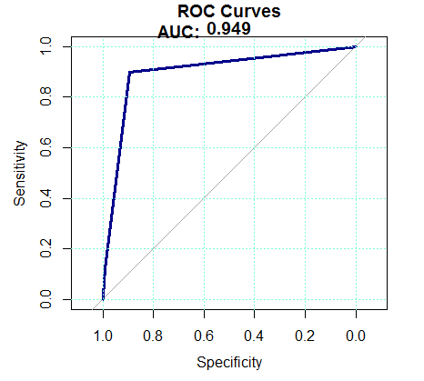
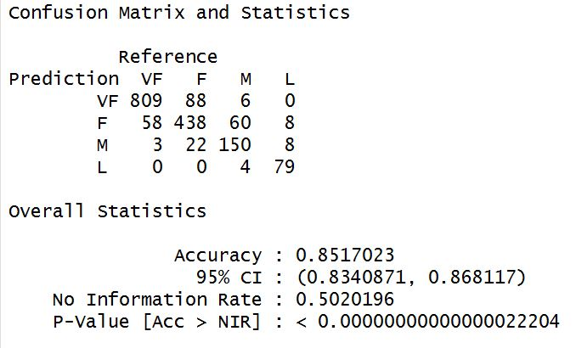
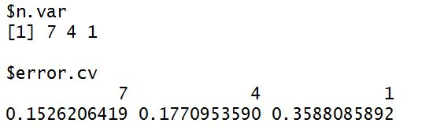
Random Forest
Build several decision trees on bootstrapped training sample, but when building these trees, each time a split in a tree is considered, a random sample of 𝑚 predictors is chosen as split candidates from the full set of 𝑝 predictors.
Accuracy: 85.17%
AUC: 0.95
5-folds Cross validation on Random Forest

Slide 11
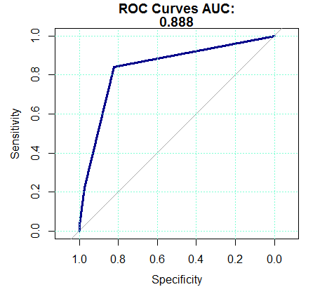
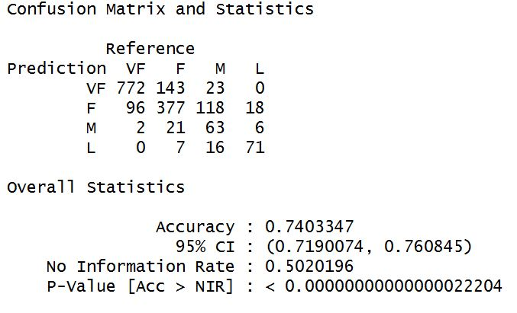

Bagging
Bagging is a special case of Random Forest where m=p.
Bootstrap Aggregation is the way decrease the variance of your prediction by generating additional data for training from your original dataset using combinations with repetitions to produce multisets of the same cardinality/size as your original data
Accuracy: 74.03%
AUC: 0.88
5-folds Cross validation on Bagging

Slide 12
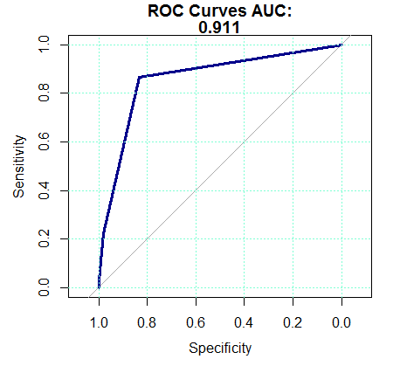
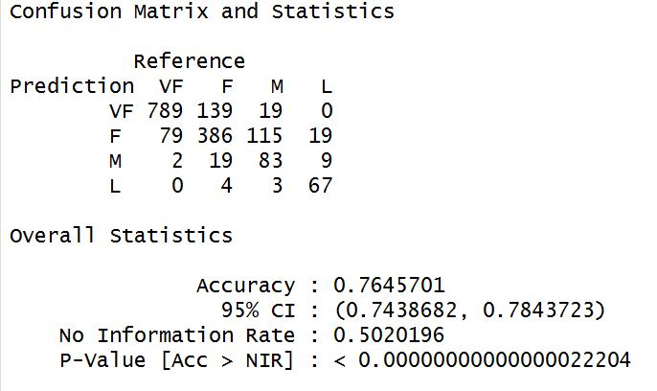

Boosting
Boosting is a two-step approach, where one first uses subsets of the original data to produce a series of averagely performing models and then "boosts" their performance by combining them together using a particular cost function (=majority vote).
Accuracy: 76.45%
AUC: 0.91
5-folds Cross validation on Boosting

Slide 13
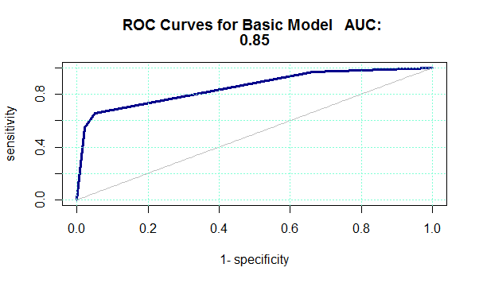
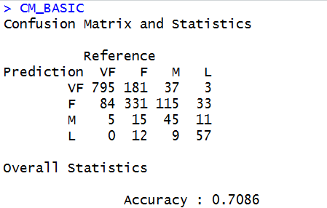
Support Vector Machine
A Support vector machine is a discriminative classifier formally defined by a separating hyperplane. The algorithm outputs an optimal hyperplane which categorizes new examples.
Accuracy: 70.86%
AUC: 0.85

Slide 14
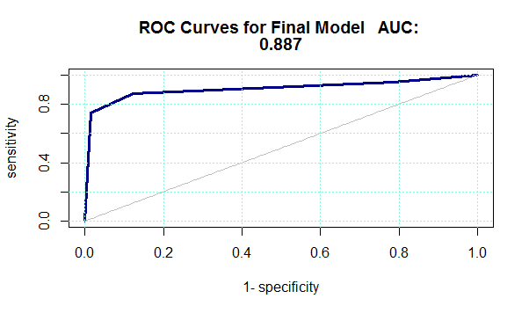
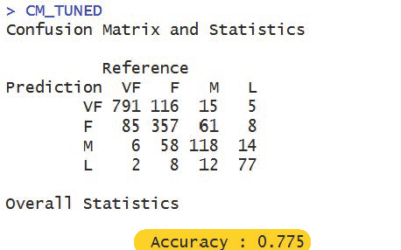
SVM – Optimized

Slide 15
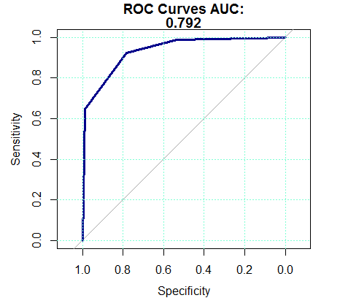
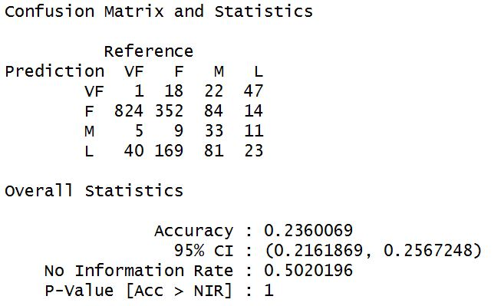
Naïve Bayes
Naive Bayes classifiers are a family of simple probabilistic classifiers based on applying Bayes' theorem with strong (naive) independence assumptions between the features.
Accuracy: 23.6%
AUC: 0.792

Slide 16
Model Selection
Classifier | Accuracy
MLR | 71.43%
MLR – Backward Selection | 71.43%
CART | 71.03%
Random Forest | 85.17%
Bagging | 74.03%
Boosting | 76.45%
SVM – Basic | 70.86%
SVM – Optimized | 77.50%
Naïve Bayes | 23.60%

Slide 17
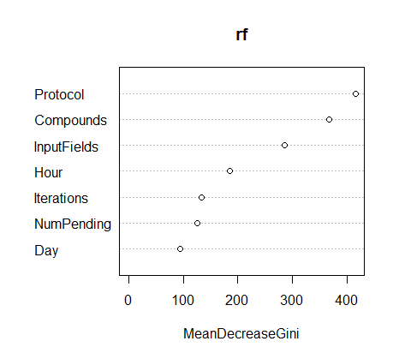
Conclusion
Among all models, Random Forest gives the most accurate predictions.
Protocol, Compounds and InputFields are top 3 predictors.

Slide 18
Thank You

