Slide 1
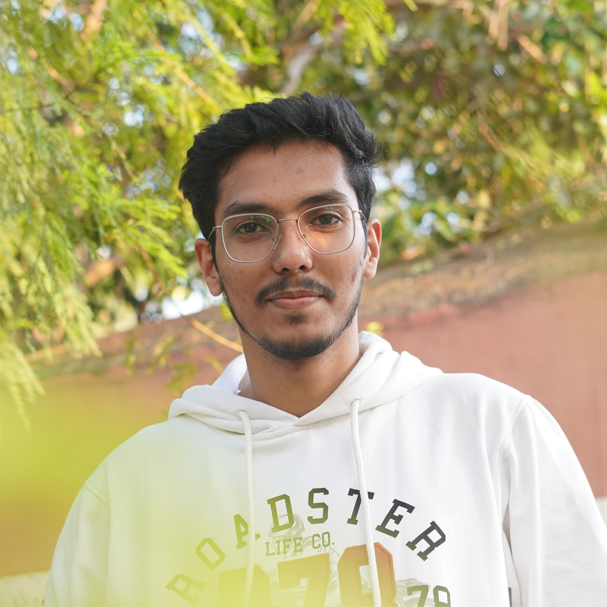
Arun Gulia Analyst/Software Engineer arun.gulia@capgemini.com +91 8978873807 A4 Grade
KEY ASSIGNMENTS
Capgemini Engineering, Bengalore (July 2022 – Current)
Technical Developer
Railway Ticket Booking System Application
Completed end to end POC of Railway ticket booking system Application along with JWT authentication, Swagger and payment testing using MERN Stack. Material-UI and React Bootstrap used for user interface with spring framework multi microservice architecture with API development stored data in Mongo DB.
CHARTER MOBILE IT
Part of the mobile IT FF4J(feature flagging service) FF4j can be used in any java application (including Android). The single dependency you must specified in pom.xml is ff4j-core. It contains an in-memory implementation for each store. On top of it, you add extra dependencies to define which database technology to use. Feature Store, Property Store and Event Repository don't have to use the same storage technology. As FF4j provides REST-API and a web console. Have worked on UI part with HTML, CSS, Bootstrap
CAMUNDA SPRING BOOT
Created a Business flow automation using Camunda Business rule tasks, sent API request from postman for testing with Mongo DB. Implemented DMN tables with a BPMN (Business process Model and Notation) to automate the Order fulfilment process using EXTERNAL TASK CLIENT of Spring Boot Application
KEY SKILLS
Core Skills Java 8 & 11
Spring Boot
Spring MVC
Apache Tomcat Standalone Server
Database
No SQL database – MongoDB
SQL database – Postgres
Web Technologies
HTML5 and CSS
Bootstrap
JavaScript
ReactJS
Dev-Ops
Git & GitHub
Docker
Postman
Cloud Skill
Azure
Business Skill
Camunda Modeler
BPMN , DMN
Education
Having 1+ years of expertise in microservice java applications with Spring boot, Spring MVC , REACT JS with Database. Ready to learn new technologies and implement them to further improve my knowledge.
Eager to work in a team of dedicated people and serve a key role in the enhancement and development of the project.
Languages
Bachelor of Engineering Electronic and Communication: 2018 - 2022
English
Telugu
Hindi

