Slide 1
MPTS-(Modern Periodic Table Safari)
This application is about the learning process which is done online
Users can login into this system following a registration process. Login is done bye using the OTP system. They are able to see the list of elements and its information. The features and uses of each elements are available. Organic and inorganic compounds of elements are available. There is a feedback system for the users. Users are provided with the periodic table.
Admin manages the whole application
Thus this project will help users to get information about the modern periodic table.
Technology – Android
Database - Firebase

Slide 2
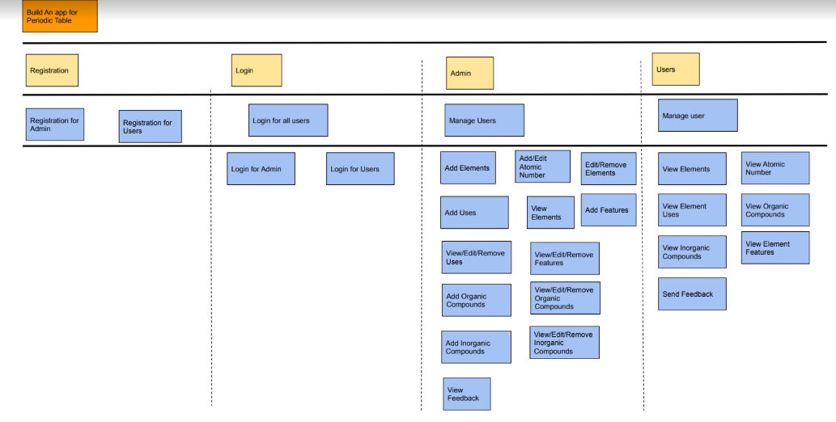
Userstory

Slide 3
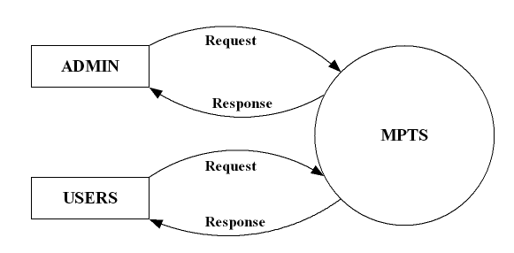
Data Flow Diagram (DFD)
Context Level DFD

Slide 4
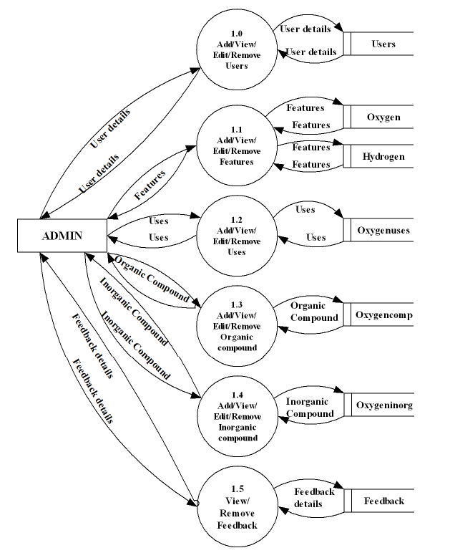
Level 1 -ADMIN

Slide 5
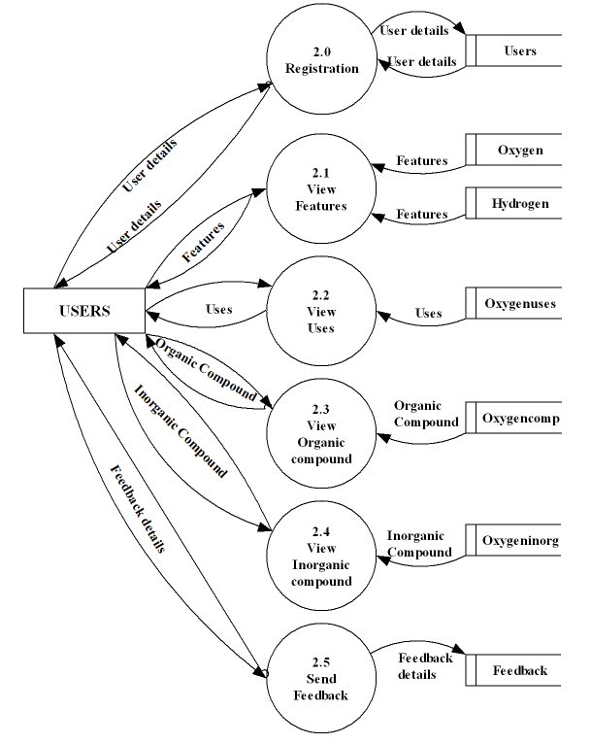
Level 1 -USERS

Slide 6
Database Design
1- Users
Field | Data type | Description
user UID | String | User id
identifier | Integer | Mobile number
email id | String | Email address
Password | String | Password
Provider | String | Sign in method
created | Date | Date of creation
Signed in | Date | Date of sign in

Slide 7
2 -Oxygen
Field | Data type | Description
featureid | String | Feature id
features | String | Features of oxygen
3 -Hydrogen
Field | Data type | Description
featureid | String | Feature id
features | String | Features of hydrogen

Slide 8
4 -Oxygenuses
Field | Data type | Description
useid | String | User id
uses | String | Uses of oxygen
5 -Oxygencomp
Field | Data type | Description
organicid | String | Organic id
organiccompund | String | Organic compounds of oxygen

Slide 9
6 –Oxygeninorg
Field | Data type | Description
inorganicid | String | inorganic id
inorganiccompund | String | inorganic compounds of oxygen
7 -Feedback
Field | Data type | Description
feedbackid | String | Feedback id
fd | String | Feedback

Slide 10
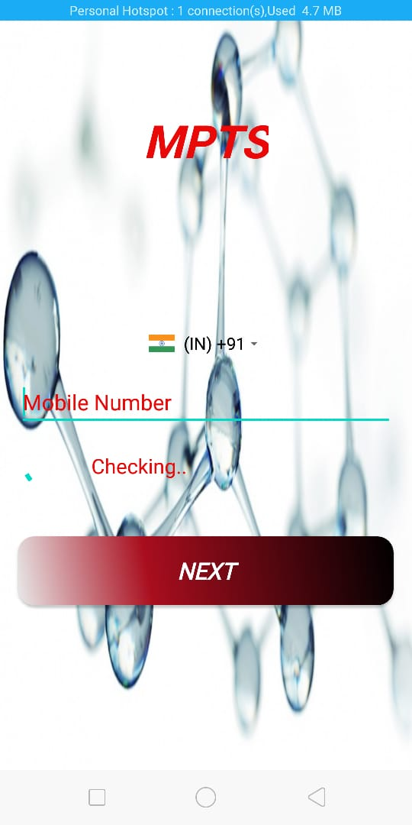
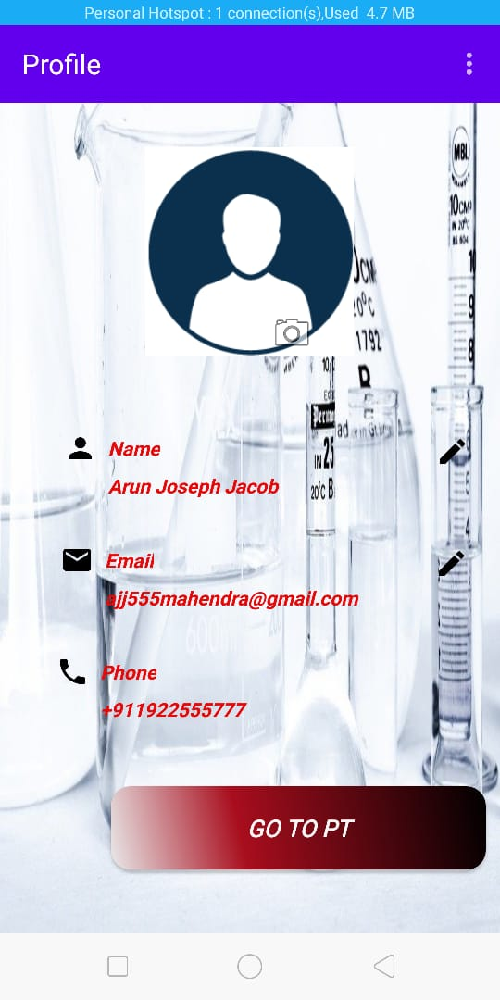
PROJECT SCREENSHOTS
User – Login
User – Profile

Slide 11
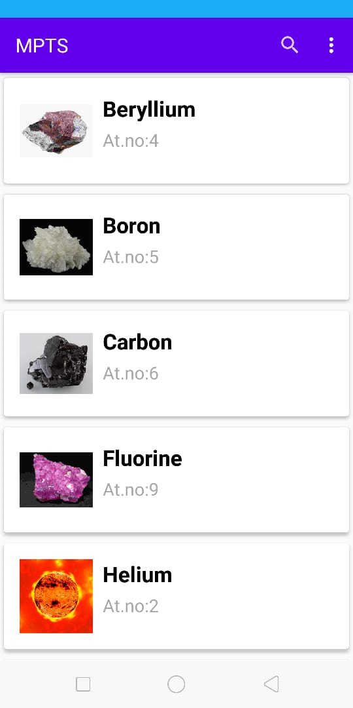
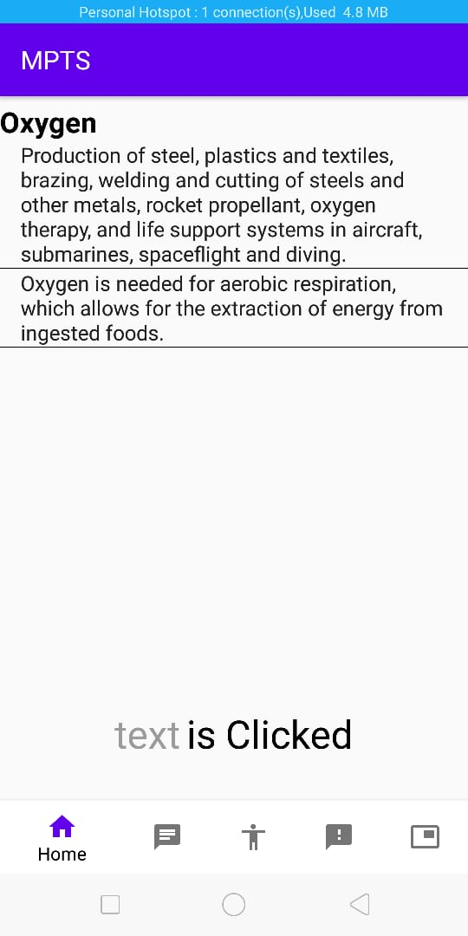
User – View Elements
User – View Element Uses

Slide 12
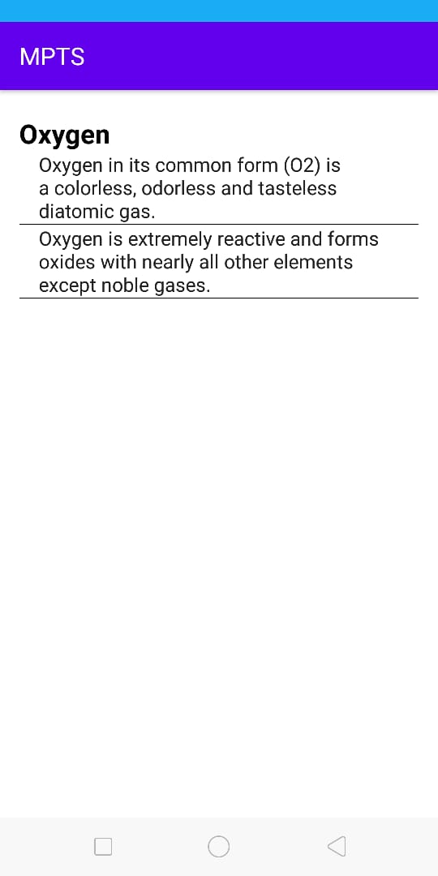
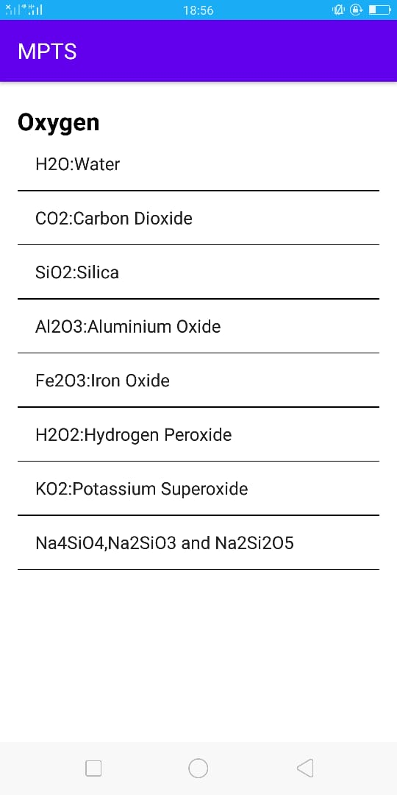
User – View Element Features
User – View Inorganic Compound

Slide 13
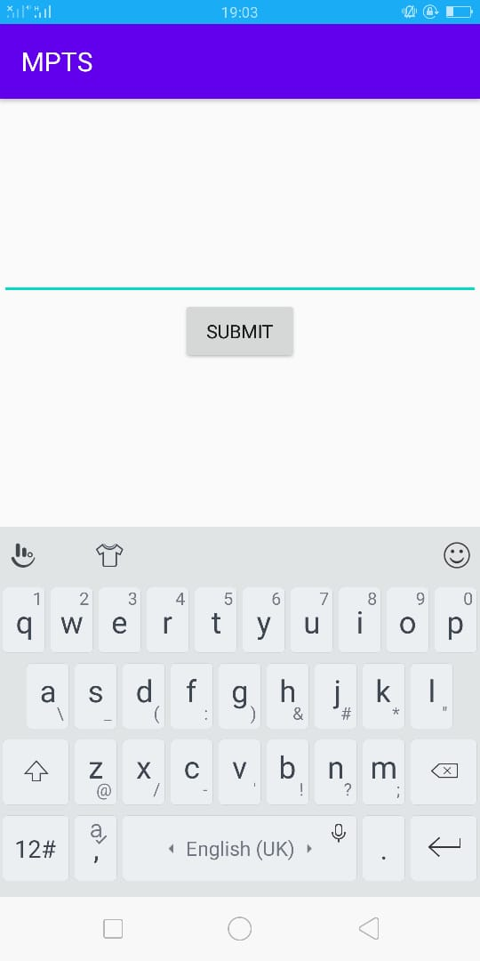
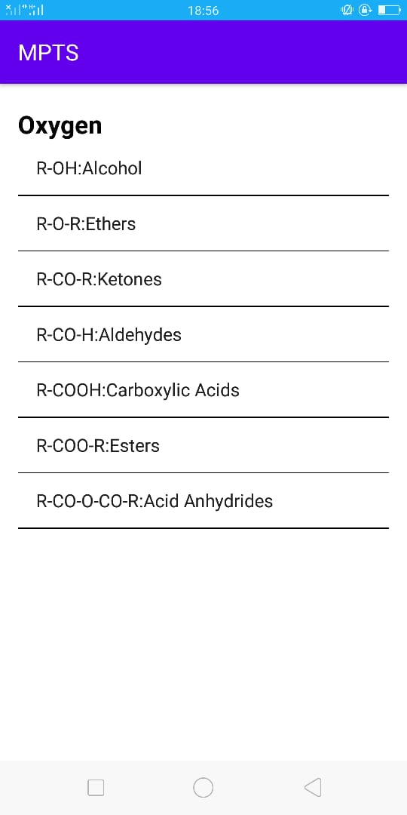
User – View Organic Compound
User – Submit Feedback

Slide 14
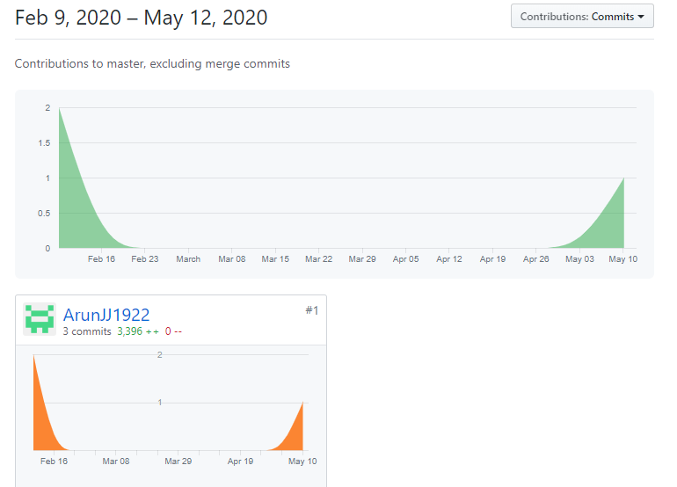
Git Contribution & Commit History

Slide 15
