Slide 1
Bank Marketing Campaign - Intelligent Targeting

Slide 2
OBJECTIVE:
To find out the customer segments who subscribed to term deposit previously and identifying the factors common among them
To predict build a predictive model which helps to find out the ways to make the marketing campaigns more efficient.
DATA DESCRIPTION:
The dataset had 11162 data points and 17 variables
https://archive.ics.uci.edu/ml/datasets/Bank+Marketing

Slide 3
Dependent variable (Y):
Deposit - Shows whether the customer has subscribed to a term deposit, Binary
Independent variables (X):
Age: Shows age of customer contacted , Numeric
Balance: Balance of the individual , Numeric
Contact: Contact communication type , Categorical
Education: Level of education, Categorical
Housing: If the customer has housing loan, Categorical
Personal Loan: If the customer has a personal loan, Categorical
Marital Status: If the customer is Married, Categorical
Job: Type of job , Categorical
Month: Last contact month of year , Categorical
Day: Last contact day of the month , Numeric
Duration: Last contact duration, in seconds , Numeric
Campaign: Number of contacts performed during this campaign for a customer, Numeric

Slide 4
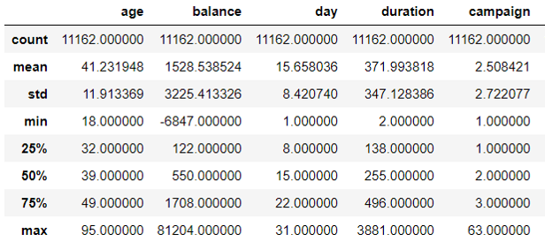
METHODOLOGY:
Data Preprocessing
Exploratory Data analysis
Find Pearson correlation coefficient
Identify Significant Independent variables
Recursive Feature Elimination
Construct Models
Check for statistical significance
Calculate Performance Metrics
DESCRIPTIVE STATISTICS:

Slide 5
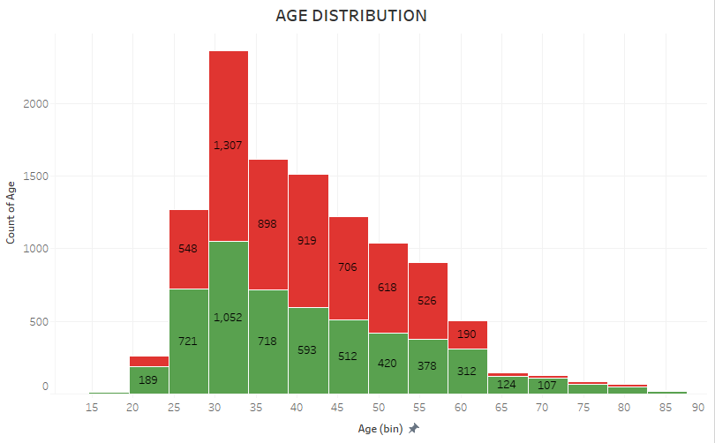
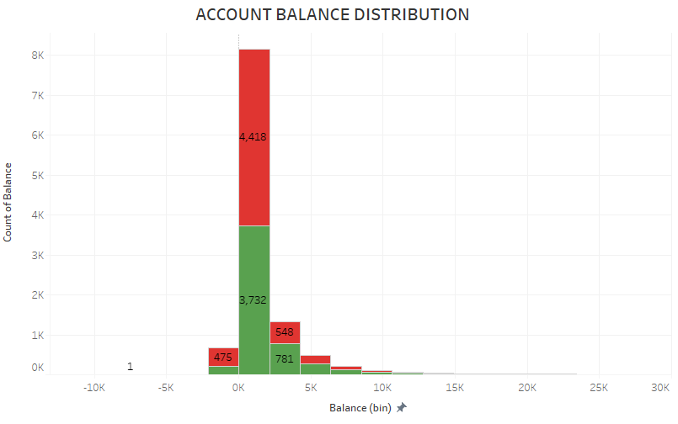
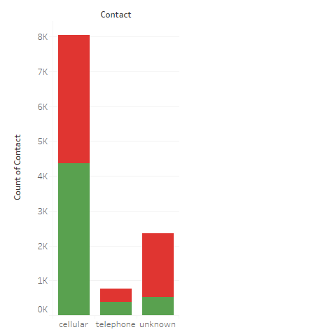
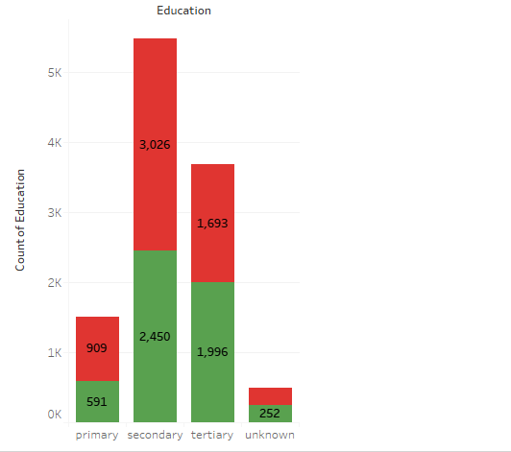
EXPLORATORY DATA ANALYSIS:
AGE
ACCOUNT BALANCE
SOURCE OF CONTACT
EDUCATION

Slide 6
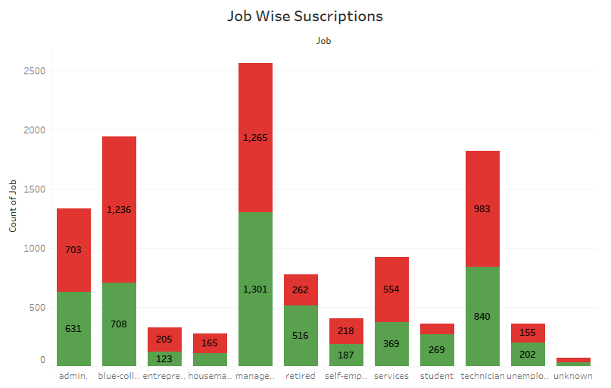
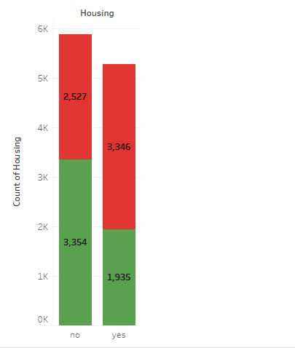
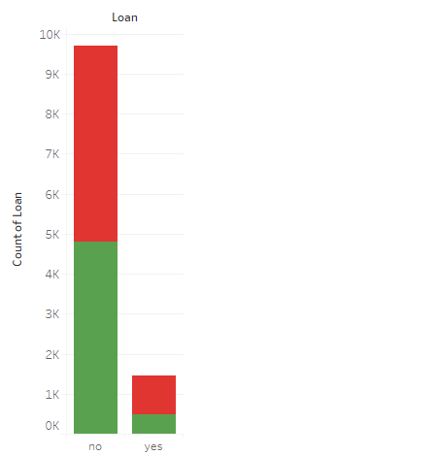
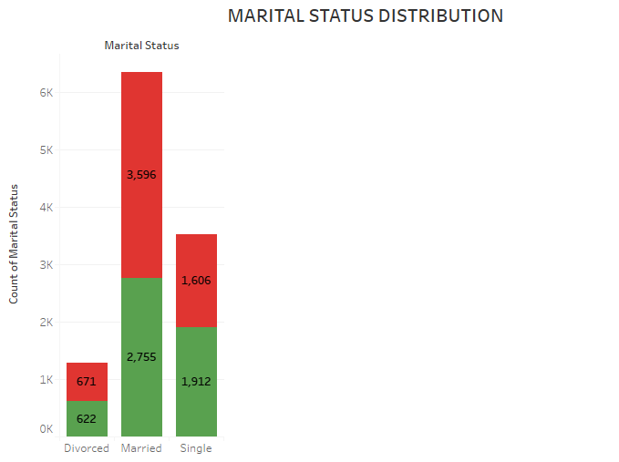
EXPLORATORY DATA ANALYSIS:
HOUSING LOAN
JOB
PERSONAL LOAN
MARITAL STATUS

Slide 7
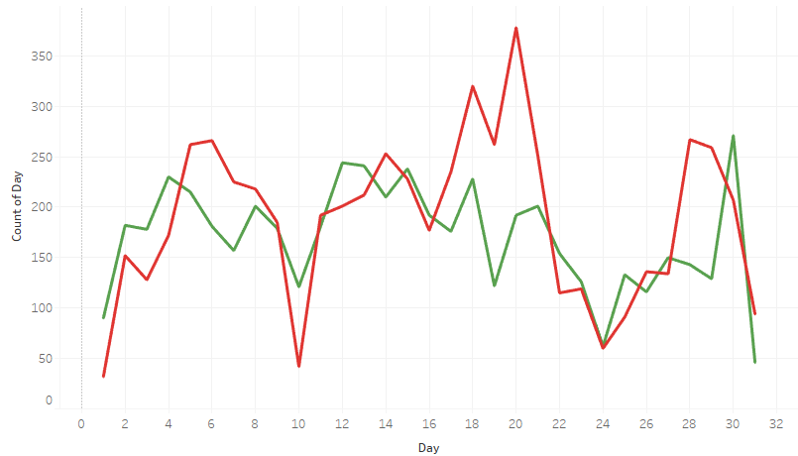
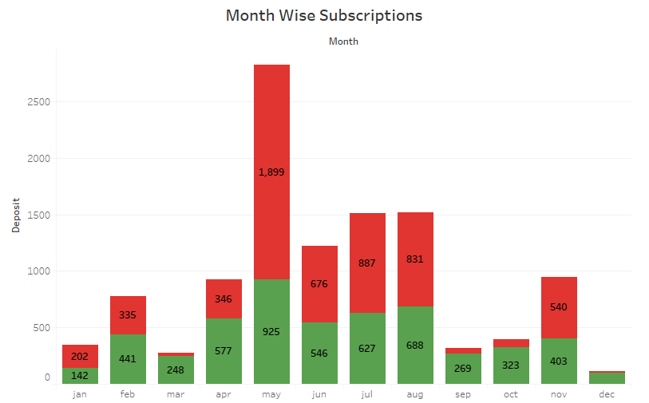
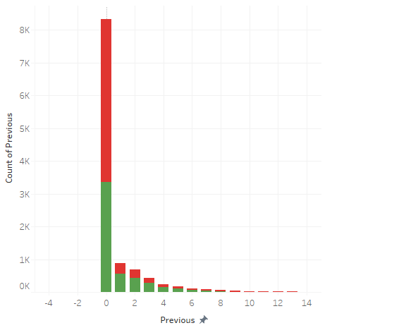
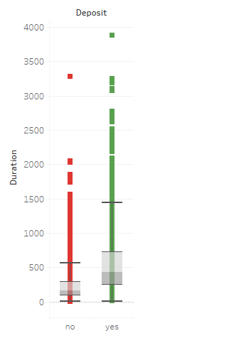
EXPLORATORY DATA ANALYSIS:
DAY -> First half of the month
Month -> Season 1 & Season 2
PREVIOUS CONTACTS
DURATION

Slide 8
CORRELATION WITH THE DEPENDENT VARIABLE:
VARIABLE CORRELATION
Campaign -0.128081
Housing Loan -0.203888
Personal Loan -0.110580
Job_blue-collar -0.100840
Day -0.056326
Job_services -0.044531
Job_entrepreneur -0.034443
Job_housemaid -0.024155
Job_technician -0.011557
Job_self-employed -0.004707
Job_admin -0.000610
Job_umemployed 0.033487
Age 0.034901
Job_management 0.036301
Balance 0.081129
Job_student 0.099953
Job_retired 0.103827
Duration 0.451919
Deposit 1.000000

Slide 9
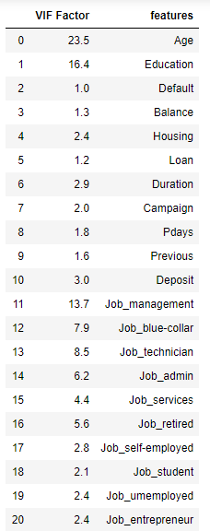
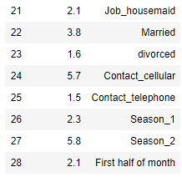
MULTI-COLLINEARITY
No perfect Multi-collinearity exists
Dummy variable trap is taken care
No two independent variables exhibit Imperfect Multi-collinearity more than a threshold of 0.3
VARIANCE INFLATION FACTOR
High VIF values for education and some of the jobs
Education will be positively correlated with the job
Hence to avoid the issue of Multi-collinearity we haven’t included jobs and education together in any of the models
RECURSIVE FEATURE ELIMINATION
It is based on the idea to repeatedly construct a model and choose either the best performing feature, setting the feature aside and then repeating the process with the rest of the features

Slide 10
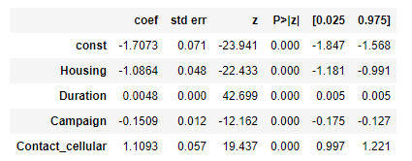
LOGIT REGRESSION:
P (Subscribing to the deposit) = Sigmoid ( -1.7073 - 1.0864*(Housing)+ 0.0048*(Duration) + 1.1093 * (Contact_cellular) - 0.1509*(Campaign) )
OUTPUT:
INTERPRETATION
Keeping all other variables constant if the duration of the call increases from 1 minute (60 sec) to 5 min (300 sec) then the probability of subscribing to the deposit increases from 0.175 to 0.40244 which is 23 % increase

Slide 11
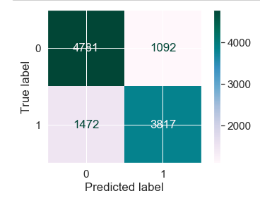
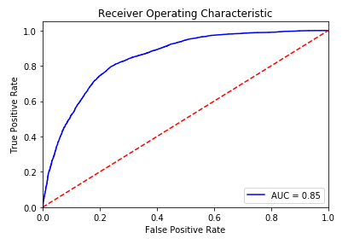
PERFORMANCE METRICS:
Total Data points | 11162
True Positives | 3817
True Negatives | 4731
False Positives | 1092
False Negatives | 1472
Accuracy Score | 0.76
Sensitivity | 0.72
Specificity | 0.81

Slide 12
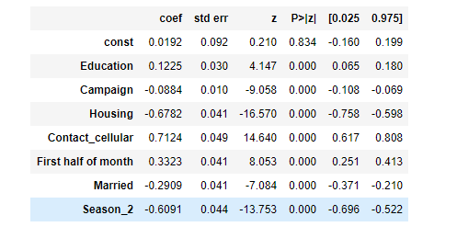
LOGIT REGRESSION: (Excluding Duration)
P (Subscribing to the deposit) = Sigmoid ( 0.0192 + 0.1225 (Education) – 0.0884 (Campaign) – 0.6782(Housing) + 0.7124 (Contact Cellular) + 0.3323
(First Half of the month) – 0.2909 (Married) – 0.6091 (Season_2) )
OUTPUT:
INTERPRETATION
Keeping all other variables constant if the campaign contacts increases from 1 to 5 times then the probability of subscribing to the deposit decreases from 0.41 to 0.29 which is 12 % decrease

Slide 13
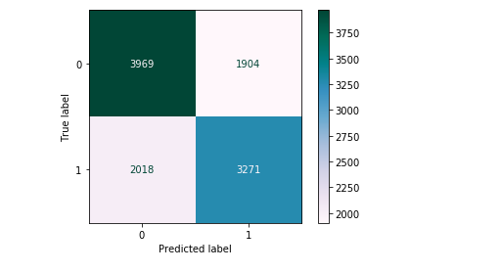
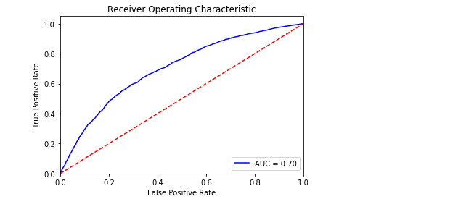
PERFORMANCE METRICS:
Total Data points | 11162
True Positives | 3271
True Negatives | 3969
False Positives | 1904
False Negatives | 2018
Accuracy Score | 0.648
Sensitivity | 0.62
Specificity | 0.67

Slide 14
REGRESSION SUMMARY:
 | MODEL 1 Including duration variable |  | MODEL 2 Excluding duration variable
 | PROBIT | LOGIT | PROBIT | LOGIT
Intercept | -0.9548 | -1.7073 | 0.0102 | 0.0192
Duration | 0.0025 | 0.0048
Education |  |  | 0.0743 | 0.1225
Campaign | -0.0834 | -0.1509 | - 0.0500 | -0.0884
Housing Loan | -0.6171 | -1.0864 | - 0.4121 | -0.6782
Contact Cellular | 0.6500 | 1.1093 | 0.4342 | 0.7124
First Half of the Month |  |  | 0.2011 | 0.3323
Married |  |  | - 0.1785 | -0.2909
Season 2 |  |  | - 0.3775 | -0.6091

Slide 15
OMITTED VARIABLE BIAS:
Other Similar deposits the customer has subscribed
Other Investments
Taxable income
Spending Habit
Interest rate
CONCLUSION:
The Recommendations for the next Marketing campaign are-
EDUCATION- Customers with good education should be contacted as they are more likely to subscribe to the term deposit.
CAMPAIGN- Same Customer should not be contacted a large number of times
HOUSING- Customer with a housing loan is less likely to subscribe to the term deposit.
CELLULAR CONTACT- Customer should be contacted through cell phone
FIRST HALF OF THE MONTH- Customers should be contacted in first half of the month, as we can see a higher conversion rate
MARRIED- Priority should be Unmarried customers as married customers are less likely to subscribe to the term deposit.
SEASON 2- Customers contacted in second season (May - Aug) of the year are less likely to subscribe to the term deposit.

