Slide 1

AAA
College of Engineering and Technology
(An Autonomous Institution)
Accredited by NBA (CIVIL,CSE, ECE, EEE, MECH),
NAAC with ‘A’ Grade, An ISO 21001: 2018 Certified Institution
(Approved by AICTE, New Delhi & Affiliated to Anna University, Chennai)
Amathur, Sivakasi - 626 005.
Department of Artificial Intelligence and Data Science

Slide 2

AAA College of Engineering and Technology
01
TITLE
PROJECT TITLE
MULTI-ENVIRONMENT CONFIGURATION MANAGEMENT WITH HELM
BATCH NAME:
1. ARUN KUMAR T (953724243007)
2. PRIYAN M (953724243040)
SUPERVISOR
[SUPERVISOR NAME]
[DESIGNATION] / AI&DS
Department of Artificial Intelligence and Data Science

Slide 3
AAA College of Engineering and Technology
02
PROBLEM DESCRIPTION
Every application runs in development, testing, staging and production, and each environment needs different settings (replicas, resource limits, log levels, feature flags). Keeping a copy of the Kubernetes manifests per environment makes the copies drift apart, and a wrong value is found only after deployment.
A change must be repeated in every copy, secrets are often written into manifests, nothing checks the values before deployment, and a failed release is hard to undo because no revision history is used.
Hence, this project is proposed: one Helm chart with a small values file per environment, a JSON Schema that validates the values, release history with rollback, and a GitHub Actions pipeline that deploys all four environments to a cluster.
Department of Artificial Intelligence and Data Science

Slide 4
AAA College of Engineering and Technology
03
OBJECTIVE
Develop a Flask dashboard showing name, environment, version and configuration.
Package the application as one Docker image (non-root) used in every environment.
Create one reusable Helm chart for development, testing, staging and production.
Keep every environment difference in a small values file (replicas, resources, flags).
Validate values with a JSON Schema, helm lint, helm template and kubeconform.
Deploy with helm upgrade --install --atomic; test, upgrade and roll back releases.
Keep secrets out of Git; verify with 62 pytest cases and GitHub Actions.
Department of Artificial Intelligence and Data Science

Slide 5
AAA College of Engineering and Technology
04
ZERO REVIEW QUERIES SUGGESTION
S.no | Query/Corrections/Suggestion | Response
1. | Explain the implementation clearly. | Flask image + one Helm chart + 4 values files; deploy.sh installs; helm test verifies.
2. | Explain the project based on the main problem. | Problem: copied, unchecked manifests drift apart. Fix: one chart, values files, schema.
3. | Provide a detailed Root Cause Analysis. | Cause: configuration copied per environment, not validated, no history. Fix: chart, schema, rollback.
4. | Specify the implementation location. | Dev machine and a kind cluster in GitHub Actions; repo arunkumar071106/new.
Department of Artificial Intelligence and Data Science

Slide 6
AAA College of Engineering and Technology
05
LITERATURE SURVEY 1
Name of the Paper | An Empirical Study on Configuration Errors in Commercial and Open Source Systems
Year of Publish | 2011
Name of the Authors | Z. Yin, X. Ma, J. Zheng, Y. Zhou, L. N. Bairavasundaram, S. Pasupathy
Name of the Journal | ACM SOSP (23rd Symposium on Operating Systems Principles)
Methodology | Studies 546 real misconfiguration cases from commercial and open-source systems.
Inferences | Many misconfigurations are illegal parameter values, so settings should be typed and checked before deployment.
Department of Artificial Intelligence and Data Science

Slide 7
AAA College of Engineering and Technology
06
LITERATURE SURVEY 2
Name of the Paper | Systems Approaches to Tackling Configuration Errors: A Survey
Year of Publish | 2015
Name of the Authors | T. Xu, Y. Zhou
Name of the Journal | ACM Computing Surveys, vol. 47, no. 4
Methodology | Surveys techniques to prevent, detect and diagnose configuration errors.
Inferences | Prevention and detection before deployment are separate from diagnosis: schema (prevention); lint, tests and CI (detection).
Department of Artificial Intelligence and Data Science

Slide 8
AAA College of Engineering and Technology
LITERATURE SURVEY 3
07
Name of the Paper: | Characterizing Defective Configuration Scripts Used for Continuous Deployment
Year of Publish: | 2018
Name of the Authors: | A. Rahman, L. Williams
Name of the Journal: | IEEE ICST (11th Int. Conf. on Software Testing, Verification and Validation)
Methodology: | Analyses defects in open-source configuration scripts that are used for continuous deployment.
Inferences: | Configuration code is defect-prone, so the chart and values need review, version control and automated tests.
Department of Artificial Intelligence and Data Science

Slide 9
AAA College of Engineering and Technology
08
LITERATURE SURVEY 4
Name of the Paper | Security Misconfigurations in Open Source Kubernetes Manifests: An Empirical Study
Year of Publish | 2023
Name of the Authors | A. Rahman, S. I. Shamim, D. B. Bose, R. Pandita
Name of the Journal | ACM Transactions on Software Engineering and Methodology
Methodology | Analyses 2,039 Kubernetes manifests from 92 repositories and finds 11 categories of security misconfiguration.
Inferences | Missing resource limits and weak security contexts are common; our chart sets limits, a non-root user and drops capabilities.
Department of Artificial Intelligence and Data Science

Slide 10
AAA College of Engineering and Technology
09
LITERATURE SURVEY 5
Name of the Paper | Helm Charts for Kubernetes Applications: Evolution, Outdatedness and Security Risks
Year of Publish | 2023
Name of the Authors | A. Zerouali, R. Opdebeeck, C. De Roover
Name of the Journal | IEEE/ACM MSR (20th Int. Conf. on Mining Software Repositories)
Methodology | Analyses 9,482 Helm charts and their container images for outdated and vulnerable components.
Inferences | Public charts often carry outdated or vulnerable components, so our chart pins versions and uses a slim base image.
Department of Artificial Intelligence and Data Science

Slide 11
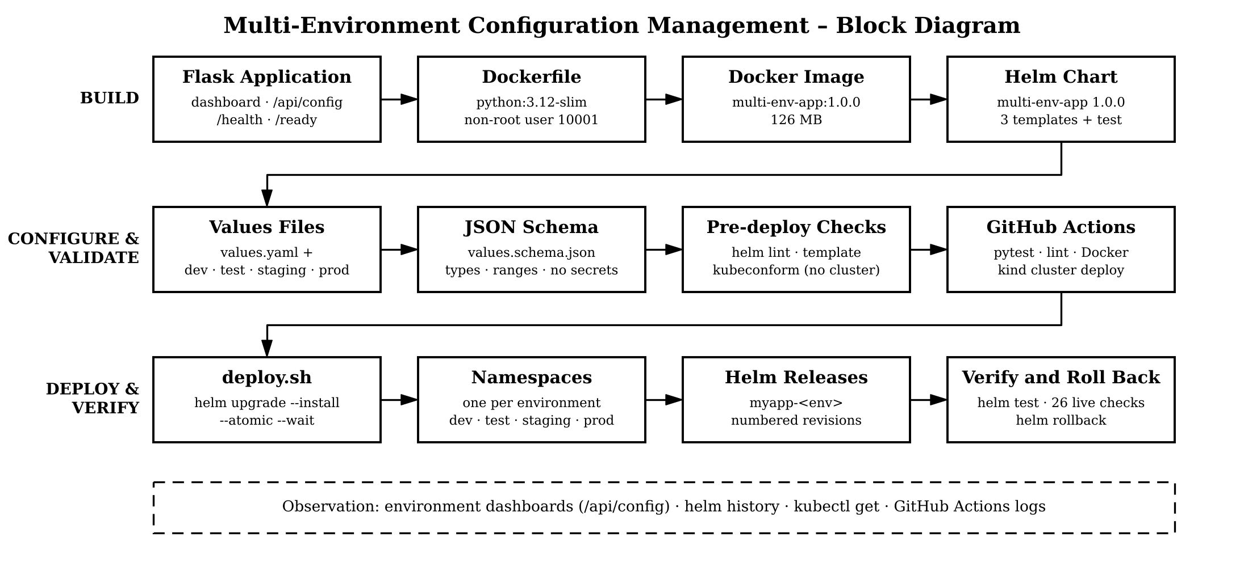
AAA College of Engineering and Technology
10
BLOCK DIAGRAM
Department of Artificial Intelligence and Data Science

Slide 12
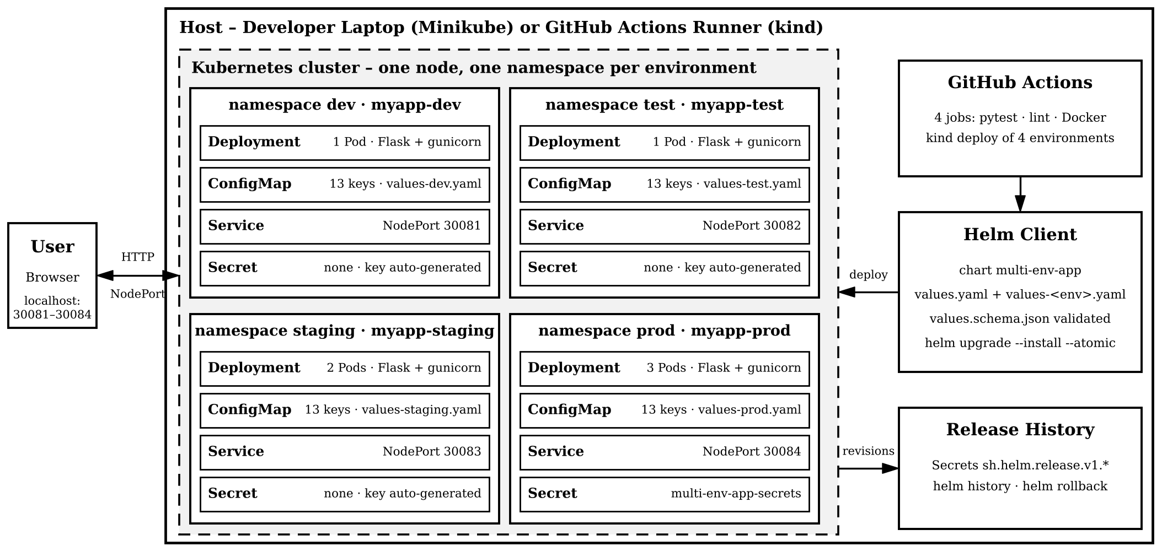
AAA College of Engineering and Technology
11
SYSTEM ARCHITECTURE
Department of Artificial Intelligence and Data Science

Slide 13
AAA College of Engineering and Technology
12
DESCRIPTION
The project is a multi-environment configuration-management solution: a Flask dashboard is packaged as one Docker image (python:3.12-slim, non-root) and deployed to development, testing, staging and production from a single Helm chart.
Each environment is a small values file (28–43 lines) over values.yaml. values.schema.json rejects unknown environments, wrong types, out-of-range numbers and secrets before deployment; a checksum annotation restarts Pods on changes.
deploy.sh runs helm upgrade --install --atomic into one namespace per environment (dev, test, staging, prod); production reads SECRET_KEY from a Kubernetes Secret. helm test, upgrade, history and rollback manage the releases.
GitHub Actions runs 62 pytest cases, helm lint, template and kubeconform checks and a Docker smoke test, then deploys all four environments to a kind cluster on every push.
Department of Artificial Intelligence and Data Science

Slide 14
AAA College of Engineering and Technology
13
RESULTS AND DISCUSSION
Developed the Flask dashboard and the Helm chart; all four environments were deployed in 40 s on a kind cluster, with 1, 1, 2 and 3 replicas.
All 56 settings reported by the running Pods matched the values files; 26 of 26 live checks (including 4 helm tests) and 62 of 62 pytest cases passed.
The schema rejected 14 of 14 invalid inputs before deployment; for four environments the chart needs 42 % fewer lines than copied manifests.
An upgrade to a missing image was undone by --atomic; helm upgrade created revision 2 and helm rollback restored version 1.0.0 as revision 3.
1.2 to 1.5 % of requests failed during rolling updates even with maxUnavailable: 0, and none with a 5 s preStop delay; Minikube was not executed.
Department of Artificial Intelligence and Data Science

Slide 15
AAA College of Engineering and Technology
14
TIME SPAN
S.NO | Particulars | Approx Time Duration | Status of Completion
1 | Literature Survey and Analysis | 1 week | Completed
2 | System Design and Requirements | 1 week | Completed
3 | Flask Application and Dashboard | 1 week | Completed
4 | Dockerfile and Docker Image | 1 week | Completed
5 | Helm Chart, Values and Schema | 2 weeks | Completed
6 | Scripts, Tests and CI Workflow | 2 weeks | Completed
7 | Cluster Testing and Validation | 2 weeks | Ongoing
8 | Report Writing and Documentation | 2 weeks | Completed
Department of Artificial Intelligence and Data Science

Slide 16
AAA College of Engineering and Technology
15
BUDGET
S.No | Particulars | Specification / Model | No. of Units Required | Approx. Price per Unit (₹) | Total Amount (₹)
1 | Software Tools | Open-source tools | 1 | 0 | 0
2 | Internet and Data | Image pulls, docs | 1 | 1,000 | 1,000
3 | Cloud VM (Optional) | Linux VM for demo | 1 | 2,000 | 2,000
4 | Testing and Maintenance | Testing, debugging | 1 | 1,500 | 1,500
5 | Documentation | Printing, binding | 1 | 1,500 | 1,500
Department of Artificial Intelligence and Data Science

Slide 17
AAA College of Engineering and Technology
16
REFERENCES
[1] Z. Yin, X. Ma, J. Zheng, Y. Zhou, L. N. Bairavasundaram and S. Pasupathy, "An empirical study on configuration errors in commercial and open source systems," in Proc. 23rd ACM Symposium on Operating Systems Principles (SOSP), 2011, pp. 159–172.
[2] T. Xu and Y. Zhou, "Systems approaches to tackling configuration errors: A survey," ACM Computing Surveys, vol. 47, no. 4, Art. 70, Jul. 2015.
[3] A. Rahman and L. Williams, "Characterizing defective configuration scripts used for continuous deployment," in Proc. 11th IEEE Int. Conf. on Software Testing, Verification and Validation (ICST), 2018.
Department of Artificial Intelligence and Data Science

Slide 18
AAA College of Engineering and Technology
17
REFERENCES
[4] A. Rahman, S. I. Shamim, D. B. Bose and R. Pandita, "Security misconfigurations in open source Kubernetes manifests: An empirical study," ACM Trans. Softw. Eng. Methodol., 2023.
[5] A. Zerouali, R. Opdebeeck and C. De Roover, "Helm charts for Kubernetes applications: Evolution, outdatedness and security risks," in Proc. 20th IEEE/ACM Int. Conf. on Mining Software Repositories (MSR), 2023.
[6] The Helm Authors, "Values files," Helm Documentation. https://helm.sh/docs/chart_template_guide/values_files/
Department of Artificial Intelligence and Data Science

