Slide 1

House Price Analysis & Predictions Using Machine Learning
LEAD THE SCENE AND KEEP IT GREEN !!!
PREPARED BY
ARUN KUMAR

Slide 2
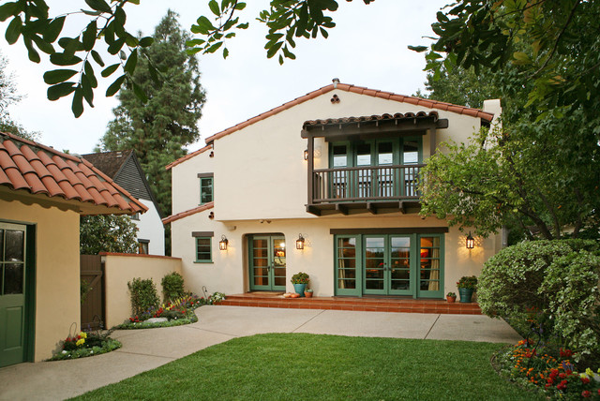
PROBLEM STATEMENT
House Price Dataset where we predict the housing price (Sales data) for each Ground value through Python, Scikit-Learn (Machine learning).

Slide 3
Table of Contents
Problem Statement
Data Processing
Target Variable
Log Transformation
Feature Engineering
Data Correlation
Validation Functions
Scores
Stacking Models
Conclusion

Slide 4
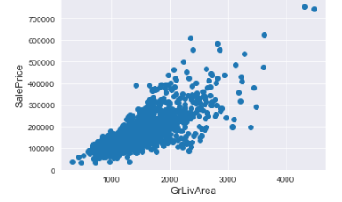
DATA PROCESSING
1. PANDAS PROFILING
Pandas profiling is an open source module with which we can quickly performed Exploratory Data Analysis with just a few lines of code. Pandas profiling performed all the work of visualizing and understanding the distribution of each variable thus generating a report with all the utmost important information easily available.
2. DELETING OUTLIERS
Here, we have deleted the outliers from the raw dataset to get ahead step towards the actual data to be analyzed upon.

Slide 5
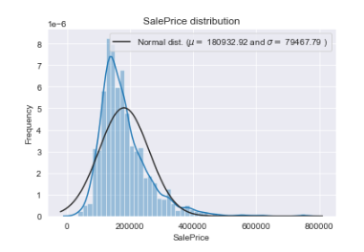
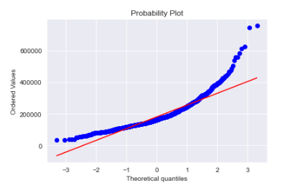
TARGET VARIABLE

Slide 6
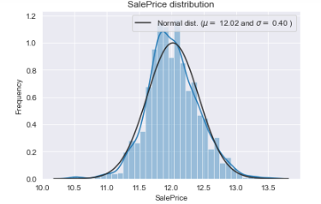
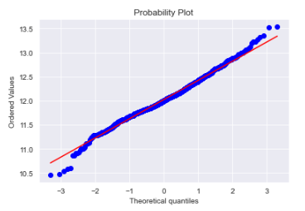
LOG-TRANSFORMATION OF THE TARGET VARIABLE

Slide 7
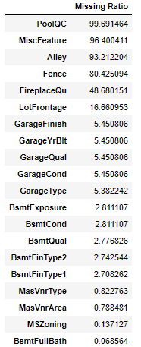
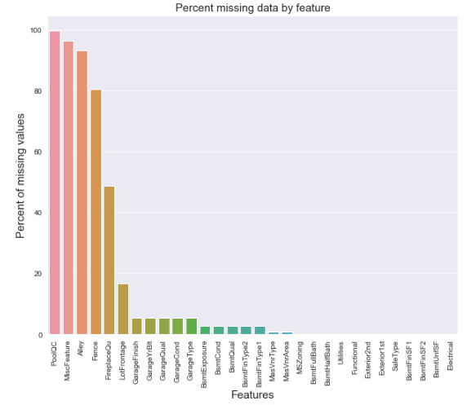
FEATURES ENGINEERING

Slide 8
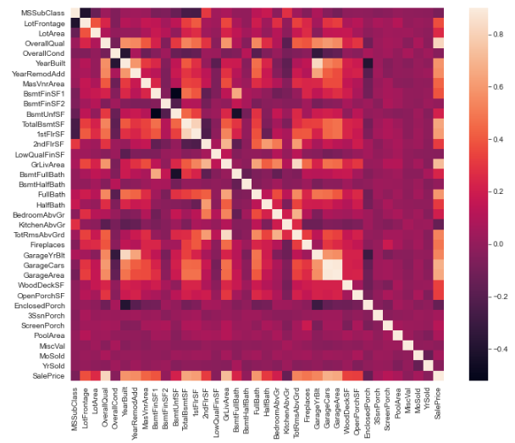
DATA CORRELATION

Slide 9
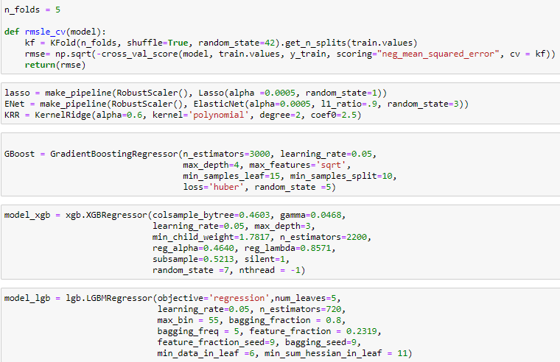
VALIDATION FUNCTION

Slide 10
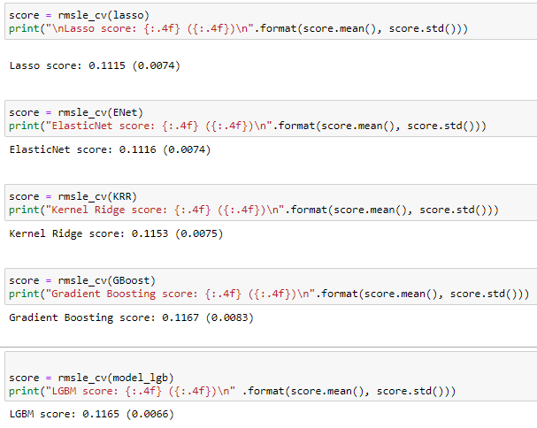
SCORES

Slide 11
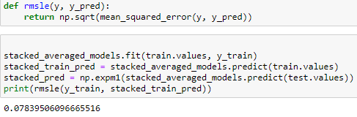
STACKING MODELS

Slide 12

XGBOOST
LIGHTBGM

Slide 13
CONCLUSION
Throughout this analysis I made a machine learning regression project from end-to-end and I learned and obtained several insights about regression models and how they are developed.
With the above analysis we predicted the house prices for every distinguished item from the raw data.
Its dream for every individual to buy a home.
House pricing list serves as a great boon for all the tenants to buy a home.
This prediction greatly helps house owners to approx. find out the value of their flats/houses.
From investment pov, it helps to find out when exactly one should invest to buy or rent their respective flats/houses.

Slide 14
What is home? My favorite definition is "a safe place," a place where one is free from attack, a place where one experiences secure relationships and affirmation. It's a place where people share and understand each other. Well, sometimes home is a person.
Thank You !!
Arun Kumar

