Slide 1
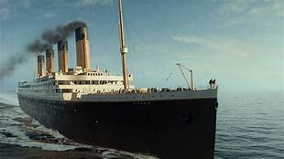
Statistical Analysis of Titanic dataset along with Machine learning models
PREPARED BY
ARUN KUMAR

Slide 2
Table of Contents
Problem Statement and Packages
Pclass
EMBARKED
EMBARKED vs Survival
Parch vs Survived SibSp vs Survived
Age vs. Survival
Corr Features
Comparing Models

Slide 3
PROBLEM STATEMENT
In this kernel, I am going to do a detailed statistical analysis of Titanic data set along with Machine learning models. I will also include visualizations to explain analysis and the machine learning models will be used to predict passenger survival status. Let's get started.
Importing Packages
import pandas as pd
import numpy as np
import matplotlib.pyplot as plt
from sklearn.linear_model import LogisticRegression
from sklearn.svm import SVC, LinearSVC
from sklearn.neighbors import KNeighborsClassifier
from sklearn.tree import DecisionTreeClassifier
from sklearn.ensemble import RandomForestClassifier
from sklearn.naive_bayes import GaussianNB
from sklearn.linear_model import Perceptron
from sklearn.linear_model import SGDClassifier

Slide 4
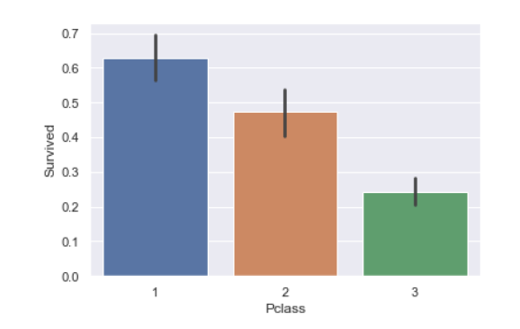
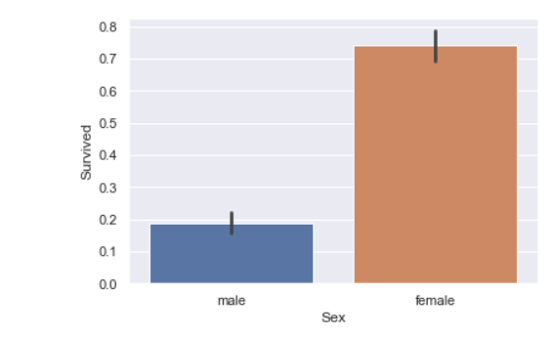
Pclass
Sex vs. Survival

Slide 5
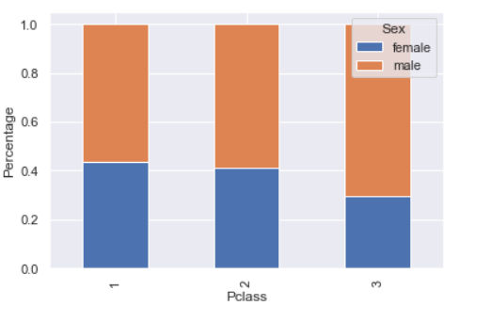
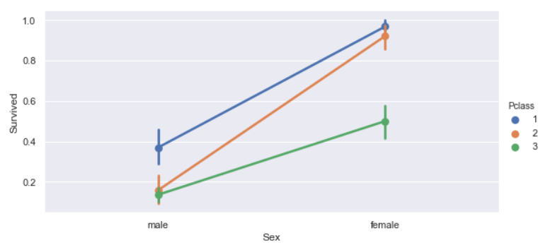
Pclass & Sex vs Survival

Slide 6
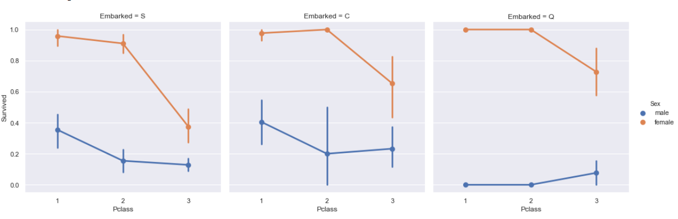
Embarked

Slide 7
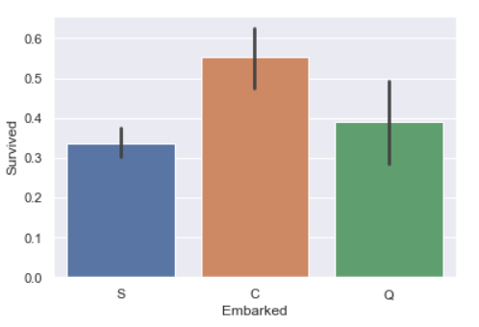
Embarked vs Survived

Slide 8
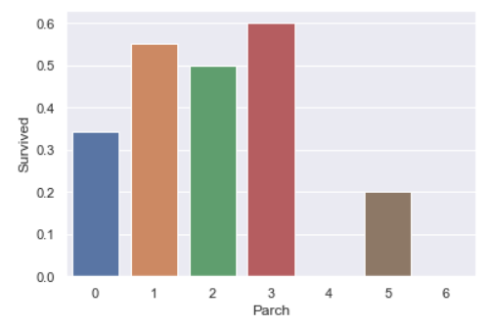
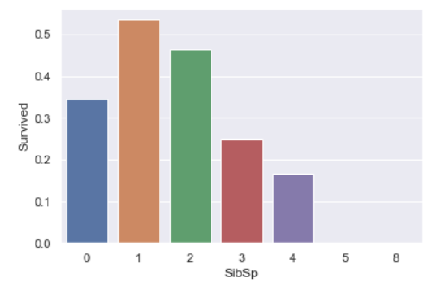
Parch vs Survived - SibSp vs Survived

Slide 9
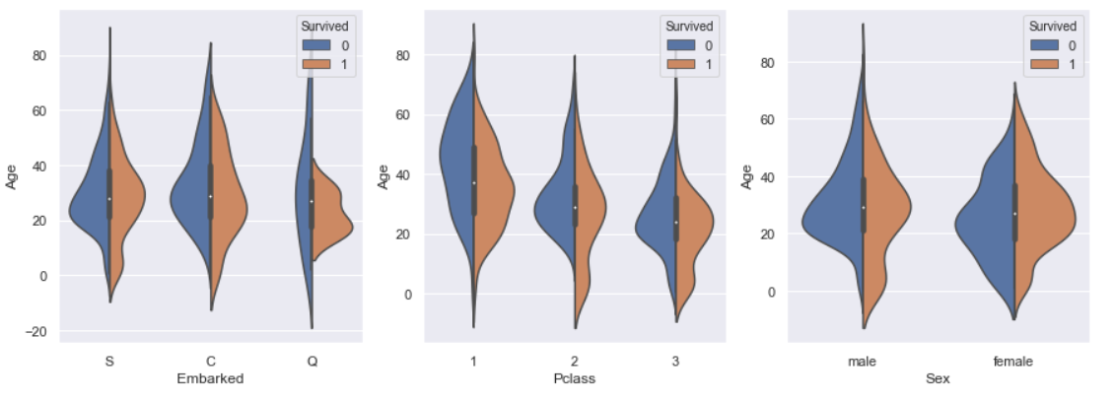
Age vs. Survival

Slide 10
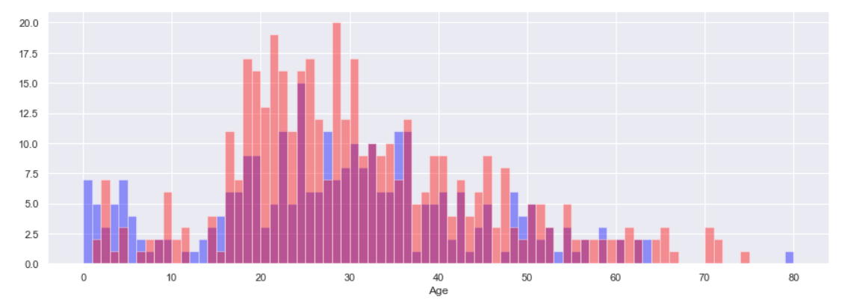

Slide 11
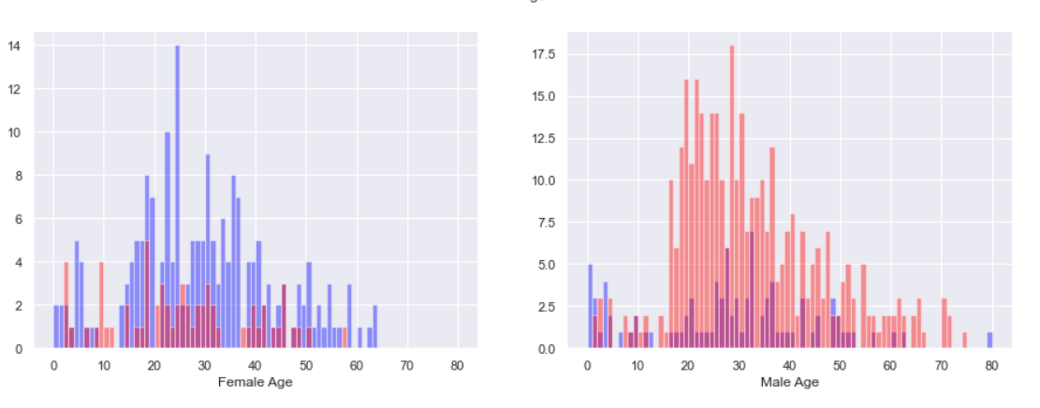

Slide 12
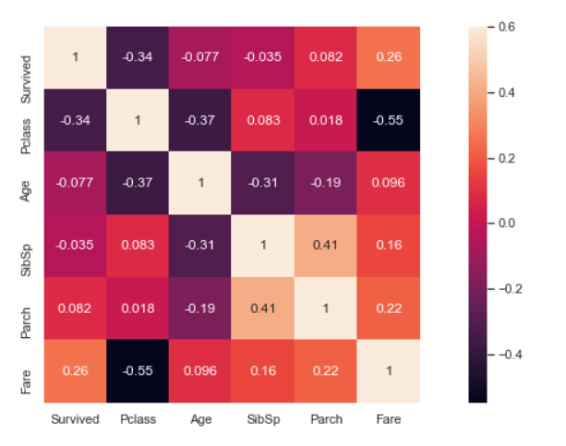
Correlating Features

Slide 13
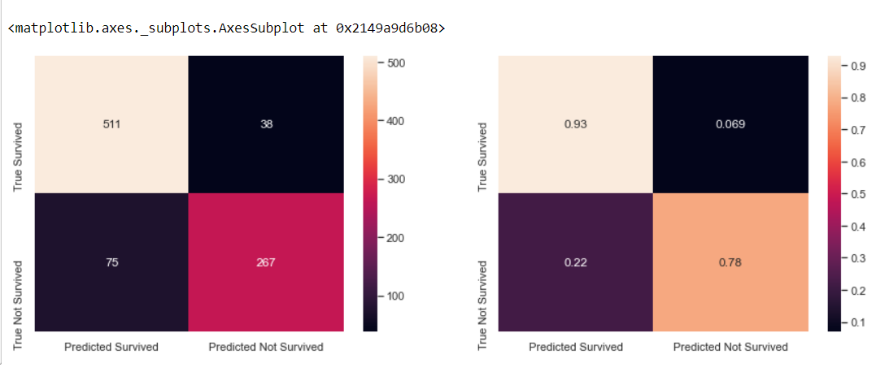

Slide 14
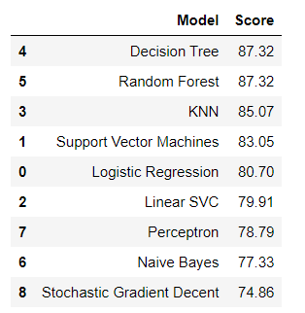
Comparing Models

