Slide 1
Sales Dashboard Report
Prepared by: Arun Kumar Joshi
Date: 02/01/2025

Slide 2
Introduction
In an effort to analyze and visualize key sales performance metrics, I developed an interactive Sales Dashboard. The goal was to provide a comprehensive overview of customer count, profit trends, sales distribution across states and categories, and top-performing customers.

Slide 3
Situation
Our team developed an interactive Sales Dashboard to provide insights into customer count, profit trends, sales distribution, and top customers.

Slide 4
Task
The objective was to create a user-friendly and visually appealing dashboard that allows stakeholders to monitor sales performance across different dimensions such as time, product categories, and geographical regions. The dashboard needed to include elements like customer count, profit trends, and sales breakdown by category and month

Slide 5
Action - Data Preparation
• Collected and cleaned sales data.
• Ensured data accuracy and consistency.
• Prepared data for visualization.

Slide 6
Action - Visualization
• Used various charts (bar graphs, line charts, pie charts).
• Implemented filters for better exploration.
• Optimized dashboard for KPIs.

Slide 7
Action - Optimization
• Ensured dashboard intuitiveness.
• Focused on visual appeal and accessibility.
• Highlighted key performance indicators.

Slide 8
Result
• Provided actionable insights into sales trends.
• Helped stakeholders in strategic decision-making.
• Improved sales data visibility.

Slide 9
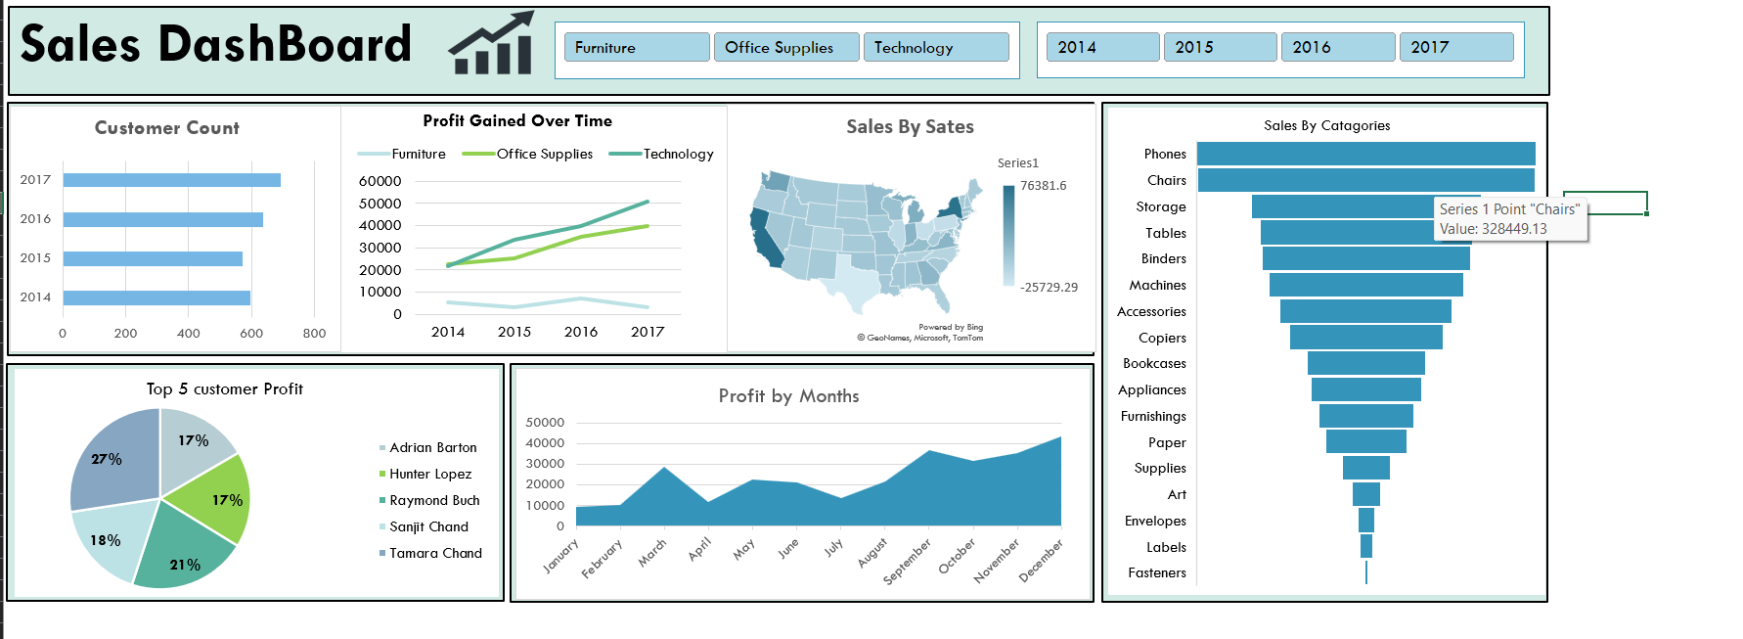
Sales Dashboard Overview

Slide 10
Conclusion and Future Scope
• Summary of findings.
• Potential improvements such as additional features and data sources.

